Slide 1
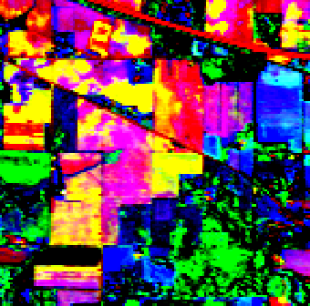
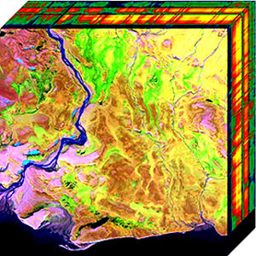
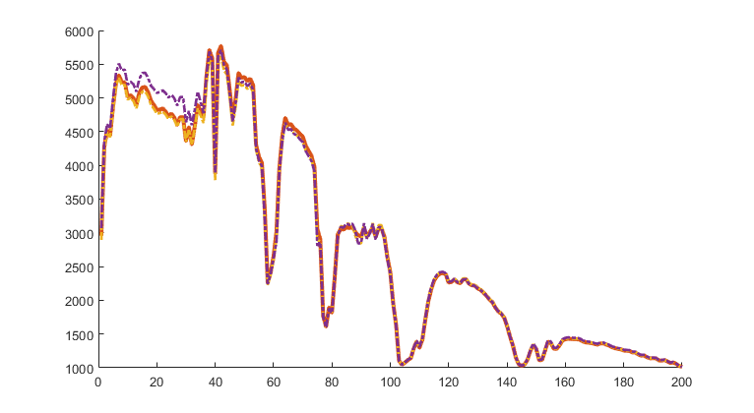
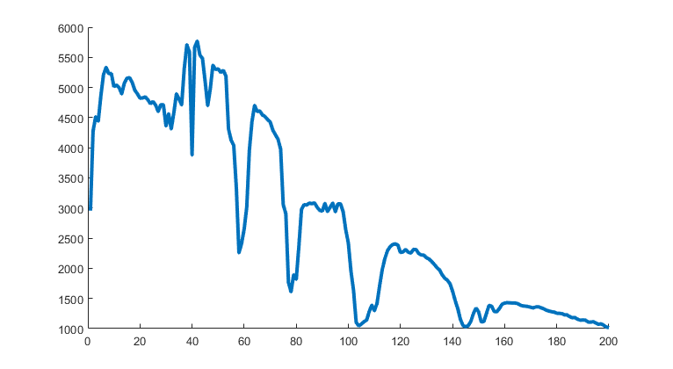

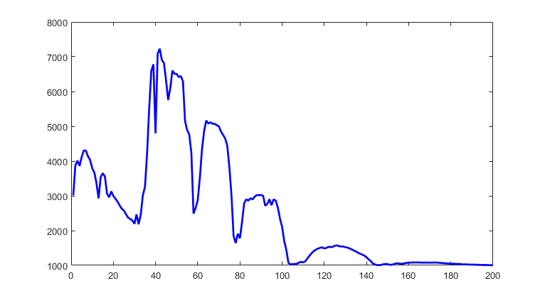
Hyperspectral image
wiki
Pixels - Points
Create
New component
Spectral Signatures - components
Components
Create
New cluster
Spectral Signatures - clusters
Clusters
Spectral Signatures - clusters
Segmentation Map

Slide 2
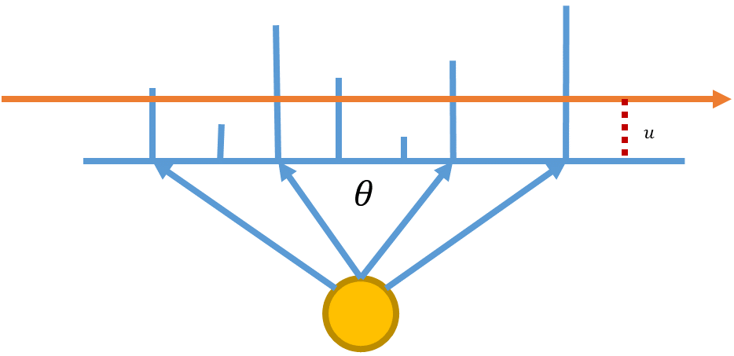
Slice Sampler

