Slide 1
Unsupervised Blind Image Quality Assessment
By
Rajeev Bhatt Ambati,
M.S in Electrical Engineering.
Email: rza67@psu.edu
April 05, 2018

Slide 2
Introduction
In many computer vision problems, we have to estimate the quality of an image predicted by a machine learning algorithm.
e.g. Super Resolution, image denoising, image compression, generative models, segmentation and several robotics applications.
A quality score can be used to evaluate algorithms or use the metric as loss function to train the models.
The image quality assessment (IQA) methods proposed in the literature can be classified as follows:
Full-reference IQA: A reference image is available to with which a given image is compared.
No-reference/Blind IQA: No reference image is provided and the quality score has to be estimated only with the given image.

Slide 3
Previous Work
The core idea of recent deep learning approaches to IQA is by fine-tuning a pre-trained CNN by regressing over ground truth quality scores. [1][2]
Most methods just classify the image as high/low quality i.e. as a two class classification problem.
Few other methods use a Siamese of CNNs to incorporate a ranking loss in [3] and for multi-scale inputs in [4].
All these methods produce a single mean score despite the fact that individual scores depends on different subjects.
NIMA [5] instead predicts a histogram of distributions and weighted sum over subject scores is calculated to get the final rating. This is the current state-of-the-art in Blind IQA.

Slide 4
Datasets
Large-Scale Database for Aesthetic Visual Analysis (AVA) [6]
Tampere Image Database 2013 (TID2013) [7]
AVA contains about 255,000 images obtained from 1,447 photography challenges.
Each image has three scores from which only aesthetic is used for IQA.
This score is obtained by averaging over the responses of 200 people from the contest.
These image ratings are between 1 and 10 in which high score implies a good quality image.
TID2013 was originally used for full-reference IQA tasks.
It contains 25 reference images each with 5 levels of distortion for 24 types of distortion.
Each subject is shown two images and the chosen high quality image gets one point and zero point to the other.
A Mean Opinion Score (MOS) is calculated by averaging over the experiments of 971 observers.

Slide 5
Motivation
Due to the recent success of Convolutional Neural Networks (CNNs), deeplearning approaches are explored by fine tuning a pre-trained AlexNet or VGG16 which is regressed over ground truth ratings.
These annotations are very expensive and solving IQA in an unsupervised learning setting is worth exploring.
The proposed methods have no knowledge or prior of a good or bad image.

Slide 6
Motivation
A prior of a good or bad image may improve the performance since a quality score is relative.
Even the subject in TID2013 [7] experiments also have access to another image and doesn’t rate just by viewing a single image.
This unsupervised problem can be solved by capturing an aesthetic manifold and distance from which can be modelled as a quality score.
Two ways of capturing this aesthetic manifold will be discussed.

Slide 7
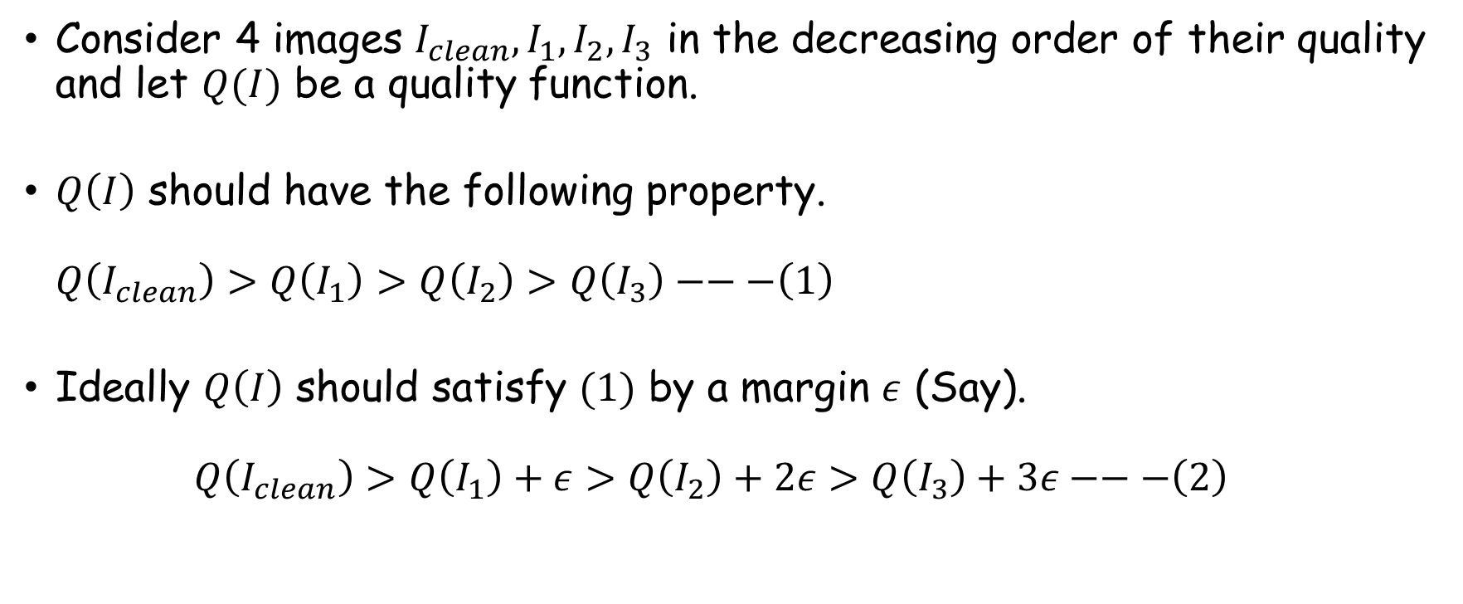
Approach 1: Pre-trained CNN features
Consider 4 images $I_{clean},I_{1},I_{2},I_{3}$ in the decreasing order of their quality and let $Q(I)$ be a quality function.
$Q\left(I\right)$ should have the following property. $Q\left(I_{clean}\right)>Q\left(I_{1}\right)>Q\left(I_{2}\right)>Q\left(I_{3}\right)−−−\left(1\right)$
Ideally $Q\left(I\right)$ should satisfy $(1)$ by a margin $ε$ (Say). $Q\left(I_{clean}\right)>Q\left(I_{1}\right)+ε>Q\left(I_{2}\right)+2ε>Q\left(I_{3}\right)+3ε−−−\left(2\right)$

Slide 8
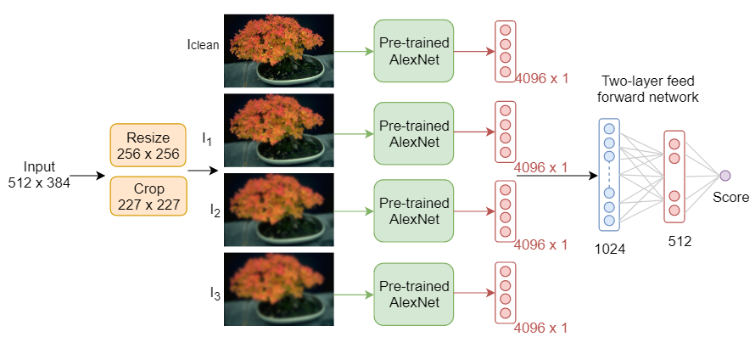
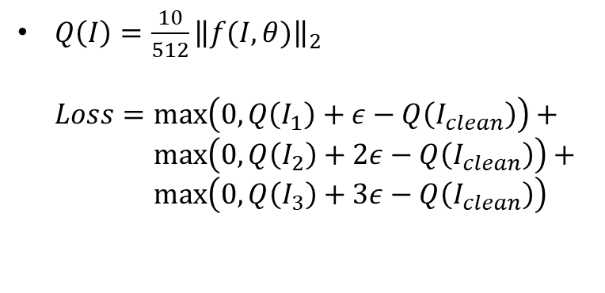
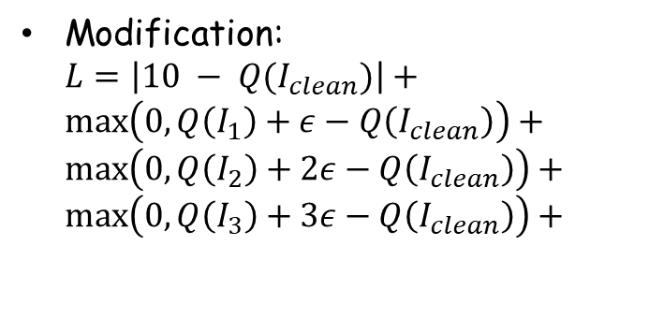
Architecture
$Q\left(I\right)={\frac{10}{512}\left\|f(I,θ)\right\|}_{2}$ $Loss=max\left(0, Q\left(I_{1}\right)+ε−Q\left(I_{clean}\right)\right)+$ $\max\left(0,Q\left(I_{2}\right)+2ε−Q\left(I_{clean}\right)\right)+$ $max\left(0,Q\left(I_{3}\right)+3ε−Q\left(I_{clean}\right)\right)$
Scores are hard to interpret !
Modification: $L=\left|10 − Q(I_{clean})\right|+$ $\max\left(0, Q\left(I_{1}\right)+ε−Q\left(I_{clean}\right)\right)+$ $\max\left(0, Q\left(I_{2}\right)+2ε−Q\left(I_{clean}\right)\right)+$ $\max\left(0, Q\left(I_{3}\right)+3ε−Q\left(I_{clean}\right)\right)+$
Figure 1: Images of different quality are fed to CNN to obtain encoded vectors. All these 4 CNN weights are shared across each other. At test time, computing the output neuron gives the quality score.
Easy for interpretation !

Slide 9
Train and Test split
600 x 5 images of the TID2013 dataset are split into 80%, 20% for train, validation and test respectively.
From 2400 images, train and validation set are created as follows:
Train = [‘reference’, ‘level1’, ‘level2’, ‘level3’] x 480
Validation = [‘level4’, ‘level5’] x 480
All 600 images comprising of 5 levels of distortion are used for testing.

Slide 10
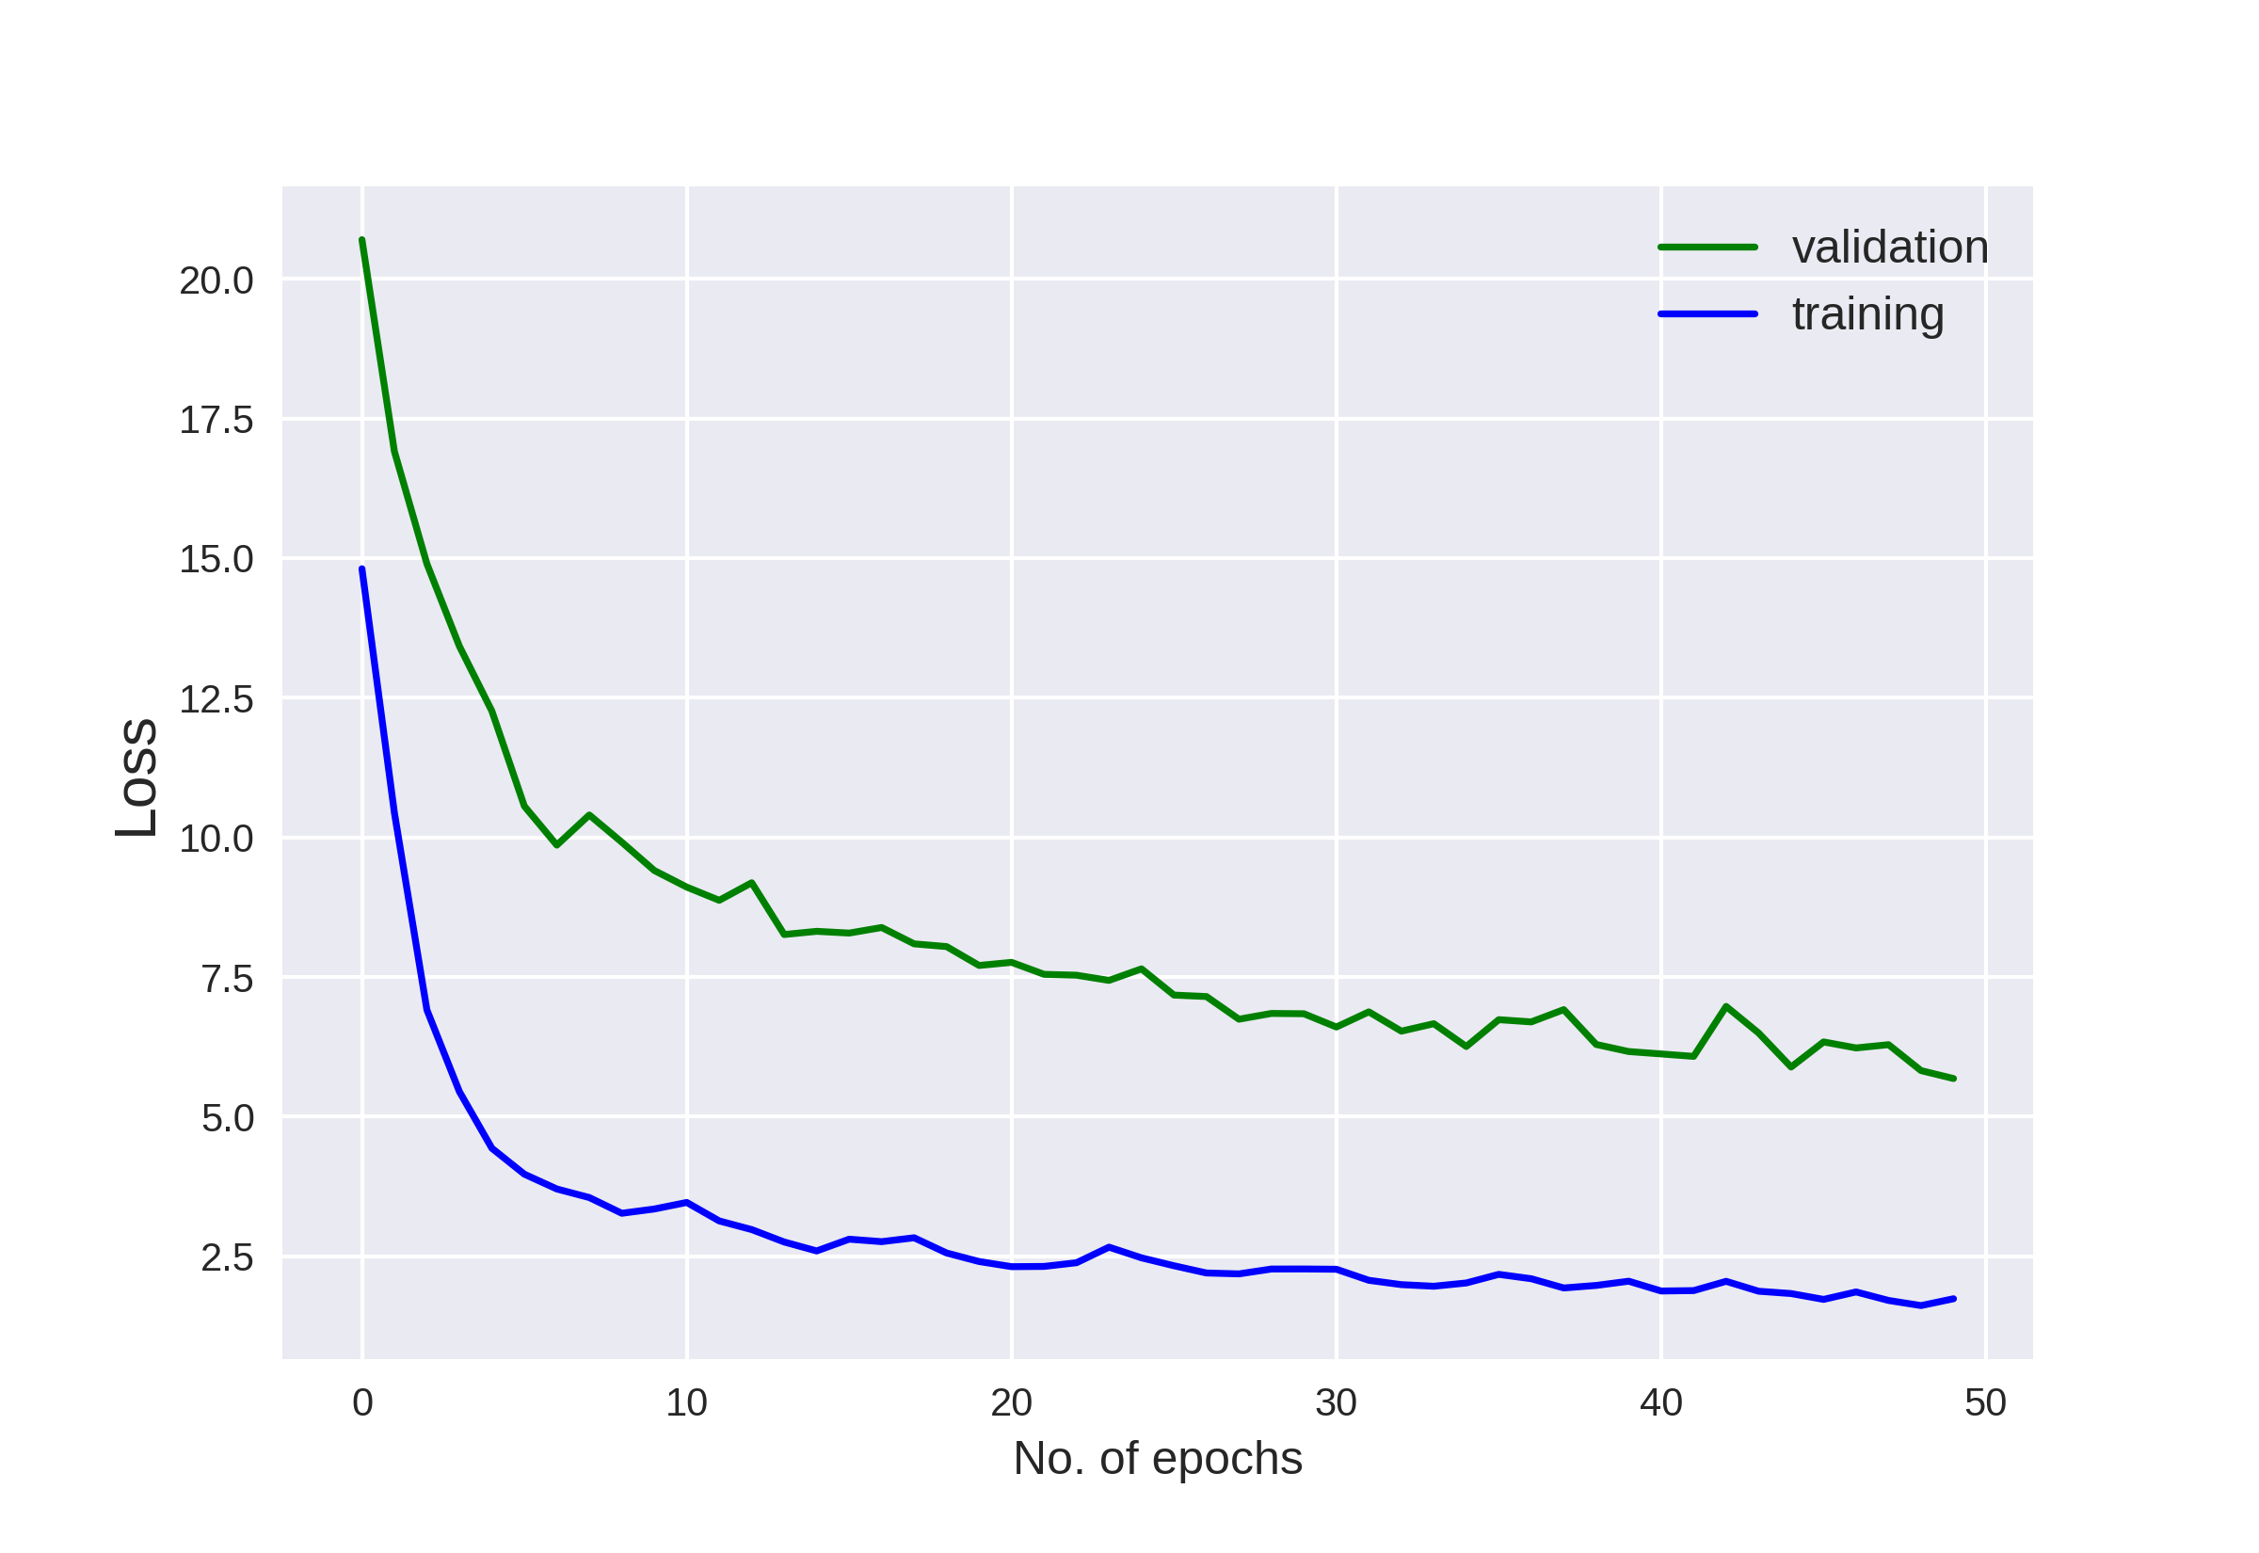
Results
Figure3: Training and validation loss as the number of epochs increases.

Slide 11
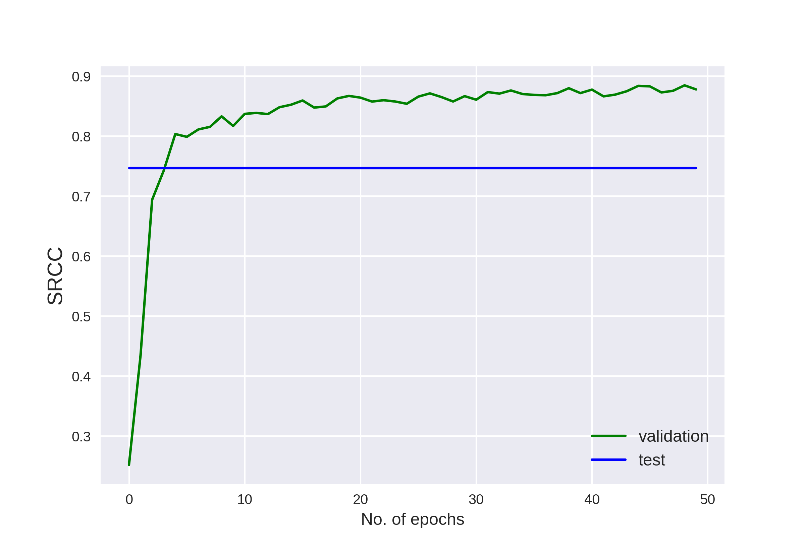
Results
Figure4: SRCC (Spearman’s Rank correlation coefficient) score for validation and test sets.

Slide 12
Results
Method | SRCC | LCC
NIMA (MobileNet) [5] | 0.698 | 0.782
NIMA (Inception-v2) [5] | 0.750 | 0.827
Moorthy et al. [8] | 0.88 | 0.89
NIMA (VGG16) [5] | 0.944 | 0.941
Bianco et al. [9] | 0.96 | 0.96
This method | 0.75 | 0.7
Table 1: Results on TID2013 dataset. SRCC (Spearman’s Rank correlation coefficient) and LCC (Linear correlation coefficient) are computed between predicted and ground truth scores. This method outperforms the ones shown in green. Note that this method is unsupervised while the rest are supervised.

Slide 13
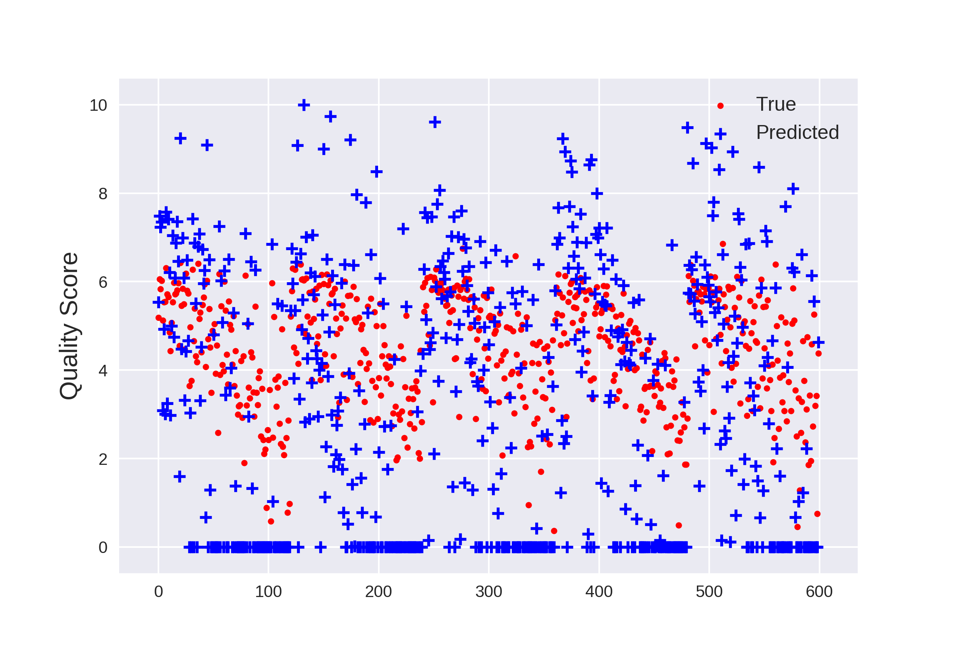
Analysis
Predicted scores satisfy the range but doesn’t exactly match the true scores.
Fine-tuning of the whole network may improve the performance.
Explore other networks like Inception, ResNet, MobileNet
Figure 5: Scatter plot of true and predicted quality scores

Slide 14
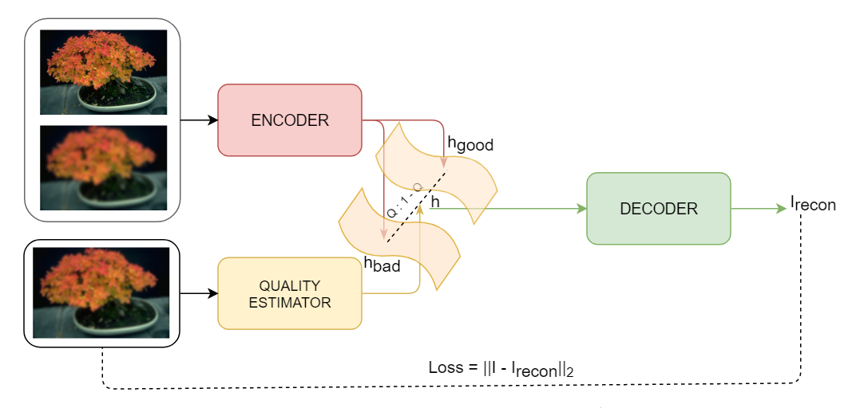
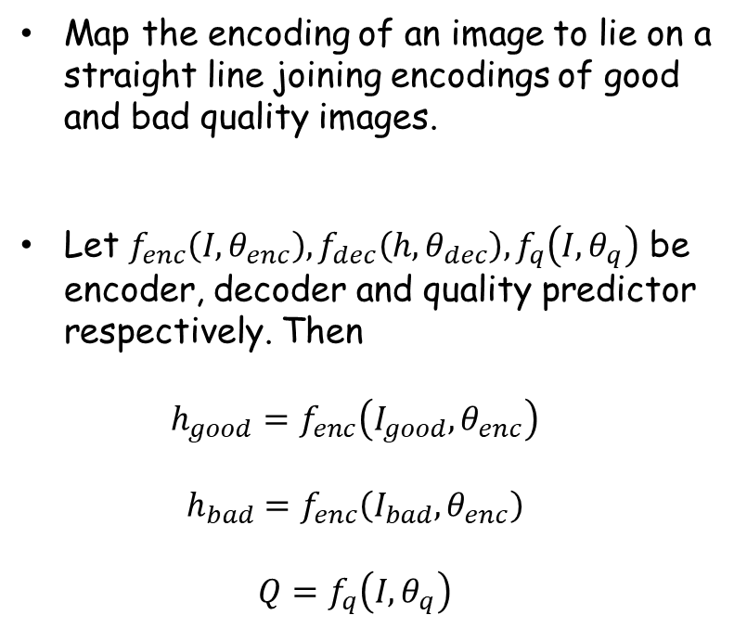
Approach 2: Mapping encoded representations
Map the encoding of an image to lie on a straight line joining encodings of good and bad quality images.
Let $f_{enc}\left(I, θ_{enc}\right),f_{dec}\left(h, θ_{dec}\right),f_{q}\left(I, θ_{q}\right)$ be encoder, decoder and quality predictor respectively. Then $h_{good}=f_{enc}\left(I_{good}, θ_{enc}\right)$ $h_{bad}=f_{enc}\left(I_{bad}, θ_{enc}\right)$ $Q=f_{q}\left(I, θ_{q}\right)$
Figure 6: The good, bad image encodings are obtained from the encoder. The architectural prior introduced forces quality estimator to learn a score that will help decoder in reconstructing the image I. At test time a forward pass through quality estimator gives the quality score.

Slide 15
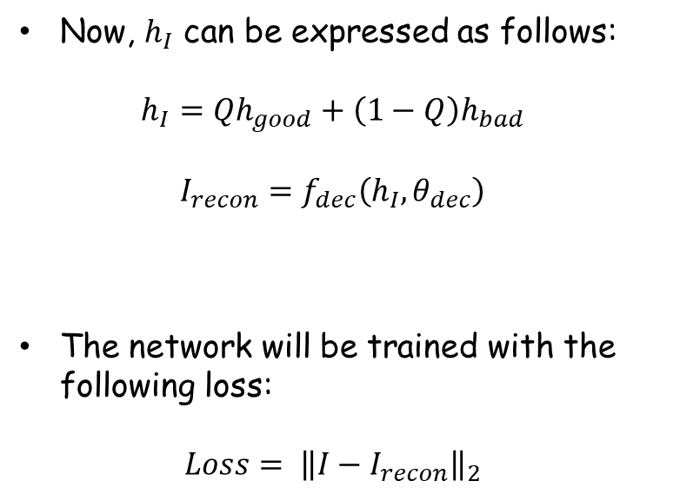
Approach 2: Mapping encoded representations
Now, $h_{I}$ can be expressed as follows: $h_{I}=Qh_{good}+\left(1−Q\right)h_{bad}$ $I_{recon}=f_{dec}\left(h_{I}, θ_{dec}\right)$
The network will be trained with the following loss: $Loss= {\left\|I−I_{recon}\right\|}_{2}$
Figure 6: The good, bad image encodings are obtained from the encoder. The architectural prior introduced forces quality estimator to learn a score that will help decoder in reconstructing the image I. At test time a forward pass through quality estimator gives the quality score.

Slide 16
References
L. Kang, P. Ye, Y. Li, and D. Doermann, “Convolutional neural networks for no-reference image quality assessment,” in Proceedings of the IEEE Conference on Computer Vision and Pattern Recognition, 2014, pp. 1733–1740. 1
S.Bosse,D.Maniry,T.Wiegand,andW.Samek,“Adeepneuralnetwork for image quality assessment,” in Image Processing (ICIP), 2016 IEEE International Conference on. IEEE, 2016, pp. 3773–3777. 1
X. Lu, Z. Lin, H. Jin, J. Yang, and J. Z. Wang, “Rating image aesthetics using deep learning,” IEEE Transactions on Multimedia, vol. 17, no. 11, pp. 2021–2034, 2015. 1, 6
S. Ma, J. Liu, and C. W. Chen, “A-lamp: Adaptive layout-aware multipatch deep convolutional neural network for photo aesthetic assessment,” in Computer Vision and Pattern Recognition (CVPR), 2017 IEEE Conference on. IEEE, 2017. 1, 5, 6
H. T .Esfandarani and P. Milanfar, “NIMA: Neural Image Assessment”, Computing Research Repository (CoRR), 2017.
N. Murray, L. Marchesotti, and F. Perronnin, “AVA: A large-scale database for aesthetic visual analysis,” in Computer Vision and Pattern Recognition (CVPR), 2012 IEEE Conference on. IEEE, 2012,pp.2408– 2415. 1, 2, 6, 7, 8
N.Ponomarenko,O.Ieremeiev,V.Lukin,K.Egiazarian,L.Jin,J.Astola, B. Vozel, K. Chehdi, M. Carli, F. Battisti et al., “Color image database TID2013: Peculiarities and preliminary results,” in Visual Information Processing (EUVIP), 2013 4th European Workshop on. IEEE, 2013, pp. 106–111. 1, 3, 4, 7, 8
A. K. Moorthy and A. C. Bovik, “Blind image quality assessment: From natural scene statistics to perceptual quality,” IEEE Transactions on Image Processing, vol. 20, no. 12, pp. 3350–3364, Dec 2011. 9
S. Bianco, L. Celona, P. Napoletano, and R. Schettini, “On the use of deep learning for blind image quality assessment,” CoRR, vol. abs/1602.05531, 2016. [Online]. Available: http://arxiv.org/abs/1602.05531 2, 9

Slide 17
Questions ?

