Slide 1

Preprocessing step
(e.g. PCA)
Data Normalization
(e.g. Z-Score)
IP Metrics
Tcp Metrics
Application Metrics
Reduced matrix
Big matrix representing the multi dimensional space
Clustering
engine
Normalized matrix
(for calculating distances)
Data corresponding
to typical pattern
Anomalies

Slide 2
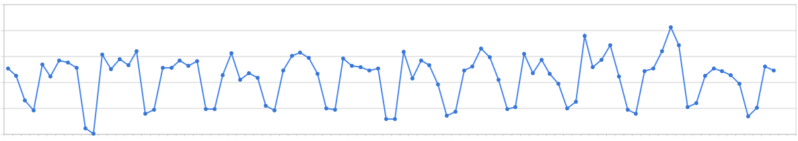
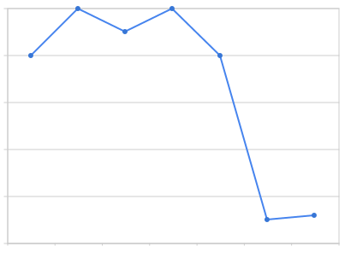
Estimated period
(using autocorrelation)
Estimated baseline
(using weighted moving average)

Slide 3
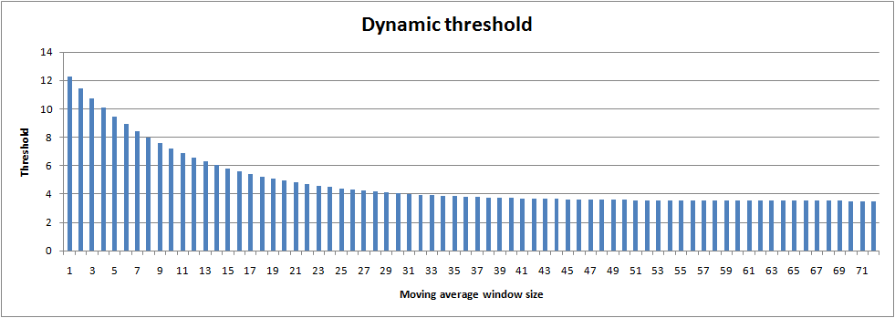
Dynamic threshold
Short moving average
Moving average
(using last residuals)
Long moving average
Normal
Short moving average
Anomaly
Long moving average
Residuals
(computed with the baseline)

Slide 4
Anomaly Detector
Anomaly Detector
XML interface
XML interface
Processor Plugin
Processor Plugin
Processor Filter Plugin
Processor Filter Plugin
Processor Filter Plugin
Processor Filter Plugin
Input Filter Plugin
Packet Processor
Extractor Plugin
Input Plugin
Packets

