Slide 1
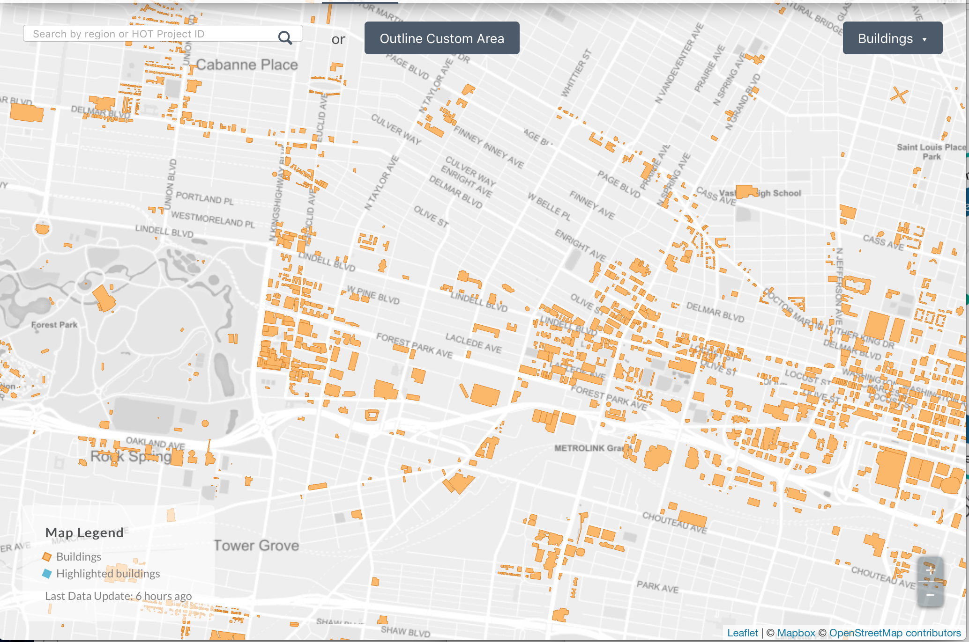
Mapathons
- Dustin Turpin

Slide 2
Tools to Use
ID - Editor
Mobile Apps
Field Papers
Mapbox
GPS device
QGIS OSM editor
More!

Slide 3
Why Do We Need OSM?
Using OSM
@Openstreetmap contributors
Apple maps
Foursquare Labs
Anyone can use it
Analytics

Slide 4
Event Details
October 14th at 1pm
14th and St Louis Ave
Open to everyone and family friendly training available on site
Contact:
Dustin Turpin - dturpin@boundlessgeo.com
Notes:
Mapathon definition - A mapping even in which the participants contribute to OpenStreetMap and focused on a particular area. Tasks are divided among the participants. Both indoor and outdoor tools are used. Participatns are encouraged to bring a computer, phone or a notebook. All skill levels are welcome. On the spot training is provided.

