Slide 1
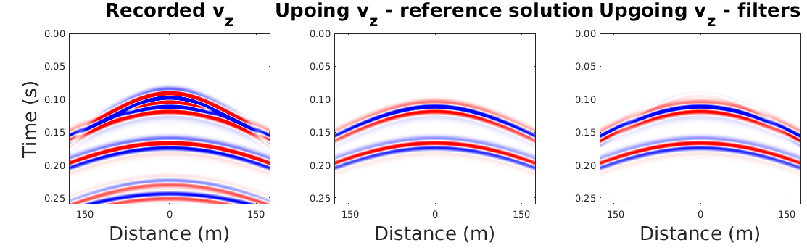
output from UD_filters_OBC_synthetic.m

Slide 2
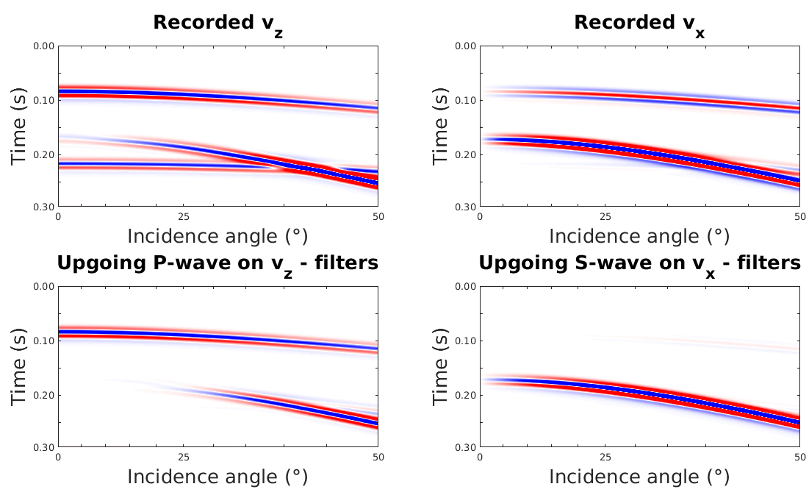
output from PS_filters_OBC_synthetic.m

Slide 3
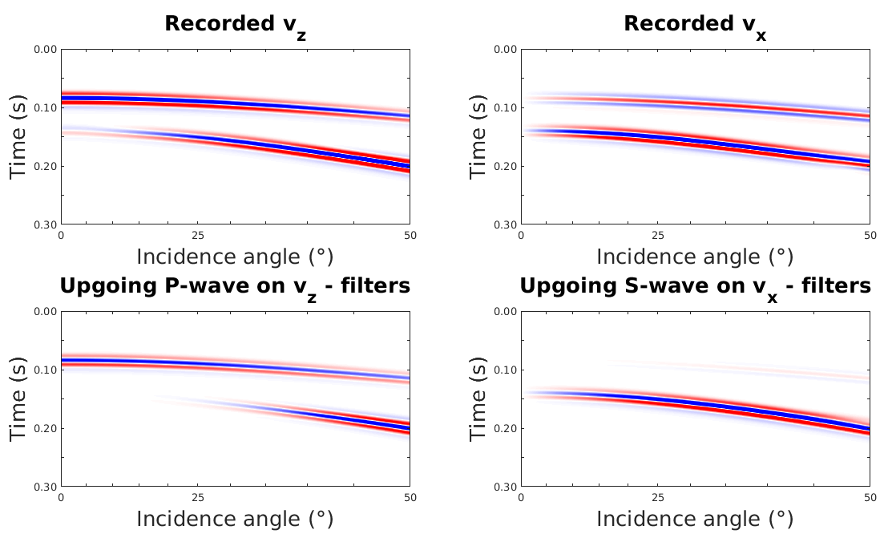
output from PS_filters_land_synthetic.m

Slide 4
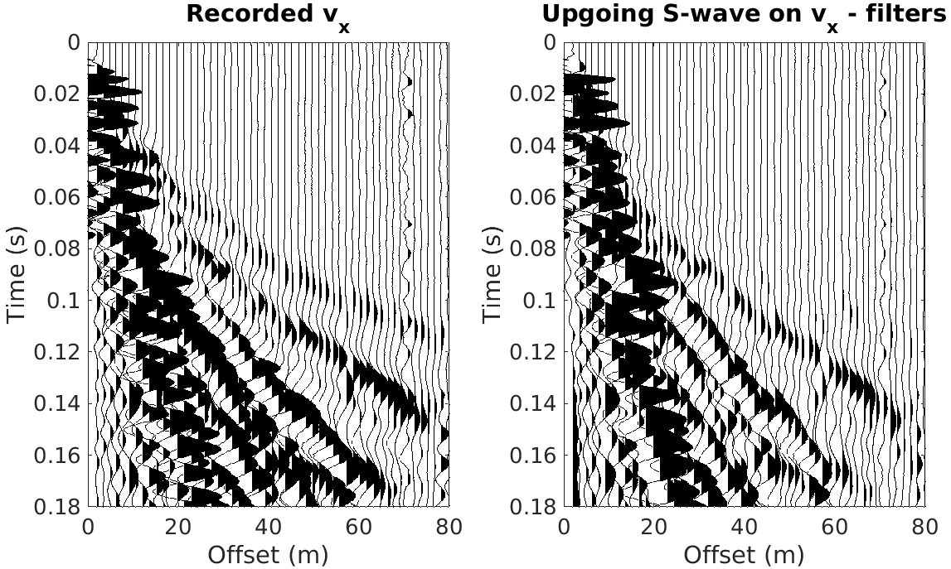
output from PS_filters_land_field.m

