Slide 1
Seismic Wavefield Reconstruction in the Presence of 6C Observations
Taufiqurrahman
Seismology Group Meeting, 6 February 2018

Slide 2
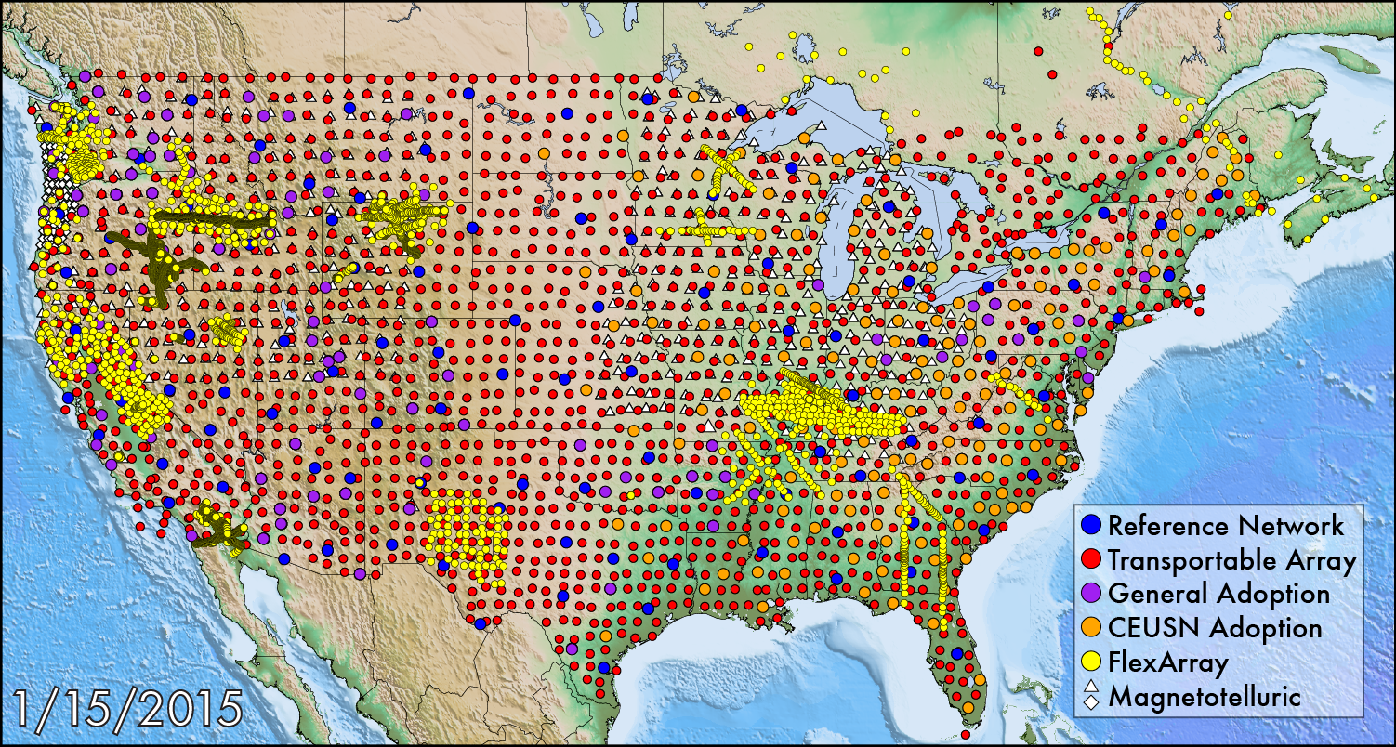
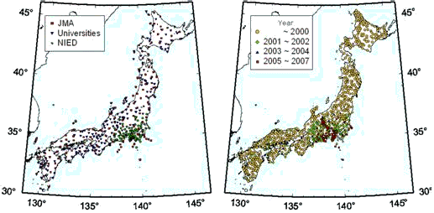
Large Seismic Networks
USArray (http://www.usarray.org/)
Hi-net (http://www.hinet.bosai.go.jp/), one of the densest, distance ~20 km between receivers (Okada et. al., 2004)
courtesy: http://www.usarray.org/
courtesy: http://www.hinet.bosai.go.jp/

Slide 3
Seismic Gradiometry - Introduction
New technique for treating a large array data to reconstruct and to characterize a seismic wavefield observed
Original concept by Langston (2007a), to measure the spatial gradient of seismic waves observed by dense array. He showed that slowness could be directly estimated.
Igel (2005) proposed a similar approach with rotational seismometers.
Langston (2007b) SG applied to 2D problem
Langston (2007c) improved its stability in time domain
Langston & Liang (2008) SG applied to polarized waves
Liang & Langston (2009) estimated Rayleigh waves with grid locations collocated with seismic stations (limited to the station location)
Spudich (1995) performed a similar series expansion to estimate surface strain and stress tensors recorded by dense array
Liu & Holt (2015)
Maeda (2016) used SG to reconstruct the seismic wavefield as a continuous 2D field irrespective of the station location

Slide 4
Seismic Gradiometry - Benefits
SG has the advantage that it estimates slowness as a spatially varying value, whereas other array methods ie. semblance method (Neidell & Taner, 1971) which assume a homogeneous plane-wave incidence and utilize phase differences to estimate slowness
SG models both phase and amplitude of the observed wavefield
Possibility to separate non-plane wave characteristics, ie. the radiation pattern and geometrical spreading
SG is a tool for reconstructing a spatially continuous seismic wavefield
Divergence (div) and Rotation (rot) of 3C seismic wavefield can be estimated by SG and used to characterize seismic wave propagation features

Slide 5
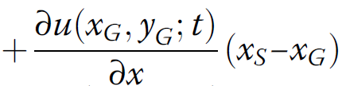
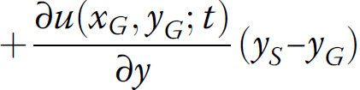




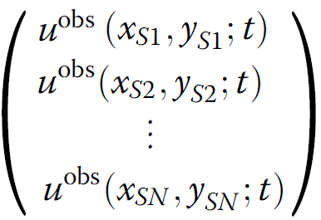
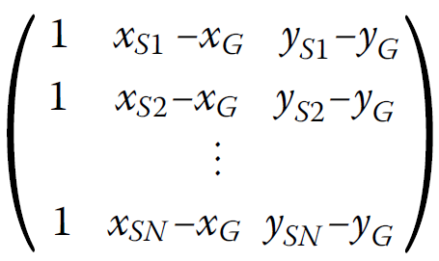
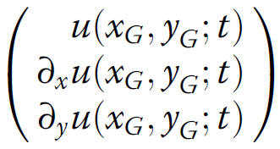

SG Method - Theory
Uses Taylor series expansion (1st order) of the seismic wavefield in 2D horizontal space
Using several observations from stations near target grid to construct an observation equation (N is the number of stations used for estimation)
observed
location
nearby grid
location
1st order
Taylor expansion
displacement
spatial
derivatives

Slide 6





SG Method - Theory (continued)
If input data 3 or more stations then it is over-determined problem, regularization by smoothing or damping is not necessary, we use least-squares (LSQ) method to estimate the wave amplitude and the spatial gradients
Computational cost reduced by using a previously computed kernel matrix for LSQ calculation because the inverse problem depends only on the station configuration (K is a weighting factor and W is a diagonal weight matrix eg. Menke, 2012)
Decompossed as follow
weighting
factor

Slide 7


SG Method - Theory (continued)
Weighting done by empirically adopted the Gaussian function with variance and cutoff distance
The quality of the estimation of m (the displacement and the spatial gradients) depends on locations of the stations relative to the grid point.
The quality of the estimation of m improves as the number of stations used increases
However, the use of more distant stations may under-estimate of the spatial derivatives of the waves, therefore Maeda (2016) used only stations within 50 km with smoothly decreasing weighting factor

Slide 8
Love & Rayleigh Wave Decomposition

Slide 9
Slowness Estimation

Slide 10
SG Notebook Project for Winter School
Simple 2D horizontal space (x,y,t)
Rock properties (phase velocities)
SG analytical solution
FDM + PML (or SALVUS?)
Point source or moment tensor (simulate an earthquake, P-SV or SH, Rayleigh wave), f = 10-15 Hz
3C and 6C, around 20-50 receivers, random spreading with distance ~20-30 m
Using 6C we directly observe spatial gradients field (skip the displacement interpolation as used in Liu & Holt (2015) part 2.2) so that can also solved the SG parameters estimation (A- and B-coefficients part 2.3)
Solving for structural parameters (see part 2.4 of Liu & Holt, 2015), link to the Helmholtz equation
Compare observed from numerical solution (FDM + PML) with seismic gradiometry (SG) solution
Compare estimated slowness/phase velocities with the real value

Slide 11
Results
Feasibility test with numerical solution (see Maeda, 2016 part Results)

Slide 12
References
Igel, H., Schreiber, U., Flaws, A., Schuberth, B., Velikoseltsev, A., Cochard, A. (2005). Rotational motions induced by the M8.1 Tokachi-oki earthquake, September 25, 2003. Geophys. Res. Lett. 32(8):L08309.
Langston, C., & Liang, C. (2008). Gradiometry for polarized seismic waves. Journal of Geophysical Research, vol. 113.
Liang, C., & Langston, C. (2009). Wave gradiometry for USArray: Rayleigh waves. Journal of Geophysical Research, vol. 114.
Liu, Y., & Holt, W. (2015). Wave gradiometry and its link to Helmholtz equation solutions applied to USArray in the eastern U.S. Journal of Geophysical Research: Solid Earth.
Maeda, T., Nishida, K., & Obara, K. (2016). Reconstruction of a 2D seismic wavefield by seismic gradiometry. Progress in Earth and Planetary Science.

