Slide 1
Persistence
JPA
Hibernate
Spring Data

Slide 2
But first
One to One
One to Many
Many to One
Many to Many
Notes:
Ex 1 - POJOs for Pizza and Ingredients

Slide 3
Java?
JDBC approach
ORM

Slide 4
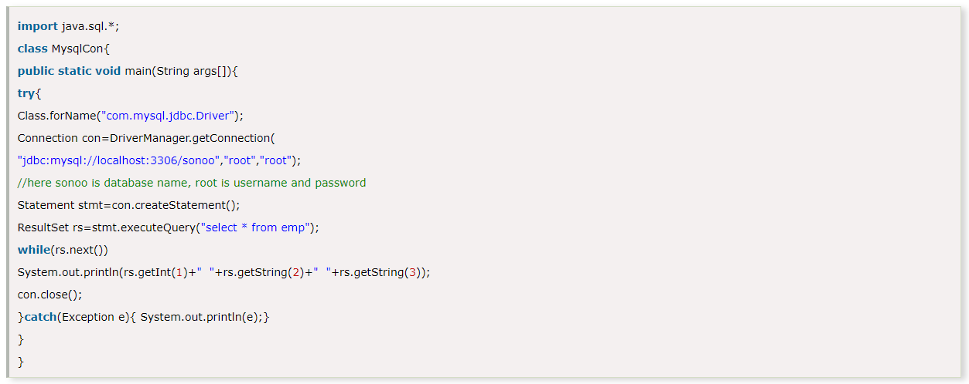
JDBC Approach

Slide 5
ORM
Java Persistence API (JPA) (standard) -> provider Hibernate
@Entity
Table 🡺 Class
Column 🡺 Property
a Tuple 🡺 an Instance
<dependency>
<groupId>org.springframework.boot</groupId>
<artifactId>spring-boot-starter-data-jpa</artifactId>
</dependency>

Slide 6
@Table
@Id
@GeneratedValue(strategy = GenerationType.IDENTITY)
@Column
@OneToOne
@OneToMany
@ManyToOne
@ManyToMany
@Enumerated(EnumType.STRING)
@Lob
Notes:
Ex 2 - annotate classes and start app

Slide 7
H2 - in memory DB
Postgres
MySQL - MariaDB
Oracle
<dependency>
<groupId>com.h2database</groupId>
<artifactId>h2</artifactId>
<scope>runtime</scope>
</dependency>

Slide 8
DB configs
application.properties
spring.datasource.url=jdbc:h2:mem:testdb
spring.datasource.driverClassName=org.h2.Driver
spring.datasource.username=sa
spring.datasource.password=password
spring.jpa.database-platform=org.hibernate.dialect.H2Dialect
spring.jpa.hibernate.ddl-auto= create-drop
spring.jpa.show-sql=true
spring.jpa.open-in-view=false
Notes:
Ex 3 - get app running

Slide 9
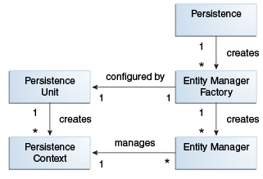
No data?
@PersistenceContext
private EntityManager em;

Slide 10
EntityManger em
em.find(Pizza.class, id)
em.persist(pizza)
em.merge(pizza)
em.createQuery(“...JPQL query string…”)
Notes:
Ex 4 - persist and fetch test data

Slide 11
@Transactional
ACID
Atomic, Consistent, Isolated, Durable
@EnableTransactionManagement
Out of the box with Spring Boot

Slide 12
Collections
@OneToMany(cascade = CascadeType.ALL, fetch = FetchType.EAGER)
@ManyToOne where it's useful +
@OneToMany(mappedBy = "pizza")
@JoinTable where necessary
Notes:
Ex 5 - Make test data save work with collection

Slide 13
Exercise
Create entities for Customer and Order
Customer:
Name
Type: New, Occasional, Frequent
can have many Orders
Order
Date
Price
Can contain many Pizzas
Create an endpoint to get all Orders

