Slide 1
Responsibilities of an Application Backend
Database Management:
- Store, retrieve, update, and delete data.
- Ensure data integrity and consistency.
Application Logic:
- Core business rules and processing.
- Controls how data is created and changed.
Authentication and Authorization:
- Login, permissions, and secure access control.
API Management:
- Handles HTTP routing, request/response, and API security.
Performance Optimization:
- Efficient memory and data handling, load balancing.

Slide 2
Responsibilities of an Application Backend
Security Measures:
- Protect against threats like SQL injection, XSS.
Data Integration:
- Connects to databases, APIs, and external services.
Session Management:
- Maintains user state between requests.
Error Handling and Logging:
- Detect, log, and respond to application errors.
Backup and Recovery:
- Ensures data can be restored after failure.
Notification Services:
- Manages emails, SMS, or system alerts.
Scalability Management:
- Adjusts resources to meet demand efficiently.

Slide 3





What Do We Need to Build a Backend?
A server that listens for client requests:
- Examples: Tomcat, Jetty, Undertow.
- Tomcat: a web server and servlet container.
- Can be embedded or run standalone.

Slide 4
Web Server vs Application Server
🌐 Web Server:
- Handles HTTP requests.
- Serves static files (HTML, CSS, JS).
- Examples: Apache HTTPD, Nginx.
⚙️ Application Server:
- Runs dynamic app logic (Java, PHP, etc.).
- Handles servlets, database access, business logic.
- Examples: Tomcat, Wildfly, WebSphere.
🧠 Spring Boot includes an embedded application server (Tomcat).

Slide 5

What is a Servlet?
🧩 A Servlet is a Java class that handles HTTP requests.
- Uses HttpServletRequest and HttpServletResponse.
- Lives inside a servlet container (like Tomcat).
- Spring Boot wraps this with DispatcherServlet and annotations.
Example:
@WebServlet("/hello")
public class HelloServlet extends HttpServlet {
protected void doGet(HttpServletRequest req, HttpServletResponse res) throws IOException {
res.getWriter().write("Hello world");
}
}

Slide 6
HTTP Request and Response
📬 HTTP Request:
- Method: GET, POST, PUT, DELETE.
- URL, headers, and optional body (JSON, form).
📤 HTTP Response:
- Status code (200, 404, 500).
- Headers: Content-Type, etc.
- Body: plain text, JSON, HTML.
💡 Tools like Postman help visualize this.

Slide 7
Frameworks: Why We Use Them
Servlet API is powerful but verbose.
Spring Framework simplifies web development:
- Dependency Injection (DI): loose coupling and modularity.
- Aspect-Oriented Programming (AOP): cross-cutting concerns like logging.
- Removes repetitive boilerplate code.

Slide 8
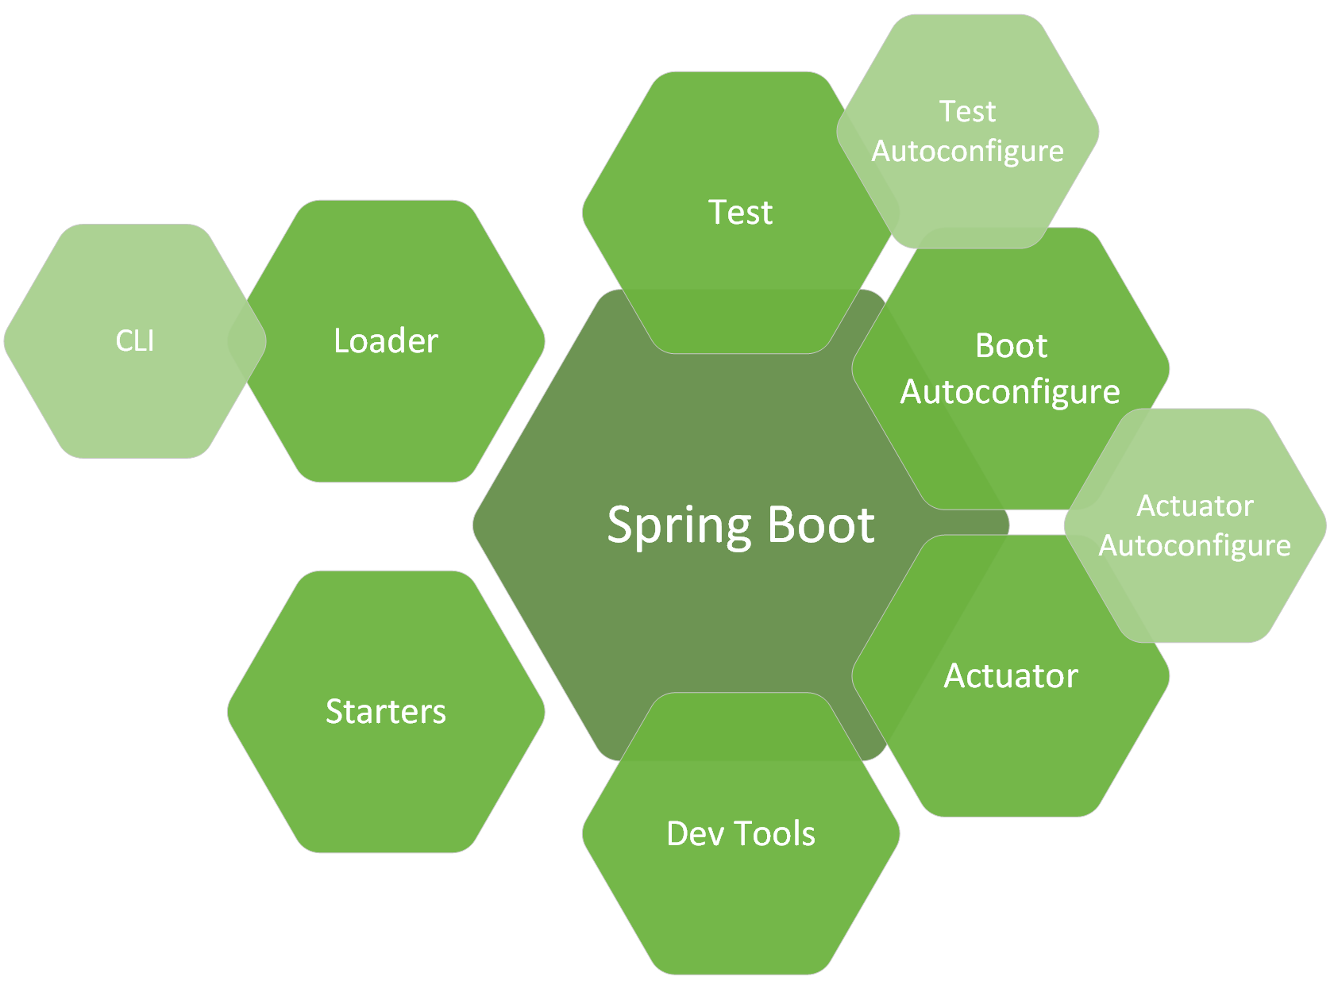
Spring Boot

Slide 9
Introduction to Spring Boot
🚀 What is Spring Boot?
- A framework to build production-ready Spring applications quickly.
- Eliminates boilerplate code and configuration.
- Comes with embedded servers like Tomcat.
- Convention over configuration.
- Opinionated defaults to simplify setup.

Slide 10
Why Use Spring Boot?
✅ Advantages:
- Rapid development with minimal configuration.
- Embedded server (no need to deploy WAR files).
- Huge ecosystem: Spring Data, Spring Security, Spring Cloud.
- Built-in production features: metrics, health checks.
- Easy integration with modern tools (Docker, Kubernetes, AWS).

Slide 11
Core Features of Spring Boot
🔧 Core Features:
- Auto-Configuration: Automatically configures application based on dependencies.
- Spring Boot Starters: Pre-configured starter dependencies for common use cases.
- Spring Boot CLI: Command-line tool to run and test apps quickly.
- Spring Boot Actuator: Production-ready monitoring and management tools.

Slide 12
Build Tool: Maven
Maven automates project build and dependency management.
Project Object Model (POM):
- pom.xml defines project config and dependencies.
Dependencies and Repositories:
- Automatically fetches and manages libraries.
Build Lifecycle:
- Phases: compile → test → package.
- Automates full build process.
Plugins and Goals:
- Extendable via plugins for tasks like compile or deploy.

Slide 13
Spring Boot Starters
🔧 What are Starters?
- Starters are dependency descriptors.
- They simplify Maven/Gradle config for common use cases.
- Each starter includes a curated set of dependencies.
- Examples: spring-boot-starter-web, spring-boot-starter-data-jpa.
- Helps avoid version conflicts and speeds up setup.

Slide 14
Common Spring Boot Starters
🚀 Popular Starters:
- spring-boot-starter-web → for web apps and REST APIs.
- spring-boot-starter-data-jpa → JPA + Hibernate + DB connectivity.
- spring-boot-starter-security → authentication and authorization.
- spring-boot-starter-test → testing tools and frameworks.
- spring-boot-starter-thymeleaf → HTML templating engine.

Slide 15
Spring Boot Actuator Overview
Monitoring and managing your Spring Boot application with built-in production-ready features.

Slide 16
Spring Boot Actuator
📈 What is Actuator?
- Adds production-ready features to Spring Boot apps.
- Provides monitoring and management endpoints.
- Helps inspect running app: health, metrics, beans, env, etc.
- Endpoints are exposed as REST APIs.

Slide 17
Useful Actuator Endpoints
🛠️ Common Endpoints:
- /actuator/health → Application health status.
- /actuator/info → App metadata (name, version).
- /actuator/metrics → Performance metrics.
- /actuator/env → Current environment properties.
- /actuator/beans → List of Spring beans.

Slide 18
Health Endpoint – Works Out of the Box
• /actuator/health is available by default.
• Shows basic application health (e.g. UP, DOWN).
• Requires no configuration for basic status.
• Add Spring dependencies (like DB, Redis) to auto-extend health checks.

Slide 19
Ex 00
Generate a new Spring Boot project with version 3.4.5, Java 17 and Maven.
Add spring-boot-starter-actuator and spring-boot-starter-web dependencies.
Check actuator/health endpoint works

Slide 20
Enabling Other Endpoints
• By default, only /actuator/health is exposed over HTTP.
• To expose others, use:
management.endpoints.web.exposure.include=info,health,metrics
• To expose everything (not recommended for prod):
management.endpoints.web.exposure.include=*

Slide 21
The Info Endpoint – Needs Configuration
• /actuator/info returns {} by default.
• It requires info.* properties in application.properties or YAML.

Slide 22
Configuring the Info Endpoint
application.properties:
info.app.name=My App
info.app.version=1.0.0
info.feature.experimental=true
→ Result in /actuator/info:
{
"app": { "name": "My App", "version": "1.0.0" },
"feature": { "experimental": true }
}

Slide 23
Spring Boot 3.x Note – Info Contributors Are Disabled by Default
• You must explicitly enable info contributors in Spring Boot 3.x:
management.info.defaults.enabled=true
management.info.env.enabled=true
• Optional: enable build or git info contributors
management.info.build.enabled=true
management.info.git.enabled=true

Slide 24
Custom InfoContributor (Optional)
• For full control over /actuator/info:
@Component
public class MyInfoContributor implements InfoContributor {
public void contribute(Info.Builder builder) {
builder.withDetail("my", Map.of("key", "value"));
}
}

Slide 25
Additional Actuator Endpoints
• /actuator/metrics – application and JVM metrics (Micrometer)
• /actuator/env – all environment properties
• /actuator/loggers – view and change logging levels
• /actuator/httptrace – recent HTTP request traces (requires httptrace dependency)
• /actuator/threaddump – thread dump snapshot
• /actuator/heapdump – JVM heap dump
• /actuator/prometheus – Prometheus scrape endpoint (with Prometheus registry)

Slide 26
Summary
• /actuator/health works out of the box.
• /actuator/info requires configuration.
• Spring Boot 3.x: enable contributors explicitly.
• You can extend /info with custom InfoContributors.

Slide 27
Ex 01
Enable actuator/info endpoint.
Add to application.properties details about the app (name,description,version) and on a different tag, details about the developer (name, role).
Debug InfoEndpointAutoConfiguration with and without info endpoint enabled

Slide 28
5. Spring MVC
A powerful module for building web applications.
- Based on Model-View-Controller pattern.
DispatcherServlet:
- Front controller for routing requests.
- Delegates to appropriate controller handlers.
MVC Breakdown:
- Model: business logic and data.
- View: renders output (HTML, XML, JSON).
- Controller: processes input and coordinates model + view.

Slide 29
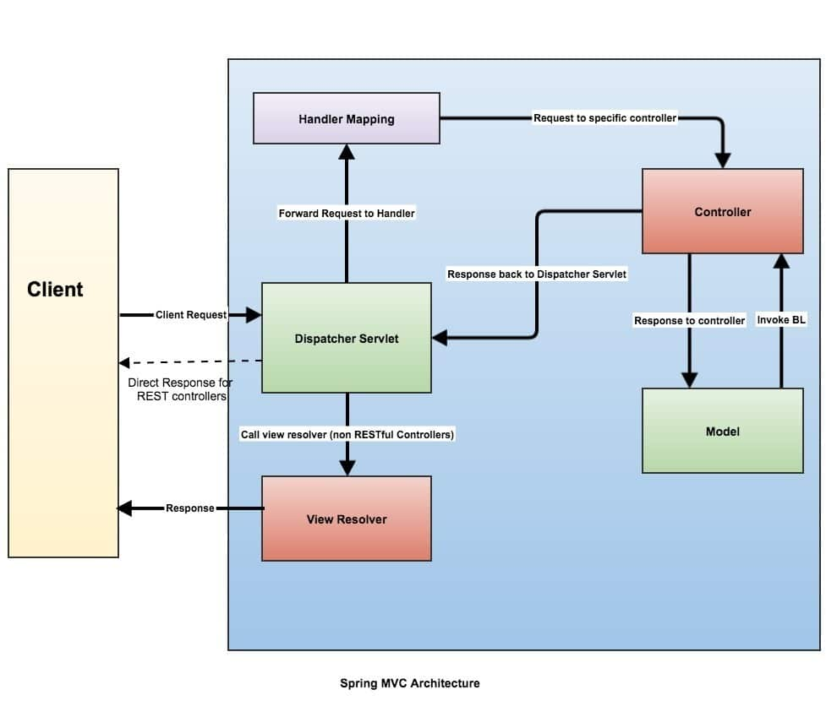

Slide 30
Spring Boot HTTP Request Lifecycle
🔄 What happens when a request hits Spring Boot:
1. Browser/client sends HTTP request to server (e.g. localhost:8080).
2. Embedded Tomcat receives the request.
3. DispatcherServlet handles the request.
4. Spring matches the URL to a @RestController method.
5. The method runs and returns a response object.
6. Response is serialized (e.g. JSON) and sent back over HTTP.

Slide 31
Introduction to Spring Web & REST
Spring Web provides tools to build web and RESTful applications.
- REST: Representational State Transfer — a design pattern for APIs.
- Spring MVC handles HTTP requests and responses via annotations.
- RESTful APIs follow HTTP methods to expose resources (data).
- Controller classes define endpoints for the web or APIs.

Slide 32
@RestController and @RequestMapping
@RestController:
- Combines @Controller + @ResponseBody.
- Tells Spring to return data directly (JSON by default).
@RequestMapping:
- Base annotation to map web requests to handler methods.
- Can be applied at class or method level.
- Can define method, path, headers, params, etc.

Slide 33
HTTP Method-Specific Mappings
@GetMapping("/items"):
- Maps to HTTP GET for retrieving resources.
@PostMapping("/items"):
- Maps to HTTP POST for creating new resources.
@PutMapping("/items/{id}"):
- Maps to HTTP PUT for updating existing resources.
@DeleteMapping("/items/{id}"):
- Maps to HTTP DELETE for deleting resources.
@PatchMapping("/items/{id}"):
- Maps to HTTP PATCH for partial updates.

Slide 34
Interpreting Request Data
@PathVariable:
- Extracts value from URI path. Example: /items/{id}.
@RequestParam:
- Extracts query parameter. Example: /search?keyword=book.
@RequestBody:
- Maps the HTTP request body to a Java object (usually JSON).
@RequestHeader:
- Reads HTTP header value from request.
@ModelAttribute:
- Binds form fields to a model object (mainly for web forms).

Slide 35
Example REST Controller
@RestController
@RequestMapping("/api/items")
public class ItemController {
@GetMapping("/{id}")
public Item getItem(@PathVariable Long id) { ... }
@PostMapping
public Item createItem(@RequestBody Item item) { ... }
}

Slide 36
Ex 02
Create a PizzaController with:
- an endpoint that returns a list of Pizzas ("Salami", "Prosciutto", "Capriciosa“, etc)
- an endpoint that uses a path variable to return one Pizza by name
- an endpoint that uses a request parameter to filter Pizzas that contain a sequence of characters in their name

Slide 37
Intro to Spring: Beans & Dependency Injection

Slide 38
What is a Bean?
• A Spring **bean** is an object managed by the Spring IoC container.
• Created, initialized, and injected automatically by Spring.
• Typically defined using annotations like `@Component`, `@Service`, `@Repository`, or `@Bean`.

Slide 39
Creating a Bean
@Component
public class Engine {}
@Service
public class CarService {
@Autowired
private final Engine engine;
public CarService() {
}
}

Slide 40
What is Dependency Injection?
• Technique where one object provides dependencies of another object.
• You don't create the object manually; Spring injects it.
Benefits:
✅ Loose coupling
✅ Easier testing
✅ Clean, readable code

Slide 41
Dependency Injection Types
• **Constructor Injection** (recommended):
Ensures dependencies are final and not null.
• **Field Injection**: Uses `@Autowired` on fields (less testable).
• **Setter Injection**: Optional dependencies, mutable objects.

Slide 42
Constructor Injection Example
@Component
public class Car {
private final Engine engine;
@Autowired
public Car(Engine engine) {
this.engine = engine;
}
}

Slide 43
Spring Bean Scopes
• **Singleton** (default): One shared instance.
• **Prototype**: New instance every time it's requested.
• **Request** (web): One per HTTP request.
• **Session** (web): One per HTTP session.
Use `@Scope("prototype")` to set.

Slide 44
Bean Scope Example
@Component
@Scope("prototype")
public class TaskProcessor {
// new instance every time
}

Slide 45
@Bean vs @Component
• `@Component`: Automatically detected via classpath scanning.
• `@Bean`: Declares a bean in a `@Configuration` class manually.
Use `@Bean` when you don't control the class source or need customization.

Slide 46
Manual Bean Definition Example
@Configuration
public class AppConfig {
@Bean
public Engine engine() {
return new Engine("V8");
}
}

Slide 47
Summary
• Beans are the backbone of Spring apps.
• DI allows Spring to inject what you need automatically.
• Choose the right bean scope for your use case.
• Use `@Component` for automatic, `@Bean` for manual definitions.

Slide 48
Spring Bean Lifecycle Phases
Key phases:
Bean Instantiation
Populate Properties (Dependency Injection)
Aware Interfaces Callback
BeanPostProcessor Pre-Initialization
@PostConstruct
InitializingBean.afterPropertiesSet()
Custom init-method
BeanPostProcessor Post-Initialization
Bean Destruction: @PreDestroy, DisposableBean.destroy(), custom destroy-method

Slide 49
@PostConstruct Annotation
Definition and Usage
Part of javax.annotation package (JSR-250)
Executed after dependency injection and before Spring init callbacks
Applicable to methods with no arguments
Runs only once per bean instance

Slide 50
Example: @PostConstruct
Example in a Spring component:
@Component
public class MyBean {
@PostConstruct
public void init() {
// initialization logic
}
}

Slide 51
Ex 03
Create A Pizza class with a Long id and String name fields
Create a Pizza Service class and implement Pizza creation, search and filtering logic into the Service
Inject Pizza Service (field or constructor injection) into Pizza controller

Slide 52
Spring Proxies
Interface-based vs Class-based (CGLIB)
Understanding how Spring creates dynamic proxies

Slide 53
Why Proxies?
• Intercept method calls for AOP (transactions, security, caching)
• Add functionality before/after method execution
• Decouple cross-cutting concerns from business logic

Slide 54
JDK Dynamic Proxies
• Used when bean implements at least one interface and proxyTargetClass=false
• Creates a proxy implementing the specified interfaces
• Delegates calls to the target bean
• **Limitation:** Cannot proxy concrete classes or non-interface methods
Example:
ProxyFactory factory = new ProxyFactory(targetBean);
factory.setInterfaces(MyService.class);
MyService proxy = (MyService) factory.getProxy();

Slide 55
CGLIB Proxies
• Used when bean has no interfaces or proxyTargetClass=true
• Creates a subclass of the target class at runtime
• Can proxy classes and methods directly
• **Limitation:** Final classes/methods cannot be proxied
Example:
Enhancer enhancer = new Enhancer();
enhancer.setSuperclass(MyClass.class);
enhancer.setCallback(advice);
MyClass proxy = (MyClass) enhancer.create();

Slide 56
Configuring Proxy Type
• Annotation:
@EnableAspectJAutoProxy(proxyTargetClass = true/false)
• XML:
<aop:config proxy-target-class="true|false"/>

Slide 57
Determining Proxy Strategy
1. If proxyTargetClass=true → CGLIB proxy always
2. Else if bean implements interfaces → JDK Dynamic Proxy
3. Else → CGLIB proxy

Slide 58
Pros & Cons
• **JDK Proxies:**
– ✔ Interface enforcement
– ❌ Cannot proxy classes
• **CGLIB Proxies:**
– ✔ Class proxying
– ❌ Cannot proxy final classes/methods
– Slightly more complex and heavier

Slide 59
Summary
• Spring uses JDK proxies by default when interfaces are present
• Use proxyTargetClass to force CGLIB
• Choose based on your bean design and AOP needs
• Understanding proxies helps debug AOP and transaction behavior

Slide 60
Spring Annotation Essentials
Overview of key annotations for bean selection, ordering, and conditional configuration.

Slide 61
@Primary
• Marks a bean as the default when multiple candidates exist.
• Ideal for choosing one implementation.
Example:
@Component
@Primary
public class DefaultPaymentService implements PaymentService {}

Slide 62
@Qualifier
• Disambiguates beans by name or custom qualifier.
• Use when multiple beans implement the same interface.
Example:
public class OrderService {
@Autowired
@Qualifier("creditCardService")
private PaymentService paymentService;
}

Slide 63
@Order
• Specifies ordering for collections or aspects.
• Lower values have higher priority.
Example:
@Component
@Order(1)
public class FirstFilter implements Filter {}

Slide 64
@ConditionalOnBean
• Registers a bean only if another bean exists.
• Often used in auto-configuration.
Example:
@Bean
@ConditionalOnBean(DataSource.class)
public JdbcTemplate jdbcTemplate(DataSource ds) {
return new JdbcTemplate(ds);
}

Slide 65
@ConditionalOnProperty
• Registers a bean based on a property value.
• Enables feature toggles via config.
Example:
@Bean
@ConditionalOnProperty(name = "feature.x.enabled", havingValue = "true")
public FeatureX featureX() {
return new FeatureX();
}

Slide 66
@ConditionalOnClass & @ConditionalOnMissingBean
• @ConditionalOnClass: only if a class is on the classpath.
• @ConditionalOnMissingBean: only if a bean is NOT present.
Example:
@Configuration
@ConditionalOnClass(name = "com.google.gson.Gson")
public class GsonConfig {}

Slide 67
Ex 04
Create a Pizza Service interface with multiple implementations
Inject (using constructor injection) all implementations into the Pizza Controller and refactor methods to take all Pizza Services into account.
Inject exactly one Pizza Service as a “fast pizza service”. Use a new endpoint to retrieve a pizza only from this service
All generated spring proxies should be JDK proxies

