Slide 1
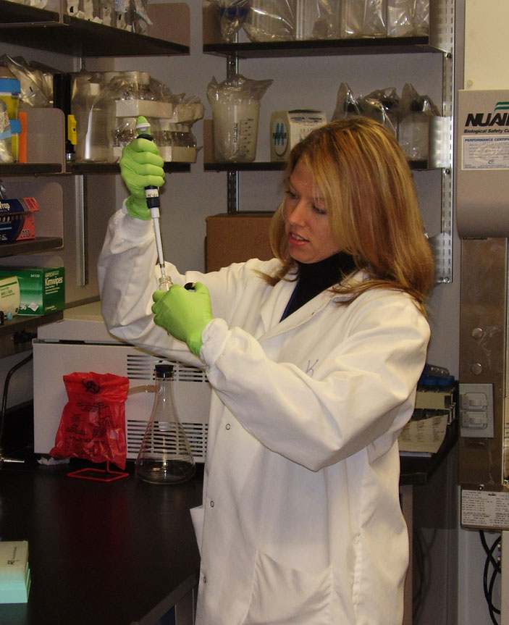
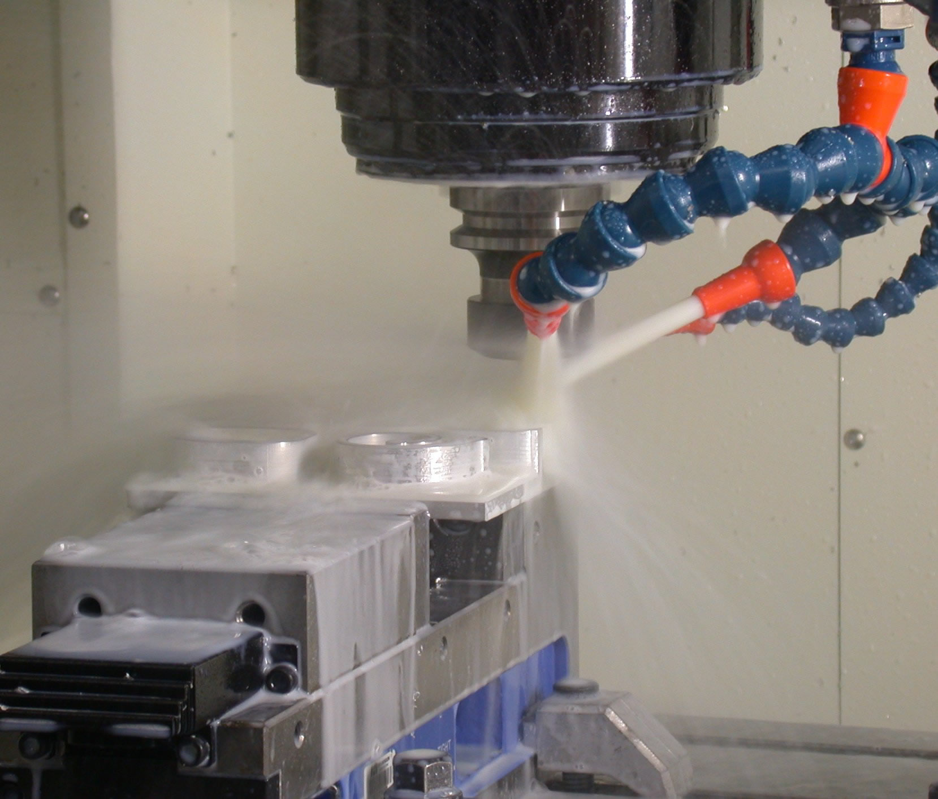
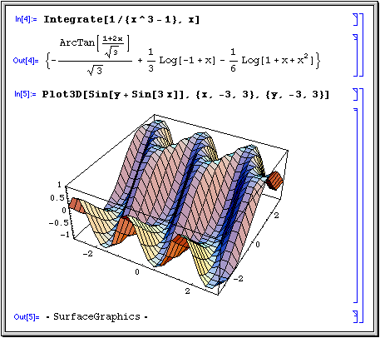
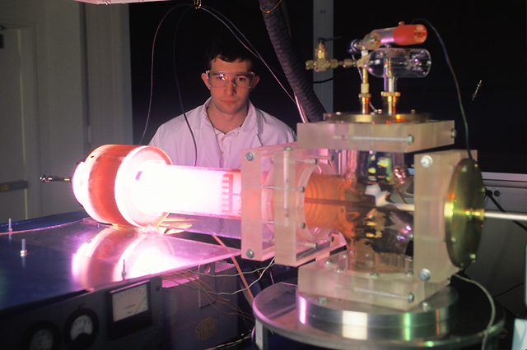
STEM
Science
Technology
Computer
Programming
Mathematics
Engineering

Slide 2
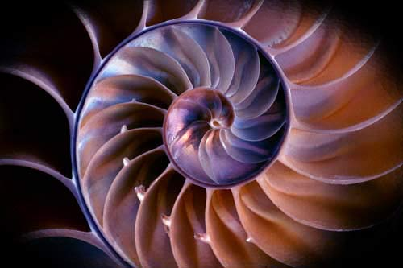
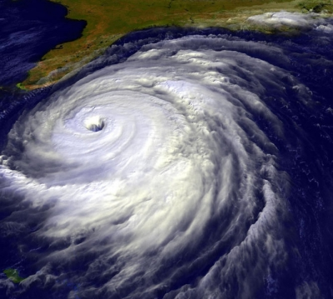
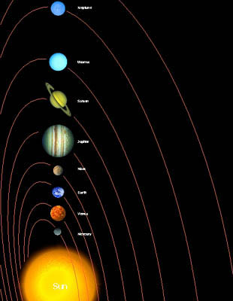
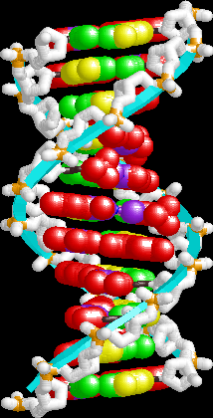
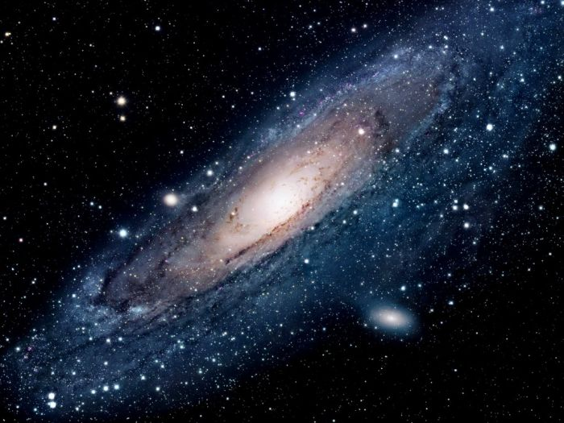
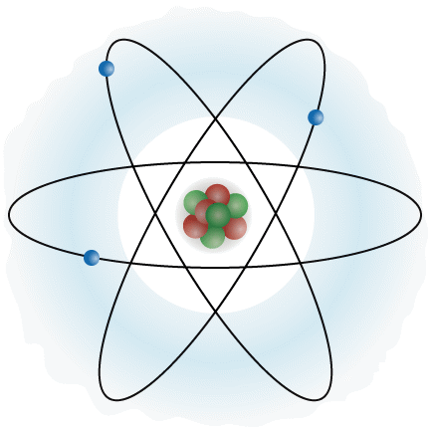
    Patterns: The Fundamental "Stuff" Out Of Which
    Everything In The Universe Is Made

Slide 3

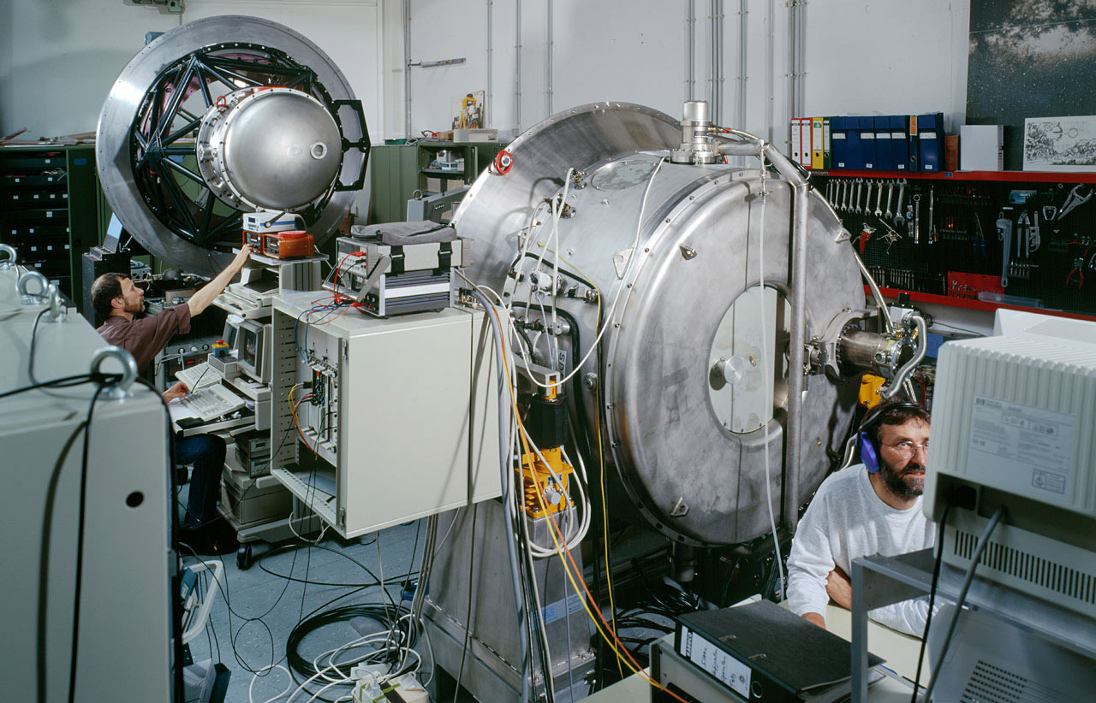
    Science: A System For Discovering And Organizing Patterns

Slide 4
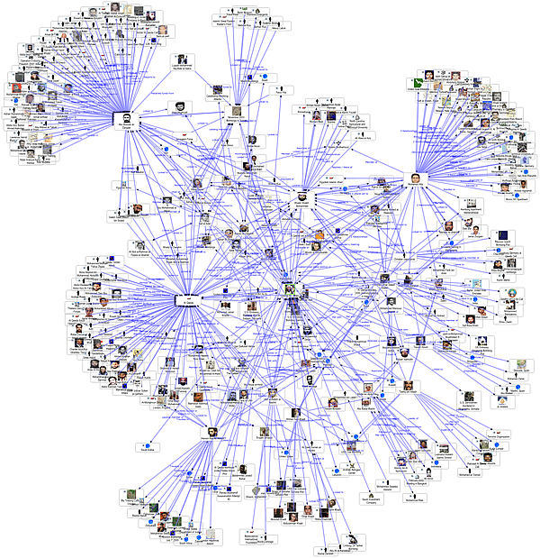
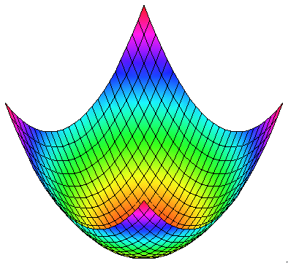
    Mathematics: The Language Of Patterns

Slide 5
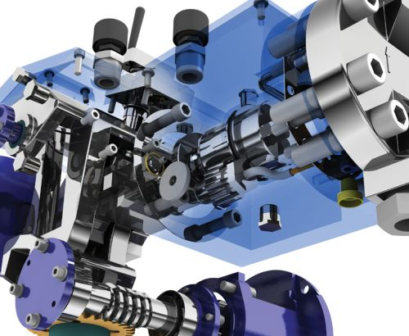
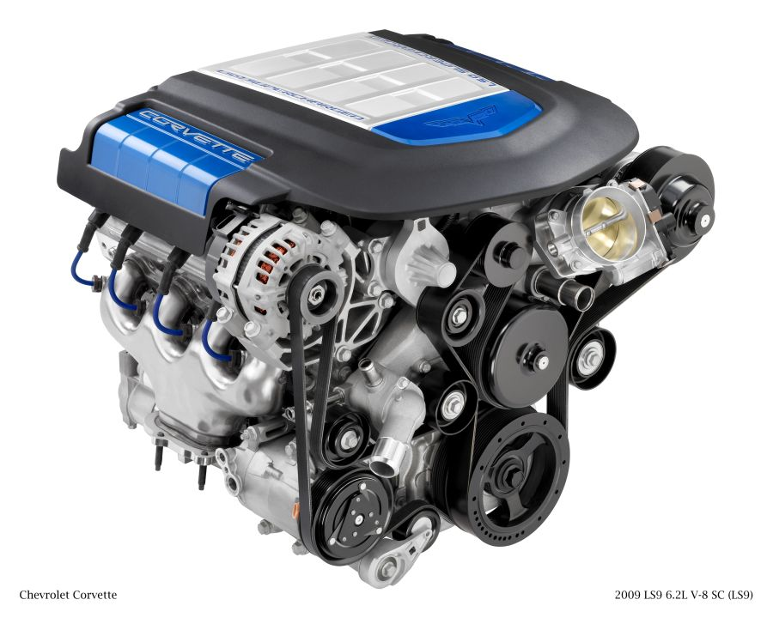
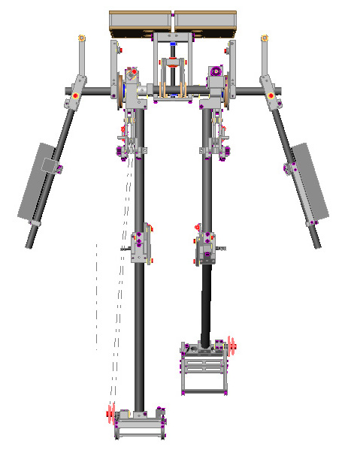
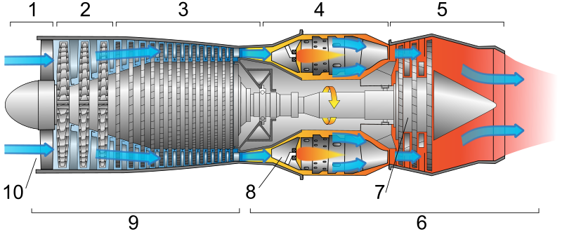
    Engineering: Designing Things With Patterns

Slide 6
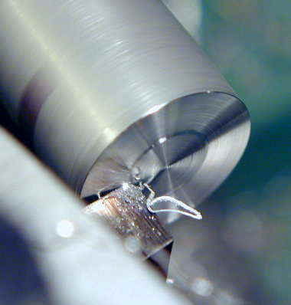
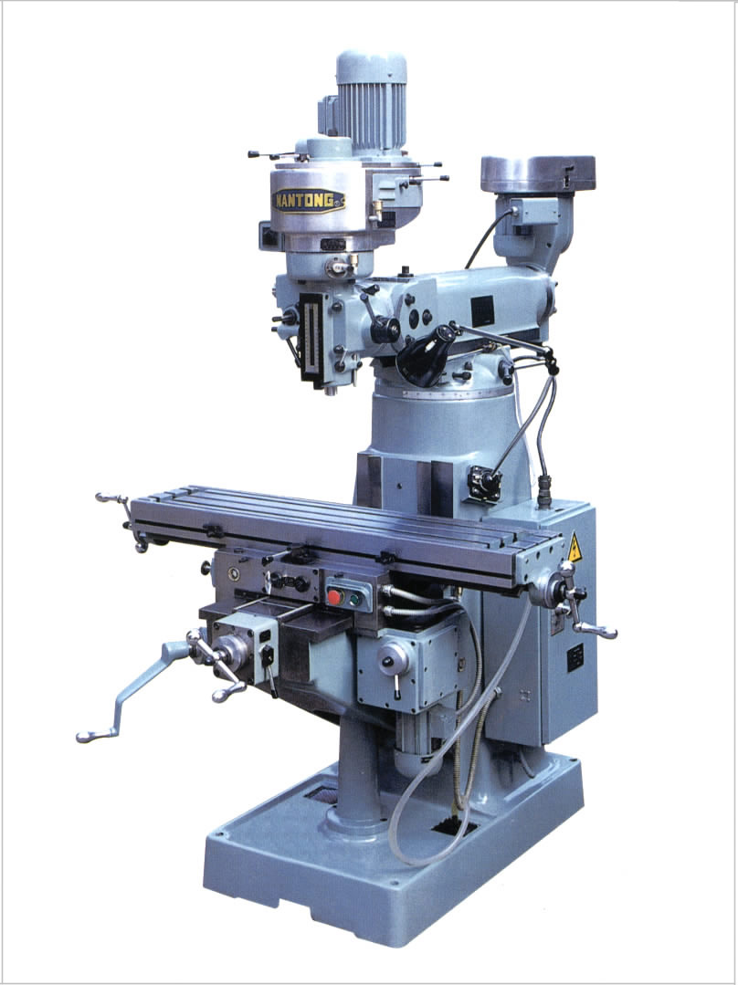
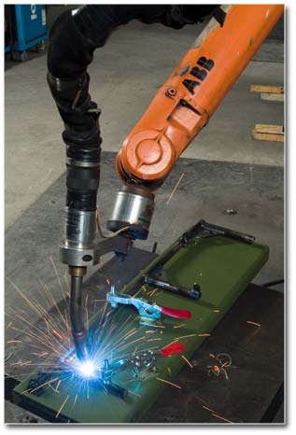
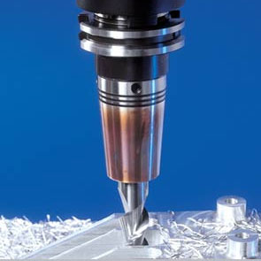
    Technology: Making Things With Patterns

Slide 7
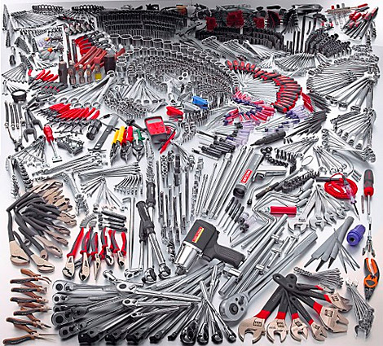
  What Tools Are Used For Analyzing And Manipulating Patterns?

Slide 8


    Level 1 Tool: Pencil Marks On Paper = Walking

Slide 9
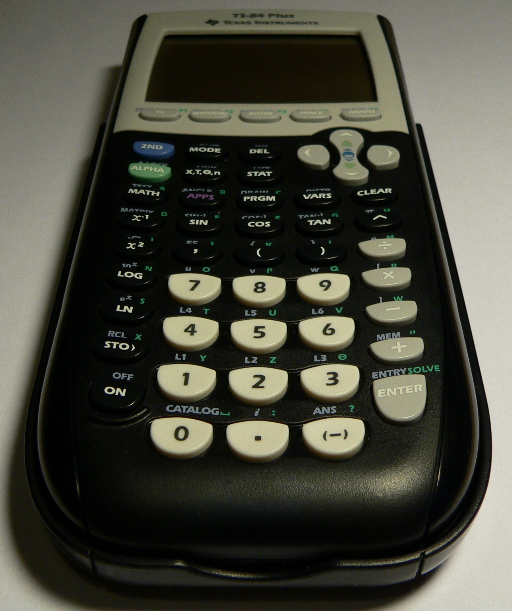
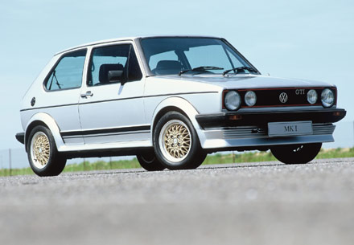
    Level 2 Tool: Hand Held Calculator = Automobile

Slide 10
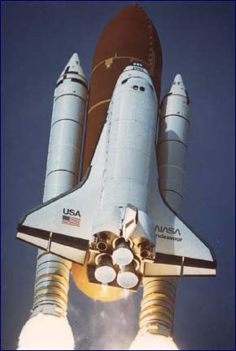
    Level 3 Tool: Computer Programming With Loops = Spacecraft

Slide 11
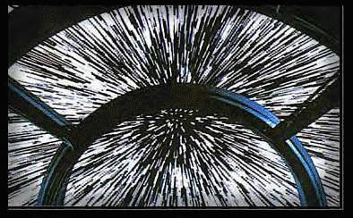
    Level 4 Tool: Computer Programming With Formulas/Theorems = Spacecraft With Hyperdrive

Slide 12
  All The STEM Areas Are Quickly Becoming Programming Based Because Programming Is One Of The Most Powerful Tools We Have For Working With Patterns

Slide 13
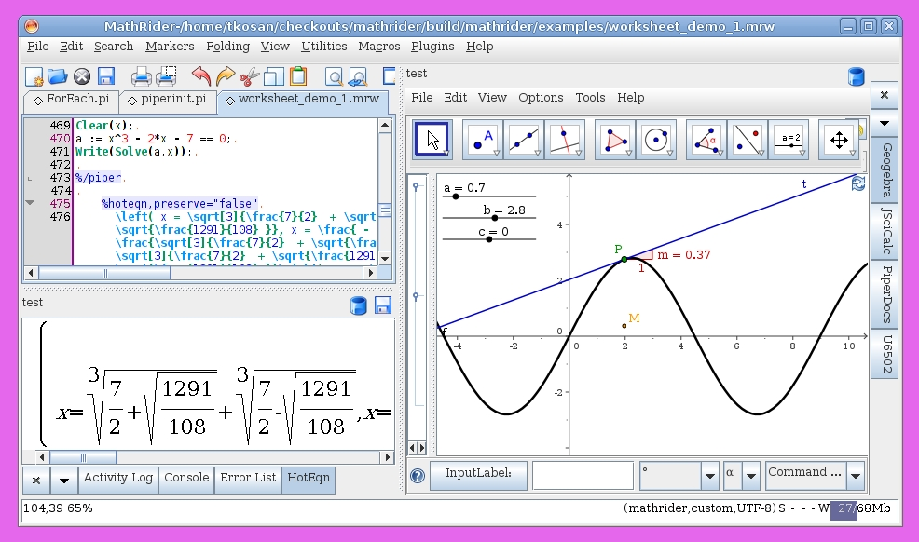
    MathRider - A Programming-Based Problem
    Solving Environment For The STEM Disciplines

Slide 14
    MathPiper
    Is a free open source application.
    Is an easy-to-learn programming language.
    Is much more powerful than a graphing calculator.
    Symbolic mathematics.
    Numerical mathematics.
    Graphing.
    Simulations.
    Visualizations.
    Specifically designed for use in education.
    SERIOUS FUN!
    http://mathpiper.org

