Slide 1
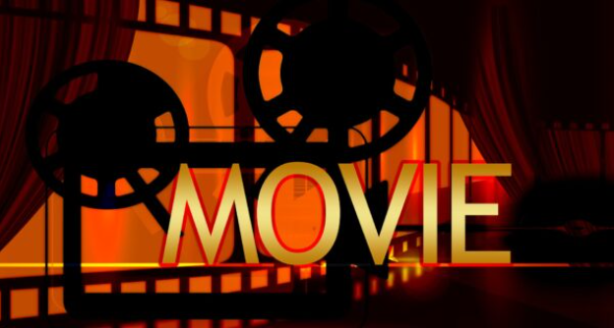
Judge A Movie By Its Cover
Βογιατζής Γιωργος
Πράσινος Μιχάλης
Ζούρου Μυρσίνη

Slide 2
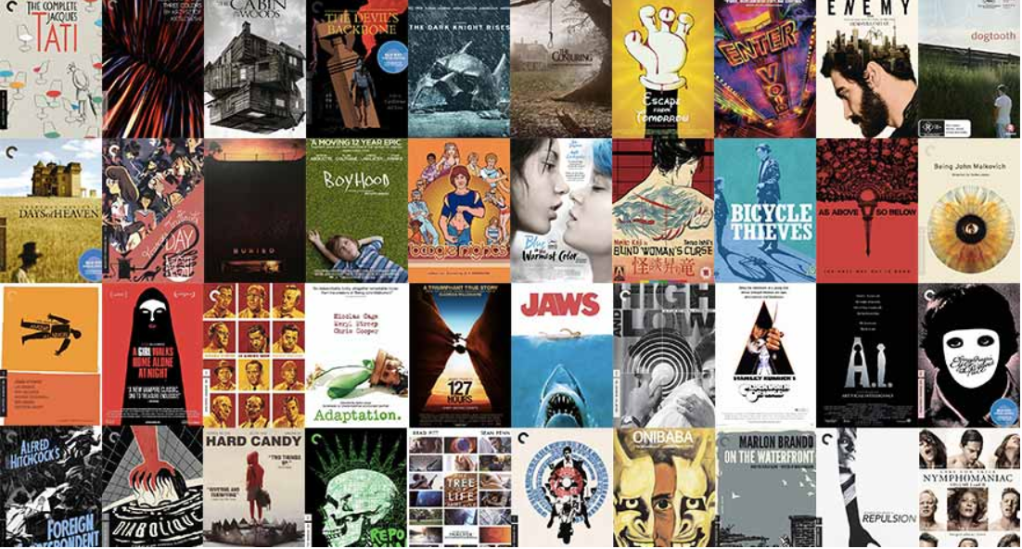
The idea
It is crucial for the movie industry, that the cover image depicts the movie genre AND wins the audience attention.
But what if we can predict the movie genre of the cover image or the short description?

Slide 3
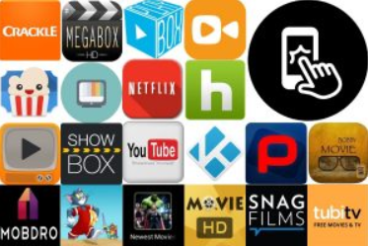
Our scope
We will try to predict the movie genre by its cover image, short description or both.
This project aims to help the film industry in creating posters and descriptions, that match the actual movie genre and also movie platforms such as Netflix to classify the movies successfully.

Slide 4
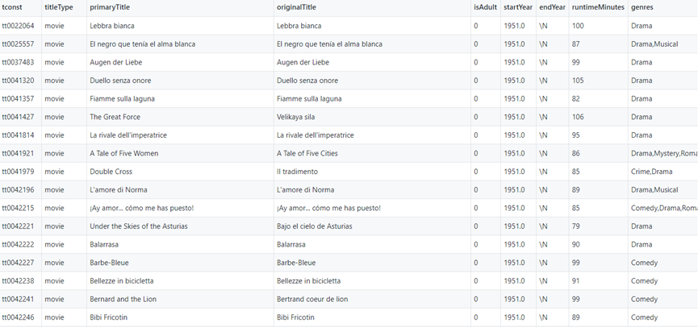
Dataset
Our dataset comes from the IMDb (Internet Movie Database) and has the following form:

Slide 5
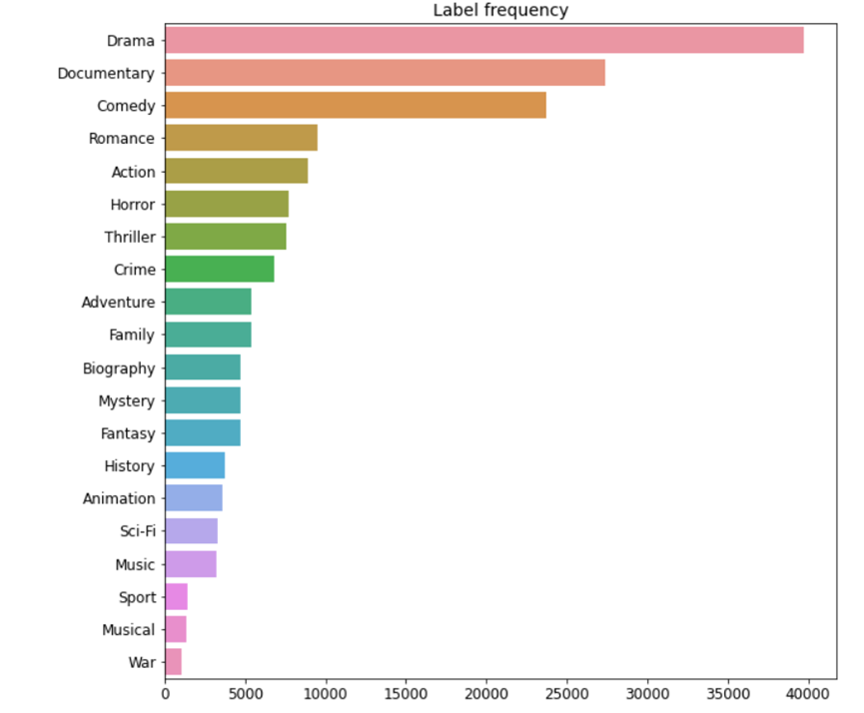
Dataset
Our final dataset contains 100054 cover images with the below movie genre distribution

Slide 6
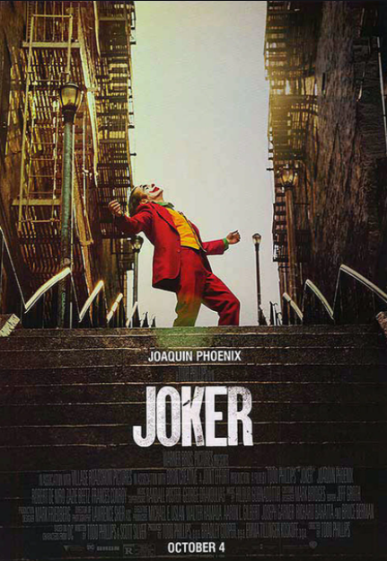
CNN (Convolution Neural Network)
The model takes the poster as input and returns the predicted genre of the movie.
Split the data into train and validation set.
Rescaled the pixels of the images divided with the max value (255)
Create 4 convolutional layers
Below we represent the composition of our model:
Genre
Conv2D
Batch Normalization
MaxPooling2D
Dropout
Flatten
Dense

Slide 7
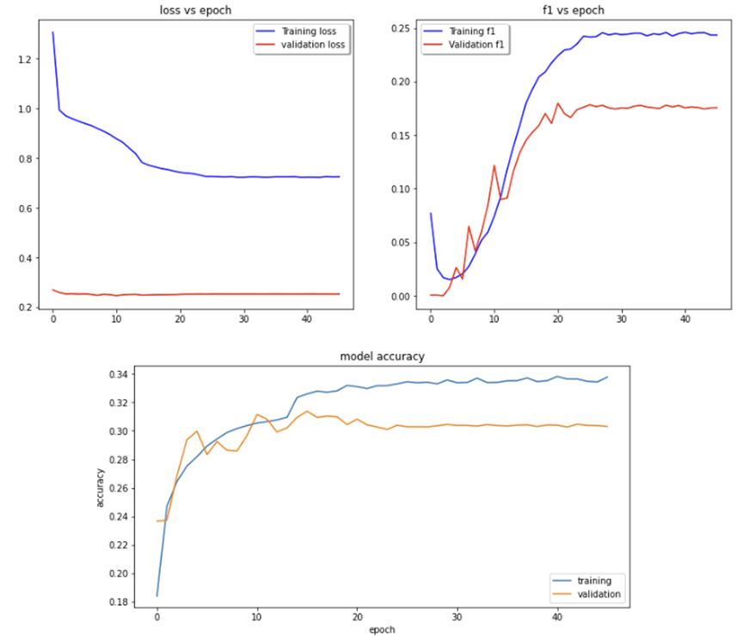
Results
CNN
Accuracy: 25%
Precision: 60%
Recall:26%
F1*:14%
Our model has the best F1 result when the movie genre is drama.
From the learning Curves, we can identify that the validation dataset appears easier for our model to predict than the training dataset.
* (Weighted average of precision and recall)

Slide 8
CNN-LSTM (long-short term memory network)
The model takes as input the short description of the movie and returns the predicted genre of the movie.
Split the data into train and validation set
Clean the dataset from general used words in short description
Tokenize our words
Replace each token with one embedding
Make the embedding not trainable
Below we represent the composition of the model
Genre
Conv2D
Embedding
MaxPooling2D
Spatial Dropout
LSTM
Dense

Slide 9
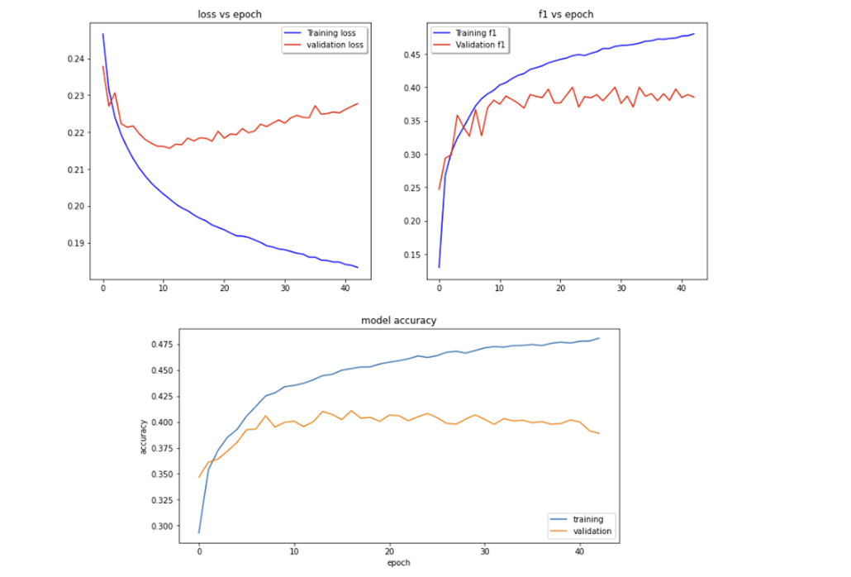
Results
CNN-LSTM
Accuracy:25%
Precison:34%
Recall:25.6%
F1*:25%
Same as the previous model, it is more precise when dealing with drama or documentary film descriptions.
Regarding the Learning curve (loss vs epoch) we can observe that the training dataset has too few examples as compared to the validation dataset, hence the loss appears to improve over the first epochs, however a gap remains in both curves. F1 score and model accuracy suggest the same problem.
* (Weighted average of precision and recall)

Slide 10
Conclusion
Both models have a low performance.
Our main issue is that the dataset is imbalanced, and therefore we judged the models mainly on the f1 score.
The CNN-LSTM model performs better in such cases - Slightly higher score.
The precision of the CNN model could not be taken into account, since we have a small amount of total predicted positive observations, hence higher precision.
Next Step is to create a different-more balanced dataset, and rerun both models to eliminate the problems caused by it.

Slide 11
THANK YOU FOR YOUR ATTENTION

