Slide 1
CSC675 Database Design Project Sporting Goods Online Store

Slide 2
Online Store Description
Store has employees that sell the products. Employees have unique ID, Name and Job Title.
Store has customers who order products. Customers have unique ID, Name, Address and Phone Number.
Products have unique Code, Category, Name, Price and Quantity in Stock.
Customers make orders that contain products. Order has unique ID, Date and Product Quantity.
Store sells products of different vendors. Vendors have unique ID, Name, Address and Phone Number.
Each order has associated with it a customer ID that bought it and an employee ID that sold it.
Each product has associated with it a vendor that sold it.
The date in which a vendor sold a product is specified.

Slide 3
ER Diagram
V_Name
E_ID
V_address
E_Name
C_ID
V_ID
Vendor
Employee
E_Job_Title
C_Name
V_Phone_Number
Customer
Vend
V_Date
C_Address
Sell
Buy
P_Code
C_Phone_Number
Contains
Product
Order
P_Name
O_ID
P_Price
O_Date
P_Category
O_Product_Quantity
P_Quantity_In_Stock

Slide 4
Schema
Order (O_ID:integer ,O_Date: date, O_Product_Quantity: integer).
Product (P_Code: string, P_Category: string, P_Name: string, P_Price: real, P_Quantity_In_Stock: integer).
Customer(C_ID: integer, C_Name:string, C_Address:string, C_Phone_Number: string).
Vendor(V_ID:integer, V_Name:string, V_Address:string, V_Phone_Number:string).
Employee(E_ID: integer, E_Name: string, E_Job_Title:string).
Vend(P_Code: string, V_ID: integer, V_Date: date)
Buy(O_ID: integer, C_ID: integer)
Sell(O_ID: integer, E_ID: integer)
Contains(O_ID: integer, P_Code: string)

Slide 5
Due to Key Constraints we can merge tables (Buy + Sell + Order, Vend + Product)
Buy_Sell_Order (O_ID:integer ,O_Date: date, O_Product_Quantity: integer, E_ID: integer, C_ID: integer).
Vend_Product (P_Code: string, P_Category: string, P_Name: string, P_Price: real, P_Quantity_In_Stock: integer, V_date: date, V_ID: integer).
Customer(C_ID: integer, C_Name:string, C_Address:string, C_Phone_Number: string).
Vendor(V_ID:integer, V_Name:string, V_Address:string, V_Phone_Number:string).
Employee(E_ID: integer, E_Name: string, E_Job_Title:string).
Contains(O_ID: integer, P_Code: string)

Slide 6
Creating Database and Tables
CREATE DATABASE Online_Store;
CREATE TABLE Vendor( V_ID INTEGER, V_Name VARCHAR (128), V_Address VARCHAR (128), V_Phone_Number VARCHAR (16), PRIMARY KEY(V_ID));
CREATE TABLE Employee(E_ID INTEGER, E_Name VARCHAR (128), E_Job_Title VARCHAR (64), PRIMARY KEY(E_ID));
CREATE TABLE Customer(C_ID INTEGER, C_Name VARCHAR (128), C_Address VARCHAR (128), C_Phone_Number VARCHAR (16), PRIMARY KEY(C_ID));
CREATE TABLE Buy_Sell_Order(O_ID INTEGER, O_Date DATE, O_Product_Quantity INTEGER, C_ID INTEGER, E_ID INTEGER, PRIMARY KEY(O_ID), FOREIGN KEY(C_ID) REFERENCES Customer(C_ID), FOREIGN KEY(E_ID) REFERENCES Employee(E_ID) );
CREATE TABLE Vend_Product(P_Code VARCHAR(4), P_Category VARCHAR(64), P_Name VARCHAR (128), P_Price DECIMAL(7,2) , P_Quantity_In_Stock INTEGER, V_ID INTEGER, V_Date DATE, PRIMARY KEY(P_Code), FOREIGN KEY(V_ID) REFERENCES Vendor(V_ID));
CREATE TABLE Contains(O_ID INTEGER, P_Code VARCHAR (4), PRIMARY KEY(O_ID, P_Code), FOREIGN KEY(O_ID) REFERENCES Buy_Sell_Order (O_ID), FOREIGN KEY(P_Code) REFERENCES Vend_Product(P_Code));

Slide 7
Creating Index
CREATE INDEX indx_V_phone on Vendor(V_Phone_Number);
CREATE INDEX firstLetter on Vend_Product (P_Name(1));

Slide 8
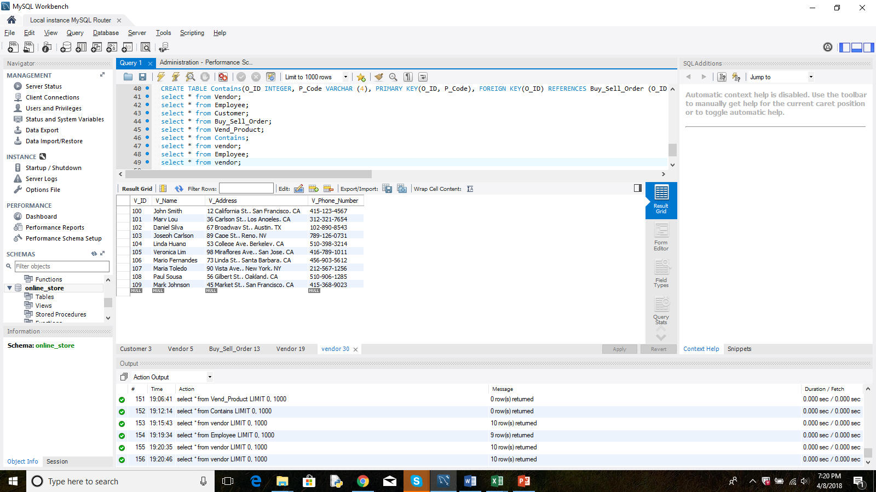
Contents of Vendor Table

Slide 9
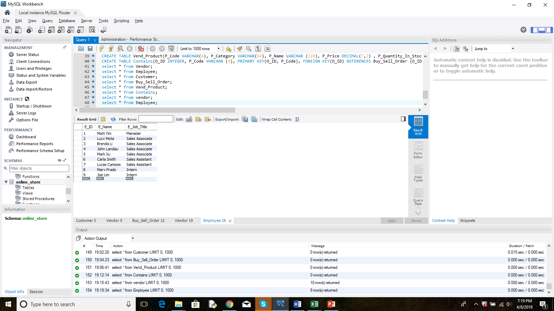
Contents of Employee Table

Slide 10
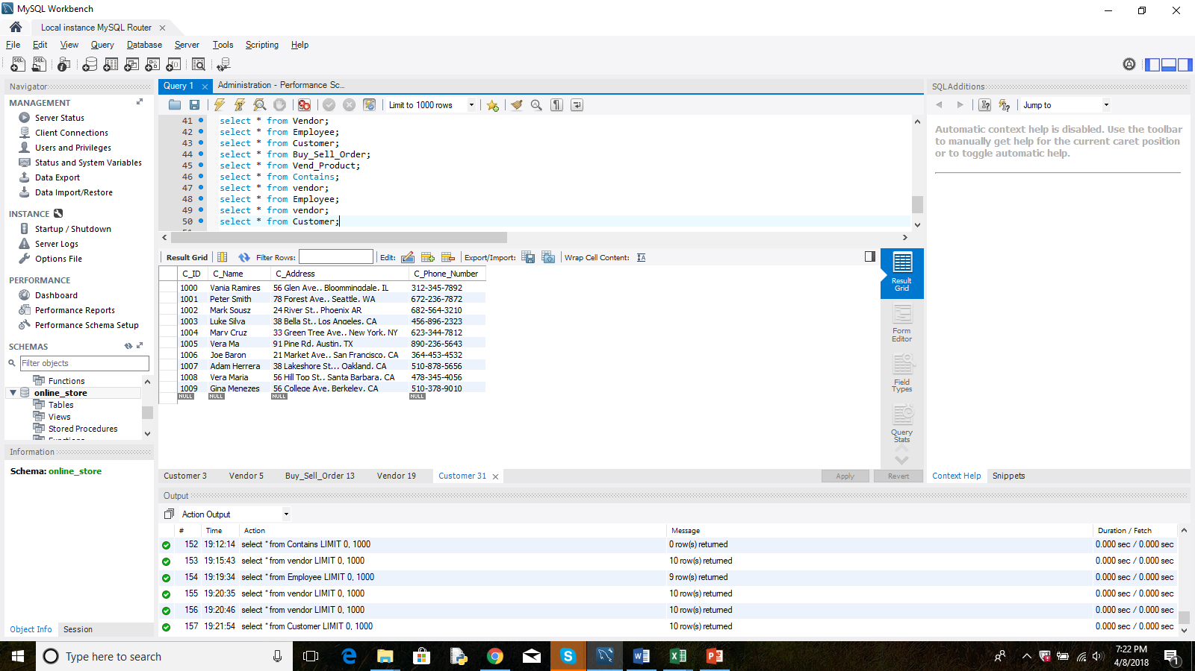
Contents of Customer Table

Slide 11
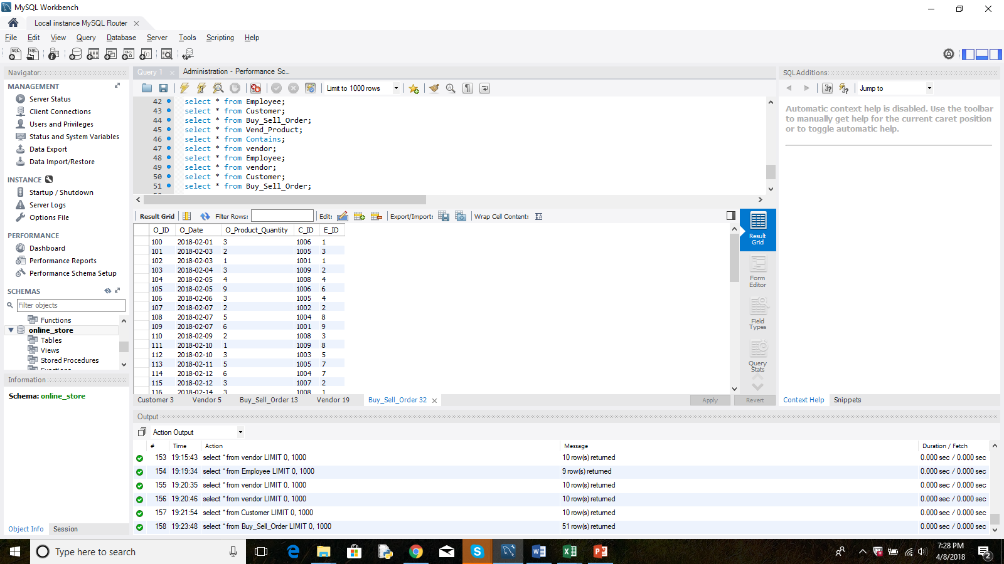
Contents of Buy_Sell_Order Table

Slide 12
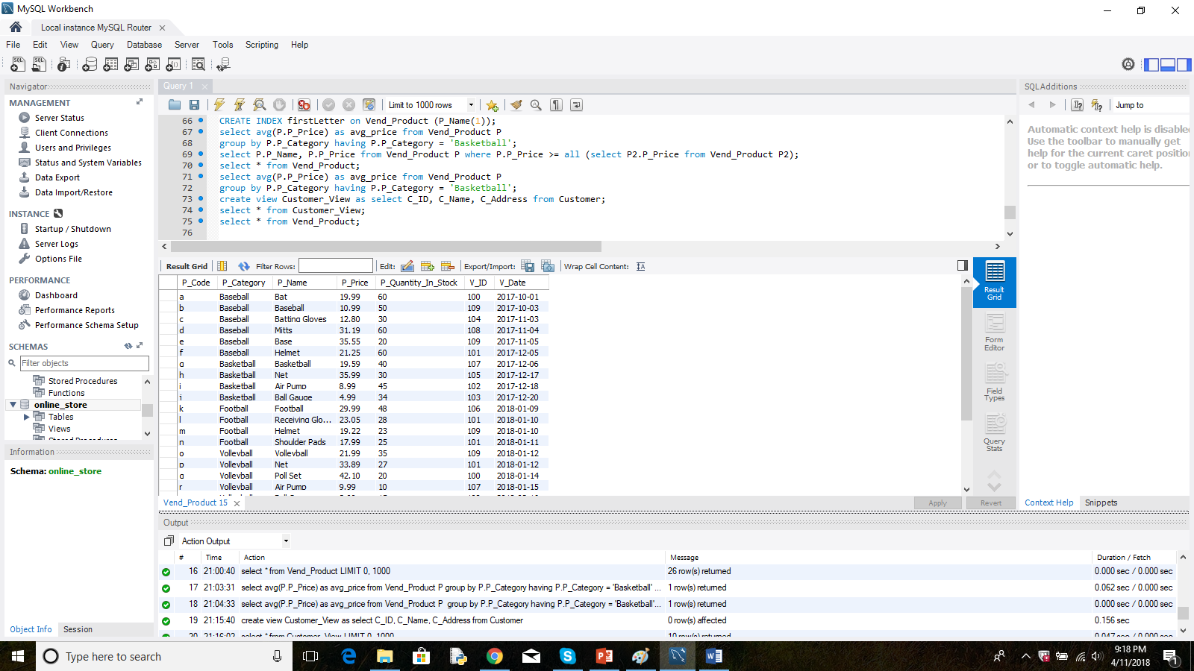
Contents of Vend_Product Table

Slide 13
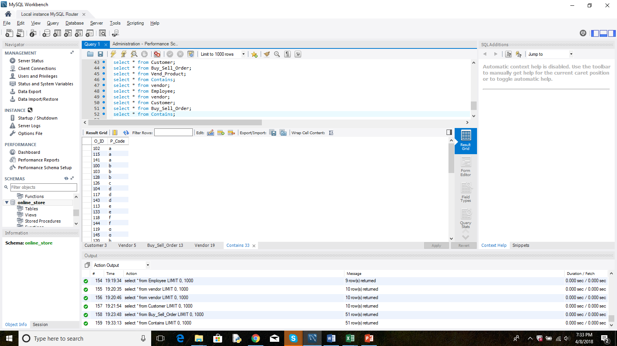
Contents of Contains Table

Slide 14
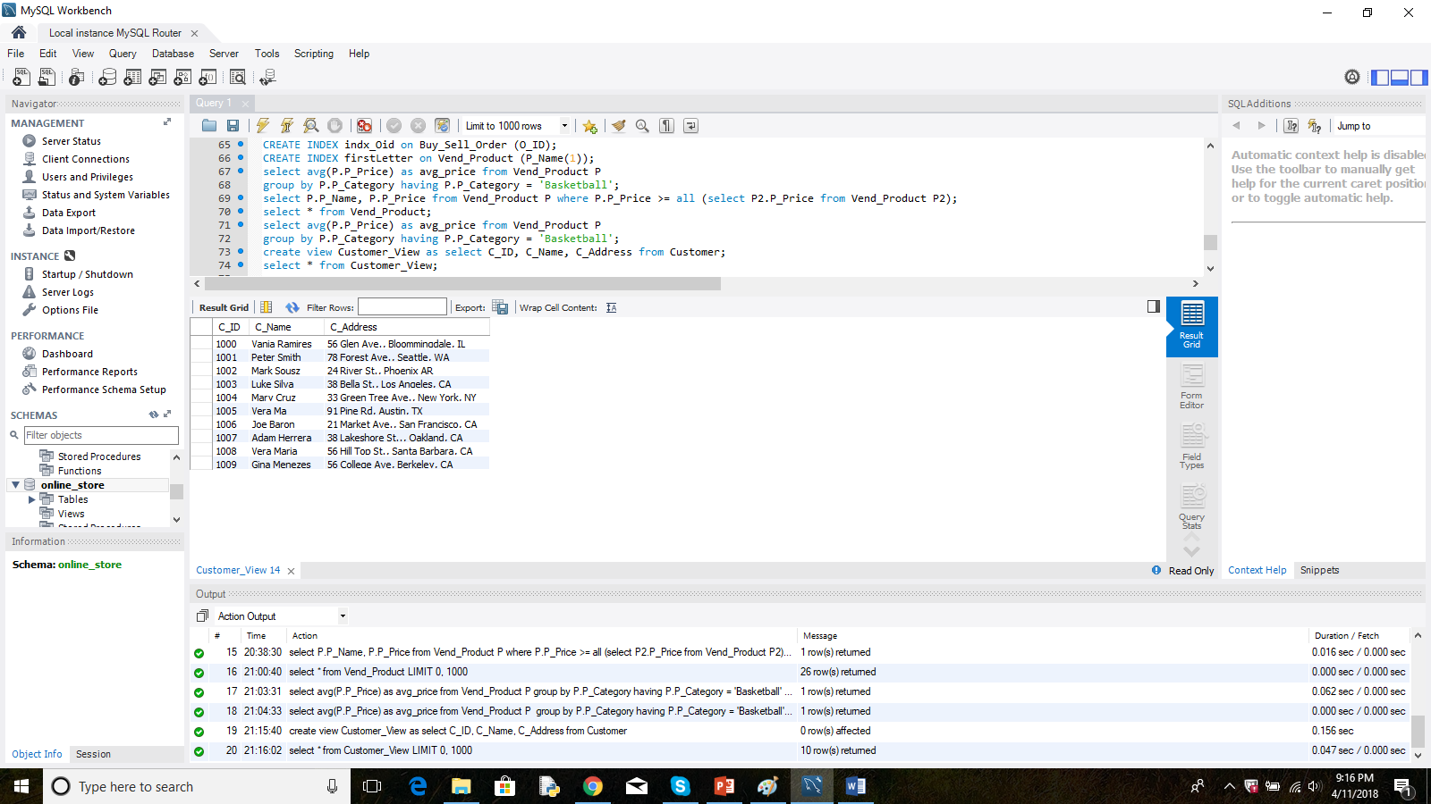
Creating a view that hides customer phone number: create view Customer_View as select C_ID, C_Name, C_Address from Customer;

Slide 15
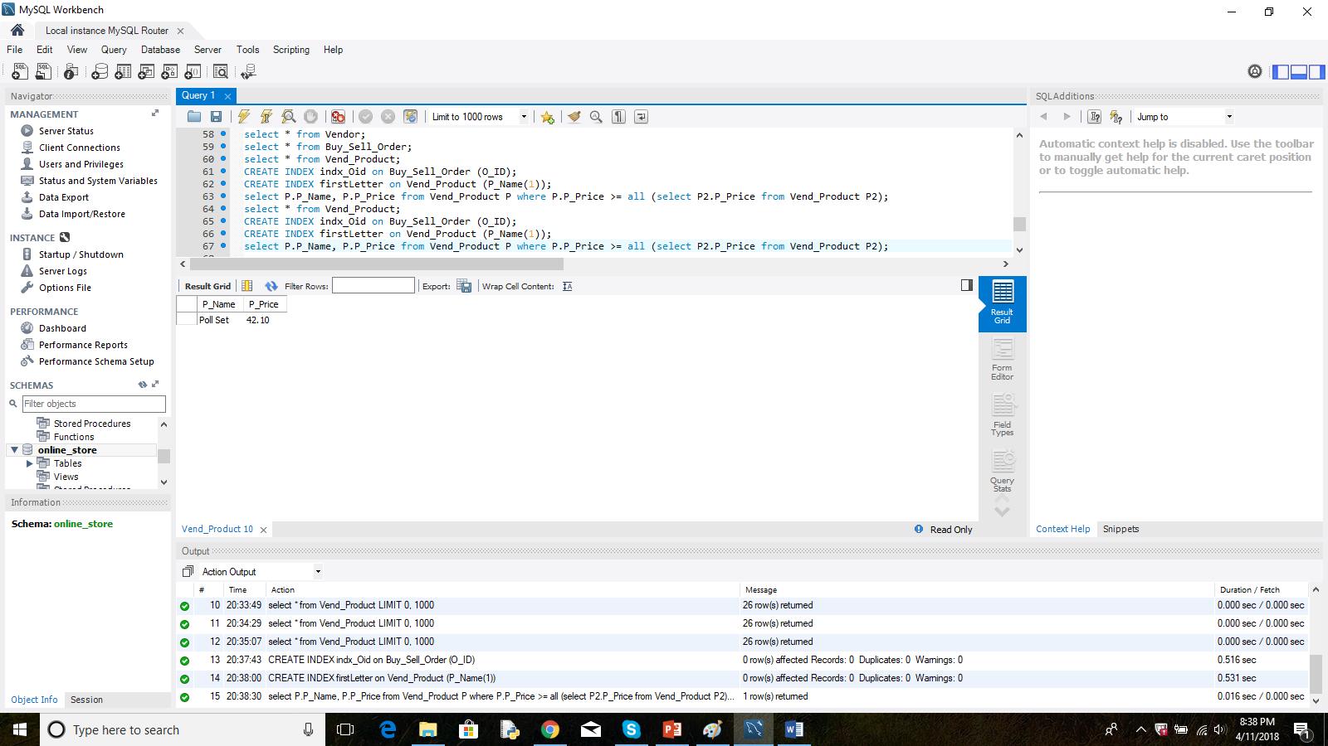
SQL query using “all”: Find name and price of the product with the highest price: select P.P_Name, P.P_Price from Vend_Product P where P.P_Price >= all (select P2.P_Price from Vend_Product P2);

Slide 16
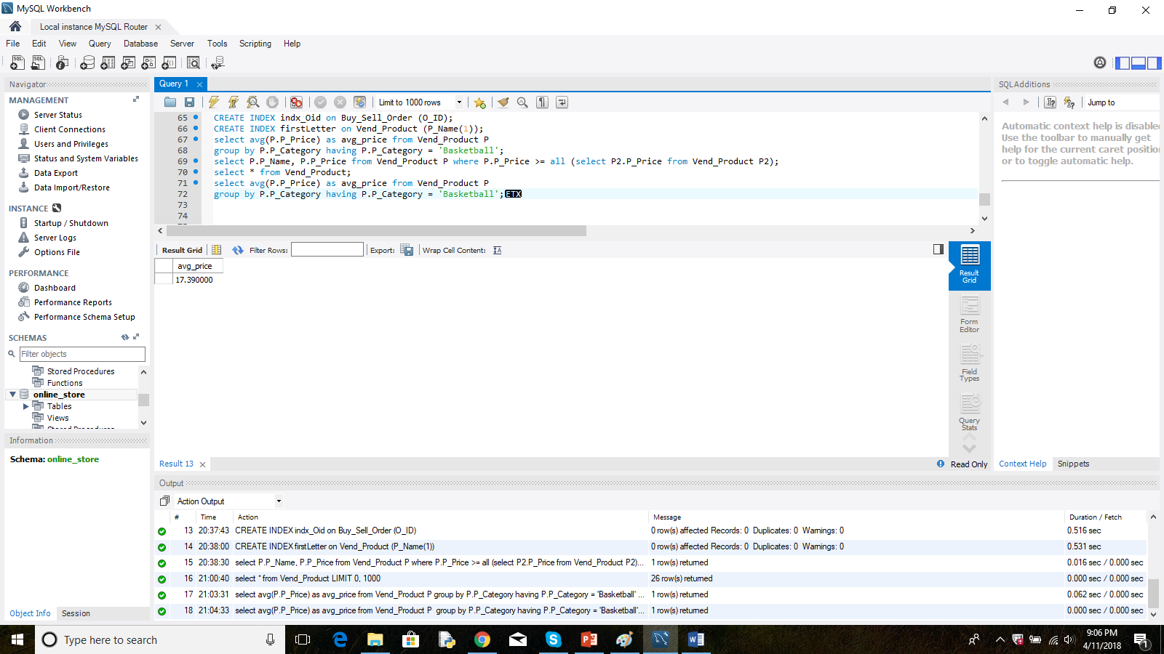
SQL query using aggregate “avg”: Find the average price of the products in the Basketball category: select avg(P.P_Price) as avg_price from Vend_Product P group by P.P_Category having P.P_Category = 'Basketball';

Slide 17
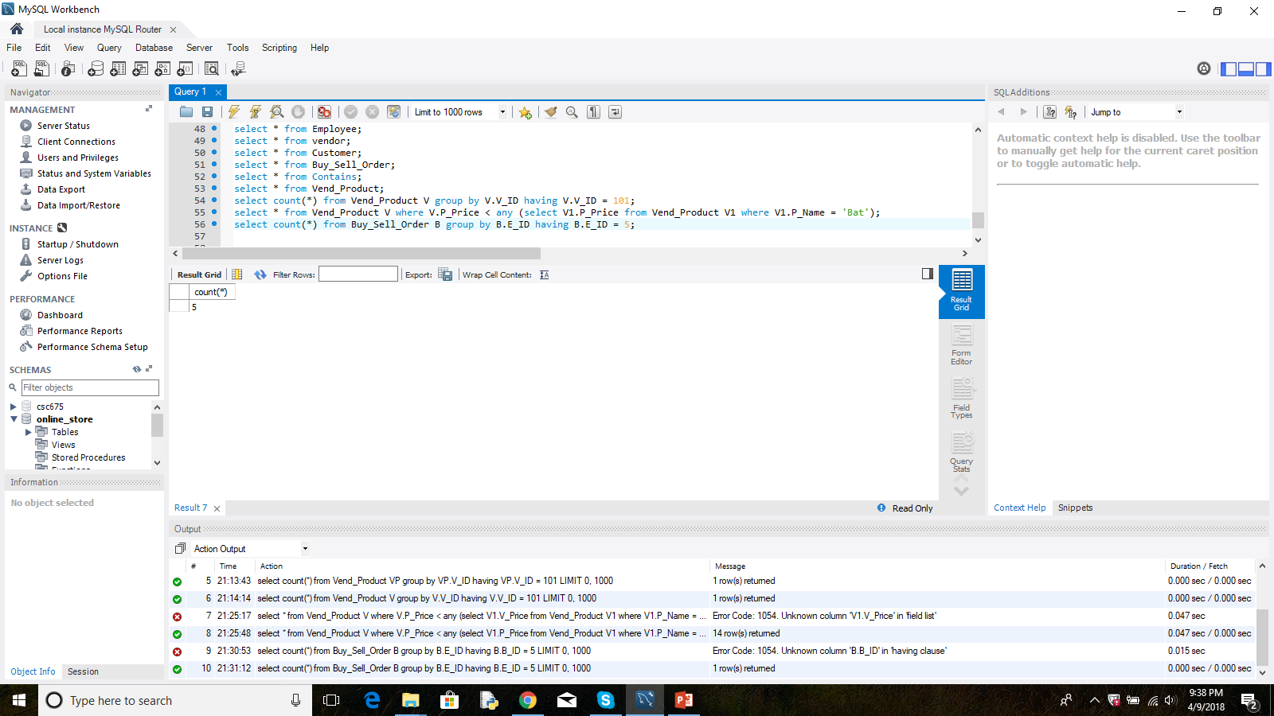
SQL query using “group by”: Find how many products were sold by employee with ID= 5 select count(*) from Buy_Sell_Order B group by B.E_ID having B.E_ID = 5;

Slide 18
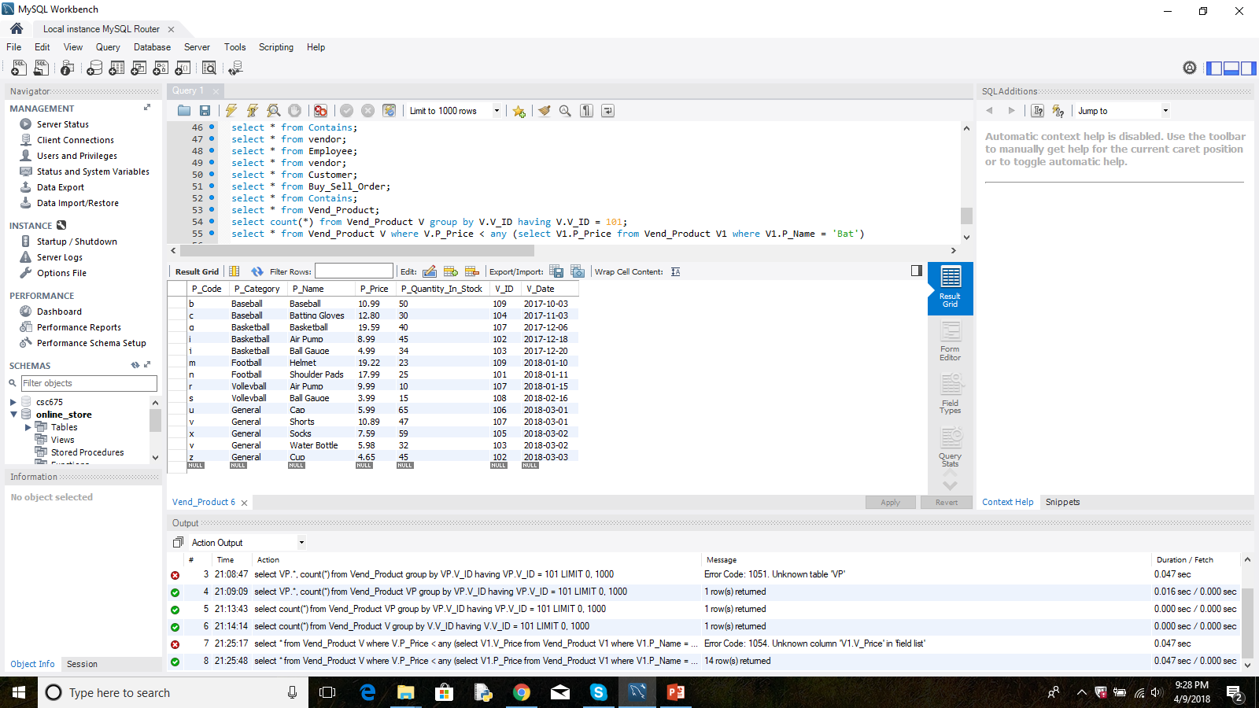
SQL query using “any”: Find the products that are cheaper than ‘Bat’ select * from Vend_Product V where V.P_Price < any (select V1.P_Price from Vend_Product V1 where V1.P_Name = 'Bat')

Slide 19
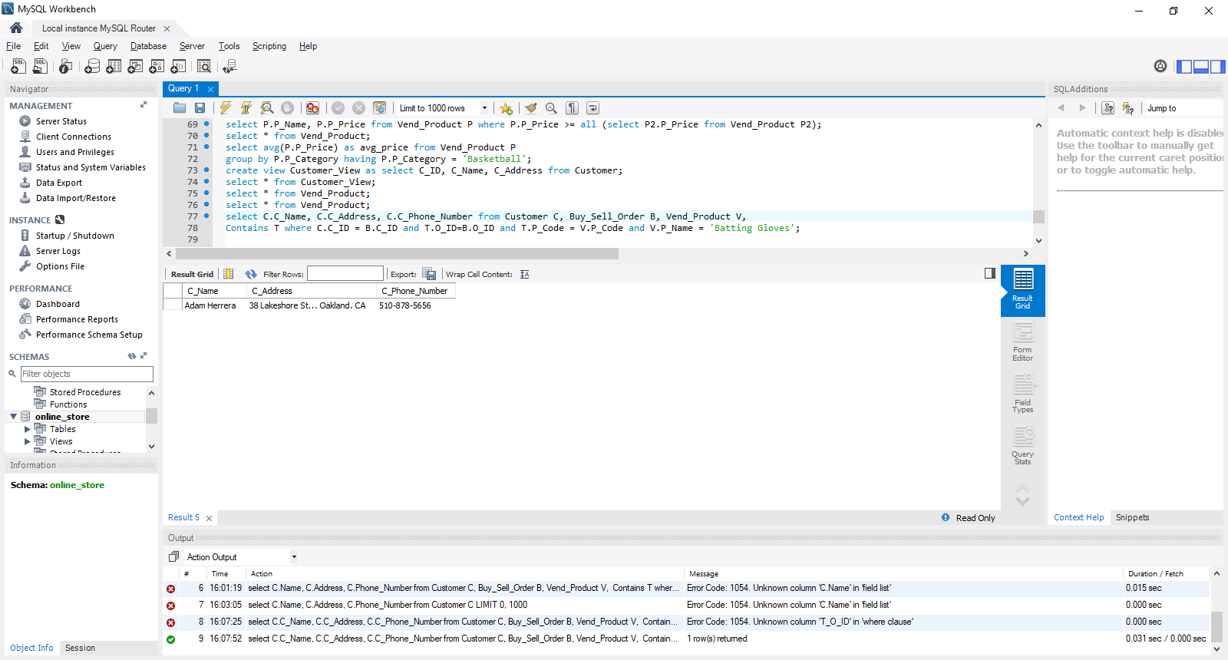
SQL query using joins: display name, address and phone number of clients that have bought Batting Gloves select C.C_Name, C.C_Address, C.C_Phone_Number from Customer C, Buy_Sell_Order B, Vend_Product V, Contains T where C.C_ID = B.C_ID and T.O_ID=B.O_ID and T.P_Code = V.P_Code and V.P_Name = 'Batting Gloves';

Slide 20
The End
Thank you!!!

