Slide 1
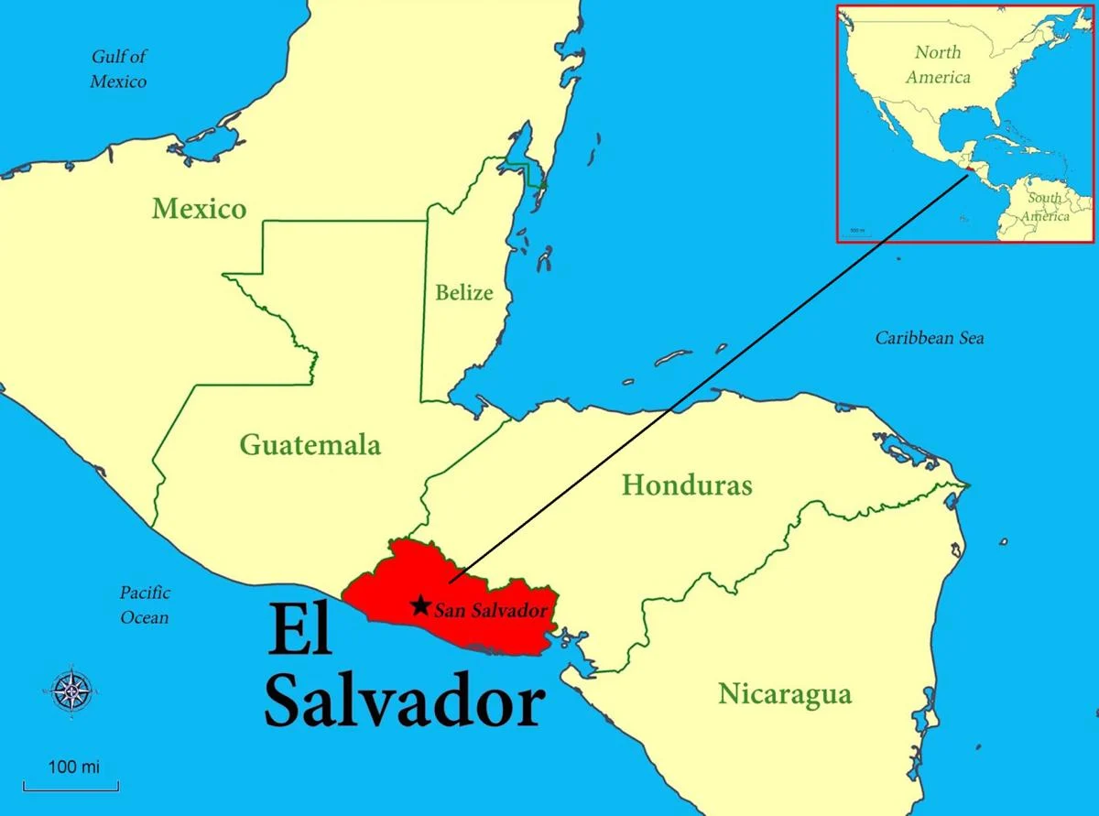


Impacts of Civil War and Dollarization in El Salvador
Geraldine Araujo
linkedin.com/in/geraldine-araujo/
Notes:
-Reason why ES: I’m from El Salvador
-Wanted to see what insights I could find using the World Development Indicators database.

Slide 2

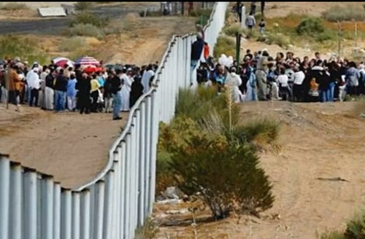
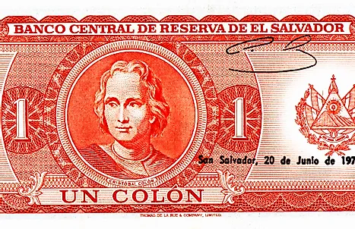
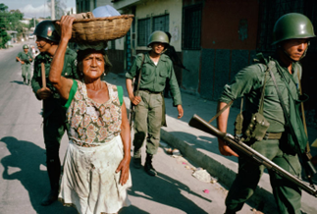

Introduction
Events
Civil war: 1979 – 1992
Dollarization: USD adopted as national currency in 2001
Indicators
Gross Domestic Product (GDP) growth rate “is the average rate of change of GDP at market prices based on constant local currency.”¹
Numbers of refugees/migrants who have left El Salvador.
1. World Health Organization (WHO)
Notes:
Two events I will consider are (1) the 12-yr Civil War, and (2) the adoption of the US dollar in 2001 (also known as Dollarization), to see if there are trends connected with the 2 indicators.

Slide 3


Why does this matter?
Impacts of conflict/wars
Impacts of changes and adoption of new currencies
Can help to anticipate future trends
Tell us where to look
Dataset for this project is from the World Development Indicators (kaggle.com)
Notes:
Why does this matter? By examining the impacts of major events like conflicts/war and changes in national currency on indicators like GDP and migration, we can use this information to help predict future trends and can also help steer our attention to factors that matter.
To quickly illustrate two recent examples, the first is the War in Ukraine. Back in April 2022 the International Monetary Fund predicted in its World Economic Outlook that global GDP would be “significantly slowdown due to the war in Ukraine,” a prediction likely facilitated by examining past examples in other countries.
Another is the use of cryptocurrency. Focusing on E.S., the country made the controversial decision in 2021 to use Bitcoin as legal tender. The dataset I used for this presentation ends in 2014, and we will see that following the years of Dollarization in 2001 there is a relationship between US GDP and El Salvador’s GDP. However, with ES’s acceptance of Bitcoin as legal tender, future research can look and see if it will impact E.S.’s GDP and even skew away from US GDP trends.

Slide 4
Gross Domestic Product
Civil War:
1979-1992
Adoption of USD $:
2001 - Present
Notes:
The first indicator we will examine is E.S.’s GDP growth rate, here we see an overview of El Salvador’s GDP growth rate from 1966-2014. At a glance we can see that the GDP growth rate has yet to recover to it’s 1966 numbers. And we also see a significant decrease in GDP growth rate that begins at the lead up to the civil war (highlighted red).
Interestingly, we have an increase just shortly before the end of the war, but afterwards there’s a steady decline in GDP growth rate. In an effort to help the economy, the Salvadoran government adopts the US dollar in 2001. The years post dollarization are marked by green dotted line. It seemed to have moderately helped btwn 2004-2006, but overall, it doesn’t make a significant difference. I was drawn by the drop in 2009 and it occurred to me to look at US GDP growth rate for the years post-2001.

Slide 5


GDP Post Dollarization in 2001
Notes:
Here we see both the US and Salvadoran GDP growth rate since 2001.
Very similar! And we see the same drop in GDP growth rate in 2009 matches drop in the United States. This also coincides with the 2007-2008 Global Financial Crisis, which was the most serious financial crisis since the Great Depression. A lot of countries were impacted but not all, and here we see how it impacted both E.S. and the U.S.

Slide 6
GDP Post Dollarization in 2001
Notes:
If we zoom out, we see that prior to dollarization, the GDP percent rate were not similar in both countries. This could indicate that the GDP growth rate in El Salvador was influenced by the US dollar. Implementation of dollarization impacts El Salvador GDP growth rate, but perhaps not how it was intended.

Slide 7
Refugees from El Salvador
Data starts in 1990
The definition of refugees have been defined by various conventions and statutes.
Excludes asylum seekers and people who have not received a decision as registered refugees.
Notes:
The 2nd indicator I examined was the number of refugees whose country of origin was El Salvador, which according to this chart has been declining with a slow increase after 2010.
If we were to focus on refugee numbers during the civil war (red) we see that we don’t have too much data to look at (starts 1990). However, w/in the red, we can see that after 1991 it starts to drop (context, war ended in Jan 1992, which could explain wind down in refugees in 1991)
Shifting our focus now to dollarization (green) we do see a continuing decline in refugees, but there is a slow increase after 2010.
However, an important thing to note is that there are ‘rules’ around the definition of a refugee.

Slide 8
Net migration from El Salvador
(Total # of emigrants – Total # of immigrants = Net migration from E.S. )
Emigrants: people migrating from El Salvador
Immigrants: people migrating to El Salvador
Notes:
For that reason, although it is important to consider refugee data, I also looked at the net number of migrants leaving El Salvador. This data takes the total number of emigrants and subtracts the number of immigrants. This leaves us with a remainder number of emigrants to give us a net number of people leaving El Salvador (This data is estimated every 5 years). Fortunately, we have more data that predates further from the Refugee data.
So now if we were to focus on the years during the Civil War, not only can we see a steady increase in people leaving El Salvador during the war, but also leading up to the war as well (could have been an indication of conflict to come..).
Additionally, we now see different numbers when focusing on the data post Dollarization.

Slide 9
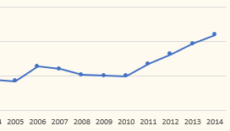
Net migration from El Salvador
(Total # of emigrants – Total # of immigrants = Net migration from E.S. )
Refugees from El Salvador post-Dollarization
Notes:
Remember when we looked at refugee data, we were seeing a slow increase in refugees that was starting in 2010.
BUT in Net Migration, we actually see an overall decrease in migrants leaving El Salvador (really starting in 1997). One possible reason why we saw an increase of refugees despite a decrease in emigration could be that out of the people that have left, more people qualified under the definition of Refugee. Determining this would require further investigation, which could be an incentive for future research.

Slide 10
Conclusion
GDP growth decreased and slowed during and following the Civil War.
Net migration from El Salvador increased preceding and during the war.
Net migration decreasing since 1997. Decrease continuing under dollarization.
Dollarization has tied E.S. GDP with U.S.A. GDP (similar progression since 2001).
Dollarization has not made a significant improvement in overall GDP.

Slide 11



Thank you!

