Slide 1
Newton, L-BFGS-B, DE, BFGS, and SANN provide valid estimations while NM, PORT, CG, Nelder-Mead, and LM do not
Share of valid and invalid estimations by solver method

Slide 2
Invalid estimations are a mix of solvers having issues converging or returning parameter values outside of the validity filters
Number of estimations by type of validity per solver
A Solver
B Statistics
C Economics
A
A
A
B
B
C
C
C
C

Slide 3
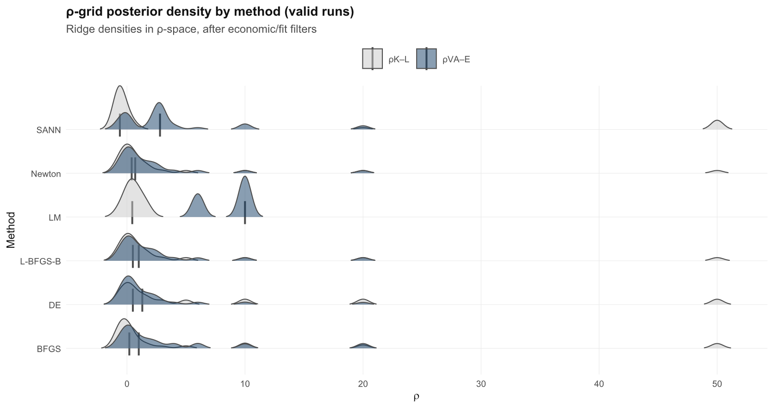
Invalid estimations are a mix of solvers having issues converging or returning parameter values outside of the validity filters
Number of estimations by type of validity per solver

Slide 4
Invalid estimations are a mix of solvers having issues converging or returning parameter values outside of the validity filters
Number of estimations by type of validity per solver

