Slide 1
1st IPC-SHM Project 2 Research
Jiayuan Chen, Zilu Wang, Weiyi Kong
Tongji University

Slide 2
Problem Overview
Target:
Anomaly detection based on real monitoring data collected on an existing bridge
Data:
744*38*72000 recorded by 38 sensors that work consecutively for 1 month(31days) and own the same sampling frequency of 20Hz. Corresponding labels are also provided.

Slide 3
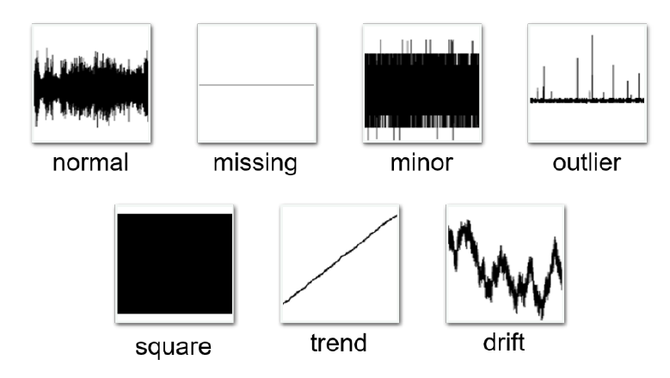
Problem Overview
Order | Anomaly Pattern | Description
1 | Normal | The time response is normal oscillation curve; frequency response is peak-like (may differ between bridges)
2 | Missing | Most/all of the time response is missing, which makes the time and frequency response zero
3 | Minor | Relative to normal sensor data, the amplitude is very small in the time domain
4 | Outlier | One or more outliers appear in the time response
5 | Square | The time response is like a square wave
6 | Trend | The data has an obvious trend in the time domain and has an obvious peak value in the frequency domain
7 | Drift | The vibration response is non-stationary, with random drift

Slide 4
Data Analysis
Problem:
A enormous amount of data -- 744*38*72000
Unbalanced distribution of various types of data
Solution:
Pick out a equal amount of each data types for later training (200)
Simplify the data.

Slide 5
Data Analysis
Simplifier1 (getData.py, adopted):
Use the greatest absolute value in every *length* numbers.
(We took length=8 here)
= max(abs(data of length)) if not all NaN
= mean(all data) if all NaN

Slide 6
Data Analysis
Simplifier1 (getData.py, adopted):
Use the greatest absolute value in every *length* numbers.
(We took length=8 here)
Pros:
Easy to understand, Easy to realize, Runs faster, Reflects the trend of source data
Cons:
Will amplify the fluctuation, Small data screened by big data

Slide 7
Data Analysis
Simplifier2 (getData.py):
Use 2 values calculated as follow as representative value in every *length* numbers. (We took length=8 here)
Besides, all data’s mean and std (standard deviation) are the first 2 numbers.
= mean(data of length) – mean(all data)
= max(abs(data of length– mean(data of length)))
= mean(all data)
= std(all data)

Slide 8
Data Analysis
Simplifier2 (getData.py):
Use the greatest absolute value in every *length* numbers.
(We took length=8 here)
Pros:
Comprehensive details, Reflect the general trend of source data
Cons:
Not easily understandable, Inconvenient for manual categorization

Slide 9
SVM
NN
Manual
An efficient methemetical approach. Proven to work well in some simple cases. Our initial attempt.
Well-known machine learning tool in big-data territory. Efficacious in most cases. Panacea for ML prlblems.
Our self-made method for certain categorilization. Requires a serial of previous work. The best solution for this project.

Slide 10
Declaration
Following training procedure are based on these data conditions:
We use 200 of each types (making it 1400 in total) sets of data to form our training dataset.
Simplifying Length=4. Thus, the shape of training dataset will be 1400*9000.
We took data in such a day as our testing data that these data has never been used in training dataset. (In fact, if one take 200 of each data types, 17 days of original data will be enough for this process. The testing data we used is either from day 20 (Jan 21) or day 26 (Jan 27))

Slide 11
Phase 1: SVM
An initial attempt using multi-class SVM.
Github source code by namoshizun:
https://github.com/namoshizun/Multiclass-SVM-Classifier.git

Slide 12
Phase 1: SVM Result
Order | Anomaly Pattern | Accuracy | Recall | F1-score | Support
1 | Normal | 0.00 | 0.00 | 0.00 | 445
2 | Missing | 0.14 | 0.99 | 0.24 | 86
3 | Minor | 0.00 | 0.00 | 0.00 | 52
4 | Outlier | 0.00 | 0.00 | 0.00 | 25
5 | Square | 1.00 | 0.96 | 0.98 | 100
6 | Trend | 0.84 | 0.48 | 0.61 | 185
7 | Drift | 1.00 | 0.63 | 0.77 | 19
Weighted Average |  | 0.31 | 0.31 | 0.27 | 912
As a mathematical algorithm, SVM has a limited space for adjustment. Bad results like this reveals SVM’s incompatibility for the problem.
However, SVM does get a perfect result for type 5, but it is later confirmed that this accuracy does not always hold true, this conclusion thus making SVM unpractical for all types.

Slide 13
Phase 2: Neural Network
We do not use complicated neural networks containing a lot of hidden layers like that used in CV, for a complex NN will lose a lot of details, which is crucial for our problem.
Samples
…
…
7 Types
( We took length=4 in our program,
so there are 9000 samples in this case)

Slide 14
Phase 2: Neural Network Result
Order | Anomaly Pattern | Accuracy | Recall | F1-score | Support
1 | Normal | 0.94 | 0.92 | 0.93 | 440
2 | Missing | 1.00 | 1.00 | 1.00 | 45
3 | Minor | 0.74 | 0.43 | 0.54 | 47
4 | Outlier | 0.19 | 0.27 | 0.22 | 37
5 | Square | 0.84 | 0.97 | 0.90 | 97
6 | Trend | 1.00 | 0.66 | 0.79 | 211
7 | Drift | 0.33 | 1.00 | 0.49 | 35
Weighted Average |  | 0.88 | 0.82 | 0.83 | 912
* Here we already used type-2 method to guarantee an absolutely accurate prediction of type 2, which we will mention later. The original result was not that good.

Slide 15


Phase 3: Manual Categorization
Motivation:
Neural Network has sent some inspiring messages, but its accuracy is still not enough. Some specific types perform poorly in NN approach.
Act:
Do it manually.

Slide 16

Phase 3: Type-2 Method
Type 2 is the easiest type to tell even without the help of any machine learning tools.
(Minimum-mean)/mean < 1e-3
(Maximum-mean)/mean < 1e-3
Type 2

Slide 17
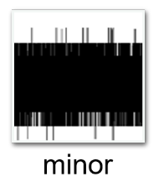
Phase 3: Type-3 Method
Telling type 3 is also an easy task, and it shares many common points with determining type 2.
If not type 2
Maximum – minimum < 4e-4
Type 3

Slide 18
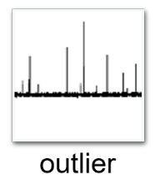
Phase 3: Type-4 Method
This is the most difficult work in the whole project. Since we’ve known NN performance is a disaster here, another way must be found to become the substitute.
First, we have to detect anomalous points. LSTM is adopted here to perform Time Series Anomaly Detection (TSAD).

Slide 19
Phase 3: TSAD Using LSTM
outlierDetection.py
Long short-term memory (LSTM) is an artificial recurrent neural network (RNN) architecture used in the field of deep learning. Unlike standard feedforward neural networks, LSTM has feedback connections. LSTM networks are well-suited to classifying, processing and making predictions based on time series data, since there can be lags of unknown duration between important events in a time series.
The idea of using LSTM here is to first predict time series, then we use predicted results and the actual result to judge the anomalous interval (which we set to 8 times std in our project).

Slide 20
Phase 3: Type-4 Method
After getting some stats about anomalous points, we have to decide the number of anomalous points that determines the dataset is belong to outlier or not.
Besides, some supporting stats may also be needed. It takes time to find out the parameters that separates outlier with other types.

Slide 21
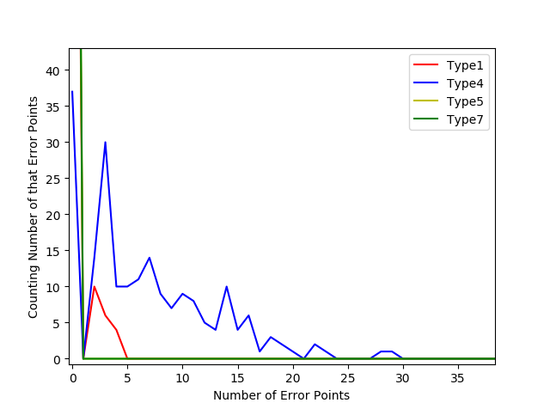
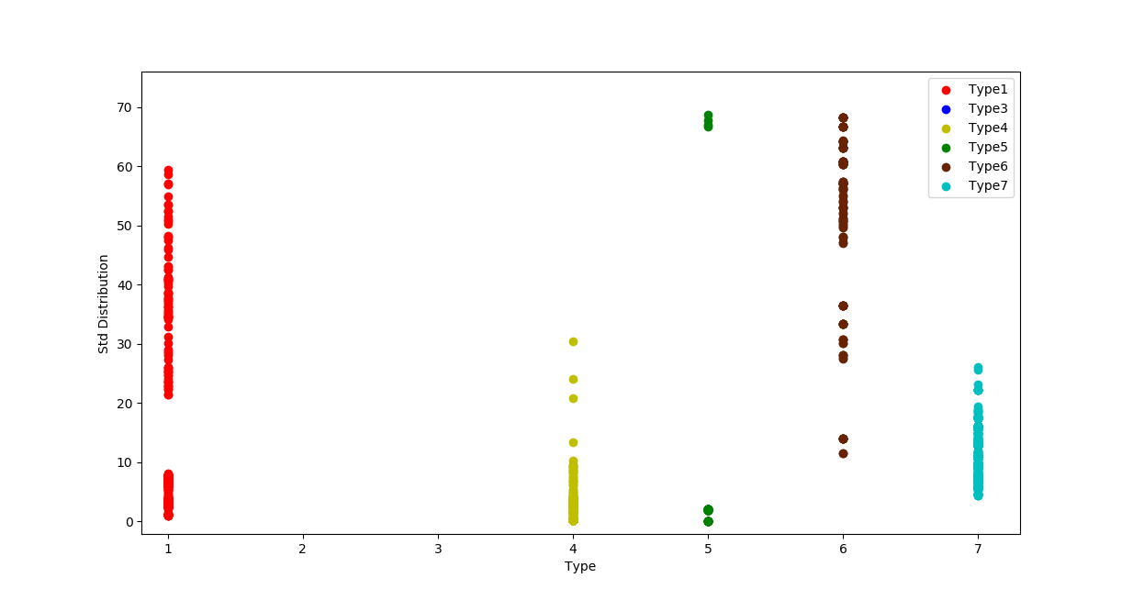
Phase 3: Type-4 Method
10000*Std Distribution
Anomalous Points Number

Slide 22
Phase 3: Type-4 Method
Final judgement.
35 > anomalous points > 0
10000*std < 10.5
Type 4

Slide 23

Phase 3: Type-5 Method*
As mentioned previously, SVM can be a potential solution for accurate, fast type 5 detection. However, both SVM and NN perform erratically. SVM prediction tends to be “bold”, with a very high precision (usually 1.00) and an unstable recall (can be as low as 0.46 and as high as 0.96). On the other side, NN prediction is relatively “cautious”, with a high recall (>0.95) and a medium but a bit more stable precision of (0.7-0.9).
SVM can be a solution here and needs further investigation.
* Not deployed in uploaded program.

Slide 24
Phase 3: Type-5 Method (New)*
It has been demonstrated in Type-4 graphs that some type 5 can have a huge Std. One may feel confused with how many type-5 behave this way since std distribution of type 5 seems spread all along y-axis.
In fact, the majority of type-5 (all Type-5 in the case we tested using data of Jan.27) has a large std such that 10000*std > 2000. Thus, we now own a new method to accurately distinguish type-5.
10000*std > 2000
Type 5
* Deployed in program after presentation filming.

Slide 25
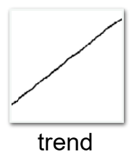
Phase 3: Type-6 Method
Since type 6 owns the best linearity, it’s a good idea to determine it by the score of linear regression.
R2-score of linear regression > 0.95
Type 6

Slide 26
Phase 3: NN + Manual Approach
Determined by NN:
1. Normal
7. Drift
Determined by Manual:
2. Missing
3. Minor
4. Outlier
5. Square
6. Trend

Slide 27
Phase 3: NN + Manual Result
Order | Anomaly Pattern | Accuracy | Recall | F1-score | Support
1 | Normal | 0.98 | 0.95 | 0.96 | 445
2 | Missing | 1.00 | 0.97 | 0.98 | 86
3 | Minor | 0.96 | 0.90 | 0.93 | 52
4 | Outlier | 0.79 | 0.76 | 0.78 | 25
5 | Square | 1.00 | 0.96 | 0.98 | 100
6 | Trend | 0.96 | 1.00 | 0.98 | 185
7 | Drift | 0.32 | 0.63 | 0.42 | 19
Weighted Average |  | 0.96 | 0.95 | 0.95 | 912

Slide 28
Explanation
Huge difference between the size of type 1 and 7 can be a peril to the prediction validation of NN since they are the only two type trained and predicted in network. (But we should not forget that type 1 did well when NN alone was adopted previously, which makds NN a good solution for type 1)
Manual approaches for type 2, 3, 5, 6 are perfect.
Type 4 gets the lowest f1-score of only 0.78, but it is the best we can acquire for now. Type 4 accuracy also has a close tie to simplifying length.
Type-4 method deserves further research.

Slide 29

Thanks!
Contact Me:
geraintcjy@gmail.com
+86 15221839633

