Slide 1
In the name of God
RMI Exercise Report
Distributed Systems
Reza Sajedi
Fall 1400

Slide 2
GitHub
This project has been published on GitHub.
Instructions to use as a library or run the example is available.
Anyway, the instructions have been also included in this report.
https://github.com/geraked/js-rmi

Slide 3
Design
Based on HTTP protocol.
Local and remote objects communicate using JSON messages.
The developer doesn’t realize the background communication and feels like it’s a local object.
Local objects POST three types of messages to the server to call methods, get properties and set properties of remote objects.
The server puts the return value in a message and replies.
When we say local object, we mean a proxy of actual remote object.

Slide 4
Design
Multiple clients can connect to remote object.
Inheritance and consistency has been considered.
The binding of client and server is dynamic.
No external library is used.
The usage is very similar to Java RMI.
The implementation consists of two parts: ServerStub, ClientStub

Slide 5
Design
ServerStub is implemented in lib/server.js :
https://github.com/geraked/js-rmi/blob/master/lib/server.js

Slide 6
Design
ClientStub is implemented in lib/client.js :
https://github.com/geraked/js-rmi/blob/master/lib/client.js

Slide 7
Design Examples of messages
{
"type": "method",
"name": "looseWeight",
"args": [5]
}
human.looseWeight(5)

Slide 8
Design Examples of messages
{
"type": "get",
"name": "age"
}
human.age

Slide 9
Design Examples of messages
{
"type": "set",
"name": "height",
"value": 1.80
}
human.height = 1.80

Slide 10
Strength
Generalized to use as a library.
Compiler works is not needed, thanks to JS.
All types in JS are supported: string, number (float|integer), boolean, array, object, etc.
Best practices in programming are followed.

Slide 11
Weaknesses
It’s a simple library and maybe doesn’t provide advance features of complex libraries such as Java RMI, Pyro, etc.

Slide 12
Run the example application
Make sure Node.js has been installed on your machine.
Download the repository as ZIP or use the following command:
git clone https://github.com/geraked/js-rmi.git
Go to the directory where the file package.json exists and execute the command:
npm run example

Slide 13
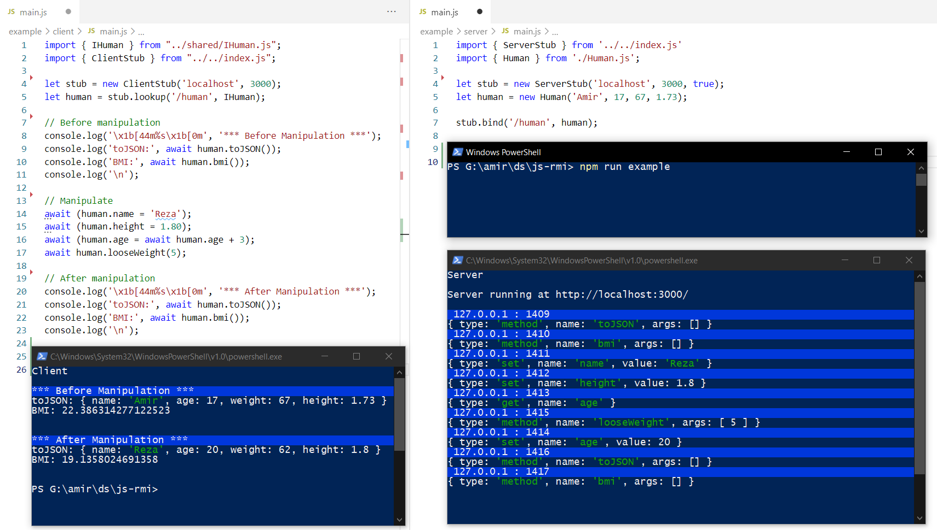
Client code
Server code
Run the example application

Slide 14
Use as a library The example application
Install the library.
Define your interface and share it between the server and clients.
Implement the interface on the server.
Create an object of that type on the server and bind it.
Lookup the remote object from the client and use it.

Slide 15
Use as a library Install
Execute the following command in the root of your npm project to get the library:
npm i https://github.com/geraked/js-rmi.git

Slide 16
Use as a library Define an interface
Define your desired interface and share it between the server and clients.
https://github.com/geraked/js-rmi/blob/master/example/shared/IHuman.js

Slide 17
Use as a library Implement the interface
Implement the interface on the server.
https://github.com/geraked/js-rmi/blob/master/example/server/Human.js

Slide 18
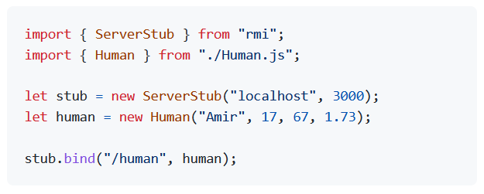
Use as a library Create remote object & bind
Create an object of that type on the server and bind it.

Slide 19
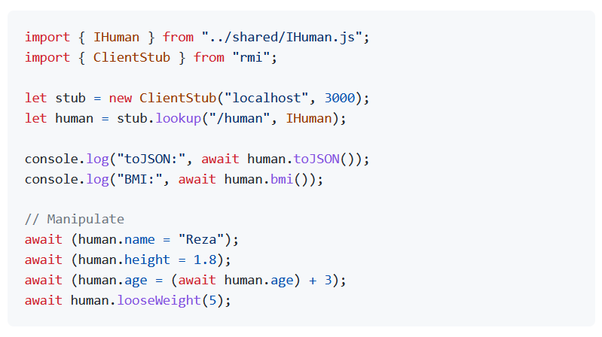
Use as a library Lookup the remote object
Lookup the remote object from the client and use it.

