Slide 1

AfCFTA Intelligence Systems · MVP / Proof of Concept
AfCFTA AgroTrade
Intelligence Platform
An AI-enabled agricultural market transmission and coordination
intelligence system — diagnosing inefficiency, reconstructing
hidden trade, and simulating AfCFTA policy interventions.
Gerald T. Mazise · BSc Food Science & Technology (Food Biotech) · MBA (AI) · Kenya · Tanzania · Zambia · 2013–2022

Slide 2
The African Agricultural Paradox
The challenge is not production. It is coordination failure.
⚡
⏱
👁
Surplus & Deficit Coexist
Arbitrage Persists for Months
Data Blindness
Zambia records maize surplus while Tanzania faces shortfalls — within the same season. Kenyan markets command prices that should attract imports, yet formal trade fails to materialize.
Price gaps large enough to fund profitable trade sit unresolved for 3–6+ months. Markets are not correcting. Something is systematically blocking arbitrage.
Informal trade likely exceeds formal recorded flows by 2–4×. Policymakers are designing interventions for a trade system they can only partially see.
AATIP | Gerald T. Mazise | MVP / POC
2 / 20

Slide 3
AfCFTA Creates the Framework.
Where AATIP Lives
Intelligence Makes It Operational.
Market Inefficiency Diagnosis
The AfCFTA eliminates tariffs on 90% of goods and creates legal architecture for continental trade. This is necessary but insufficient. The World Bank estimates 81% trade increase potential by 2035 — but only if complementary reforms materialize in logistics, market intelligence, and border facilitation.
Identifies where trade should occur but doesn't
Corridor Intelligence
Ranks 6 bilateral pairs by real-time opportunity
✓
Tariff reform (AfCFTA)
✓
Standards harmonization
Informal Trade Detection
✓
Dispute resolution
Reconstructs hidden flows (87Mt inferred)
–
Market intelligence infrastructure
–
Corridor-level trade optimization
Policy Simulation
–
Informal trade visibility
$9.3B impact quantified under AfCFTA Full
–
Policy impact quantification
AATIP | Gerald T. Mazise | MVP / POC
3 / 20

Slide 4
One Central Question
"Why are African markets failing to converge, where should trade already be occurring, and what interventions restore efficient market transmission?"
The Core Metric
MIS Threshold Interpretation
Market Inefficiency Score (MIS)
> 1.5
Structural market failure
MIS = (P_partner − P_local − Logistics) / Logistics
0.5 – 1.5
Strong arbitrage signal
Scale-invariant. Corridor-comparable. Theory-grounded.
Positive MIS = trade is economically viable but not occurring.
Negative MIS = markets have converged efficiently.
0 – 0.5
Trade economically viable
−0.2 – 0
Near convergence
< −0.2
Market converged
AATIP | Gerald T. Mazise | MVP / POC
4 / 20

Slide 5
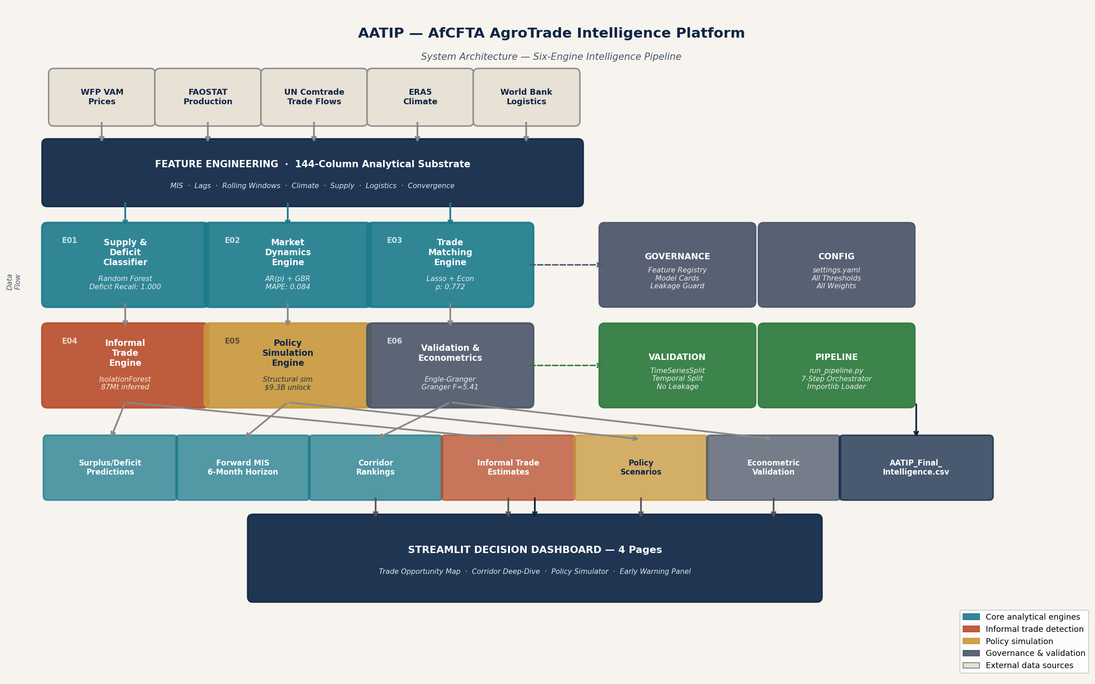
System Architecture
Nine layers. Each feeds the next. No single black box.
AATIP | Gerald T. Mazise | MVP / POC
5 / 20

Slide 6
Six Analytical Engines
Each engine has a single, well-defined purpose. Each feeds the next. None is a black box.
E01
Supply & Deficit
Classifier
E02
Market Dynamics
Engine
E03
Trade Matching
Engine
Random Forest · n=200 · class_weight=balanced
AR(p) + Gradient Boosting · ECM residuals
Econ Composite → Lasso → Hard Gates
Deficit Recall: 1.000 on 2022 test
6-Month Forward MIS · MAPE: 0.084
Spearman ρ = 0.772 on 2022 test
E04
Informal Trade
Engine
E05
Policy Simulation
Engine
E06
Validation &
Econometrics
IsolationForest · Probabilistic Inference
Structural mechanics · Elasticity sweep
Engle-Granger · Granger · ECM · Beta OLS
87Mt implied informal volume
$9.3B unlock under AfCFTA Full
TAN→KEN: cointegrated + causal
AATIP | Gerald T. Mazise | MVP / POC
6 / 20

Slide 7
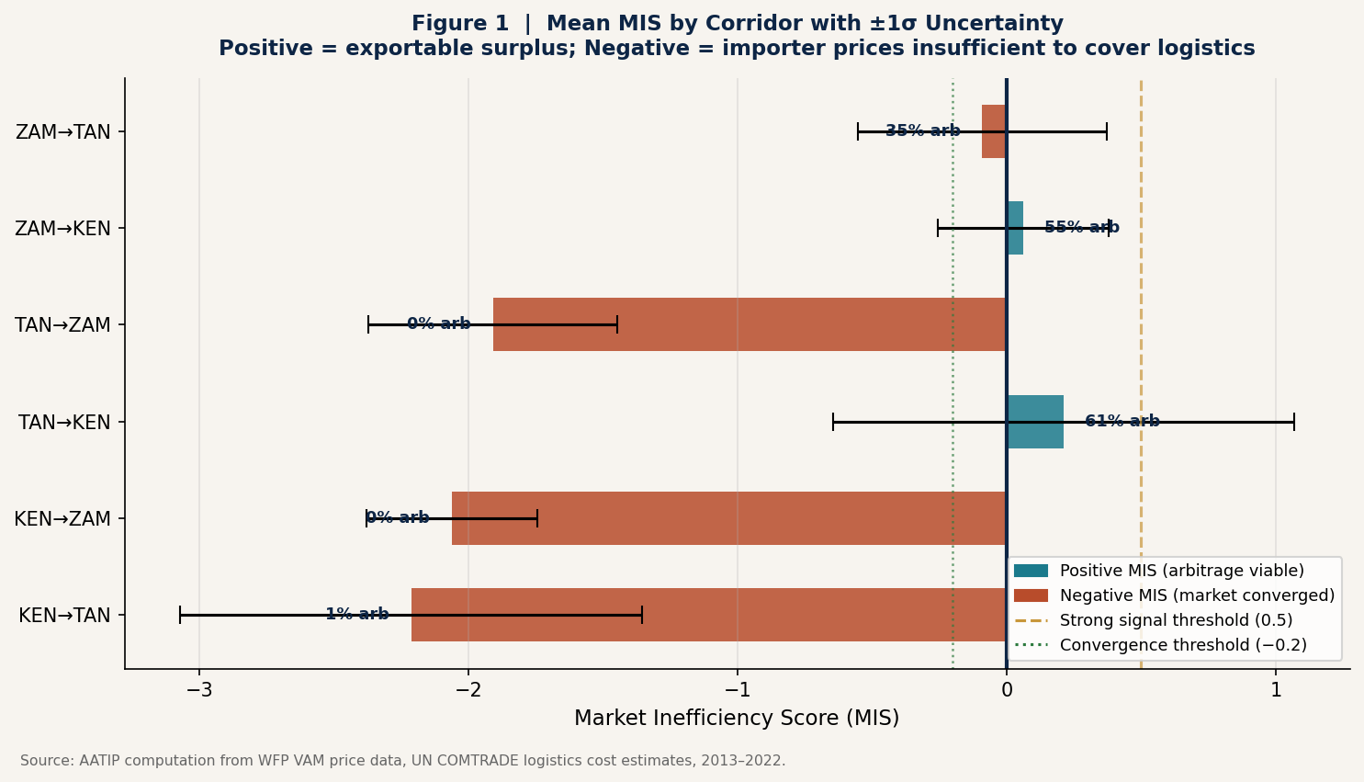
Key Insight 1 — Market Efficiency Varies Dramatically by Direction
Not all corridors are equal. Two routes run profitably; four remain structurally blocked.
TAN→KEN
+0.21
Trade viable 82% of months
ZAM→KEN
+0.06
Viable 55% of months
KEN→TAN
−2.21
Structurally blocked
KEN→ZAM
−2.06
Structurally blocked
AATIP | Gerald T. Mazise | MVP / POC
7 / 20

Slide 8
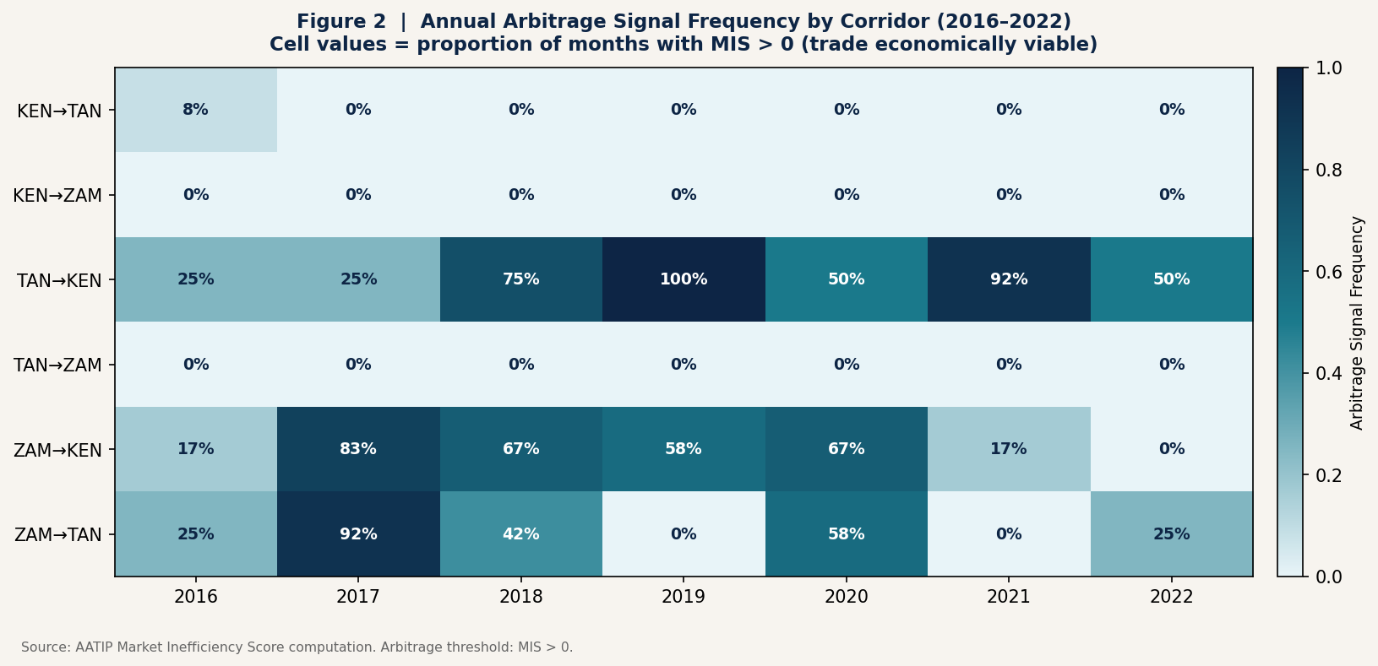
Key Insight 2 — Arbitrage Is Structural, Not Seasonal
TAN→KEN shows positive MIS 82% of months — this is a systemic coordination failure, not a weather event.
Darker cells = higher fraction of months with MIS > 0 (trade economically viable). Source: AATIP computation from WFP VAM prices, 2016–2022.
AATIP | Gerald T. Mazise | MVP / POC
8 / 20

Slide 9
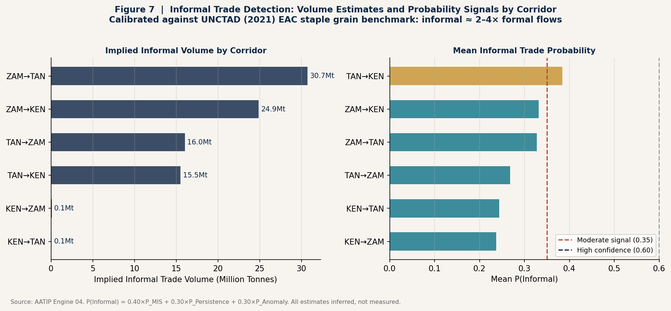
Key Insight 3 — The Invisible Economy
87 million tonnes of implied informal trade — likely 2–4× formal recorded flows. Policy built on formal data alone is incomplete.
87Mt
Implied informal trade
mid est. 2013–2022
0.39
P(Informal) TAN→KEN
highest signal corridor
2–4×
Formal flow multiplier
All informal trade estimates are probabilistic inferences, not measurements. Calibrated against UNCTAD (2021).
UNCTAD EAC benchmark
AATIP | Gerald T. Mazise | MVP / POC
9 / 20

Slide 10
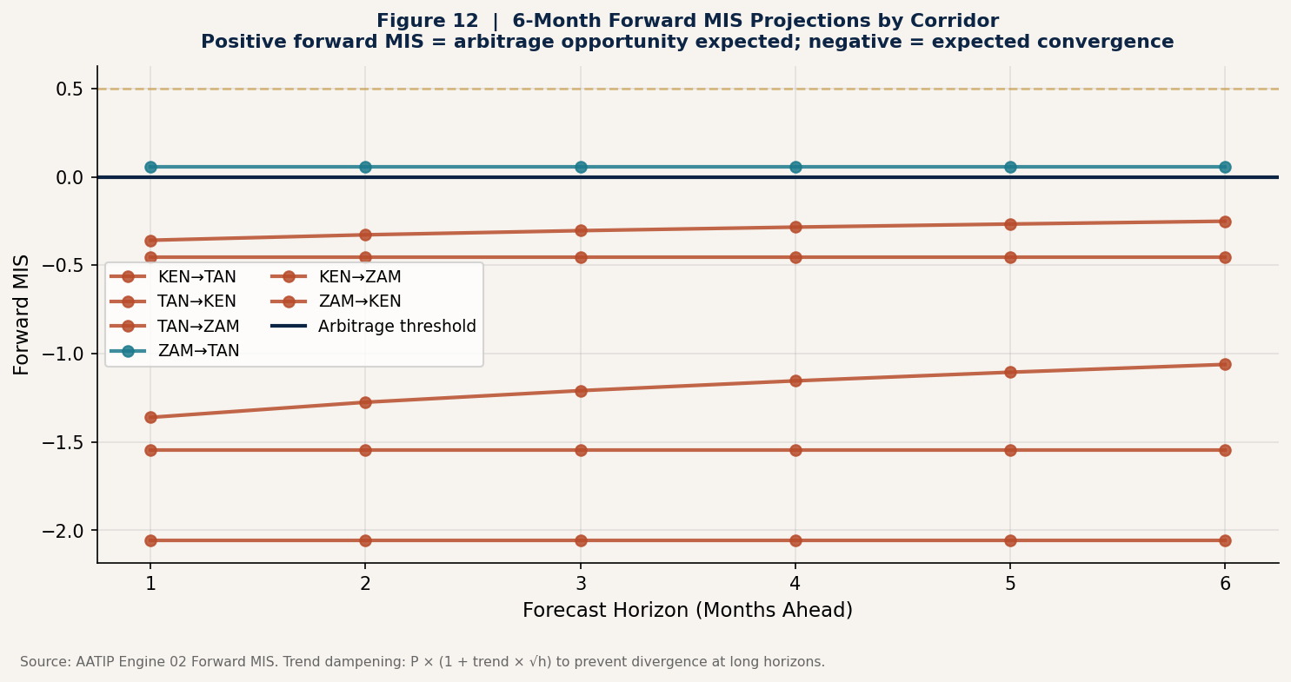
Key Insight 4 — Anticipatory Intelligence
AATIP doesn't react to market failures. It projects which corridors are about to become inefficient — before it happens.
6-Month
Forward MIS
ZAM→TAN
+0.057
Emerging
opportunity
TAN→KEN
+0.044
Sustained
arbitrage
ZAM→KEN
+0.022
Thin but
viable
Formula: P̂(t+h) = P(t)×(1+trend×√h)
√h dampening prevents divergence at long horizons.
AATIP | Gerald T. Mazise | MVP / POC
10 / 20

Slide 11
Machine Learning Stack
All models implemented in scikit-learn 1.8. No black-box libraries. Full auditability.
Random Forest
Handles nonlinear interactions, interpretable feature importance, robust at small n
Deficit Recall = 1.000
Supply classification
Gradient Boosting
Additive boosting captures price trend dynamics with climate leading indicators
MAPE = 0.084 (TZ test)
Price forecasting
LassoCV
L1 regularization auto-selects 26/37 features; sparse, interpretable β coefficients
Spearman ρ = 0.772
Trade corridor ranking
IsolationForest
Unsupervised — no labeled training data exists for informal flows; anomaly = informal signal
87Mt inferred
Informal trade detection
Temporal validation: TimeSeriesSplit(n=5) exclusively. Train 2013–2021. Test 2022. No random splits anywhere. Zero data leakage confirmed.
AATIP | Gerald T. Mazise | MVP / POC
11 / 20

Slide 12
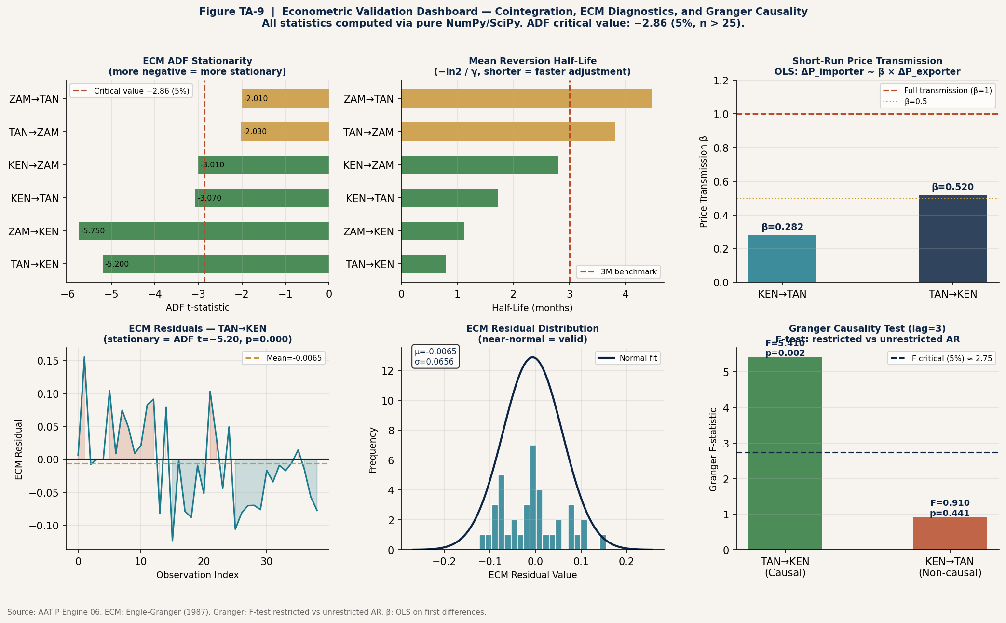
Econometric Validation
Statistical proof that TAN→KEN is a genuinely integrated market — not just a correlated one.
Engle-Granger
Cointegration
ADF t = −3.256
p = 0.002 ✓
TAN→KEN
Granger
Causality
F = 5.41
p = 0.002 ✓
TAN→KEN
ECM
Half-Life
0.79 months
Fastest adj.
TAN→KEN
Price
Transmission β
β = 0.520
Partial (asymm.)
TAN→KEN
Pure NumPy/SciPy implementation — no external econometrics libraries. Full auditability.
AATIP | Gerald T. Mazise | MVP / POC
12 / 20

Slide 13
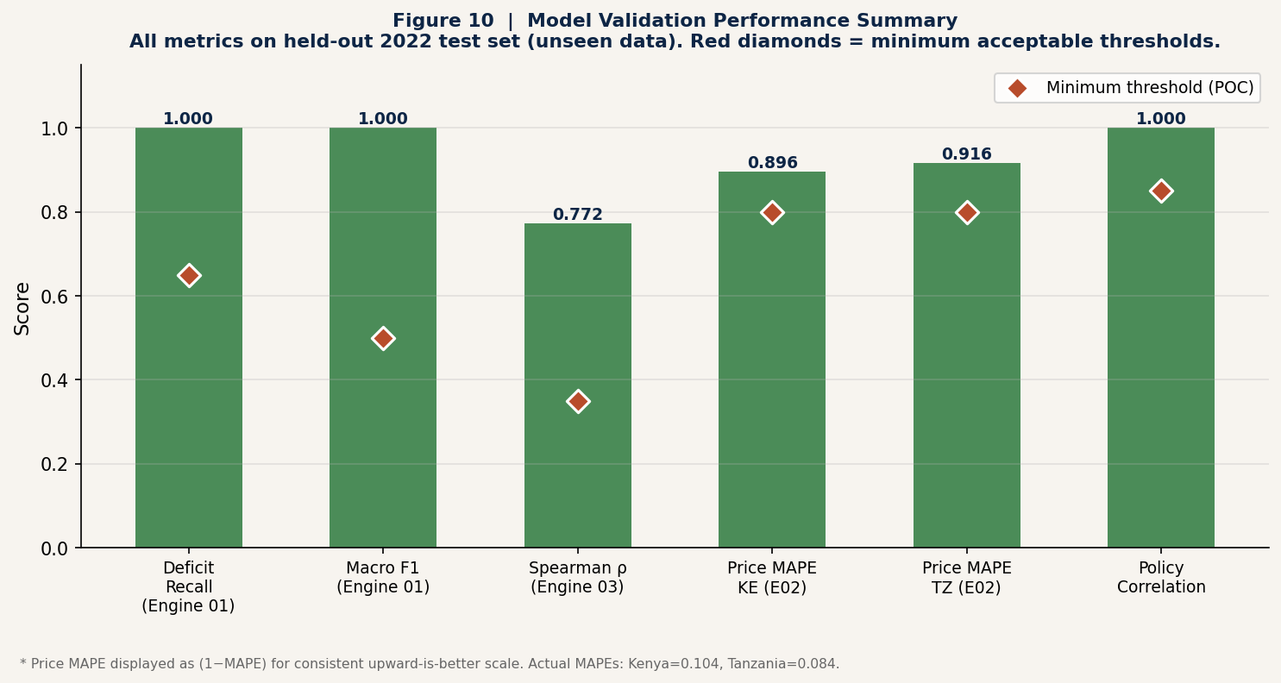
Validation Scorecard
All 10 criteria evaluated on held-out 2022 data the model never saw during training.
1.000
0.772
0.084
1.000
Deficit Recall
Spearman ρ
Price MAPE
Policy Cross-Val
E01 · 2022 test
E03 · Ranking quality
E02 · Tanzania test
E05 · corr = 1.000
AATIP | Gerald T. Mazise | MVP / POC
13 / 20

Slide 14
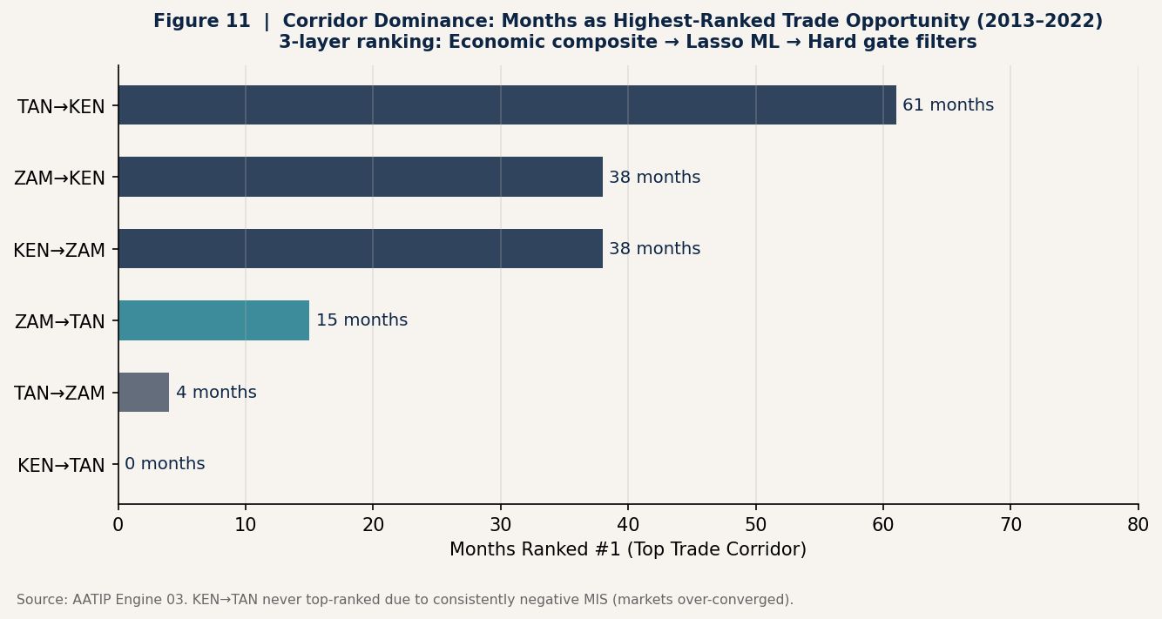
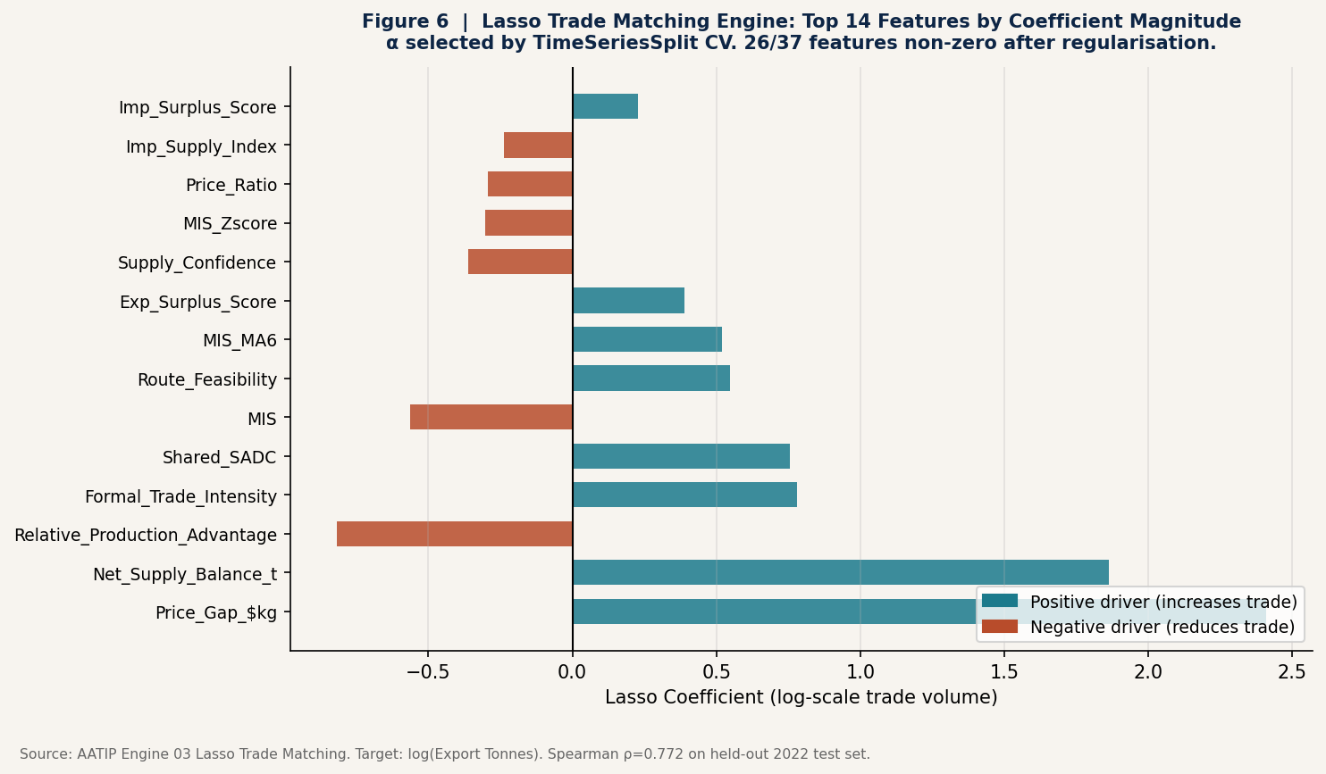
Corridor Intelligence — Ranking and Opportunity
Three-layer ranking: Economic composite → Lasso ML → Hard feasibility gates. 42% of observations gate-blocked.
TAN→KEN: The Primary Corridor
61 months ranked #1 · Cointegrated · Granger causal · Highest informal signal · Fastest ECM adjustment (0.79 months)
Converging evidence from ML ranking, econometrics, and informal trade detection — all pointing to the same corridor.
AATIP | Gerald T. Mazise | MVP / POC
14 / 20

Slide 15
Policy Simulation — What AfCFTA Can Unlock
Structural simulation of AfCFTA border and logistics cost reductions — cross-validated at corr = 1.000.
Baseline
AfCFTA Phase 1
AfCFTA Full
Current State
AU 2027 Interim Target
AU 2035 Full Implementation
Border: 0% · Transport: 0%
Border: −20% · Transport: 0%
Border: −50% · Transport: −10%
0
9.23Mt
30.31Mt
incremental tonnes
incremental tonnes
incremental tonnes
$0
$2.82B
$9.26B
0 corridor-months unlocked
17 corridor-months unlocked
62 corridor-months unlocked
AATIP | Gerald T. Mazise | MVP / POC
15 / 20
Partial equilibrium model. Base elasticity ε = 2.0. Sensitivity range: 1.0–3.5.

Slide 16
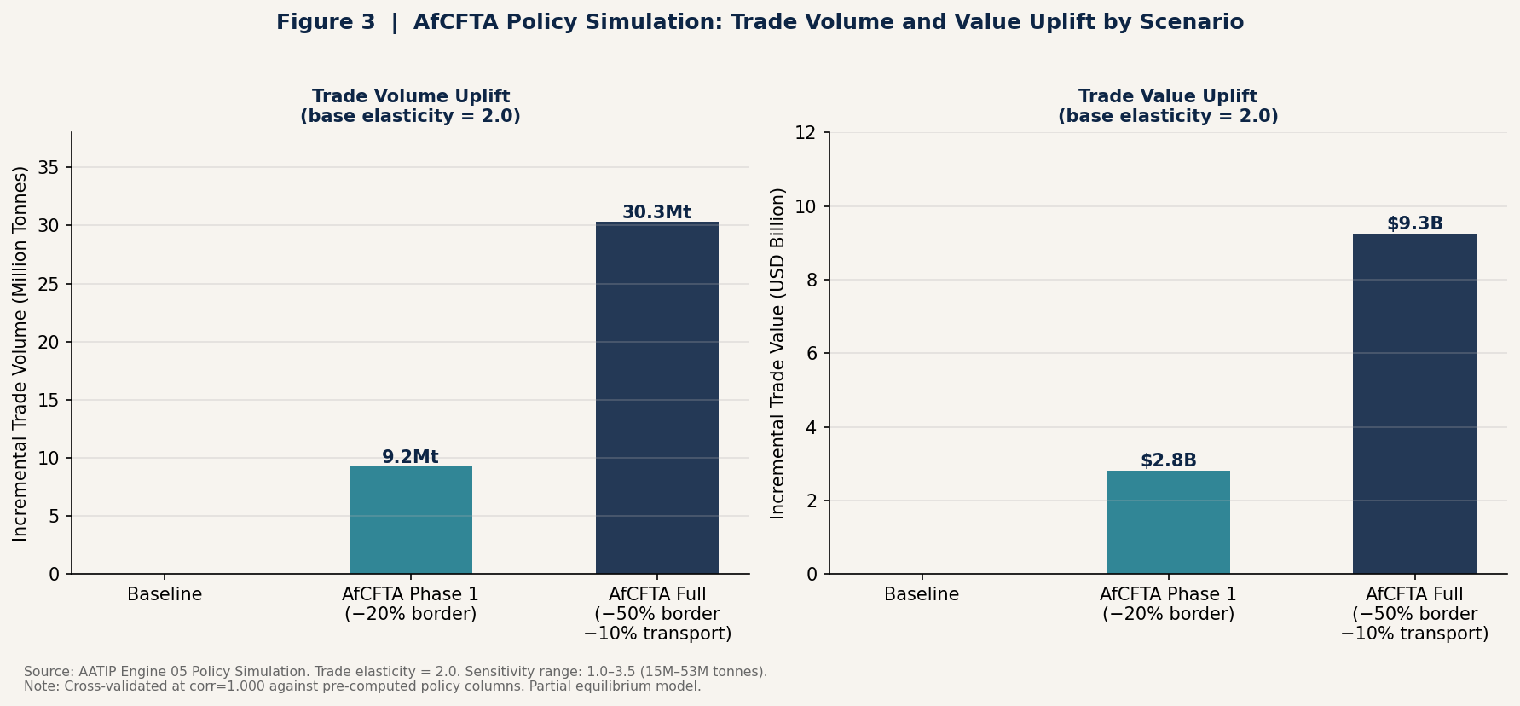
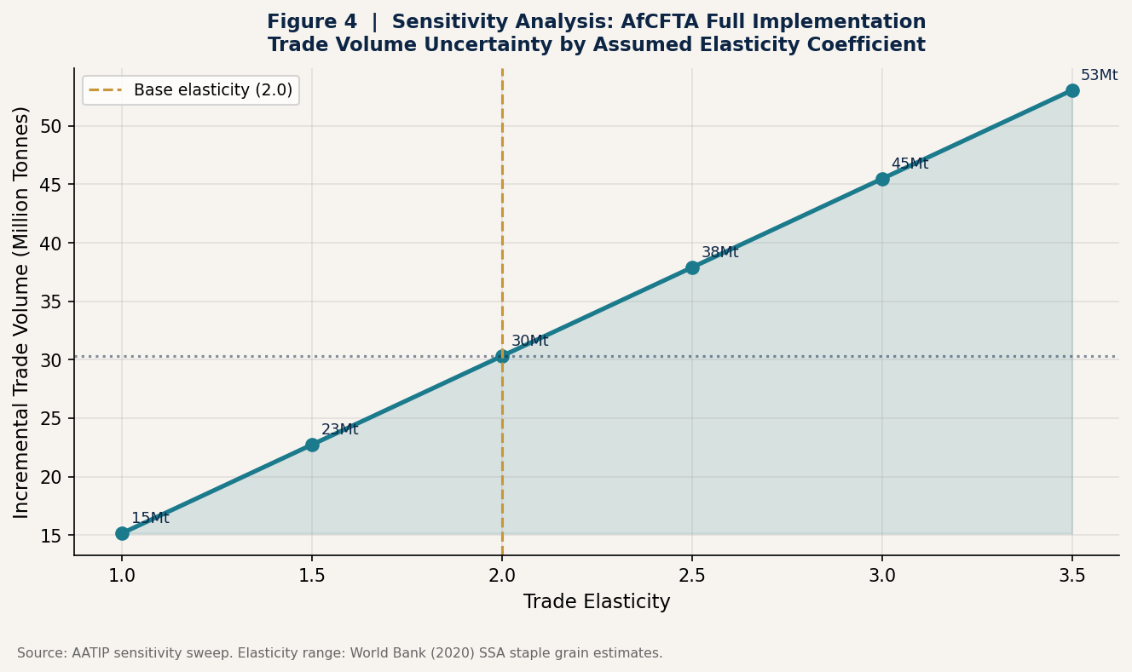
Policy Simulation — Results and Sensitivity
Direction is unambiguous. Magnitude depends on elasticity — uncertainty is honest and bounded.
15.2Mt
30.3Mt
53.0Mt
$9.3B
62
Conservative
(ε = 1.0)
Base case
(ε = 2.0)
Optimistic
(ε = 3.5)
Base case
value
Months
unlocked
AATIP | Gerald T. Mazise | MVP / POC
16 / 20

Slide 17
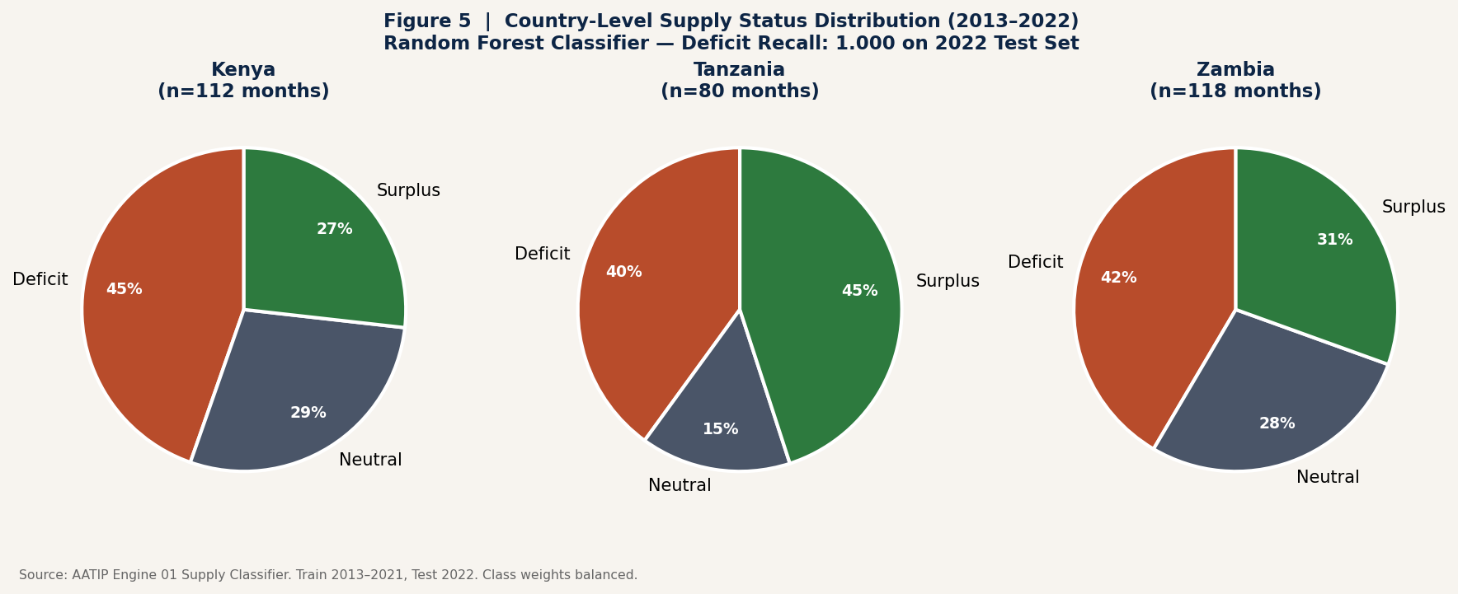
Food Security Intelligence
Deficit detection recall of 1.000 — every food security crisis month in 2022 correctly identified.
Early Warning
Framework
Climate anomaly detected
→ Supply forecast adjusted
Pre-harvest scarcity flag
→ Trade window alert
MIS persistence > 3M
→ Structural intervention alert
P(deficit) ≥ 0.45
→ Humanitarian early warning
AATIP | Gerald T. Mazise | MVP / POC
17 / 20

Slide 18
Built for Institutional Deployment
Governance, auditability, and reproducibility are structural — not added later.
📋 Feature Registry
⚙️ Configuration Layer
📄 Model Cards
All 144 features formally catalogued with engine membership and leakage guard enforcement. Validation runs before any model trains — not as a post-hoc check.
Every threshold, weight, and scenario parameter in a single settings.yaml. Change platform behaviour without touching code. Auditable and version-controlled.
One JSON governance card per engine: training data, performance metrics, assumptions, and known limitations. Satisfies institutional transparency requirements.
⏱ Temporal Discipline
🔍 Zero Leakage Guard
📊 Pipeline Orchestrator
Zero random splits anywhere. TimeSeriesSplit exclusively. Year-based train/test boundaries. Temporal leakage audit runs at pipeline start — raises ValueError if violated.
12 policy output columns formally protected. Any violation raises a hard error before training begins. Zero violations confirmed across all engines and all features.
Single command runs all 6 engines in sequence. Engines fail gracefully — one failure doesn't stop the others. Full execution log with timestamps per engine.
AATIP | Gerald T. Mazise | MVP / POC
18 / 20

Slide 19
From POC to Continental Scale
The architecture is built for scale. Data addition — not redesign — is what the next phase requires.
Phase 1 · COMPLETE
Phase 2 · NEXT
Phase 3 · FUTURE
Current POC
Regional Expansion
Continental Intelligence
▸ 3 countries · 6 corridors
▸ East & Southern Africa (15+)
▸ All 54 AU member states
▸ 2013–2022 historical
▸ Real-time price feeds
▸ Graph neural network corridors
▸ 6 analytical engines
▸ Additional commodities
▸ Reinforcement learning optimization
▸ Maize & staple grains
▸ Satellite NDVI integration
▸ AfCFTA Secretariat integration
▸ All validation thresholds met
▸ API deployment layer
▸ Development bank deployment
The feature engineering, governance layer, modular engine design, and temporal validation discipline are all production-grade — scaling requires data, not redesign.
AATIP | Gerald T. Mazise | MVP / POC
19 / 20

Slide 20
The AfCFTA provides the legal framework.
AATIP provides the intelligence infrastructure.
30.3Mt
$9.3B
87Mt
1.000
Incremental trade
(AfCFTA Full, base)
Estimated trade
value unlock
Implied informal
trade detected
Deficit detection
recall (2022 test)
Gerald T. Mazise
BSc Food Science & Technology (Food Biotech Major), Zimbabwe · MBA (AI Major), India
AfCFTA AgroTrade Intelligence Platform (AATIP) · MVP / Proof of Concept · Kenya · Tanzania · Zambia · 2013–2022
Built with Python · scikit-learn · NumPy · SciPy · Streamlit

