Slide 1
Has Bankruptcy Become a Crisis in Poland?
Exploratory Data Analysis
Author:
Gerald DeJean

Slide 2
Questions to Consider
Is it really true that the bankruptcy rate in Poland has increased over the five-year period from 2008-2012?
If so, what factors may be causing the increase in the bankruptcy rate in Poland?
Could accurate reporting of financial records provide significant information to help some businesses from not declaring bankruptcy?

Slide 3
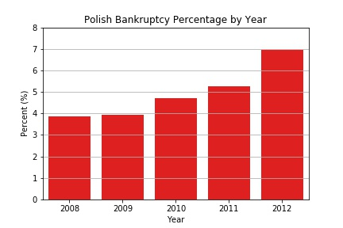
1. Is There an Increase In Bankruptcy?
Early signs may point to an increase in bankruptcy of Polish companies from 2008-2012.

Slide 4
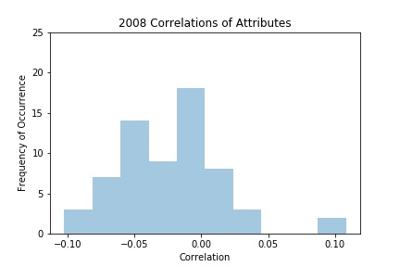
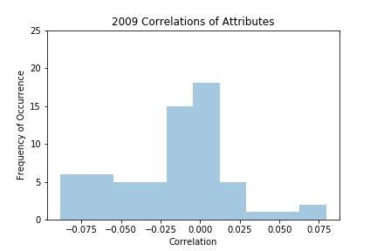
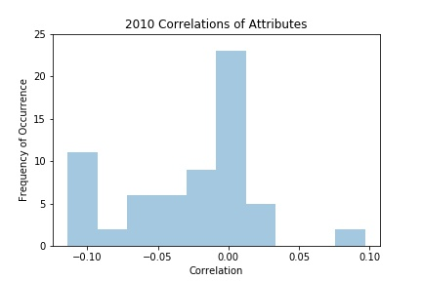
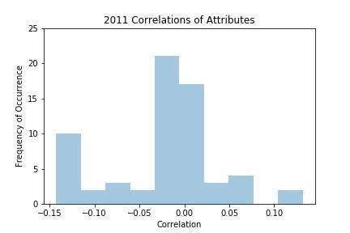
Correlation Distribution of how a company’s bankruptcy filing decision is correlated with the reported financial attributes
Tails of distribution show relatively low correlations (2008-2011)

Slide 5
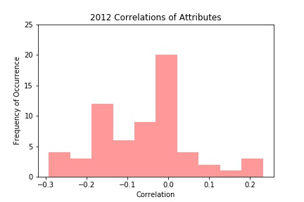
The larger magnitude of tails of the 2012 distribution shows that there may be some factor(s) contributing to a company’s bankruptcy decision.

Slide 6
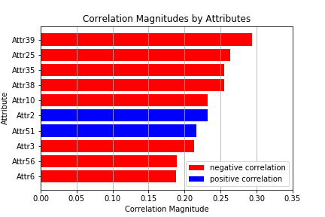
2. What Factors May Be Contributing to This Increase?

Slide 7
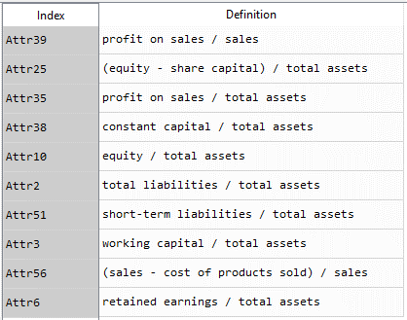
Definitions of the Top Ten Reported Financial Attributes
80% are inversely proportional to total assets, while the other 20% are inversely proportional to sales.
Thus, total assets and sales may be important factors to predicting bankruptcy decisions.

Slide 8
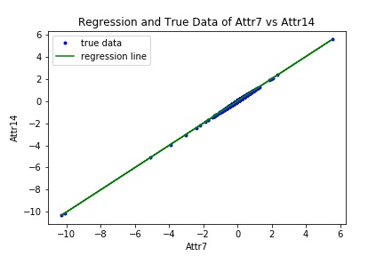

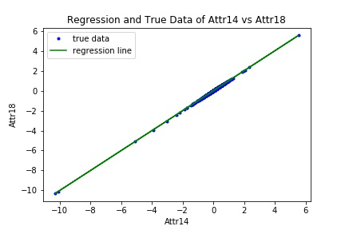
3. Is Data Being Reported Accurately?
Attr7, Attr14, Attr18 seem to have the same data. 5901 of 5910 entries have the same data.
slope = 0.9999847768361899
intercept = 2.623950924899314e-05
slope = 0.9999945803259087
intercept = 9.341657898464208e-06
slope = 0.9999822669729542
intercept = -1.525488991409506e-05
Slopes ≈ 1, Y-Intercepts ≈ 0 seem to provide support to above statement.
What does this suggest?

Slide 9
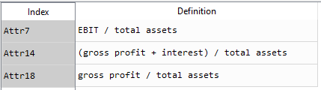
EBIT = Gross profit – Operating expenses – SG&A – Depreciation(Amortization)
If Attr7, Attr14, and Attr18 are the same for almost every instance, then it is possible that companies are not accurately reporting interest, operating expenses, SG&A, and depreciation (and/or amortization).
This could significantly impact the decision of whether a company files for bankruptcy.

Slide 10
Conclusions
Early indications point to an increase in the bankruptcy rate in Poland.
However, more thorough statistical analyses can confirm this hypothesis.
The inversely proportional relationship of total assets and sales may be important factors that influence the increase.
Accurate reporting of financial data could be significant in determining if a company files for bankruptcy.

