Slide 1
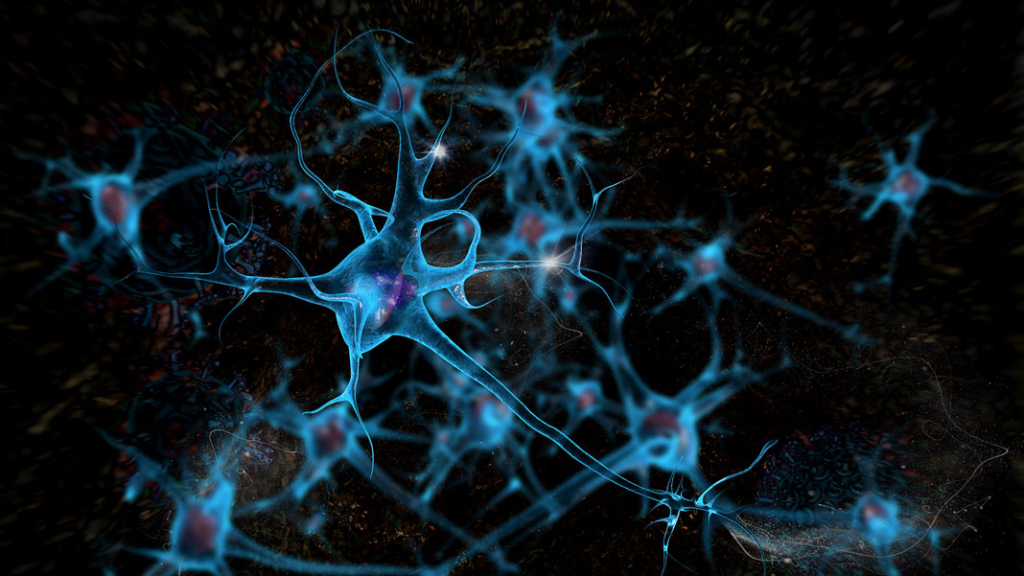
CARCINOMA

Slide 2
Abstract
“Carcinoma” is a Python application, developed in Jupyter Notebook platform. This software aims to help doctors classify breast tumors as benign or malignant, by using some simple statistical methods of Machine Learning. The architecture used falls under the category of Deep Learning and is called Artificial Neural Network (ANN).
Before diving into details of the project coding, I would like to give explanation to some concepts in Machine Learning and Statistics, which will be used in this project.

Slide 3
To be able to have our model trained, so that it can identify these tumors well, we will need real histology data from previous diagnoses. This dataset can be found in UCI Machine Learning Repository.
This dataset contains 31 parameters, of which 30 of them are input features and one is the classification digit. The input features are some measurements of the nuclei of cells, such as radius and texture, perimeter and area, smoothness and compactness, concavity and concave points, symmetry and fractal dimension.
It has a total of 569 instances and has no missing values.
There are two CSV files which make up the whole dataset. One is the matrix_of_features_x.csv, which has the input features I mentioned, and one is the matrix_of_labels_y.csv file which contains all the categorical values labeled 1 or 0, for simplicity reasons.
1 is for malignant tumor and 0 is for benign tumor.

Slide 4
Explanation of Used Concepts
ANN is a computer system or model composed of at least three layers. The input layer, the hidden layer and the output layer.
The input layer contains all the inputs. In our case these inputs are all the features in the matrix of features x.
Then you can define as many hidden layers as you want, with as many neurons inside of them as you want.
And lastly the output layer contains one or more nodes, the values of which yield a discrete probability distribution.

Slide 5
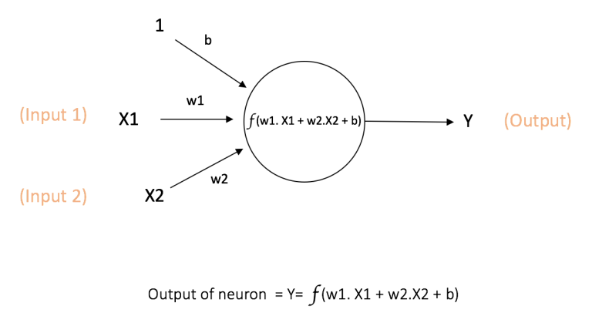
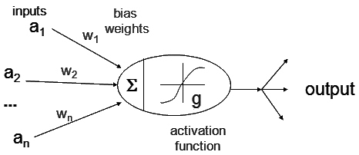
A neuron is the most fundamental part of an ANN. It is also called a node. Its duty is to receive input from the predecessor nodes and to compute an output for the next node.
A weight (w) is associated to it, which takes value depending on the relevance to the other inputs. The function f for the node is as above. There is also another input called bias b, associated with it. Its function is to provide every node with a trainable constant value.
The input of a single node can be expressed as the linear combination of the predecessor node values with respect to their weights and the bias value.

Slide 6
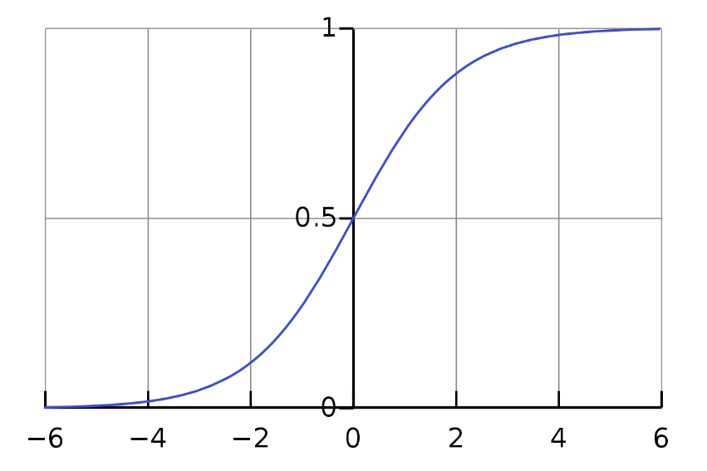

A sigmoid function also called a logistic or logit function, squashes the y values in a range between 0 and 1, so they can be used in expressing probabilities. They are used to produce the output of a neuron. Their domain is in R* and their response value is commonly monotonically increasing or decreasing. Another commonly used range is between -1 and 1.

Slide 7
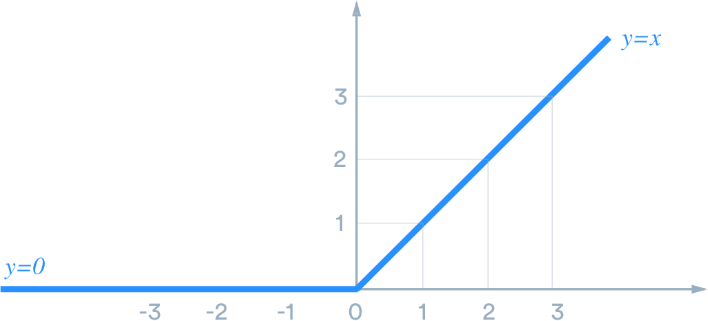

ReLU outputs zero for all x ≤ 0, otherwise outputs the given value as it is.

Slide 8
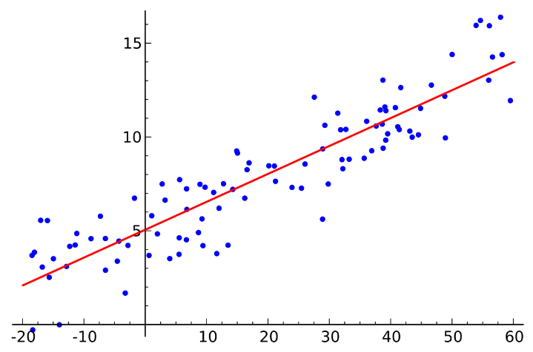
Linear Regression (LR) is one type of approach to modeling relationship between a scalar response and one or more descriptive variables. It may be a simple linear regression or multiple linear regression.

Slide 9
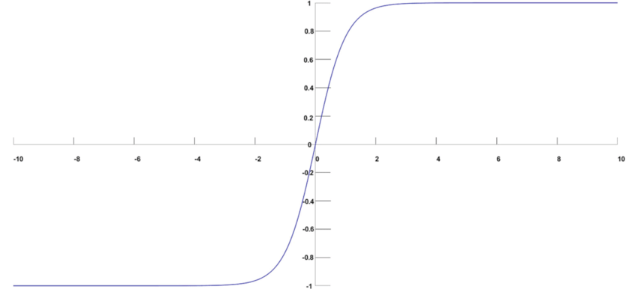
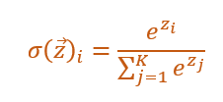
Softmax Regression:
Given vector z ⃗=[z_1,…,z_n ], the Softmax function squashes z ⃗ values between the range [0, 1] and all the resulting elements add up to 1. It is applied to the output score s. These elements represent class probabilities.

Slide 10
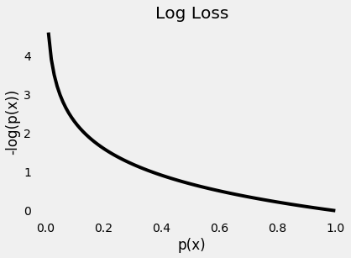
In our case we are using the Logarithmic Loss Function, also known as Logistic Loss or Cross-Entropy Loss function. This is used in multinominal logistic regression and extensions of it such as neural networks. This function returns predicted ŷ probabilities for its training data y.

Slide 11
Before explaining how the code works, I want to make known a list of steps I followed to create this model:
First, I import some libraries I will be needing throughout the implementation of the network.
Then I import the dataframes.
I apply Standardization Scaling on the values of the features.
I then split the dataframes into a total of 4 parts.
I then construct the Neural Network.
I define an Early Stopper.
I calculate the Loss and Accuracy of the Training Set and Validation Set.
I calculate the Loss and Accuracy of the Testing Set.
I calculate the AUC Score of Testing Set.
I plot the ROC Curve of the Testing Set.
I calculate the AUC Score of the Training Set.
I plot the ROC Curve of the Training Set.

Slide 12
TP: True Positive | Correctly predict something to be true.
(Tumor is malignant and we predict to be malignant).
TN: True Negative | Correctly predict that something is false.
(Tumor is benign and we predict to be benign).
FP: False Positive | Incorrectly predict that something is true.
(Tumor is benign, and we predict to be malignant).
FN: False Negative | Incorrectly predict that something is false.
(Tumor is malignant, but we say is benign).
Case 1: Maybe we would only want to make sure that a patient has cancer, without further diagnosis. To do so we could maximize True Positives and minimize False Negatives, even if it causes an increase in False Positives and decrease in True Negatives.
Case 2: On the other hand, maybe we would want to raise the diagnosis threshold, in order to collect less patients to be tested, and collect only those with IDC. This means we could maximize True Negatives and Minimize False Positives, even if it causes increase in False Negatives and decrease in True Positives.

Slide 13
We want to see the both scenarios how they perform in a single graph. That is exactly what a ROC Curve does.
AUC is the Area Under the Curve. It is a numerical value that calculates how the model performs in these situations where we raise or lower the threshold to maximize or minimize the chances of a patient being most likely diagnosed with IDC or most likely not.
The ROC Curve plots all these threshold values of the trained model.
On the y-axis we have the TPR (True Positive Rate) and on the x-axis we have the FPR (False Positive Rate).
TPR = (no. of correctly predicted positives) / (all actual positives),
FPR = (no. of incorrectly predicted positives) / (all actual negatives).

Slide 14
Let’s say we choose our threshold to be 0,3.
That means any patient with the probability below 0.3, the model would predict that the patient is most likely to have a benign tumor.
And the patient with the probability above 0.3 has a malignant tumor.
This model has more sensitivity, because if the model’s diagnosis predicts that the tumor is benign, then the correct diagnosis has higher chances of being benign also. This scenario would best fit Case 1 we covered before, where we wanted to make sure if the patient had IDC without requiring further diagnosis.
Then we will tune the threshold by raising it to 0.7 and calculate the True and False Positive Rates.
This is a Specific Model. This means that if the diagnosis by the model is positive, then it is most likely that the correct diagnosis is also positive. This case would suit more Case 2 scenario from the scenarios we covered previously.

Slide 15
Conclusion:
In this model we used Sigmoid as an activation function and Binary Cross-Entropy as a Loss Function.
This model would be considered a Logistic Regression Model and it is just one type of approach to a binary classification problem like this.

Slide 16
In the second and third model we will be using Softmax Regression and Deep Learning Softmax Regression, which for simplicity reasons I did not include in this presentation.
But in conclusion the comparison of these 3 models showed that the techniques were similar and highly accurate. The similarity may be a result of many factors, among which are the possible homogeneity of the data, the overall difficulty of the task, the parameter of the algorithms, etc. There are many advanced techniques data scientists use to optimize the performance of neural networks. These may be: Batch Normalization, Dropout and Weight Regularization, etc. Maybe by using one of these techniques, the performance might have had a slight improvement. Overall, we could see by extensive simulations on the chosen dataset that these procedures give satisfactory performances, although it should be noted that their results serve as supplementary information to the diagnostician and are not used as the final decision. For this essential reason, machine learning techniques are continuously being exploited in healthcare and clinical trial decision-making.

Slide 17
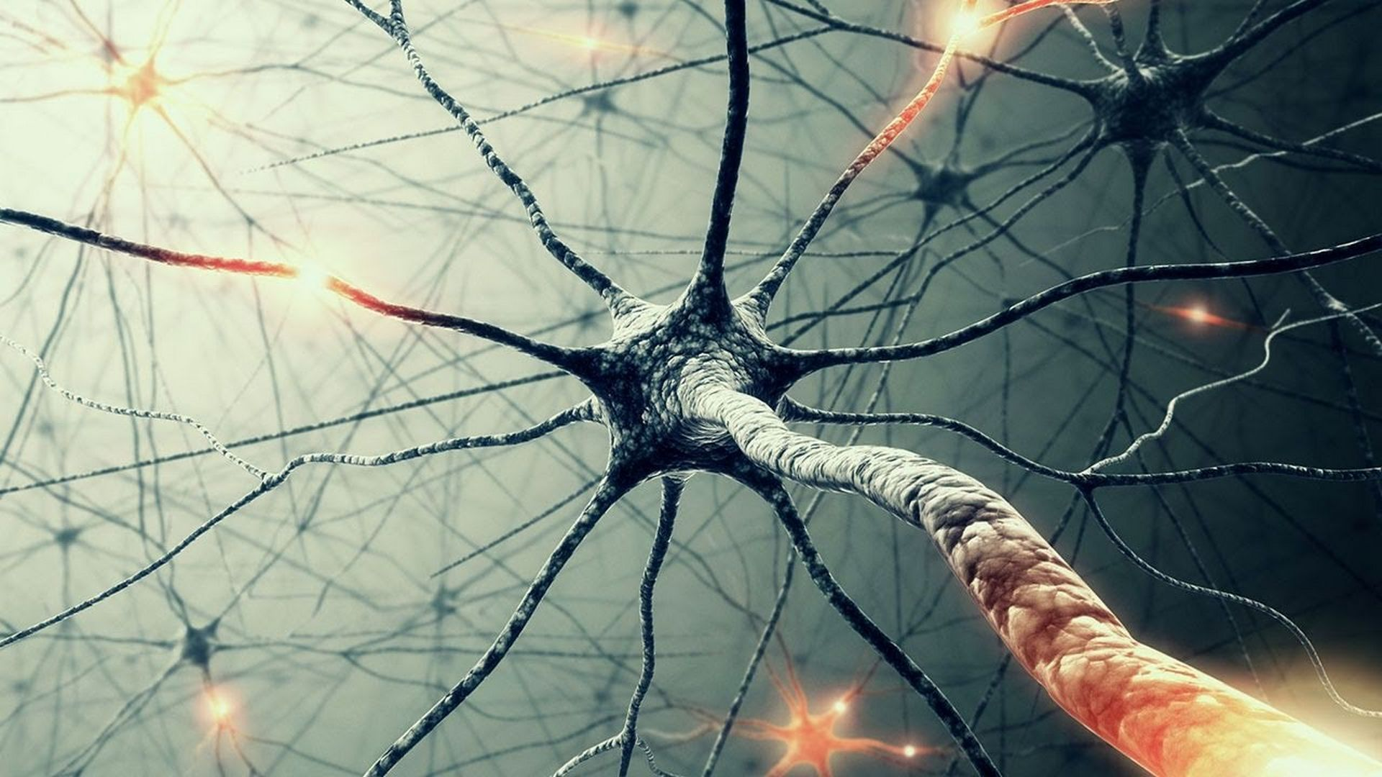
THANK YOU
Worked by: Gerald Nika.

