Slide 1
Luxury Cosmetics Pop-Up Analysis
SQL Data Science Project Portfolio Presentation
Notes:
Welcome to my project on Luxury Cosmetics Pop-Up Analysis. This is a SQL-driven data science project where I analyzed 2,100+ luxury pop-up events across multiple brands and regions. The goal was to identify key success factors and provide actionable insights for expansion strategies

Slide 2
Project Overview
• Objective: Analyze performance of luxury cosmetics pop-up events
• Dataset: 2,133 events across multiple brands, regions, and event types
• Tools: SQL, Python, Tableau/Power BI
• Focus Areas: Sales, Footfall, Event Efficiency, Pricing, and Product Performance
Notes:
The dataset included details such as event type, region, location, foot traffic, pricing, and sell-through rates. I used SQL for querying and Python for deeper analysis and visualization. The key business questions I addressed were:
1. Which regions and event types perform best?
2. How does pricing affect sales?
3. What product and city-level insights can we extract?”

Slide 3
Key Metrics
• Total Events: 2,133
• Average Sell-Through: ~78%
• Price Range: $50 - $150
• Key Regions: North America & Europe dominate sales
• Top Locations: Airports and major global cities
Notes:
Some quick stats: There were over 2,100 events analyzed, with an average sell-through rate of 78%. Most products were priced between $50 and $150. North America and Europe dominated in sales, while airports and large urban centers drove the highest traffic and conversions.

Slide 4
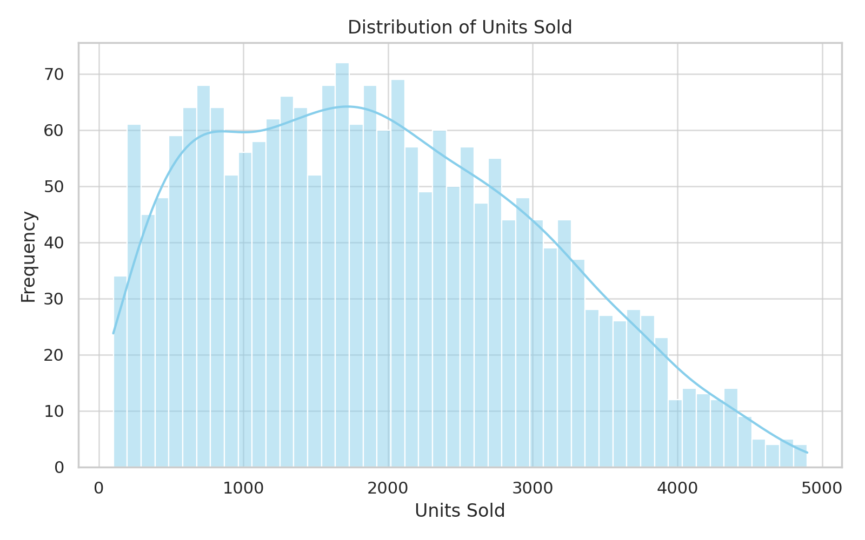
Distribution of Units Sold
Notes:
This chart shows the distribution of units sold across events. We can see most events sold between a few hundred and a few thousand units, but there’s a long tail of highly successful events. That indicates variability by location and brand.

Slide 5
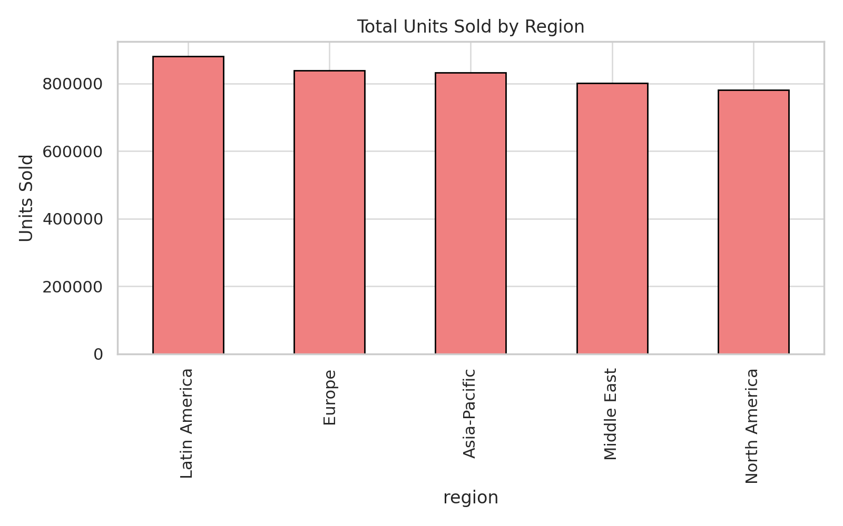
Total Units Sold by Region
Notes:
Regionally, North America and Europe contributed the largest sales volumes. Asia was also significant, but more variable across cities. This suggests North America and Europe are the most reliable markets for expansion.

Slide 6
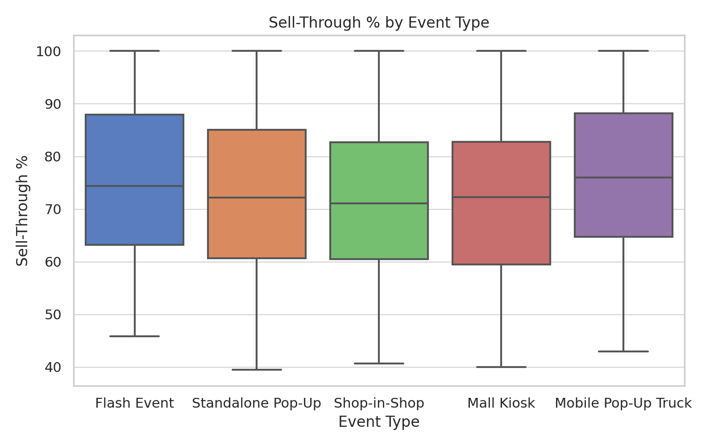
Sell-Through % by Event Type
Notes:
Here, we compare event types. Flash Events had the strongest sell-through percentages, meaning inventory sold more efficiently. Standalone pop-ups had more variation, signaling that careful inventory planning is critical for them.

Slide 7
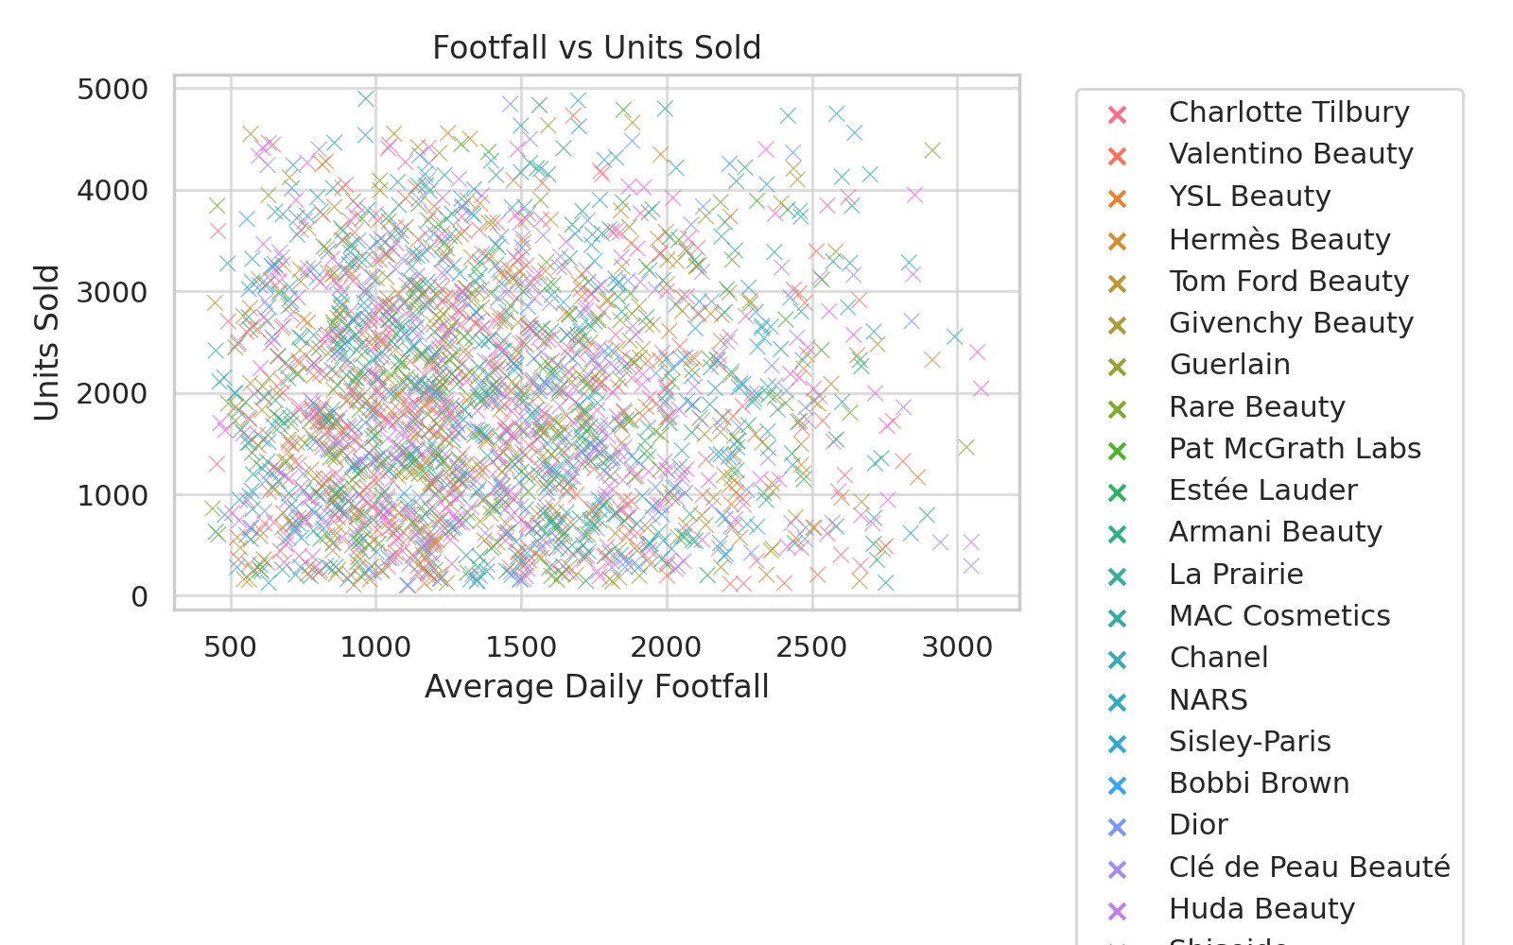
Footfall vs Units Sold
Notes:
This scatterplot shows how daily foot traffic correlates with sales. Airports consistently drive strong performance, with both high traffic and high conversion. This validates airports as prime luxury retail environments.

Slide 8
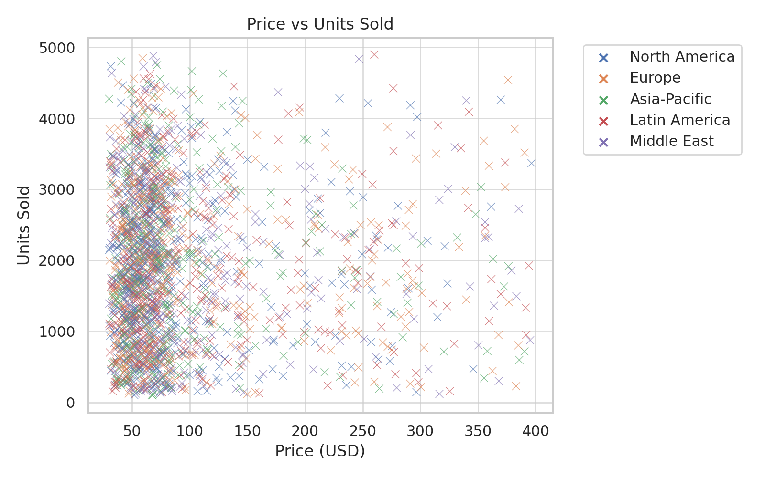
Price vs Units Sold
Notes:
This chart looks at pricing. Mid-range luxury products, between $60 and $90, sold the best. However, prestige brands like Hermès and YSL maintained performance even at higher price points — showing brand equity helps offset price sensitivity.

Slide 9
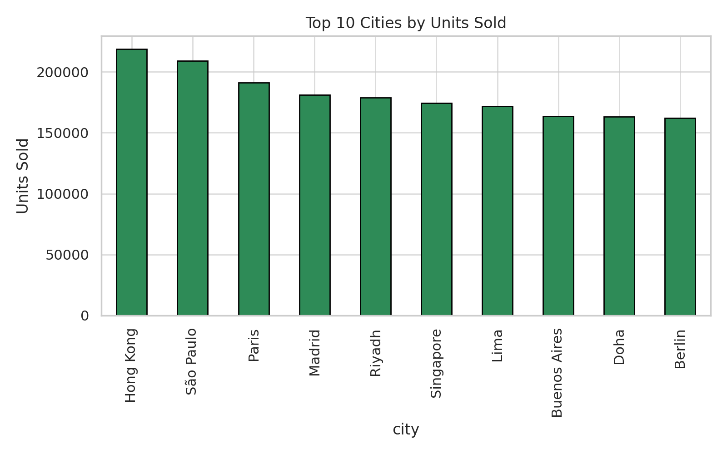
Top 10 Cities by Units Sold
Notes:
Cities like New York, London, Miami, and Berlin ranked among the top performers. These locations should be prioritized for repeat events or longer-term pop-ups.

Slide 10
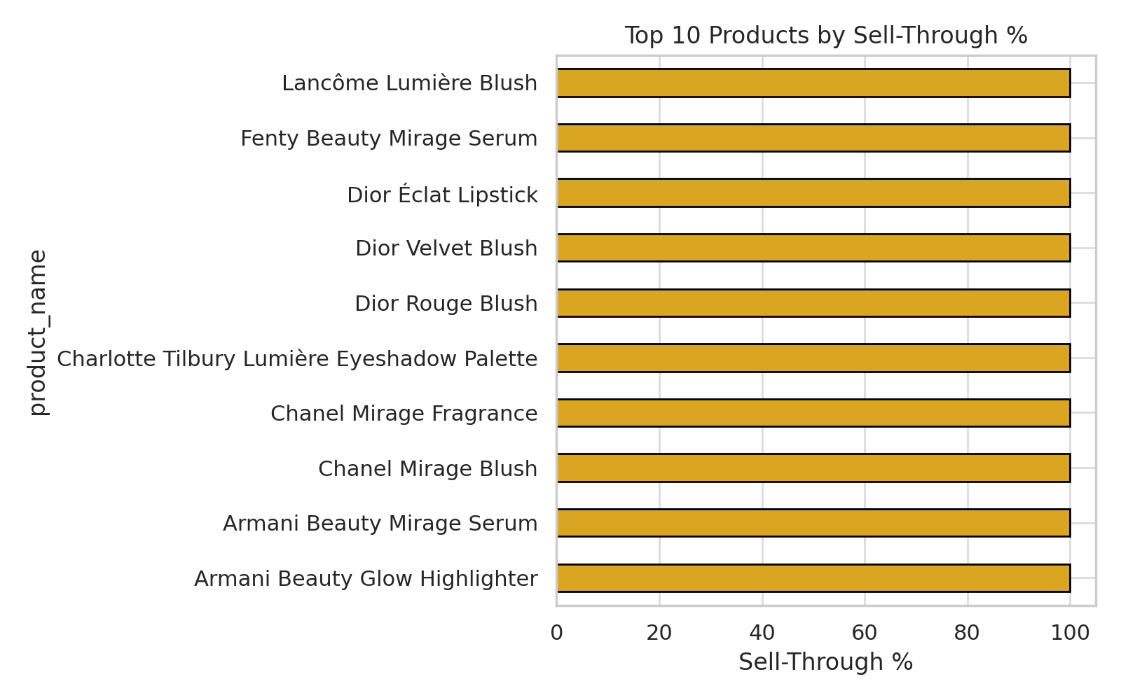
Top 10 Products by Sell-Through %
Notes:
On the product side, highlighters and eyeshadow palettes consistently had the strongest sell-through. These categories are core drivers of success and should remain central to product assortments.

Slide 11
Key Insights
• North America & Europe lead in sales performance
• Airports generate consistently high sales & footfall
• Flash Events drive urgency and higher sell-through
• Mid-range pricing ($60–$90) shows strongest demand
• Top cities: New York, London, Miami, Berlin
• Best-selling SKUs: Highlighters & eyeshadow palettes
Notes:
To summarize:
North America and Europe dominate sales.
Airports are highly effective retail hubs.
Flash events create urgency and maximize efficiency.
The $60–$90 range is the sweet spot for pricing.
Certain cities and product categories are clear winners.

Slide 12
Actionable Steps
• Expand in top-performing regions and airports
• Increase Flash Events for urgency-driven sales
• Optimize inventory for Standalone Pop-Ups
• Focus on $60–$90 price band while keeping prestige SKUs
• Replicate strategies from top-selling products
• Phase out SKUs with <70% sell-through
Notes:
Based on the analysis, I recommend:
Expanding in airports and top-performing cities.
Running more Flash Events to capitalize on urgency.
Fine-tuning inventory in Standalone Pop-Ups.
Focusing on mid-range pricing while selectively maintaining prestige products.
Phasing out SKUs with weak sell-through while scaling top performers.
This project demonstrates how SQL and analytics can translate raw data into business strategies for luxury retail.

