Slide 1
Synthetic Control Methods workshop: Examples and methods
Geraldine Clarke
Autumn 2020

Slide 2
Contents
Background
Example 1 – Tobacco Legislation
Example 2 – Redesigning Urgent and Emergency Care
Some maths
Notes:
Key variables e.g. outcomes and predictors of the outcome.

Slide 3
Background
Difference-in-differences (DiD) methods are widely used to control for confounding.
DID assumes that in the absence of an intervention, outcomes for treated and control units would follow parallel trajectories over time.
This means no predictors of the outcome that vary over time differently across treated and control groups.
SCM allows predictors to vary over time.
Can provide unbiased estimates as long as pre-intervention period is long enough
Useful for initiatives taking place at an aggregate level with few treated units and multiple controls.

Slide 4
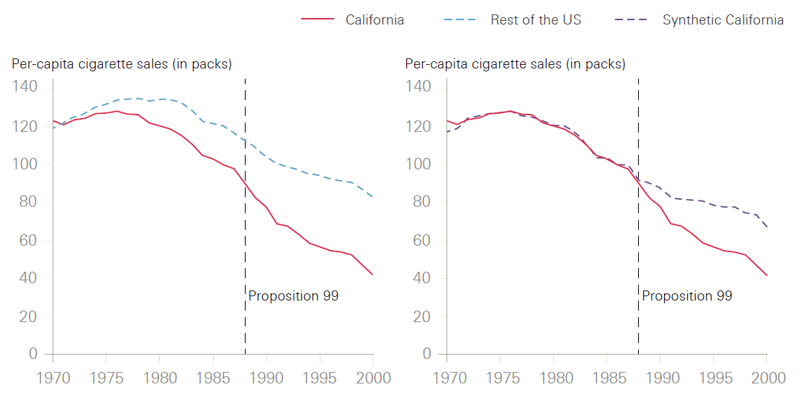
Example 1 | Impact of California 1988 anti-tobacco policies on smoking rates (Abadie et al. 1993)
Synthetic California: 33% Utah, 23% Nevada, 20% Montana, 16% Colorado and 7% Connecticut
Notes:
Proposition 99, a large-scale tobacco control program, was implemented in California in November 1988. Measures included increasing the prices of cigarettes, ear-marking tax revenues to health and anti-smoking education budgets , anti-smoking media campaigns etc. It then triggered a wave of local clean-air ordinances in California, no smoking in restaurants, work places etc.. By 1996 more than 90% of California workplaces were smoke free. Tobacco industry increased advertising and lobbying in CA as a results. Perceived to have cut smoking in California. Synthetic control method was used to assess the impact of Proposition 99 on smoking prevalence.
Using estimates of per capita cig consump (pccc) from all states in the USA, the plot shows pccc in California compared to the rest of the USA. Both decreasing but CA more? To determine this, the SC method aims to find a linear combination of a pool of donor states with the same values of key predictors in the pre-intervention period. This so called donor pool excludes any states with large scale tobacco programmes, because the idea is that these states are like CA would have been if there had not been a proposition 99. This left a pool of 38 available states. The SC was made of …..As you can see this SC had similar values of pccc in the post intervention. As mentioned, in the post-intervention, the SC is assumed to behave like CA would have behaved if there had been no proposition 99. The differences between the two lines in the post-intervention period then represents the impact of the programme. Estimate that by 1997, proposition 99 had reduced pccc in CA by about 24 packs per year.

Slide 5
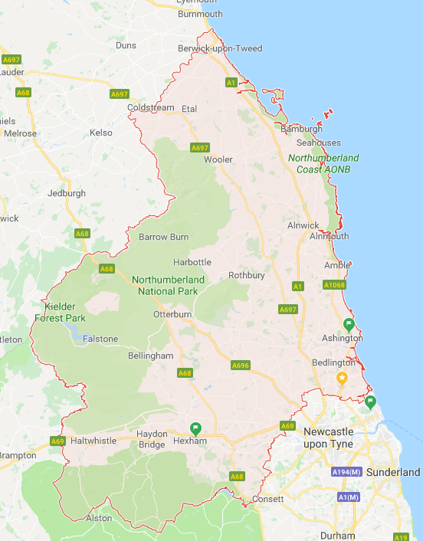
Example 2| Impact of redesigning urgent and emergency care in Northumberland (IAU 2017)
Northumberland is a Primary and Acute Care Services vanguard serving ~ 320,000.
In June 2015 a new specialist emergency care hospital was opened in Cramlington, Northumberland and three existing A&Es in North Tyneside, Hexham and Wansbeck were gradually refocused on providing care for minor injuries
Hospital activity in Northumberland CCG was compared to that of a synthetic control area formed by combining data from comparable CCGs in other parts of England.
Notes:
This study published by the IAU looked at the impac of …. ../Northumberland is a PACs vanguard…/In June 2015...
To take account of the impact of the new hospital on the local population as a whole, and since no other part of England is exactly like Northumberland, we compared all hospital activity in Northumberland…
Synthetic control is formed by…Data is combined in a way that ensures the resulting area is similar to Northumberland in terms of its historic trend in hospital use. This method is appropriate when an intervention affects an entire area, and when data are available from other similar areas.

Slide 6
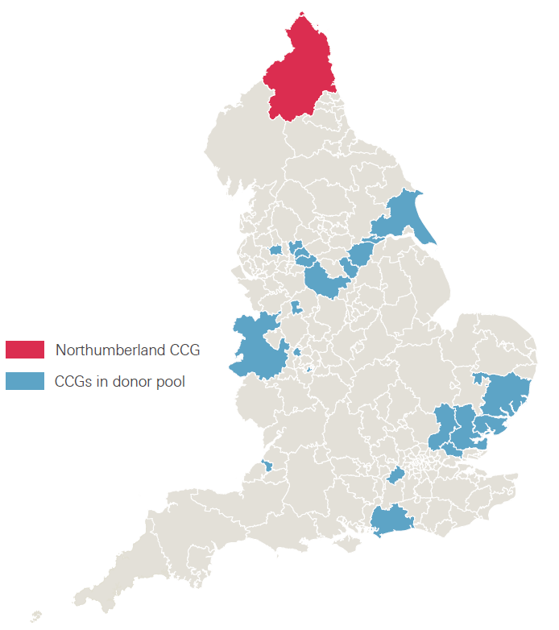
Example 2: Methods
Selecting a donor pool: 20 CCGs with similar values of
Age, gender, ethnicity
Education level
Population density
Socioeconomic and health deprivation
Number of GPs and care home beds
QOF achievement score
Disease prevalence and comorbidities
Hospital utilisation
Notes:
Identified 20 CCGs with similar values of these variables from across the country. Hospital utilisation is extracted from SUS data. All other variables are from publically available sources e.g. census, CQC etc.
This set of CCGs excludes those with major health care initiatives e.g. the new care models, those in London and those neighbouring Northumberland.

Slide 7

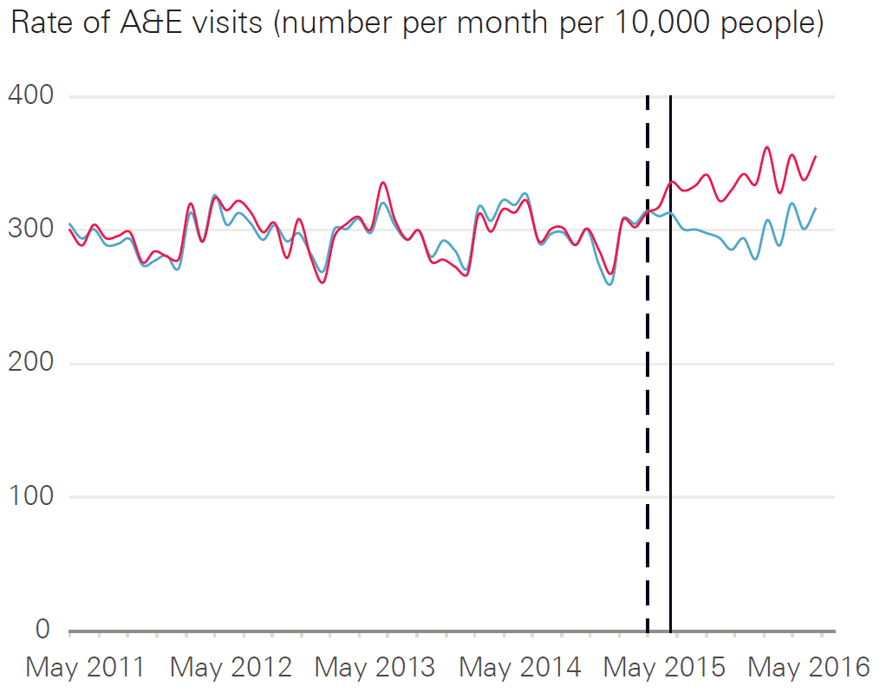
Example 2| Methods continued
Selecting the synthetic control:
33% Heywood, Middleton and Rochdale
39% Doncaster
27% North Derbyshire
1% Birmingham South and Central
Notes:
Synthetic control method chose a combination of XX. This synthetic control was designed to have similar values of all key predictors and the outcome in the pre-intervention period.
PLOT1 Rate A&E visits /10,000 people/month 4 years prior and 1 year post. Dashed=opening; Solid allows for short bedding in period. Red Northumberland; blue SC. The SC represents the counterfactual i.e. what we would have expected in the absence of the new hospital.
Prior to opening, the rates track closely (by design).

Slide 8
Example 2| Methods continued
Estimating the impact:
Differences between red and blue lines in the post-intervention period indicates an increase in A&E attendances in Northumberland CCG compared to the synthetic control after the opening of the hospital in June 2015.
Notes:
Differences between the blue and red lines in the post intervention period indicate the treatement effect. Here results indicate an increase in A&E visits in Northumberland compared to the synthetic control region after the opening of the NSECH.

Slide 9
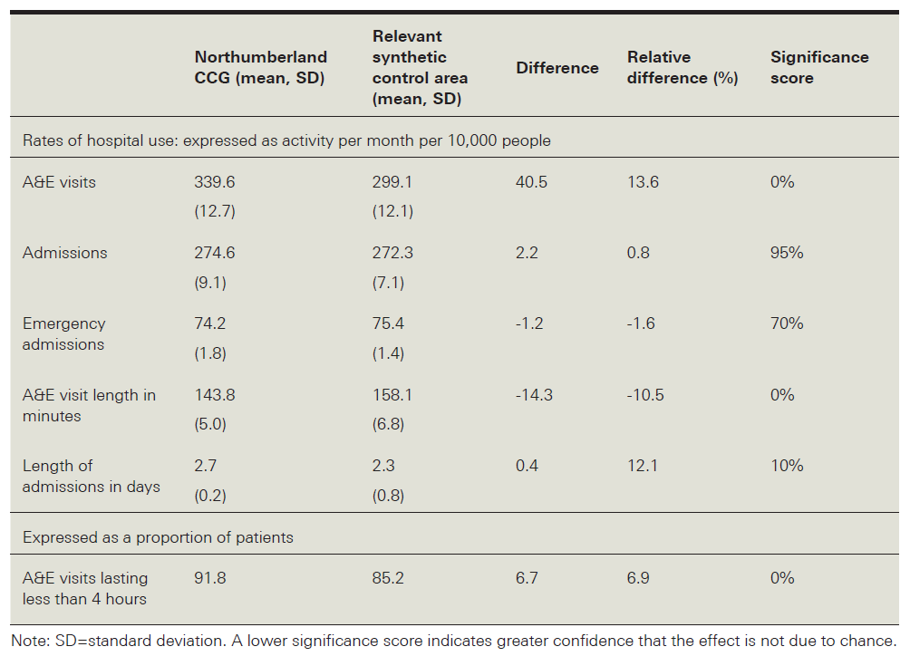
Example 2| Results
Northumberland residents had a 13.6% increase in rate of A&E visits
91.8% of patients in Northumberland were admitted, transferred or discharged within 4 hours of attending A&E, compared with 85.2% in the control area
On average, the duration of A&E visits were 14.3 minutes shorter than expected
Notes:
opening of a new state-of-the-art hospital may have made A&E a more attractive or convenient place to seek care. Other results are consistent with improvement in supply & quality of care
More qual data underlying the mechanisms of the care process required to understand the implications for future delivery of health care.

Slide 10
Some maths
 | t | Untreated |  |  |  | Treated
Unit |  | 1 | 2 | … | 8 | 9 | 10 | … | 16
Untreated | 1
 | 2
 | …
 | 100
Trt | 101

Slide 11
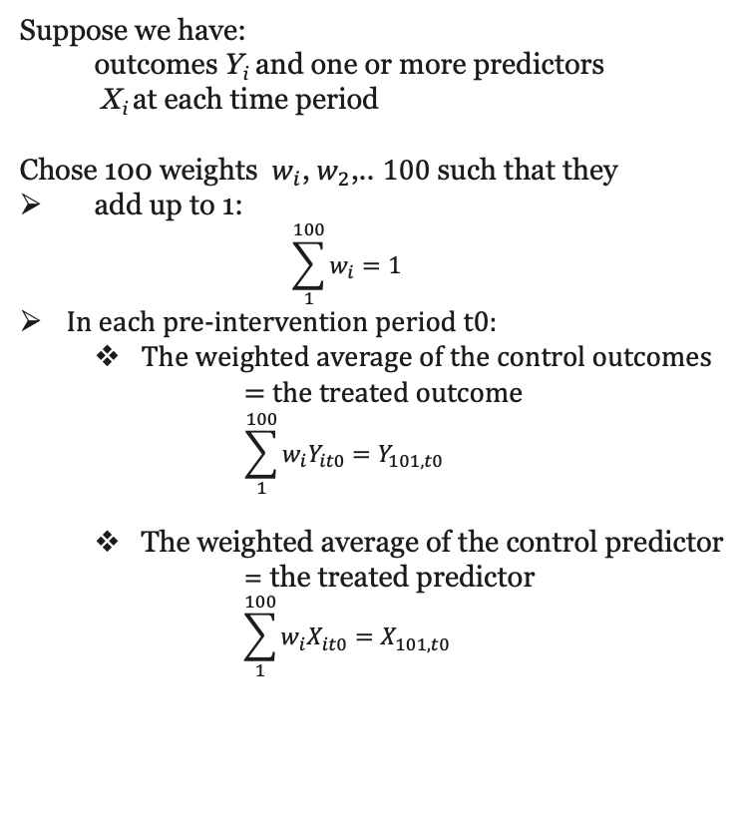
Some maths
Suppose we have:
outcomes Y_{i} and one or more predictors
X_{i} at each time period
Chose 100 weights $w_{i}$, $w_{2}$,.. $100$ such that they
add up to 1:
$$\sum_{1}^{100}{w_{i}}=1$$
In each pre-intervention period t0:
The weighted average of the control outcomes
= the treated outcome
$$\sum_{1}^{100}{w_{i}Y_{it0}=Y_{101,t0} }$$
The weighted average of the control predictor
= the treated predictor
$$\sum_{1}^{100}{w_{i}X_{it0}=X_{101,t0}}$$
 | t | Untreated
Unit |  | 1 | 2 | … | 8
Untreated | 1
 | 2
 | …
 | 100
Trt | 101

Slide 12
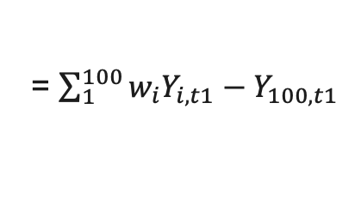
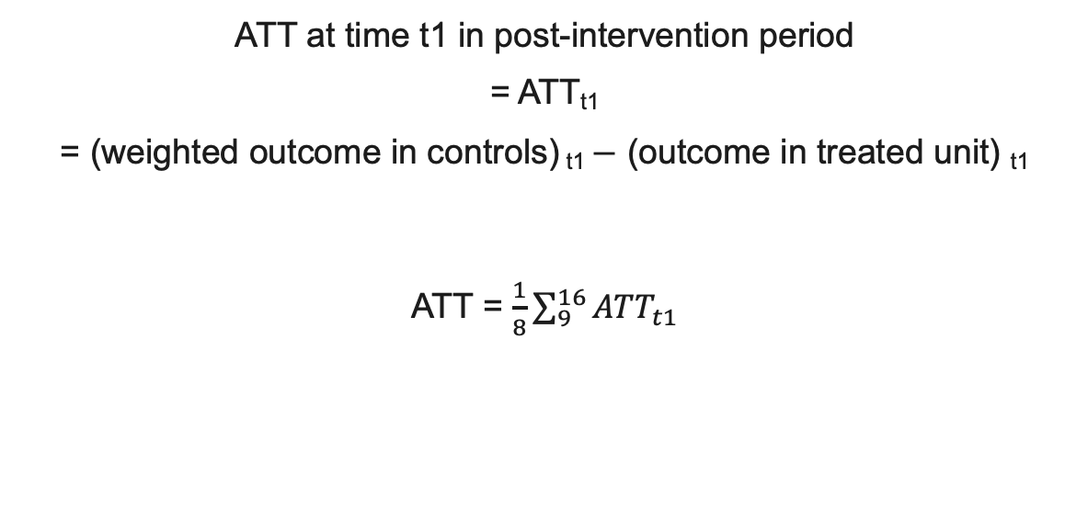
ATT
ATT at time t1 in post-intervention period
= ATT_{t1}
= (weighted outcome in controls) _{t1} $−$ (outcome in treated unit) _{t1}
ATT = $\frac{1}{8}\sum_{9}^{16}{{ATT}_{t1}}$
= $\sum_{1}^{100}{w_{i}Y_{i,t1}−Y_{100,t1}}$

Slide 13
Now open SCM_workshop_for_participants.Rmd

