Slide 1

Property Listing
BY : Gerald Nathaniel Surya

Slide 2
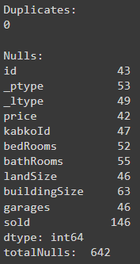
Data
From the output, there are no duplicates in the data. However, there are many null values in those data. There are 642 null values from all columns. the detail of the Nulls value in each column is in the picture on the left side.

Slide 3
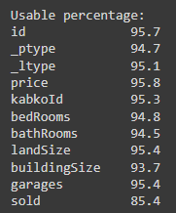
Data
The usable percentage of these data from each column is in the picture on the left side. The data is still clean enough to be used for house pricing prediction. It can impute the value with “NA” or delete the data that don't have a value.

Slide 4
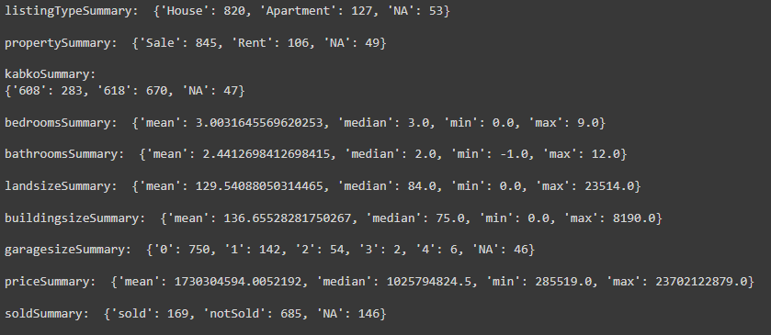
Summary
This is a summary of all columns in this data. But, there is a weird value from this data like the minimum value from bathrooms is -1 which is so strange. It should be at least have 1 bathroom. the maximum value from landsizeSummary is also weird. The landsize doesn't make sense. The maximum value from buildingSize is also weird because the maximum value of the buildingSize doesn't make sense

Slide 5
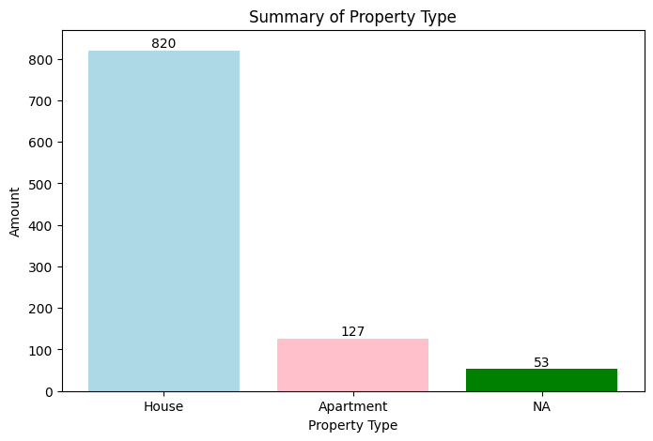
Graph of Property Type
This is a summary of property type columns (_ptype) in this data. There are 820 houses, 127 Apartments, and 53 null datas.

Slide 6

Graph of Listing Type
This is a summary of listing type columns (_ltype) in this data. There are 845 properties that are sale, 106 properties that are rent, and 49 Null data from Listing type columns.

Slide 7
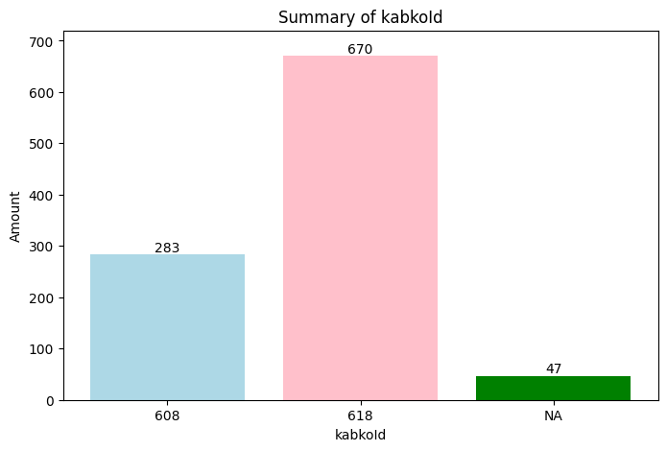
Graph of kabkoId
This is a summary of kabkoId column in this data. where there is a number of properties sold in each district or city based on their kabkoId. 283 properties that are listed in city with id 608, 670 properties that are listed in the city with id 618, and 47 properties that have no value.

Slide 8
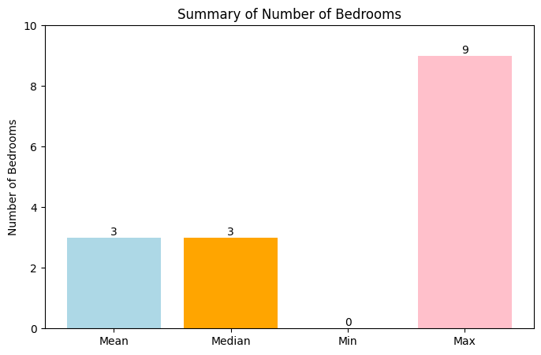
Graph of bedrooms
This is a summary of the bedroom in this data. Where in this chart, there are mean, median, min, and max for the bedrooms that have from each property. The mean of the bedrooms is 3 for the property. The median of the bedrooms is also 3. The minimal bedroom on the property is 0 and the maximal bedroom on the property is 9.

Slide 9
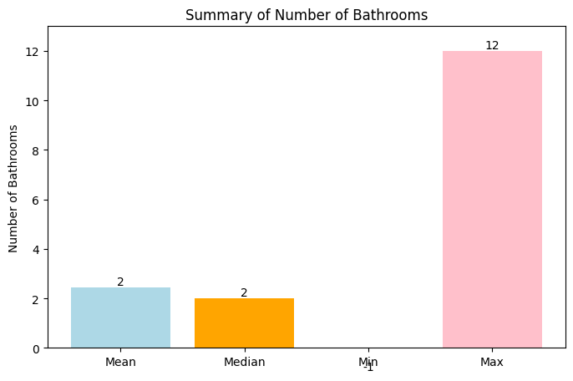
Graph of bathrooms
This is a summary of the bathroom in this data. Where in this chart, there are mean, median, min, and max for the bathrooms that have from each property. The mean of the bathrooms is 2 for the property. The median of the bathrooms is also 2. The minimal bathrooms on the property is -1 which is a strange value because its not logical for the minimal value. The maximum number of bathrooms on the property is 12.

Slide 10
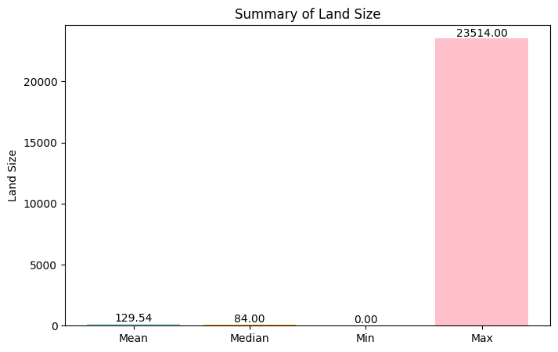
Graph of land size
This is a summary of the land size in this data. Where in this chart, there are mean, median, min, and max for the land size that have from each property. The mean of the land size is 129.54 for the property. The median of the land size is 84. The minimal land size area on the property is 0. This is a strange value because its not logical for the minimal value of land size. And the maximum land size on this data is 23514. Its also a strange value for the maximal land size.

Slide 11
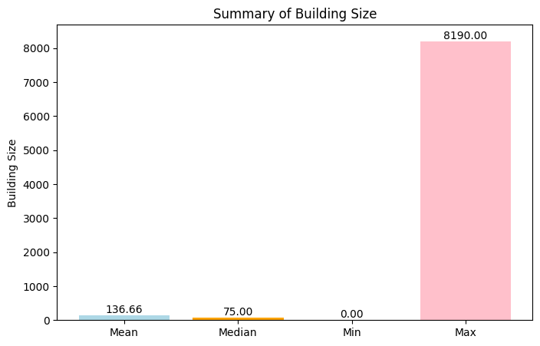
Graph of building size
This is a summary of the building size in this data. Where in this chart, there are mean, median, min, and max for the building size that have from each property. The mean of the building size is 136.66 for the property. The median of the building size is 75. The minimal building size on the property is 0. This is a strange value because its not logical for the minimal value of building size. And the maximum building size on this data is 8190. Its also a strange value for the maximal building size because it seems doesn't make sense.

Slide 12
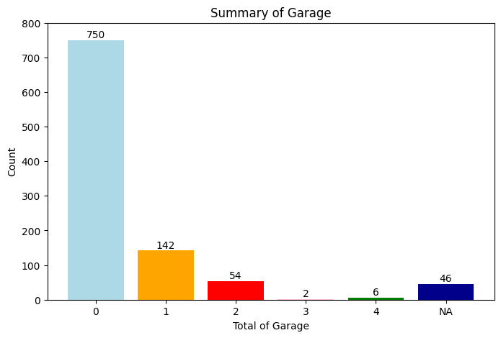
Graph of Garage
This is a summary of the garages in this data. where show how many garages it has from each property. 750 properties have no garage, 142 properties have one garage, 54 properties have two garages, 2 properties have three garages, 6 properties have 4 garages, and 46 properties have no value.

Slide 13
Graph of Garage
This is a summary of the garages in this data. where show how many garages it has from each property. 750 properties have no garage, 142 properties have one garage, 54 properties have two garages, 2 properties have three garages, 6 properties have 4 garages, and 46 properties have no value.

Slide 14
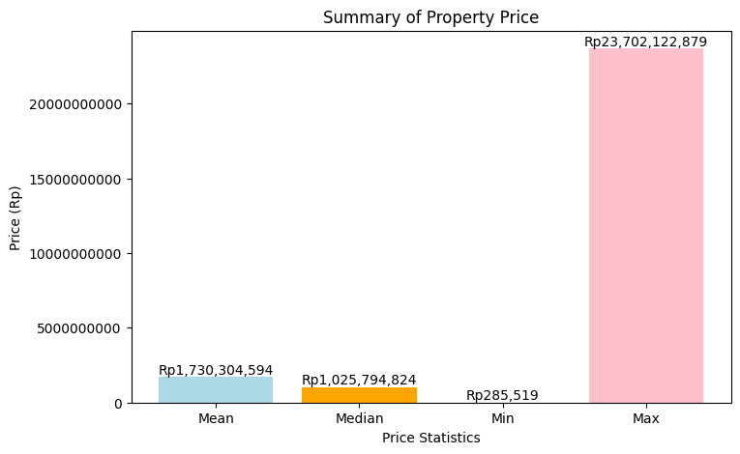
Graph of listing price
This is a summary of the listing price in this data. Where in this chart, there are mean, median, min, and max for the listing price from the data. The mean of the listing price is Rp1,730,304,594. The median of the listing price is Rp1,025,794,824. The minimal listing price on the data is Rp285,519. And the maximal listing price on this data is 23,702,122,879.

Slide 15
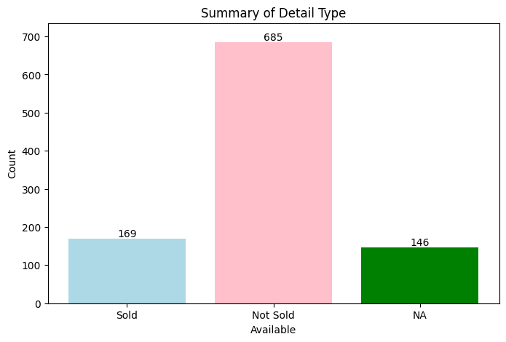
Graph of Detail
This is a summary of the detail in this data. where show how many properties that have sold or haven't sold. 169 are sold, 685 properties haven't sold, and 146 properties have no value for the detail.

Slide 16
THANK
YOU

