Slide 1
Server Hardening
Moses Ike and Paul Murley
TexSAW 2015
Credit to Daniel Waymel and Corrin Thompson

Slide 2
Outline
Introduction
Securing Your Access
Restrict Unwanted Access
Monitoring and Alerts
Note: Slides provide a good basic overview of material covered, but in-person demos will be important to a full understanding.

Slide 3
Systems
Linux (Ubuntu 14.04) Server
Always on
Always connected to the internet
Client used to administer server
Could be anything, we will use Ubuntu 14.04

Slide 4
Objectives
Understand how to:
Configure secure remote access
Defend against basic network based attacks
Configure remote alerts and monitoring
Apply concepts we talk about in new and exciting ways

Slide 5

Securing Your Access

Slide 6
Objectives
Access your system securely and reliably via a command shell
Provide basic authentication measures to prevent others from accessing your server
We will look at telnet (bad) and SSH (good)
Other relevant protocols:
SFTP (Secure File Transfer Protocol)
HTTPS (Secure Hypertext Transfer Protocol)
RDP (Remote Desktop Protocol)

Slide 7
First Thing’s First
Basic server access
Maybe physical access available
Maybe not!
In any case, we need to have a user on our server:
# adduser <username>
# adduser <username> sudo

Slide 8
Telnet – The “Old School” Solution
Username/Password authentication
Grants shell on remote computer
*** TELNET IS COMPLETELY UNENCRYPTED! ***
Why do we care?

Slide 9
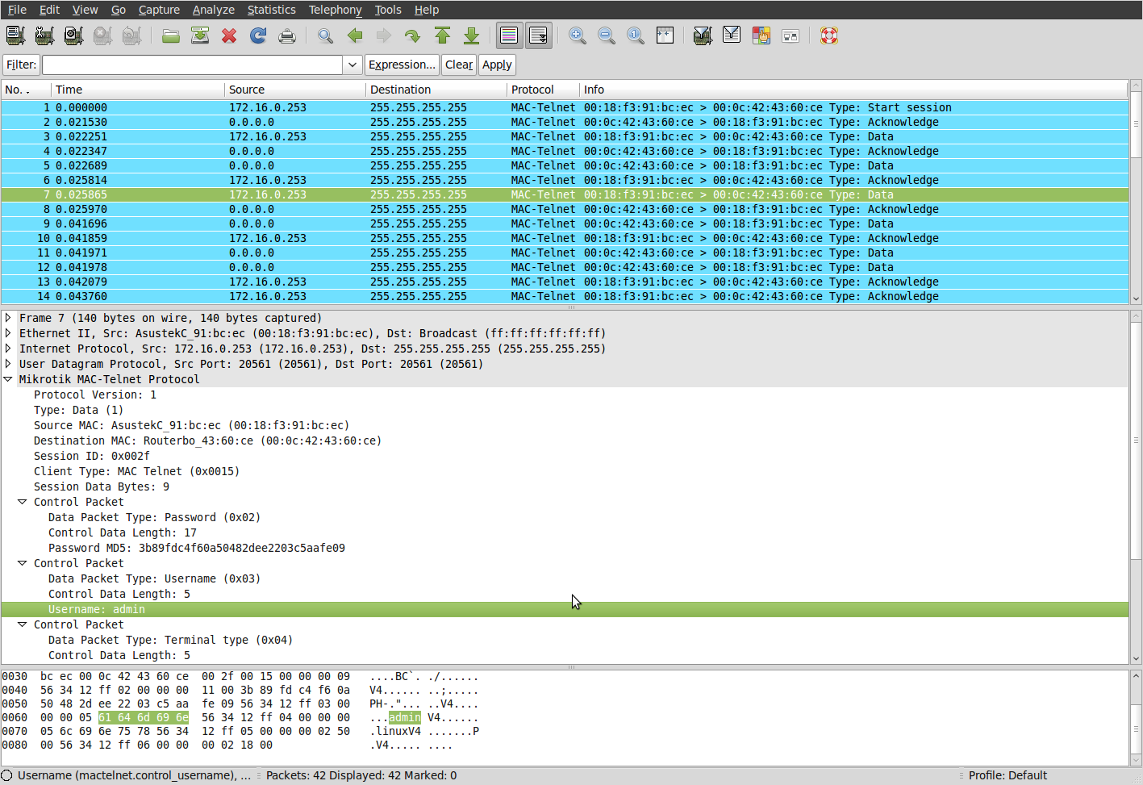

Slide 10
SSH – A Better Solution
SSH (Secure Shell) provides telnet functionality through an encrypted tunnel
You can authenticate with a password, crypto keys, or both (more on this in a minute)
Highly configurable based on your needs

Slide 11
Securing SSH
Restrict access via ssh:
# nano /etc/ssh/sshd_config
Additional lines:
# PermitRootLogin no
Disallows ssh access for root account

Slide 12
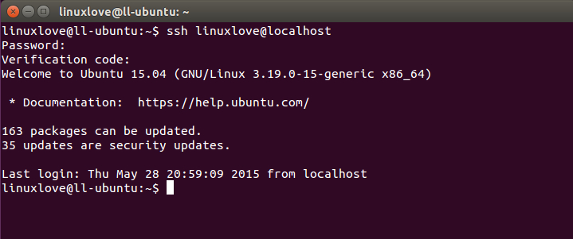
Securing SSH – Password
SSH must be installed on server
“sudo apt-get install ssh” (while connected to internet)
Client must know username, password, and IP of server

Slide 13
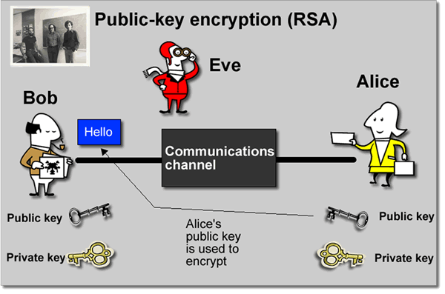
Securing SSH – RSA Keys

Slide 14
Securing SSH – RSA Keys
On client system:
$ ssh-keygen –t rsa
Now hit enter a few times…
$ cd ~/.ssh
$ ls
You should see at least two important files:
id_rsa (private key file)
Id_rsa.pub (public key file)

Slide 15
Securing SSH – RSA Keys
How do we let the server know it should trust the client?
By giving the server the public key of the client!
Trusted public keys should go in :
~/.ssh/authorized_keys
How do we do this?

Slide 16

Restricting Unwanted Access

Slide 17
Objectives
Be reasonably confident that unauthorized access will be unsuccessful
We will look at:
Lockout of IP addresses following failed access attempts
Basic firewall configuration (iptables)
Security by Obscurity: using knockd
Other related topics:
Network Intrusion Detection and Prevention Systems (IDS/IPS)

Slide 18
FAIL2BAN Block bad SSH attempts
Fail2ban allows easy lockouts following failed connection attempts. Uses Iptables.
Sudo cp /etc/fail2ban/jail.conf /etc/fail2ban/jail.local
Sudo services fail2ban restart
Can edit jail.local to make changes
Enable for more services besides SSH
Change ban time
Change allowed attempts
Whitelist IPs
Send alerts by email (or SMS via email-to-SMS gateway)

Slide 19
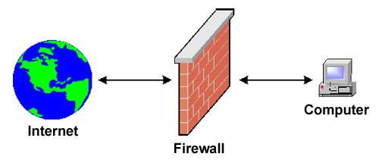
Firewalling Concept
Two main approaches:
Specify what to allow (Whitelisting)
Allow only these IP addresses
Specify what to not allow (Blacklisting)
Allow all except these IP addresses
In this scenario, whitelist is easy and more effective

Slide 20
IPTABLES
Firewall rules that runs with kernel privileges
Firewall sits between your machine and the external world
Rules are evaluated top-down.
The first rule that fits is applied, and the rest rules are ignored
This means that ordering of rules is important

Slide 21
IPTABLES RULES
ALLOW SSH CONNECTIONS
iptables -A INPUT -i eth0 -p tcp --dport 22 -m state --state NEW,ESTABLISHED -j ACCEPT
iptables -A OUTPUT -o eth0 -p tcp --sport 22 -m state --state ESTABLISHED -j ACCEPT
ALLOW SSH CONNECTION FROM A SPECIFIC NETWORK
iptables -A INPUT -i eth0 -p tcp -s 192.168.100.0/24 --dport 22 -m state --state NEW,ESTABLISHED -j ACCEPT
iptables -A OUTPUT -o eth0 -p tcp --sport 22 -m state --state ESTABLISHED -j ACCEPT

Slide 22
Rule ordering is important !
ALLOW only HTTP and SSH
iptables -A INPUT -i eth0 -p tcp --dport 80 -m state --state NEW,ESTABLISHED -j ACCEPT
Iptables –A INPUT –I eth0 –p tcp –j DENY
iptables -A OUTPUT -o eth0 -p tcp --sport 80 -m state --state ESTABLISHED -j ACCEPT
iptables -A INPUT -i eth0 -p tcp --dport 22 -m state --state NEW,ESTABLISHED -j ACCEPT
iptables -A OUTPUT -o eth0 -p tcp --sport 22 -m state --state ESTABLISHED -j ACCEPT

Slide 23


Authentication
Three possible ways to authenticate
Something you know. (e.g. password)
Something you have. (e.g. crypto card)
Something you are. (e.g. physical identifiers, fingerprints)
Single-Factor Authentication: choose one type of the above
Two-Factor Authentication: choose two types above

Slide 24
PORT KNOCKING ADDING ANOTHER LAYER OF SECURITY
Port Knocking is similar to two-factor authentication
Our example case
SSH is the only service we are running
All ports are closed
Requesting a connection (which will be refused as all ports are closed) on a pre-determined sequence of ports within a specified time period will open the port for SSH
The port closes automatically after the allowed window has passed

Slide 25
PORT KNOCKING ADDING ANOTHER LAYER OF SECURITY
For our scenario
Must “Knock” on three ports in sequence within a 10 second period.
Standard SSH port 22 will open for 10 seconds receiving connection attempts before closing automatically
Security through Obscurity ??

Slide 26
PORT KNOCKING SETTING UP PORT KNOCKING
sudo apt-get install knockd
This will install both the knockd daemon, as well as the knock utility
Default configuration is to have one knock sequence to open a port, and another sequence to close the port
Problem: What if you forget to close it?

Slide 27
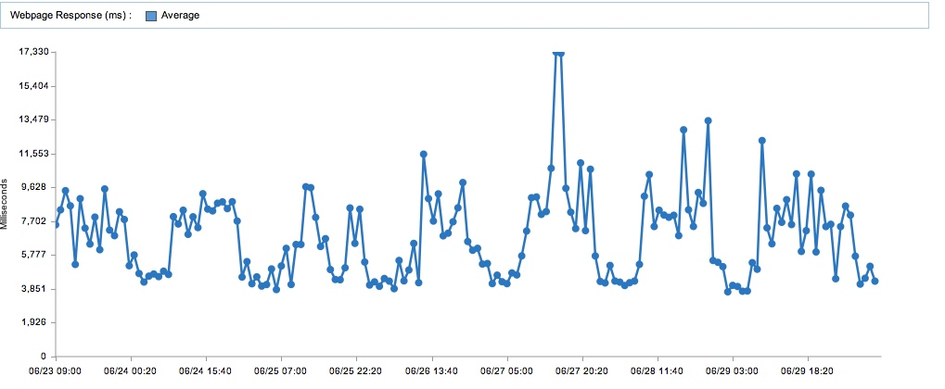
Monitoring and Alerts

Slide 28
Objectives
Increase awareness of important events on the remote system
We will look at
Automated email/SMS alerts
System Logs
Other related topics
Anti-Virus
Host-based IDS

Slide 29
Sending Email Notification SMTP CONFIGURATION
Monitoring for events and logging is good, but only if those logs and events are known
Failed access attempts (SSH in our case)
Unexpected system changes (flagged by IDS, such as tripwire)
Benign events
Task has completed
Message received (ex. IRC)
..

Slide 30
Sending Email Notifications SSMTP CONFIGURATION
Ssmtp can be used to easily send email notifications
For this scenario:
Create a gmail account to use for sending
Configure ssmtp on the system to use that account
Create a script to streamline sending notifications

Slide 31
SYSTEM LOGS TRACKING EVENTS
Some logs related to topics covered
/var/log/auth.log
/var/log/syslog
/var/log/fail2ban.log
/var/log/mail.log
~/portknock.log
Useful tool to determine what has happened on a given system.
Acts as timeline of events, unauthorized access, etc

Slide 32
RECAP
Covered the following
Securing remote access
Root Login, Public-key Login
Restricting unauthorized access
Configure Lockouts after bad access attempts, basic firewall rules, and a means of adding more layers of defense
Setting up notification of system events
Setup email/SMS alerts
Brief Look at system logs
What about a Windows system? Tablets, notebooks, etc
(Discussion)

Slide 33
Recap
Covered the following for a Linux system:
Securing (individual) remote access
Login using on-root account using keyfiles only; no remote root access permitted
Restricting unwanted access
Configure lockouts after bad access attempts, basic firewall rules, and a means of adding more layers of defense
Setting up notification of system events
Setup email/SMS alerts; discussed means of system changes triggering alerts
Brief look at system logs
What about a Windows system? Portable systems (tablets, notebooks, etc)?

