Slide 1





Headless Drupal : Modern Web
Applications with MarionetteJS.
MVC Client Side
Presented by: enzo – Eduardo Garcia
ES: http://7sabores.com/blogs/enzo
EN: http://enzolutions.com/blog
@enzolutions
enzolutions
enzo@anexusit.com
Webinar - July 2014

Slide 2
Agenda
What is MVC?
MVC Client Side is required?
Who use Backbone/Marionette JS.
Demo
Understanding Marionette JS
Resources
Questions and Answers?
Webinar - July 2014

Slide 3
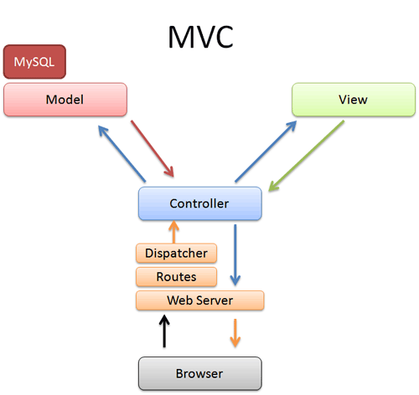

Design Pattern for Software.
Separation between data and presentation with dispatcher.
Implemented by Symfony and other frameworks
1. What is MVC?
Webinar - July 2014
Notes:
Antes del 2005 nadie queria poner que sabia JS en el CV
2006 Lanzamiento de Gmail y Ajax gano popularidad
2010 Salieron Cliente Framework implementando MVC
Enfoque de desarrollo orientado en los datos

Slide 4
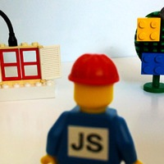
Cascading Javascript (continuos overwriting).
Too many good ideas.
JS Plugins fever.
Spaghetti Code.
Code hunters.
2. MVC Client Side is required?
Webinar - July 2014
Notes:
Statefull vs Stateless

Slide 5
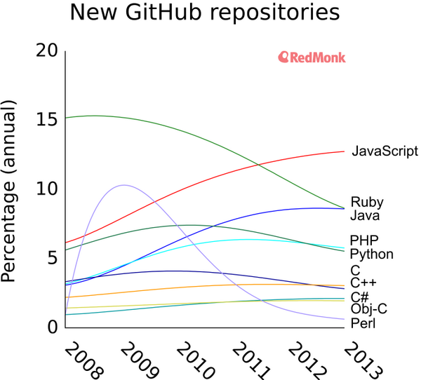
2. MVC Client Side is required?
@ https://twitter.com/dberkholz/status/395668796200849408/photo/1
Webinar - July 2014
Notes:
Statefull vs Stateless

Slide 6

No resources available in Drupal 7, even worst in Drupal 8.
Loosing business for Drupal Universe
New project Drupal 7 or Drupal 8?
2. MVC Client Side is required?
Webinar - July 2014
Notes:
Statefull vs Stateless

Slide 7

Time to Market.
Use more FrontEnd Developers (HTML, CSS, JS, NO Drupal)
Use few strong Drupal Backend Developer (Services).
Fast creation of MVP.
2. MVC Client Side is required?
Webinar - July 2014
Notes:
Statefull vs Stateless

Slide 8










3. Who use Backbone?
Webinar - July 2014

Slide 9









3. Who use Marionette JS.?
Webinar - July 2014

Slide 10

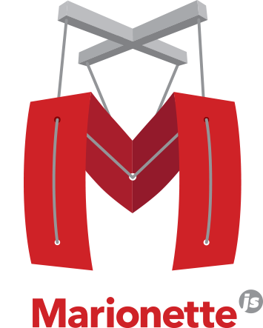
4. Demo
http://enzolutions.com/marionette-waterbed
http://enzolutions.com/marionette-timeline/
Webinar - July 2014

Slide 11
5. Understanding Marionette JS
Use underscore.js (set of basic functions for JS).
Extend backbone.js
Implement template functions with twig.js (View)
Implement data representation ( Model/Collections)
Implement routing and controller.
Webinar - July 2014

Slide 12
5. Understanding Marionette JS
Memory management and zombie-killing.
Application oriented.
Layouts ( Nested views)
Event Manager
Others
Webinar - July 2014

Slide 13
5. Understanding Marionette JS
Skeleton Structure
├── Gruntfile.js
├── bower.json
├── node_modules
├── package.json
└── web (Configurable)
├── 404.html
├── favicon.ico
├── images
├── index.html
├── js
├── scripts (application scripts)
├── models
├── robots.txt
├── scripts
├── styles
├── templates (Configurable)
├── vendor (Configurable)
└── views
Webinar - July 2014

Slide 14

6. Resources
https://groups.drupal.org/headless-drupal
https://github.com/enzolutions/generator-marionette-drupal
https://github.com/enzolutions/marionette-skeleton-app
https://github.com/enzolutions/marionette-cascading-select
https://github.com/enzolutions/marionette-timeline
https://github.com/enzolutions/marionette-waterbed
Webinar - July 2014

Slide 15
6. Resources
http://github.com/enzolutions/drupal-backbone-user-manager
https://github.com/enzolutions/drupal-backbone-node-edit-in-place
http://github.com/jashkenas/underscore/
http://github.com/jashkenas/backbone/
http://github.com/jashkenas/backbone/wiki/Extensions,-Plugins,-Resources
http://backboneconf.com/
http://backplug.io/
Webinar - July 2014

Slide 16
¿Questions and Answers?
ES: http://7sabores.com/blogs/enzo
EN: http://enzolutions.com/blog
@enzolutions
enzolutions
enzo@anexusit.com
Webinar - July 2014

Slide 17
Presented by: enzo – Eduardo Garcia
Webinar - July 2014

