Slide 1





Large scale JS applications
with MarionetteJS + Drupal.
MVC Client Side
Presented by: enzo – Eduardo Garcia
ES: http://7sabores.com/blogs/enzo
EN: http://enzolutions.com/blog
@enzolutions
enzolutions
enzo@anexusit.com
DrupalCon, Austin 2014

Slide 2
Agenda
What is MVC?
MVC Client Side is required?
Who use Backbone/Marionette JS.
Demo
Understanding Marionette JS
Resources
Questions and Answers?
DrupalCon, Austin 2014

Slide 3
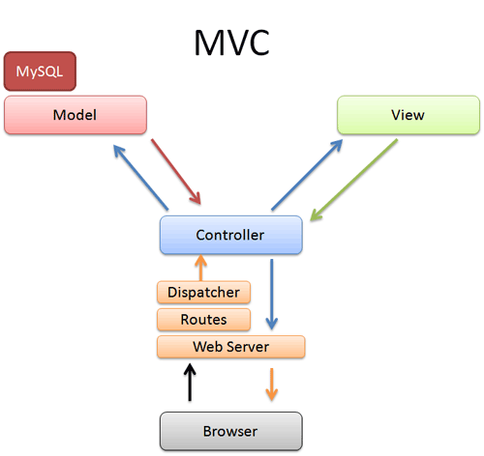

Design Pattern for Software.
Separation between data and presentation with dispatcher.
Implemented by Symfony and other frameworks
1. What is MVC?
DrupalCon, Austin 2014
Notes:
Antes del 2005 nadie queria poner que sabia JS en el CV
2006 Lanzamiento de Gmail y Ajax gano popularidad
2010 Salieron Cliente Framework implementando MVC
Enfoque de desarrollo orientado en los datos

Slide 4
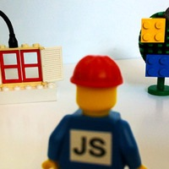
Cascading Javascript (continuos overwriting).
Too many good ideas.
JS Plugins fever.
Spaghetti Code.
Code hunters.
2. MVC Client Side is required?
DrupalCon, Austin 2014
Notes:
Statefull vs Stateless

Slide 5
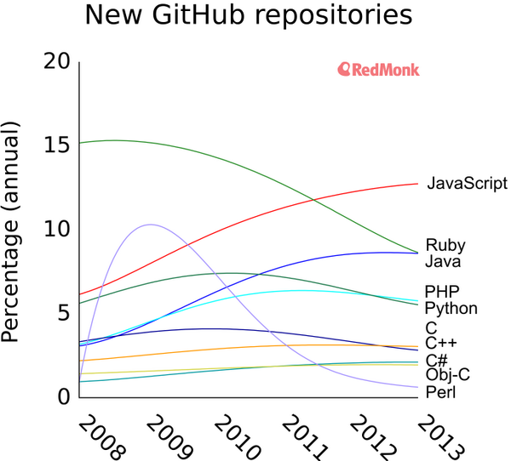
2. MVC Client Side is required?
@ https://twitter.com/dberkholz/status/395668796200849408/photo/1
DrupalCon, Austin 2014
Notes:
Statefull vs Stateless

Slide 6

No resources available in Drupal 7, even worst in Drupal 8.
Loosing business for Drupal Universe
New project Drupal 7 or Drupal 8?
2. MVC Client Side is required?
DrupalCon, Austin 2014
Notes:
Statefull vs Stateless

Slide 7

Time to Market.
Use more FrontEnd Developers (HTML, CSS, JS, NO Drupal)
Use few strong Drupal Backend Developer (Services).
Fast creation of MVP.
2. MVC Client Side is required?
DrupalCon, Austin 2014
Notes:
Statefull vs Stateless

Slide 8










3. Who use Backbone?
DrupalCon, Austin 2014

Slide 9








3. Who use Marionette JS.?
DrupalCon, Austin 2014

Slide 10

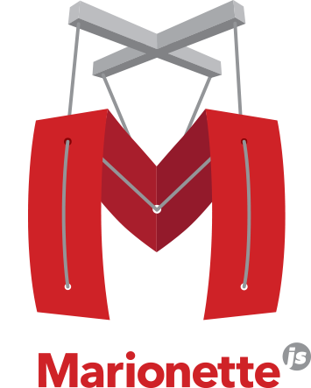
4. Demo
http://enzolutions.com/marionette-waterbed
http://enzolutions.com/marionette-timeline/
DrupalCon, Austin 2014

Slide 11
5. Understanding Marionette JS
Use underscore.js (set of basic functions for JS).
Extend backbone.js
Implement template functions with twig.js (View)
Implement data representation ( Model/Collections)
Implement routing and controller.
DrupalCon, Austin 2014

Slide 12
5. Understanding Marionette JS
Memory management and zombie-killing.
Application oriented.
Layouts ( Nested views)
Event Manager
Others
DrupalCon, Austin 2014

Slide 13
5. Understanding Marionette JS
Skeleton Structure
├── collections
├── css
├── images
├── index.html
├── js
│ └── main.js
├── layouts
├── models
├── modules
├── templates
├── vendor
└── views
DrupalCon, Austin 2014

Slide 14

6. Resources
https://github.com/enzolutions/marionette-skeleton-app
https://github.com/enzolutions/marionette-cascading-select
https://github.com/enzolutions/marionette-timeline
https://github.com/enzolutions/marionette-waterbed
http://github.com/enzolutions/drupal-backbone-user-manager
DrupalCon, Austin 2014

Slide 15
6. Resources
https://github.com/enzolutions/drupal-backbone-node-edit-in-place
http://github.com/jashkenas/underscore/
http://github.com/jashkenas/backbone/
http://github.com/jashkenas/backbone/wiki/Extensions,-Plugins,-Resources
http://backboneconf.com/
http://backplug.io/
DrupalCon, Austin 2014

Slide 16
¿Questions and Answers?
ES: http://7sabores.com/blogs/enzo
EN: http://enzolutions.com/blog
@enzolutions
enzolutions
enzo@anexusit.com
DrupalCon, Austin 2014

Slide 17
Presented por: enzo – Eduardo Garcia
DrupalCon, Austin 2014

