Slide 1





Large scale JS applications
with MarionetteJS + Drupal.
MVC Client Side
Presented by: enzo – Eduardo Garcia
ES: http://7sabores.com/blogs/enzo
EN: http://enzolutions.com/blog
@enzolutions
enzolutions
enzo@anexusit.com
Barcamp 2014 , ULATINA Mayo 2014

Slide 2
Agenda
What is MVC?
MVC Client Side is required?
Understanding Marionette JS
Who use Backbone/Marionette JS.
Demo
Resources
Questions and Answers?
Barcamp 2014 , ULATINA Mayo 2014

Slide 3
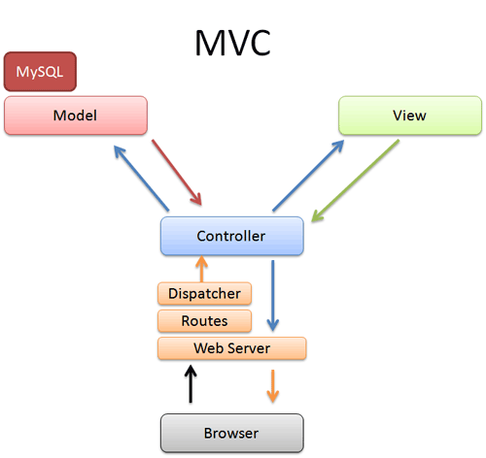

Design Pattern for Software.
Separation between data and presentation with dispatcher.
Implemented by Symfony and other frameworks
1. What is MVC?
Barcamp 2014 , ULATINA Mayo 2014
Notes:
Antes del 2005 nadie queria poner que sabia JS en el CV
2006 Lanzamiento de Gmail y Ajax gano popularidad
2010 Salieron Cliente Framework implementando MVC
Enfoque de desarrollo orientado en los datos

Slide 4
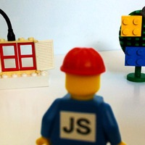
Spaghetti Code.
Cascading Javascript (continuos overwriting).
Too many good ideas.
Code hunters.
JS Plugins fever.
2. MVC Client Side is required?
Barcamp 2014 , ULATINA Mayo 2014
Notes:
Statefull vs Stateless

Slide 5
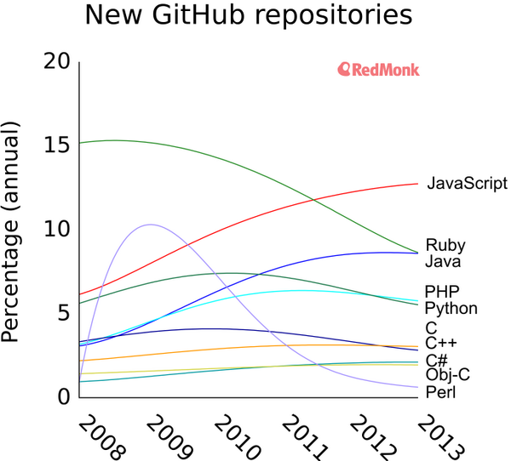
2. MVC Client Side is required?
@ https://twitter.com/dberkholz/status/395668796200849408/photo/1
Barcamp 2014 , ULATINA Mayo 2014
Notes:
Statefull vs Stateless

Slide 6
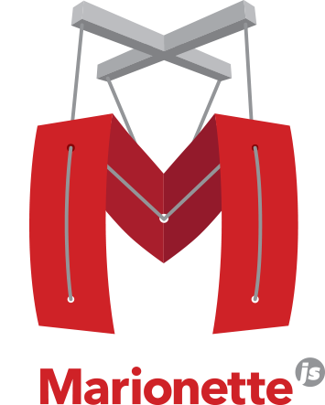
3. Understanding Marionette JS
Use underscore.js (set of basic functions for JS).
Extend backbone.js
Implement template functions with twig.js (View)
Implement data representation ( Model/Collections)
Implement routing and controller.
Barcamp 2014 , ULATINA Mayo 2014

Slide 7
3. Understanding Marionette JS
Memory management and zombie-killing.
Application concept.
Layouts ( Nested views)
Event Manager
Others
Barcamp 2014 , ULATINA Mayo 2014

Slide 8










4. Who use Backbone/Marionette JS.?
Barcamp 2014 , ULATINA Mayo 2014

Slide 9

5. Demo
http://enzolutions.com/marionette-waterbed
Barcamp 2014 , ULATINA Mayo 2014

Slide 10

6. Resources
https://github.com/enzolutions/marionette-skeleton-app
https://github.com/enzolutions/marionette-cascading-select
https://github.com/enzolutions/marionette-timeline
https://github.com/enzolutions/marionette-waterbed
http://github.com/enzolutions/drupal-backbone-user-manager
Barcamp 2014 , ULATINA Mayo 2014

Slide 11
6. Resources
https://github.com/enzolutions/drupal-backbone-node-edit-in-place
http://github.com/jashkenas/underscore/
http://github.com/jashkenas/backbone/
http://github.com/jashkenas/backbone/wiki/Extensions,-Plugins,-Resources
http://backboneconf.com/
http://backplug.io/
Barcamp 2014 , ULATINA Mayo 2014

Slide 12
¿Questions and Answers?
ES: http://7sabores.com/blogs/enzo
EN: http://enzolutions.com/blog
@enzolutions
enzolutions
enzo@anexusit.com
Barcamp 2014 , ULATINA Mayo 2014

Slide 13
Presented por: enzo – Eduardo Garcia
Barcamp 2014 , ULATINA Mayo 2014

