Slide 1

Fuel Cost Analysis
Kristin Flores
Gerald Watts
Shayet Makoshi

Slide 2
Question and Analysis
We wanted to know how fuel cost has changed over the years as cars have become more fuel efficient, but gasoline prices continue to rise. Our hypothesis about the data are:
Average fuel cost has decreased in recent years due to increased in vehicles. In this case specifically we will be looking at miles per gallon (mpg).
Standard class vehicles are more fuel efficient than performance class vehicles.
Manual transmission vehicles are more fuel efficient than automatic transmission vehicles.
The specific wheel drives of front wheel, rear wheel, and all wheel drive have similar fuel efficiency and do not seem to show a signifiable difference in fuel consumption.
Midgrade gasoline is not a significant factor in average fuel cost and does not have a noticeable affect on overall fuel cost of vehicle.

Slide 3
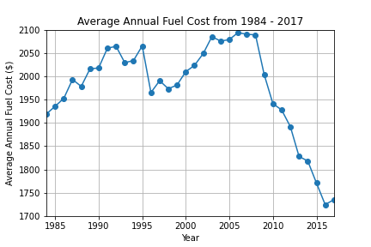
Average Annual Fuel Cost (All Vehicles)
We looked at annual fuel prices from 1984-2017. Based on the annual process that were used in comparison, it was found that

Slide 4
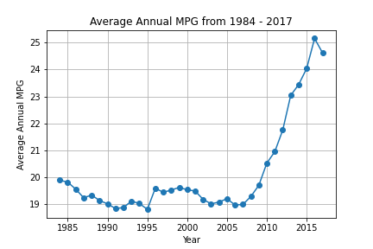
Average Annual Miles Per Gallon (All Vehicles)
The average miles per gallon (mpg) for the year was calculated from 1984-2017. There is a steady line from 19 to 20 mpg all the way until 2010 where mpg begins to break the 20 mpg threshold and goes as high as 25 mpg. This shows that vehicles were becoming more fuel efficient due to technological advances as well as a response to rising fuel costs.

Slide 5
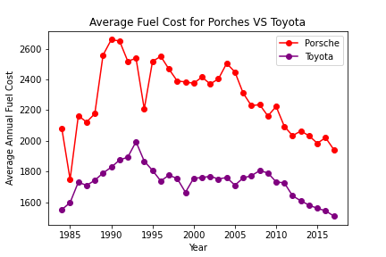
Average Annual Fuel Cost (Toyota, Porsche)
Data was pulled from 2 different class vehicles in order to see if there was any consistency in fuel costs.

Slide 6
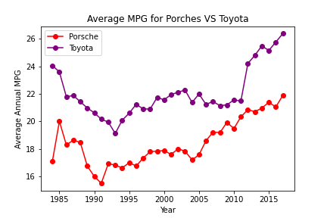
Average Annual MPG (Toyota, Porsche)
The mpg was also calculated between the 2 vehicle classes to see if there was any differences between performance and standard class vehicles.

Slide 7
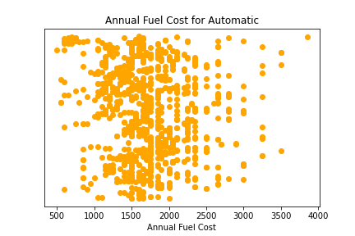
Annual Fuel Cost (Automatic)
This is the annual fuel cost found in automatic transmission vehicles. There were a few outliers, but most of the data is right before $2500.

Slide 8
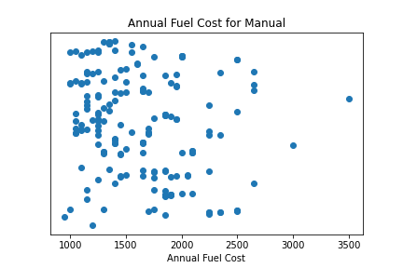
Annual Fuel Cost (Manual)
The data for manual transmission vehicles is not as frequent, possibly due to the decline of manual transmission vehicles in the market.
The average fuel cost is $

Slide 9
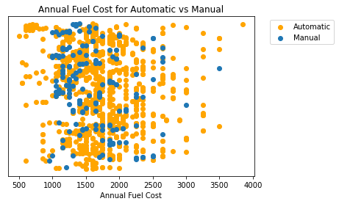
Annual Fuel Cost (Automatic vs Manual)

Slide 10
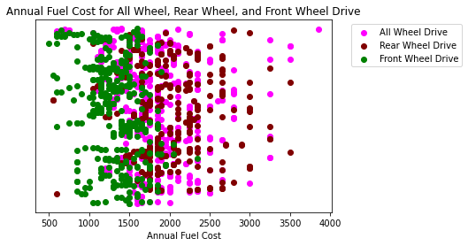
Annual Fuel Cost (Front Wheel, All Wheel, Rear Wheel)

Slide 11
Annual Fuel Cost Wheel Drive (Combined)

Slide 12
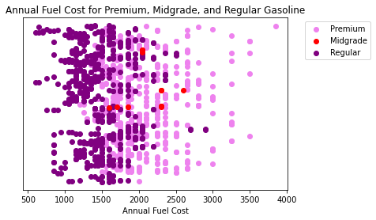
Annual Fuel Cost (Regular, Midgrade, Premium)

Slide 13
Final Analysis

Slide 14
Question and Analysis

Slide 15
Questions?

