Slide 1

Fuel Cost Analysis
Kristin Flores
Gerald Watts
Shayet Makoshi

Slide 2
Data Review
The analysis began with trying to determine the relevance of midgrade fuel.
A fuel economy dataset from the EPA led us to additional factors which could affect fuel cost.
Fuel economy dataset from EPA: https://www.kaggle.com/epa/fuel-economy

Slide 3
Questions
Average fuel cost has decreased in recent years due to increased efficiency in vehicles. In this case we will be looking at miles per gallon (mpg).
Standard class vehicles are more fuel efficient than performance class vehicles.
Manual transmission vehicles are more fuel efficient than automatic transmission vehicles.
The specific wheel drives of front wheel, rear wheel, and all wheel drive have similar fuel efficiency.
Midgrade gasoline is not a significant factor in average fuel cost and does not have a noticeable effect on overall fuel cost of vehicle.

Slide 4
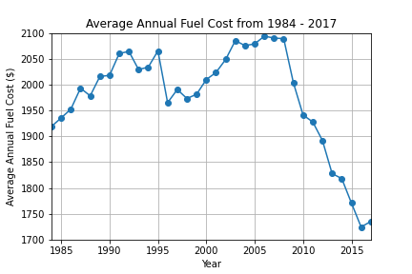
Average Annual Fuel Cost (All Vehicles)
We looked at annual fuel prices from 1984-2017. Based on the annual process that were used in comparison, it was found that fuel prices were steadily rising and falling between $1900 and $2100 until 2010 when it began trending down to below $1750.

Slide 5
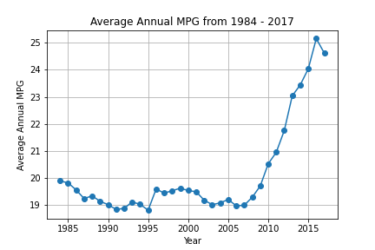
Average Annual Miles Per Gallon (All Vehicles)
The average miles per gallon (mpg) for the year was calculated from 1984-2017. There is a steady line from 19 to 20 mpg all the way until 2010 where mpg begins to break the 20 mpg threshold and goes as high as 25 mpg. This shows that vehicles were becoming more fuel efficient due to technological advances as well as a response to rising fuel costs.

Slide 6
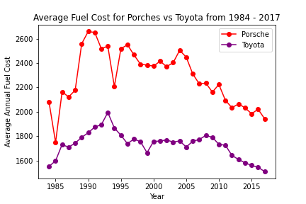
Average Annual Fuel Cost (Toyota, Porsche)
Data was pulled from 2 different class vehicles in order to see if there was any consistency in fuel costs, which were Porsche and Toyota.

Slide 7
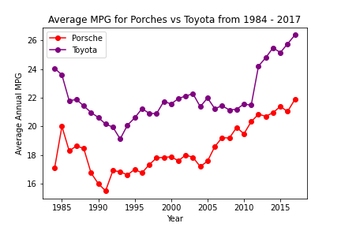
Average Annual MPG (Toyota, Porsche)
The MPG was also calculated between the 2 vehicle classes to see if there was any differences between performance and standard class vehicles. MPG started to trend downwards in the 1990’s and then rose up after 2010.

Slide 8
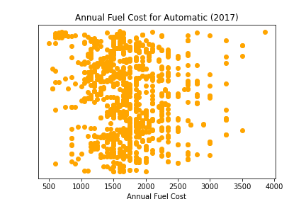
Annual Fuel Cost (Automatic)
This is the annual fuel cost found in automatic transmission vehicles. There were a few outliers, but the majority of the data is showing that most of the prices sit before $2500.
The average fuel cost for is $1753.01.

Slide 9
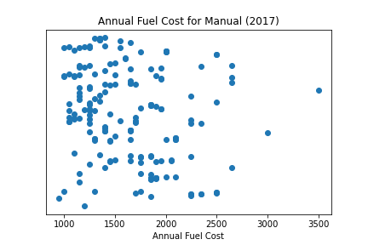
Annual Fuel Cost (Manual)
The data for manual transmission vehicles is not as frequent, possibly due to the decline of manual transmission vehicles in the market.
The average fuel cost is $1634.97.

Slide 10
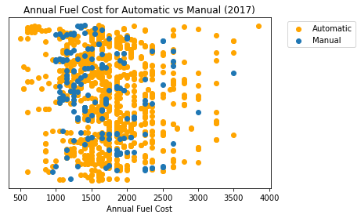
Annual Fuel Cost (Automatic vs Manual)
Based on the analysis of both transmissions, manual transmission has a slight edge in lower costs than automatic transmission.

Slide 11
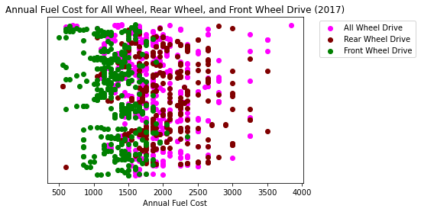
Annual Fuel Cost (Front Wheel, All Wheel, Rear Wheel)
The analysis of front-wheel, rear-wheel, and all-wheel drive were analyzed for yearly fuel costs.
Based on the data, front-wheel drive exhibited lower annual fuel costs compared to the other options.

Slide 12
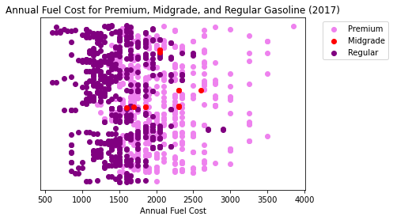
Annual Fuel Cost (Regular, Midgrade, Premium)
Fuel type was analyzed to see if there were any trends in the different types of gasoline.
The data suggests that the regular and premium gasoline costs are quite similar.

Slide 13
Final Analysis
Miles per gallon has played a role in decreasing fuel costs each year. Manufacturers are really focusing on raising the mileage to push back on the rising gasoline prices.
Standard class vehicles do show signed of stronger fuel efficiency than performance class vehicles. The Toyota’s miles per gallon were consistently higher each year than Porsche’s.
Manual transmission vehicles were typically on par and on occasion lower costing than automatic transmission vehicles. The volume of automatic transmission vehicles vastly outnumber the manual transmission vehicles.
Front-wheel, rear-wheel, and all-wheel vehicles did show similar fuel costs in 2017 with front-wheel showing the trend of lower costs than the other 2 options.
Midgrade gasoline did not show a lot of data in 2017, but also didn’t show any type of trend that would lead to a conclusion that it was more cost-effective than the other 2 options. Regular gasoline typically had lower fuel costs, but premium gasoline also showed all their vehicles were not high in price.

Slide 14
Questions?

