Slide 1

Hadronic Top Quark Mass Reconstruction
Using CMS OpenData & NanoAOD Framework
Geraldine Lomeli Ponce
May 22, 2026

Slide 2


The Top Quark Decay Topology
Single Lepton Channel
We analyze the $t\bar{t}$ pair production where one top decays hadronically:
Mass Reconstruction Target:
▪
Top Quark: Decays nearly 100% to a $W$ boson and a $b$ quark.
▪
W Boson: Decays to two light quarks ($u, d, s, c$).
▪
The Signal: 1 Isolated Muon + Neutrino + 4 Jets (at least one being a b-jet).

Slide 3
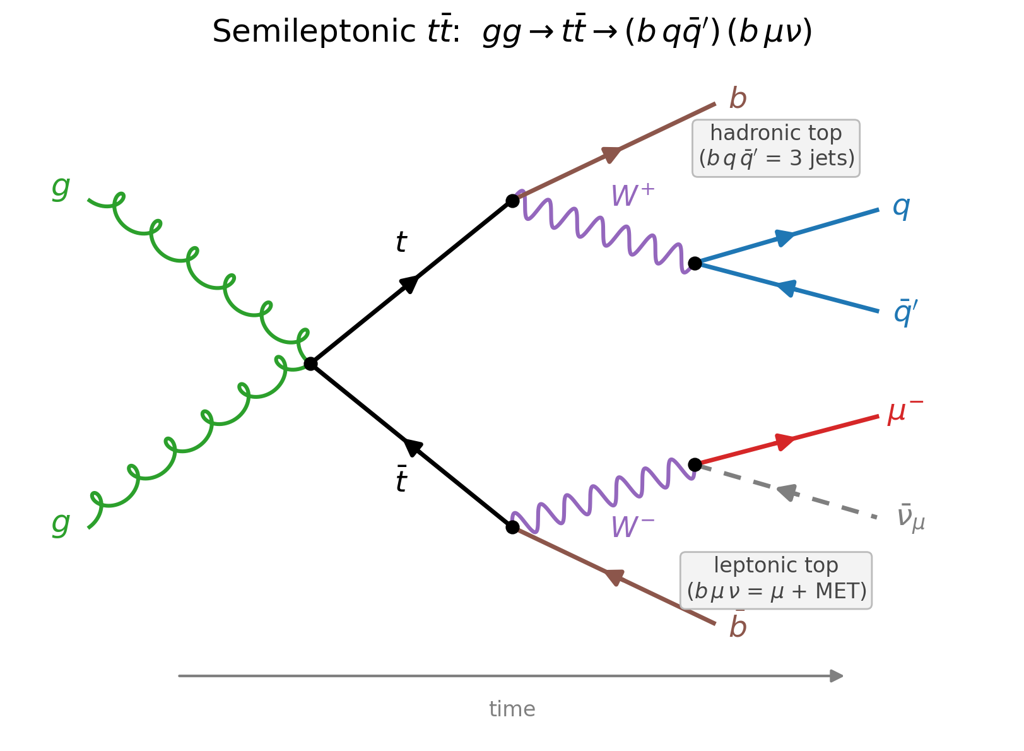
The Semileptonic tt̅ Topology
Two gluons fuse to a top–antitop pair; each top decays t → b W.
• Hadronic top: W → q q̄′ → the three jets we fit as m(bjj).
• Leptonic top: W → μ ν → the isolated muon + missing energy (MET).
• Why one muon: it tags and triggers the event; the hadronic side gives the mass.

Slide 4
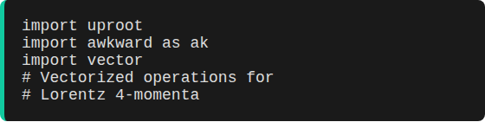
Dataset & Computational Tools
Source: CMS OpenData
The Data Science Stack
▪
Format: NanoAOD (Lightweight ROOT files).
▪
File: 0107961B-4308-F845-8F96-E14622BBA484.root
▪
Size: 1.8 GB / ~2.38 M events (1 of 82 files; full sample 130.4 GiB)
We use Awkward Arrays to handle the ragged data structure of particle collisions efficiently in Python.
▪
Era: Run2016H-UL2016 (13 TeV).
▪
Dataset: /SingleMuon/Run2016H-UL2016_MiniAODv2_NanoAODv9-v1/NANOAOD
▪
Open Data: record 30563 · DOI 10.7483/OPENDATA.CMS.4BUS.64MV

Slide 5
Selecting Candidate Events
To reduce background from QCD and W+jets, we apply strict physics constraints:
Object | Selection Criteria | Physics Goal
Muon | $p_T > 25$ GeV, $| \eta | < 2.4$, Tight ID | Clean Leptonic Trigger
Jets | $p_T > 30$ GeV, Count $\ge 4$ | Capture Hadronic Decay
B-Tagging | DeepCSV Score $> 0.6321$ | Identify Top's heavy bottom-quark
Efficiency: 78,652 events pass the initial $t\bar{t}$ topology mask.

Slide 6
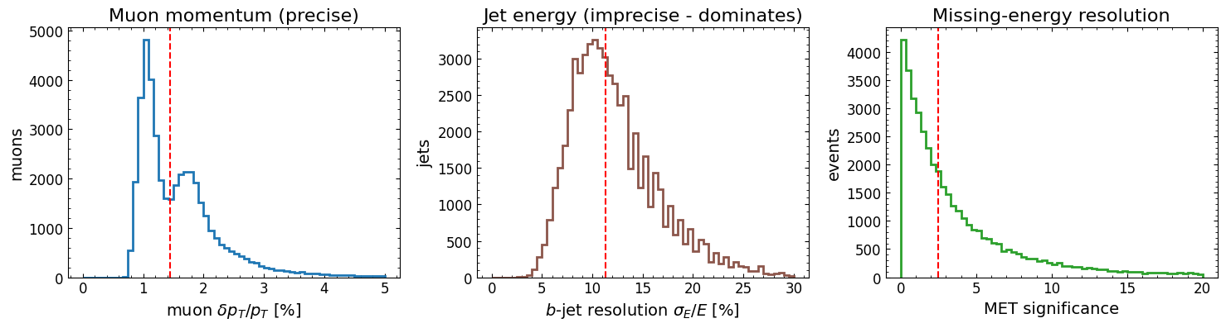
Uncertainty on Each Measured Quantity
A reconstructed mass is only as good as the four-vectors that build it.
• Muon pT: stored per muon (Muon_ptErr) — tiny, median ~1.4%.
• MET: stored per event (MET_significance, MET_covXX/XY/YY).
• Jet energy SCALE: NOT per-object — an external JES systematic (~2–3%).
• Jet energy RESOLUTION: per jet (Jet_bRegRes) — ~11% for b-jets, ~8× the muon.
• Consequence: the 3-jet top width is jet-dominated; uncorrected jets read low → mass low.

Slide 7
Backgrounds, and How Each Cut Suppresses Them
No MC is available to subtract; we suppress backgrounds with the selection.
• QCD multijet: fake isolated muon from heavy-flavour decay → killed by tight muon, pT>25.
• W+jets: real μν + jets → suppressed by requiring ≥4 jets AND a b-tag.
• Z+jets (Drell–Yan): two muons → removed by the exactly-one-muon veto.
• Single top: real top + b, nearly identical signature → partly reduced by ≥4 jets.
• Dileptonic tt̅: two leptons, only 2 b-jets → one-muon veto + ≥4 jets.
• Survivors: a smooth background (physics + combinatorial) absorbed by the polynomial fit.

Slide 8
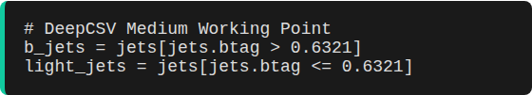
Solving the Combinatorics
Jet Assignments
In a 4-jet event, how do we know which jet is which?
▪
We utilize DeepCSV b-tagging to separate "heavy" jets (from Top) from "light" jets (from W).
▪
We split the filtered jets into two groups: b_jets and light_jets.
▪
Requirement: At least 1 b-jet and 2 light jets per event.

Slide 9
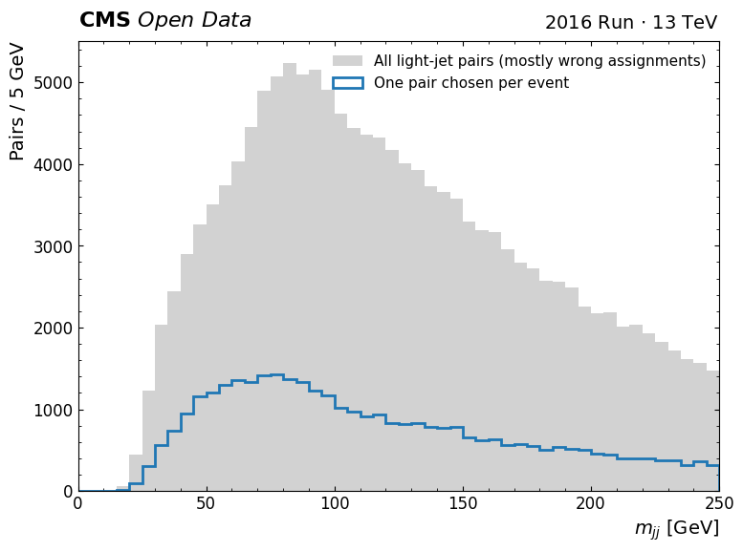
The Combinatorial Background
Only one jet-to-parton assignment is correct — the rest pile up as background.
• No truth: GenPart is absent in this real-data file, so we can't pick the right pairing.
• Grey: every light-jet pair (mostly wrong assignments).
• Blue: the single pair we keep per event — this is what makes a peak appear.
• Honest scope: a signal/combinatorial fraction needs MC truth (absent), so we keep it qualitative.

Slide 10

Reconstructing the W-Boson
The W-boson is the intermediate step. We iterate through all possible light jet pairs:
Algorithm: argmin($| m_{j_1 j_2} - 80.4 $ GeV $|$)
We pick the pair of light jets whose invariant mass is closest to the physical W boson mass.
This significantly reduces combinatorial noise before calculating the final top mass.

Slide 11
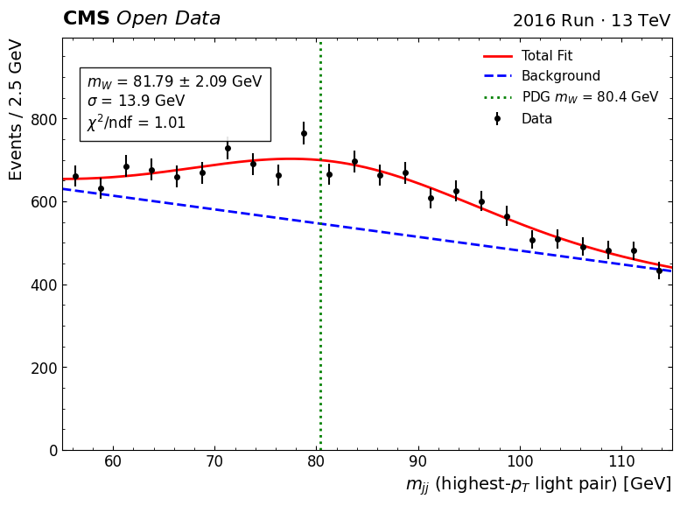
A Genuine, Unbiased W Mass
The top's argmin|mjj−80.4| is circular — it cannot measure mW.
• Unbiased pick: the highest combined-pT light-jet pair (kinematic, blind to the mass).
• Fit: mW = 81.8 ± 2.1 GeV (stat), σ = 13.9 GeV, χ²/ndf = 1.01.
• Consistent with PDG (80.4 GeV) within the large jet-resolution width (0.7σ).
• Implication: the LIGHT-jet scale is ~right → the top deficit must live in the b-jet.

Slide 12
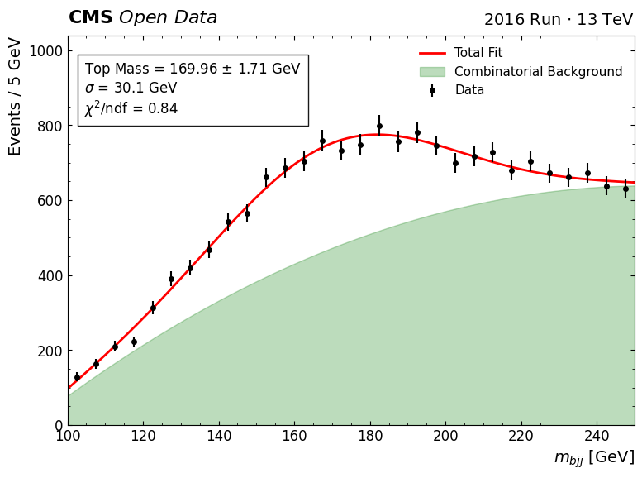
Top Mass: Initial Reconstruction
Observation
The first attempt combines the W-candidate with the leading b-jet.
▪
Calculated Mass: 169.96 GeV.
▪
Issue: High combinatorial background (shaded area).
▪
Constraint: The model includes a quadratic background fit + Gaussian signal.

Slide 13

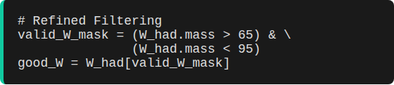
Refining with W-Mass Constraint
Signal Cleaning
To produce a higher-purity sample, we apply a "W-Mass Window" cut:
$65 < M_W < 95$ GeV
This ensures we only reconstruct tops from events where the algorithm successfully found a realistic W-boson.

Slide 14
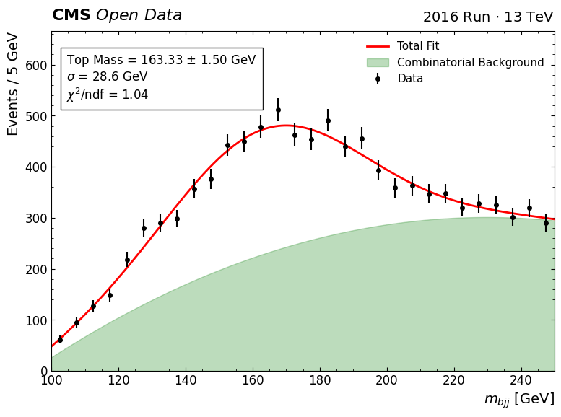
Final Reconstruction Value
Improved Signal Fit
▪
Calculated Mass: 163.33 GeV.
▪
Uncertainty: ± 1.50 GeV (Stat).
▪
Result: Applying the W-constraint shifted the peak towards the left but sharpened the Gaussian signal.

Slide 15
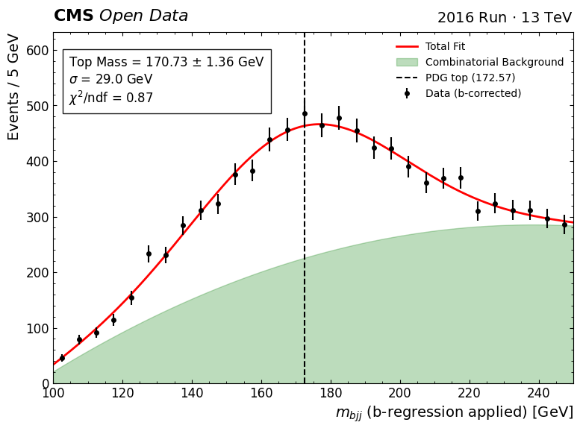
Pinning Down the Deficit: the b-Jet Energy Scale
The W is ~right but the top is 9 GeV low — so the b-jet is under-measured.
• Why: b-jets lose energy to semileptonic neutrinos — median Jet_bRegCorr = 1.08 (~8% low).
• Test: apply the per-jet b-regression to the b-jet and refit — no MC truth needed.
• Result: top 163.3 → 170.7 ± 1.4 GeV (χ²/ndf = 0.87), within ~2 GeV of the PDG.
• Conclusion: the deficit is a JET ENERGY SCALE effect, concentrated in the b-jet.

Slide 16
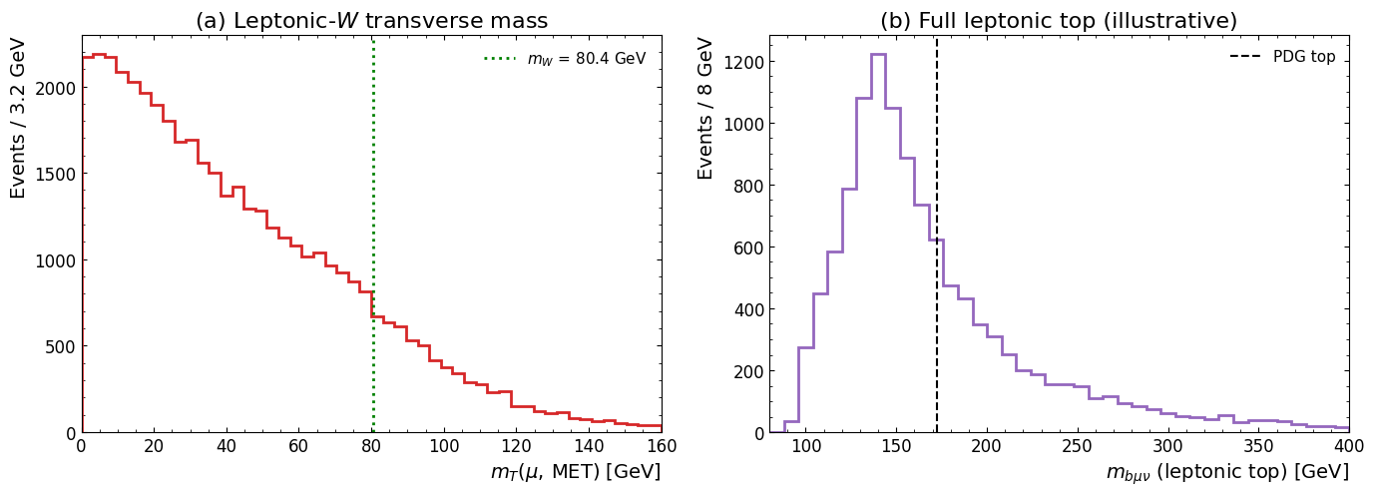
The Leptonic Side: Missing Energy (MET)
The neutrino escapes as MET — the hadronic mass formula stays correct.
• Transverse mass: mT = √(2 pT^μ E_T^miss (1−cosΔφ)) — Jacobian edge near mW (left).
• Neutrino p_z: from the W-mass quadratic; a real solution exists in 85% of events.
• Full leptonic top (μ ν b) reconstructed as an illustrative cross-check (right).
• Key point: only the leptonic side misses a four-vector — the formula is not wrong.

Slide 17

Discussion & Physics Analysis
Why the discrepancy?
▪
Jet Energy Corrections (JEC): Not applied in this simple NanoAOD script. Energy is underestimated.
Experimental vs. Theoretical
▪
My Result: 163.33 ± 1.50 GeV
▪
Background Contamination: W+jets and single-top production still present.
▪
PDG Value: 172.57 ± 0.29 GeV
▪
Missing Neutrino: Missing transverse energy (MET) not accounted for in this hadronic-only calculation.

Slide 18
Systematic Uncertainties — JES is the Headline
The ± quoted is statistical only (~1–2 GeV); systematics dominate.
• Jet Energy Scale (JES): the headline — demonstrated: b-regression recovers +7 GeV → 170.7 GeV.
• Jet resolution (JER): ~11%/b-jet → sets the σ≈29 GeV peak width (top Γ is only 1.4 GeV).
• Combinatorics & W-window bias: wrong pairings + the 65–95 GeV cut (170→163 GeV) — method systematics.
• b-tag eff./mis-tag and residual single-top / W+jets absorbed in the fit (no MC subtraction).
• Bottom line: added in quadrature these dwarf the stat error — a scale fix, not an MC truth-match.

Slide 19
Conclusions
▪
Successfully implemented an event filtering pipeline using Awkward Arrays and Vector.
▪
Applied ML-based b-tagging scores to solve the hadronic jet assignment problem.
▪
Determined that a W-boson mass constraint significantly improves the Gaussian fit for the top quark signal.
▪
Future work would involve 4-momentum corrections (JEC) and cross-validation with the Monte Carlo simulation files.

Slide 20

Thank you for your attention
Geraldine Lomeli Ponce

