Slide 1
B
Table Descriptions and Data

Slide 2
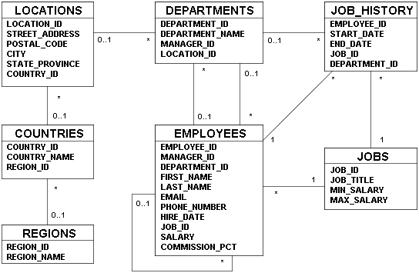
Human Resources (HR) Data Set
JOB_GRADES
GRADE_LEVEL
LOWEST_SAL
HIGHEST_SAL

Slide 3
Human Resources (HR) Data Set
  The Human Resources (HR) schema is part of the Oracle Common Schema that can be installed in an Oracle database. The practices in this course use the data from the HR schema.
  Table Descriptions
  REGIONS contains rows representing a region (such as Americas, Asia, and so on).
  COUNTRIES contains rows for countries, each of which are associated with a region.
  LOCATIONS contains the addresses of specific offices, warehouses, and/or production sites of a company in a particular country.
  DEPARTMENTS shows details of the departments in which employees work. Each department can have a relationship representing the department manager in the EMPLOYEES table.
  EMPLOYEES contains details about each employee who works for a department. Some employees may not be assigned to any department.
  JOBS contains the job types that can be held by each employee.
  JOB_HISTORY contains the job history of the employees. If an employee changes departments within the job or changes jobs within the department, a new row is inserted in this table with the old job information of the employee.
  JOB_GRADES identifies a salary range per job grade. The salary ranges do not overlap.

Slide 4

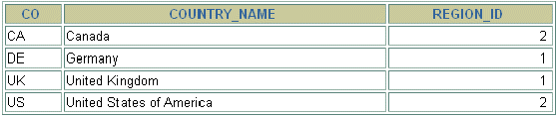
COUNTRIES Table
  DESCRIBE countries
  SELECT * FROM countries;

Slide 5
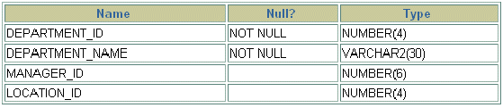
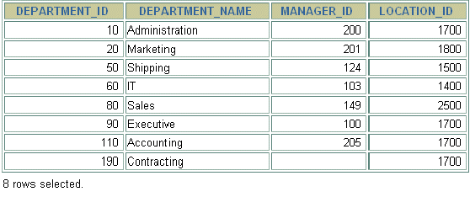
DEPARTMENTS Table
  DESCRIBE departments
  SELECT * FROM departments;

Slide 6
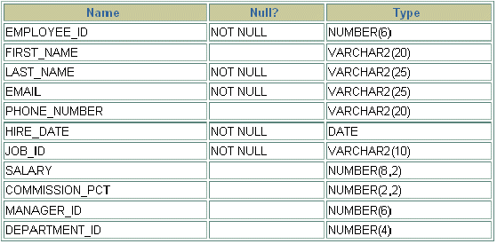
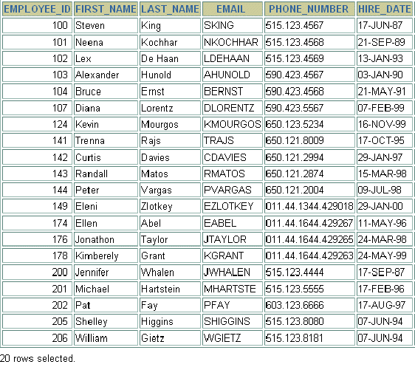
EMPLOYEES Table
  DESCRIBE employees
  SELECT * FROM employees;

Slide 7
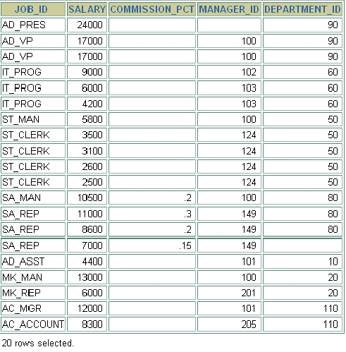
EMPLOYEES Table (continued)

Slide 8
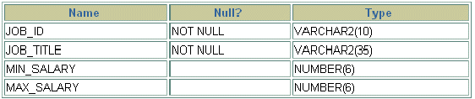
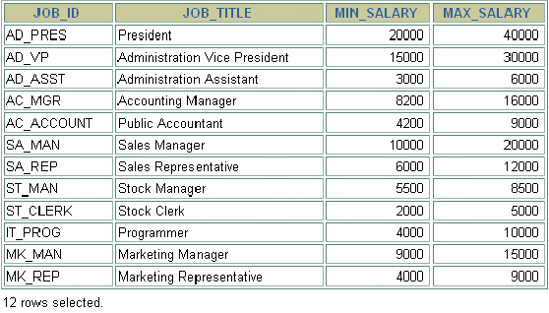
JOBS Table
  DESCRIBE jobs
  SELECT * FROM jobs;

Slide 9

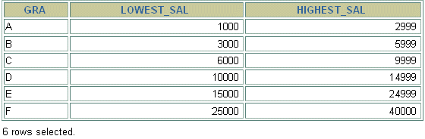
JOB_GRADES Table
  DESCRIBE job_grades
  SELECT * FROM job_grades;

Slide 10
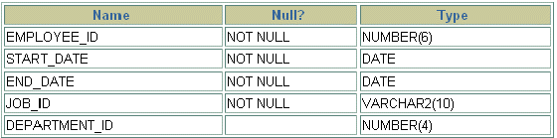
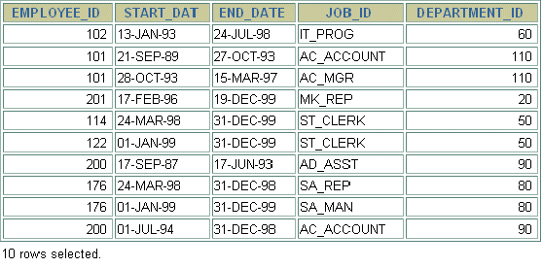
JOB_HISTORY Table
  DESCRIBE job_history
  SELECT * FROM job_history;

Slide 11
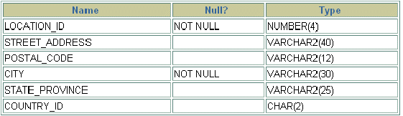
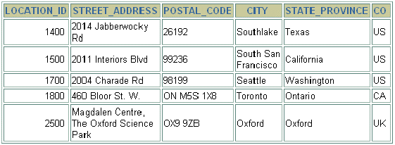
LOCATIONS Table
  DESCRIBE locations
  SELECT * FROM locations;

Slide 12

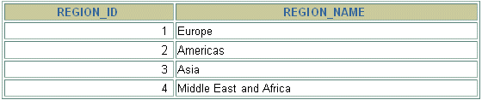
REGIONS Table
  DESCRIBE regions
  SELECT * FROM regions;

