Slide 1
Using SQL*Plus

Slide 2
Objectives
After completing this appendix, you should be able to do the following:
  Log in to SQL*Plus
  Edit SQL commands
  Format output using SQL*Plus commands
  Interact with script files
Notes:
Oracle Database 10g: SQL Fundamentals I D - <number>
Objectives
You might want to create SELECT statements that can be used again and again. This appendix also covers the use of SQL*Plus commands to execute SQL statements. You learn how to format output using SQL*Plus commands, edit SQL commands, and save scripts in SQL*Plus.

Slide 3


SQL and SQL*Plus Interaction
SQL statements
Server
SQL*Plus
Query results
Buffer
SQL
scripts
Notes:
Oracle Database 10g: SQL Fundamentals I D - <number>
SQL and SQL*Plus
SQL is a command language for communication with the Oracle9i Server from any tool or application. Oracle SQL contains many extensions. When you enter a SQL statement, it is stored in a part of memory called the SQL buffer and remains there until you enter a new SQL statement. SQL*Plus is an Oracle tool that recognizes and submits SQL statements to the Oracle9i Server for execution. It contains its own command language.
Features of SQL
Can be used by a range of users, including those with little or no programming
experience
Is a nonprocedural language
Reduces the amount of time required for creating and maintaining systems
Is an English-like language
Features of SQL*Plus
Accepts ad hoc entry of statements
Accepts SQL input from files
Provides a line editor for modifying SQL statements
Controls environmental settings
Formats query results into basic reports
Accesses local and remote databases

Slide 4


SQL Statements Versus
SQL*Plus Commands
SQL
  A language
  ANSI-standard
  Keywords cannot be abbreviated
  Statements manipulate data and table definitions in the database
SQL*Plus
  An environment
  Oracle-proprietary
  Keywords can be abbreviated
  Commands do not allow manipulation of values in the database
SQL
statements
SQL
buffer
SQL*Plus
commands
SQL*Plus
buffer
Notes:
Oracle Database 10g: SQL Fundamentals I D - <number>
SQL and SQL*Plus (continued)
The following table compares SQL and SQL*Plus:

Slide 5
Overview of SQL*Plus
  Log in to SQL*Plus
  Describe the table structure
  Edit your SQL statement
  Execute SQL from SQL*Plus
  Save SQL statements to files and append SQL statements to files
  Execute saved files
  Load commands from file to buffer to edit
Notes:
Oracle Database 10g: SQL Fundamentals I D - <number>
SQL*Plus
SQL*Plus is an environment in which you can do the following:
Execute SQL statements to retrieve, modify, add, and remove data from the database
Format, perform calculations on, store, and print query results in the form of reports
Create script files to store SQL statements for repeated use in the future
SQL*Plus commands can be divided into the following main categories:

Slide 6
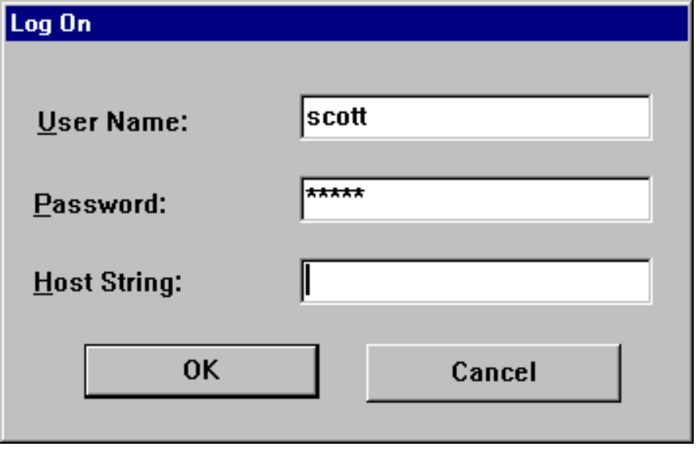
Logging In to SQL*Plus
  From a Windows environment:
  From a command line:
  sqlplus [username[/password
  [@database]]]
Notes:
Oracle Database 10g: SQL Fundamentals I D - <number>
Logging In to SQL*Plus
How you invoke SQL*Plus depends on which type of operating system or Windows environment you are running.
To log in from a Windows environment:
1. Select Start > Programs > Oracle > Application Development > SQL*Plus.
2. Enter the username, password, and database name.
To log in from a command-line environment:
1. Log on to your machine.
2. Enter the SQL*Plus command shown in the slide.
In the syntax:
username Your database username
password Your database password (Your password is visible if you enter it here.)
@database The database connect string
Note: To ensure the integrity of your password, do not enter it at the operating system prompt. Instead, enter only your username. Enter your password at the password prompt.
After you log in to SQL*Plus, you see the following message (if you are using SQL*Plus version 10.2.0.1.0):
SQL*Plus: Release 10.2.0.1.0 - Production on Fri May 19 12:12:26 2006
Copyright (c) 1982, 2005, Oracle. All rights reserved.

Slide 7
Displaying Table Structure
Use the SQL*Plus DESCRIBE command to display the structure of a table:
DESC[RIBE] tablename
Notes:
Oracle Database 10g: SQL Fundamentals I D - <number>
Displaying Table Structure
In SQL*Plus, you can display the structure of a table using the DESCRIBE command. The result of the command is a display of column names and data types as well as an indication if a column must contain data.
In the syntax:
tablename The name of any existing table, view, or synonym that is accessible to
the user
To describe the JOB_GRADES table, use this command:
SQL> DESCRIBE job_grades
Name Null? Type
---------------------------------- -------- -----------
GRADE_LEVEL VARCHAR2(3)
LOWEST_SAL NUMBER
HIGHEST_SAL NUMBER

Slide 8
Displaying Table Structure
SQL> DESCRIBE departments
Name Null? Type
----------------------- -------- ------------
DEPARTMENT_ID NOT NULL NUMBER(4)
DEPARTMENT_NAME NOT NULL VARCHAR2(30)
MANAGER_ID NUMBER(6)
LOCATION_ID NUMBER(4)
Notes:
Oracle Database 10g: SQL Fundamentals I D - <number>
Displaying Table Structure (continued)
The example in the slide displays the information about the structure of the DEPARTMENTS table.
In the result:
Null? Specifies whether a column must contain data (NOT NULL indicates
that a column must contain data.)
Type Displays the data type for a column
The following table describes the data types:

Slide 9
SQL*Plus Editing Commands
  A[PPEND] text
  C[HANGE] / old / new
  C[HANGE] / text /
  CL[EAR] BUFF[ER]
  DEL
  DEL n
  DEL m n
Notes:
Oracle Database 10g: SQL Fundamentals I D - <number>
SQL*Plus Editing Commands
SQL*Plus commands are entered one line at a time and are not stored in the SQL buffer.
Guidelines
If you press [Enter] before completing a command, SQL*Plus prompts you with a line number.
You terminate the SQL buffer either by entering one of the terminator characters (semicolon or slash) or by pressing [Enter] twice. The SQL prompt then appears.

Slide 10
SQL*Plus Editing Commands
  I[NPUT]
  I[NPUT] text
  L[IST]
  L[IST] n
  L[IST] m n
  R[UN]
  n
  n text
  0 text
Notes:
Oracle Database 10g: SQL Fundamentals I D - <number>
SQL*Plus Editing Commands (continued)
Note: You can enter only one SQL*Plus command for each SQL prompt. SQL*Plus commands are not stored in the buffer. To continue a SQL*Plus command on the next line, end the first line with a hyphen (-).

Slide 11
Using LIST, n, and APPEND
SQL> LIST
1 SELECT last_name
2* FROM employees
SQL> 1
1* SELECT last_name
SQL> A , job_id
1* SELECT last_name, job_id
SQL> L
1 SELECT last_name, job_id
2* FROM employees
Notes:
Oracle Database 10g: SQL Fundamentals I D - <number>
Using LIST, n, and APPEND
Use the L[IST] command to display the contents of the SQL buffer. The asterisk (*) beside line 2 in the buffer indicates that line 2 is the current line. Any edits that you made apply to the current line.
Change the number of the current line by entering the number (n) of the line that you want to edit. The new current line is displayed.
Use the A[PPEND] command to add text to the current line. The newly edited line is displayed. Verify the new contents of the buffer by using the LIST command.
Note: Many SQL*Plus commands, including LIST and APPEND, can be abbreviated to just their first letter. LIST can be abbreviated to L; APPEND can be abbreviated to A.

Slide 12
Using the CHANGE Command
SQL> L
1* SELECT * from employees
SQL> c/employees/departments
1* SELECT * from departments
SQL> L
1* SELECT * from departments
Notes:
Oracle Database 10g: SQL Fundamentals I D - <number>
Using the CHANGE Command
Use L[IST] to display the contents of the buffer.
Use the C[HANGE] command to alter the contents of the current line in the SQL buffer. In this case, replace the employees table with the departments table. The new current line is displayed.
Use the L[IST] command to verify the new contents of the buffer.

Slide 13
SQL*Plus File Commands
  SAVE filename
  GET filename
  START filename
  @ filename
  EDIT filename
  SPOOL filename
  EXIT
Notes:
Oracle Database 10g: SQL Fundamentals I D - <number>
SQL*Plus File Commands
SQL statements communicate with the Oracle server. SQL*Plus commands control the environment, format query results, and manage files. You can use the commands described in the following table:

Slide 14
Using the SAVE and START Commands
SQL> L
1 SELECT last_name, manager_id, department_id
2* FROM employees
SQL> SAVE my_query
Created file my_query
SQL> START my_query
LAST_NAME MANAGER_ID DEPARTMENT_ID
------------------------- ---------- -------------
King 90
Kochhar 100 90
...
20 rows selected.
Notes:
Oracle Database 10g: SQL Fundamentals I D - <number>
SAVE
Use the SAVE command to store the current contents of the buffer in a file. In this way, you can store frequently used scripts for use in the future.
START
Use the START command to run a script in SQL*Plus.
EDIT
Use the EDIT command to edit an existing script. This opens an editor with the script file in it. When you have made the changes, quit the editor to return to the SQL*Plus command line.

Slide 15
Summary
In this appendix, you should have learned how to use SQL*Plus as an environment to do the following:
  Execute SQL statements
  Edit SQL statements
  Format output
  Interact with script files
Notes:
Oracle Database 10g: SQL Fundamentals I D - <number>
Summary
SQL*Plus is an execution environment that you can use to send SQL commands to the database server and to edit and save SQL commands. You can execute commands from the SQL prompt or from a script file.

Slide 16
Notes:
Oracle Database 10g: SQL Fundamentals I D - <number>

