Slide 1

Pestering Sysadmins
Brandon Padgett
@BrandonPadgett
www.brandonpadgett.com
https://github.com/gerane

Slide 2
Prerequisites
Version Control
Source Control
Version Control
Source Control
Version Control
Source Control
Version Control
Source Control
Version Control
Source Control
Guess what sysadmins, you are developers. Your scripts that run production environments are as important (if not more so) than the application code running on those boxes. Get your heads around source control (and use it). Learn about testing (unit, integration, and acceptance) - let's catch problems before they cause outages.
- Steven Murawski

Slide 3
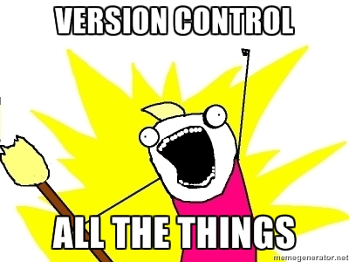
Seriously… Use Source Control
I cannot stress how important Version/Source Control is for anyone touching code.
If you aren’t using it, this is your next project.

Slide 4

What is Pester?
Pester is a Testing framework for PowerShell.
Pester is a Framework to run Unit Tests to validate PowerShell commands.
Pester is Behavior Driven Development (BDD) based.
BDD takes principles from Test Driven Development (TDD) and uses a Domain Specific Language (DSL) to express the behavior in a natural English sounding language.

Slide 5
Test Driven Development
Tests are written first.
First a failing test is created.
Then code is written to make the test pass.
Then code is cleaned up if needed.
Process is repeated.

Slide 6
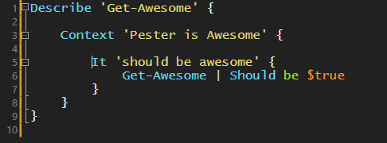
Domain Specific Language
Domain Specific Language (DSL)
A DSL is a language that has a special purpose in a specific domain.
DSL often try to express statements in a more readable form.
Pester uses a DSL similar to Make or Rake
Uses real language to express outcomes.

Slide 7
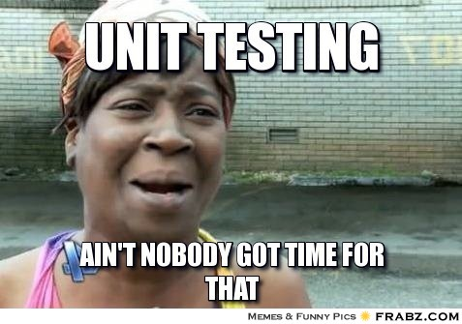
But.. But.. Buutttt!
I don’t work with developers.
I don’t build websites.
I just write PowerShell scripts.
I’m not a developer.
I’m just a sysadmin.
I takes too much time to write tests.
I’m not in DevOps
I already have a Test Environment.
I’m lazy

Slide 8
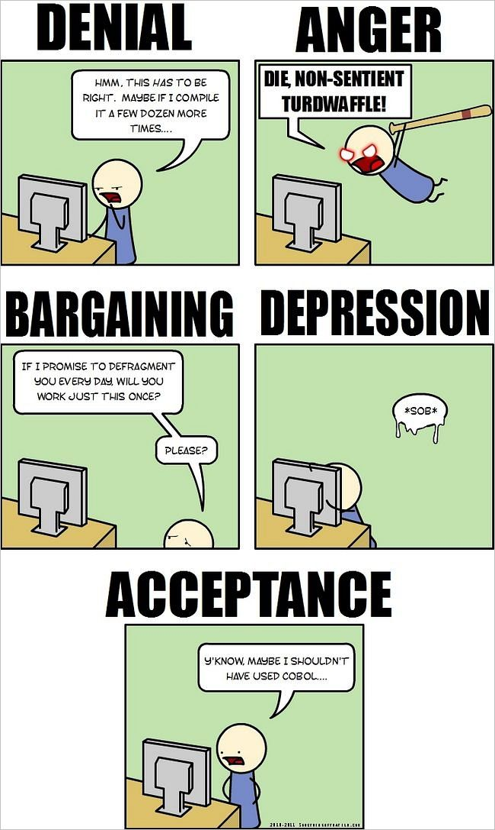
Is it for me?
If you write PowerShell, you should be writing Tests.
Who has debugged code they can’t even remember writing?
Who has written code, only to realize they had already written it and forgot?
We have terrible memories. It’s Science. They even lie to us! Memories can be jerks.
Everyone can benefit from Pester.

Slide 9
Hidden Benefits
When using Pester, you start to look at your code differently.
A modular approach is more desirable. It makes testing your code easier and makes it easier to change your code later.
This also has the added benefit of being able to keep your business logic separate from modules and functions, and it makes your code easier to share with the community.
You start looking at your code in a whole new way, and start changing your code so that it is easier to test.

Slide 10
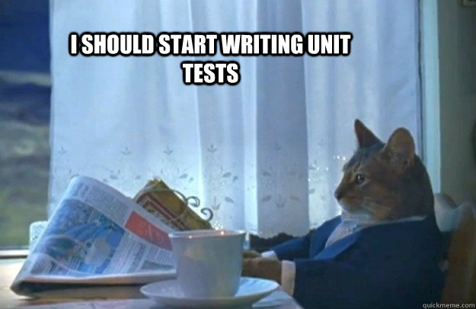
Types of Tests
Unit Tests
Integration Tests
Acceptance Tests
Operational Validation Tests

Slide 11
Unit Tests
Typically should be isolated and should not rely on anything external.
You don’t want an issue in an external process to break a test.
Unit tests often rely on Mocking commands. (Will discuss this more shortly)

Slide 12
Integration Tests
These tests are not isolated from the rest of the code or processes.
They are typically testing all processes as a whole.
These are performed after Unit Tests.

Slide 13
Operational Validation Tests
These tests ensure the processes and code perform the desired operations they were designed to do.
One example is Active Directory Validation. You compare a real report to what you expect the report should return. (There is a link to a great article on this in the Resources at the end of the powerpoint)

Slide 14
Pester’s Basic Commands
Describe
Context
It
Should
Mock
Assert-MockCalled
Assert-VerifiableMocks
InModuleScope

Slide 15
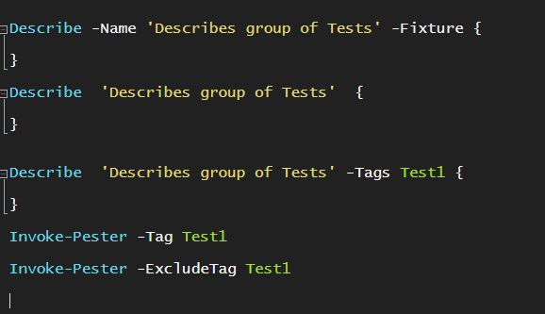
Describe
Describes a Group of Tests
Name and Fixture parameter names should be omitted.
This gives the test a more natural language feel.
Tags can be used to include only specific or exclude specific Tests when running Pester.
There is also a slight naming error with Tag and Tags. It still works, but I believe this will be fixed in a upcoming release.

Slide 16
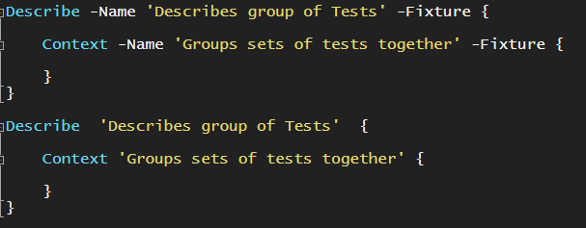
Context
Provides grouping of “It” blocks under a single Describe block.
Name and Fixture parameter names should be omitted for Context as well.
This gives the test a more natural language feel.
This is the lowest block that creates a mocking group. Mocks defined in “It” blocks are shared with the Context block.

Slide 17
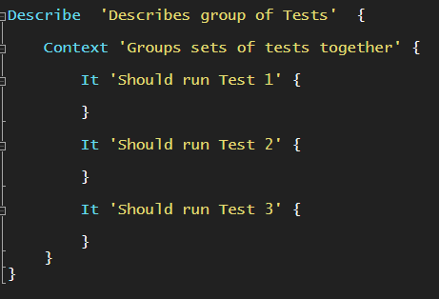
It
There should only be one assert or test per “It” block.
This helps the debugging process because you know exactly which test failed.
If the test fails it should throw a terminating error.

Slide 18
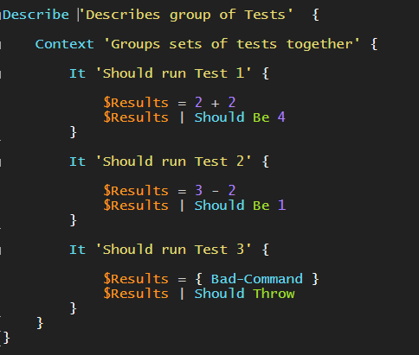
Should
Should is used to Assert comparisons of output or if the test throws an exception.
Should has a large variety of Operators. A few examples are “Be”, “Throw”, “BeNullOrEmpty” and “BeExactly”

Slide 19
Mock
Mock
Allows you to give a command alternate functionality.
This allows you to provide a script block that will be this commands new behavior.
Use the –Verifiable switch to be checked when Assert-VerifiableMocks is ran.
Assert-MockCalled
Checks to see if a Mocked command has been executed a certain number of times and throws an error if it has not.
Assert-VerifiableMocks
Checks to see all Mocks with the –verifiable switch have been executed and throws and error if they have not.

Slide 20
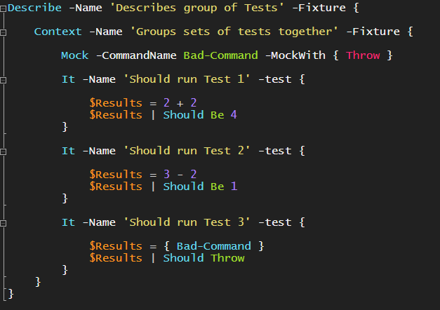
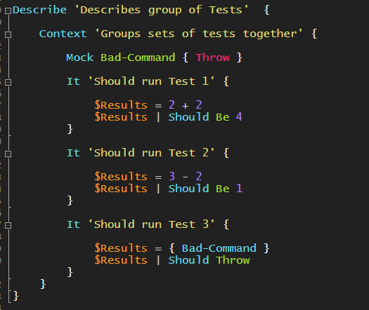
Comparison of Syntax
Full Syntax
DSL

Slide 21
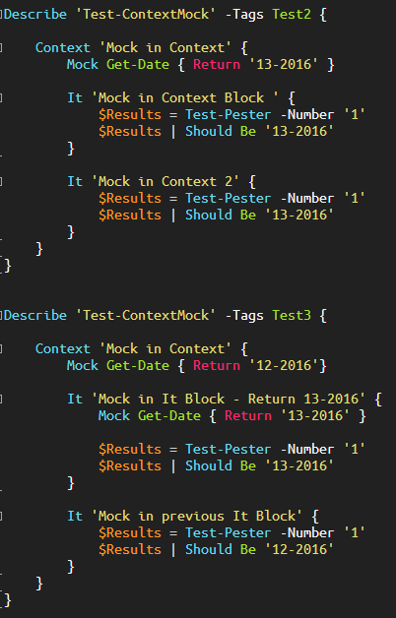
Gotchas
It Block Mocking Scopes
Mocks in “It” Blocks are shared with the Context Block.
Context is the lowest Mocking block.
The last encountered Mock will be the one used.
The Second Mock in the bottom example is used.
Mock Get-Date { Return ’13-2016’ }

Slide 22
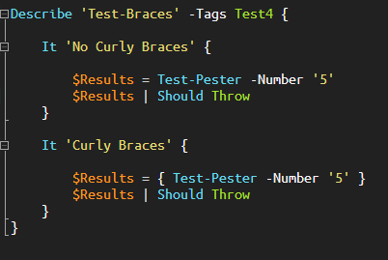
Gotchas
Asserting Throw
When Asserting Should Throw or Should Not Throw, the command must be in a scriptblock.
The Command will be executed outside of the Assertion if not in a scriptblock.
The ‘No Curly Braces’ It Block is not correct in this example.

Slide 23
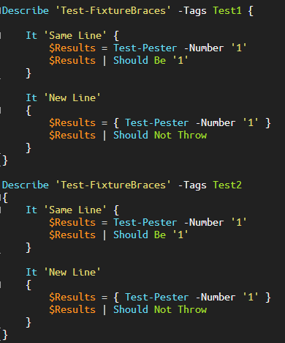
Gotchas
Fixture is a Scriptblock
To use Pester’s DSL, the -Fixture param name is omitted.
These commands do not allow braces to be on new lines like functions.
In the first example ‘New Line’ It block breaks the entire Describe Block.
The second example will also break the entire Describe Block.

Slide 24
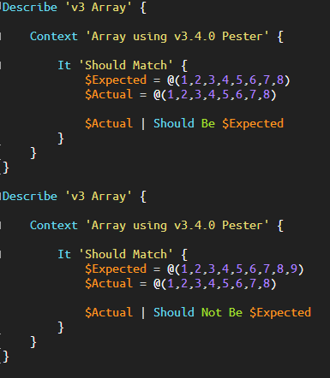
Gotchas
Comparing Arrays
Pester does not handle arrays the way you’d expect.
Since you are piping the array to Should, each value of the array is being tested individually.
There are a few solutions you can find to test arrays. I know there is at least one on the PSGallery.
Pester V4 addresses this issue and has better array handling.

Slide 25
Where are the Bugs?!
Is there a bug in my code or in my tests?
When you start to write your scripts with tests in mind this becomes less of an issue.
Breaking things down into manageable pieces really makes the debugging process a lot easier.
This is why you should also only use one Assert per It block. It makes it much easier to find the problem areas.

Slide 26
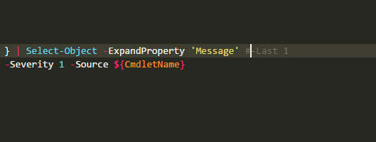
Immediate Wins
An example of an issue I caught immediately was something I forgot to uncomment.
My tests caught it when I would have overlooked it.
Who here has had an issue in production, and you immediately dove in troubleshooting the issue as quickly as possible, and the pushed the code out with the fix. Often times, these little comments or tweaks are done during these quick troubleshooting processes and overlooked or forgotten to be changed back.
Pester leads to fewer of these scenarios, but more importantly, we must stick by our processes during times of fires. We are often fire fighters, and when we are putting out fires, we tend to be sloppy and rushed. This leads to undocumented changes that will either cause problems in the short term, or on down the line when someone goes to make a change and forgets or is unaware of the changes we made when saving the day.

Slide 27
Immediate Wins
Built in Cmdlets don’t always function the way we think or expect.
An example I encountered was Eventlogs. Get-Eventlog, New-Eventlog, and Write-Eventlog can have some odd behavior.
Lognames only respect the first 8 charcters of a name. A logname of “12345678” will interfere with a logname of “1234567891011”
EventLogs can only be registered to a single source, so if a collision like this occurs it will break.
If you remove or delete an Event Source, it requires a reboot to clear the Event cache. This means that Events written during this limbo period will not be written to the proper EventLog. It will still be written to the one in the cache. However, this is not always the case. Oddly enough, about 10-20% of the time it is actually able to write to the Eventlog without a reboot. I still don’t have an explanation as to why.
I likely would have never found out about these issues without Pester. These were failing silently in rare situations in my scripts.

Slide 28
The Release Pipeline
The Release Pipeline Model Whitepaper is by Michael Greene and Steven Murawski.
The idea is to have configuration as code.
To quote the Summary,
“a fully automated solution where infrastructure is managed as code and all changes are automatically validated before reaching production.”
Pester and Version Control are key components in the Release Pipeline.
This is a process. Start with Version Control and gradually start adding new pieces of the Release Pipeline.

Slide 29
Contribute
I have published a Repository on Github called PipelineResouces with shared Links, Videos, Podcasts, Blogs, and information that I found very useful.
I would love for others to contribute as well.
I am looking for ideas on how to structure the information stored in this Repo, and would love if people with ideas opened an issue with their suggestions.
As seen in the Demo, I have added a starter Pester test that just validates the URLs, but I would love to add more tests like Spellcheck and things like improper quotations.

Slide 30
Resources
Github Projects
Pester - https://github.com/pester/Pester
June Blender’s PesterTDD - https://github.com/juneb/PesterTDD
PowerShell Operational Validation Framework - https://github.com/PowerShell/Operation-Validation-Framework
Kevin Marquette’s – PesterInAction - https://github.com/KevinMarquette/PesterInAction
DoesItScript’s - PesterDashboard - https://github.com/doesitscript/PSPesterDashboardKickstarter
Dave Wyatt - Examples - https://github.com/dlwyatt
Microsoft.PowerShell.Archive - Examples - https://github.com/PowerShell/Microsoft.PowerShell.Archive
PowerShell DscResources.Tests - Examples - https://github.com/PowerShell/DscResource.Tests
Microsoft PowerShell Tests - Examples - https://github.com/PowerShell/PowerShell-Tests

Slide 31
Resources
Twitter
Dave Wyatt - https://twitter.com/MSH_Dave
June Blender - https://twitter.com/juneb_get_help
Mike Robbins - https://twitter.com/mikefrobbins
Jakub Jares - https://twitter.com/nohwnd
PSPester - https://twitter.com/pspester
Pester Editor Integration
ISESteroids Pester Walkthrough - http://www.powertheshell.com/pester-integration/
VS Code Task Runner Docs - https://code.visualstudio.com/Docs/editor/tasks
Source Control
Steven Murawski - Future-proofing Your Career or Reading Tea Leaves? - http://stevenmurawski.com/powershell/2014/08/future-proofing-your-career-or-reading-tea-leaves/

Slide 32
Resources
Operational Validation
Operational Validation – Active Directory, Must Read - https://pshirwin.wordpress.com/2016/04/08/active-directory-operations-test/
Operational Validation – NIC Settings - https://gabrielrojas.nyc/2015/12/28/using-pester-to-test-nic-settings/
Operational Validation – System - http://mikefrobbins.com/2015/11/12/powershell-using-pester-tests-and-the-operation-validation-framework-to-verify-a-system-is-operational/
Operational Validation with Slack - https://flynnbundy.com/2016/04/24/operations-validation-framework-and-slack/
Operational Validation Gotchas - https://pshirwin.wordpress.com/2016/04/29/operational-readiness-validation-gotchas/
Videos
June Blender – TDD with Pester - PSHSummit - https://www.youtube.com/watch?time_continue=1&v=jvvh9cpD_LM
VS Code Pester Task Runner - https://channel9.msdn.com/Blogs/cloud-with-a-silver-lining/Visual-Studio-Code-Task-Runners
Release Pipeline - https://www.youtube.com/watch?v=bRd0XiMIRMs

Slide 33
Resources
Release Pipeline
RunasRadio Podcast - The Infrastructure Release Pipeline with Steve Murawski and Michael Greene - http://runasradio.com/Shows/Show/469
Release Pipeline Whitepaper - http://aka.ms/thereleasepipelinemodel

