Slide 1
PowerShell Editors
Which is right for you?
Brandon Padgett
www.brandonpadgett.com
@brandonpadgett
https://github.com/gerane

Slide 2
Materials
PowerPoint and Presentation https://github.com/gerane/EditorsPresentation
Related Blog Post http://brandonpadgett.com/releasepipeline/Part-2-Development-Environment/

Slide 3
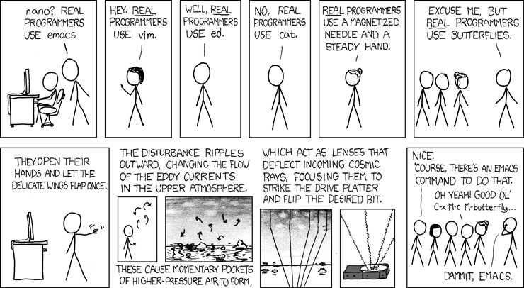
Real Programmers

Slide 4
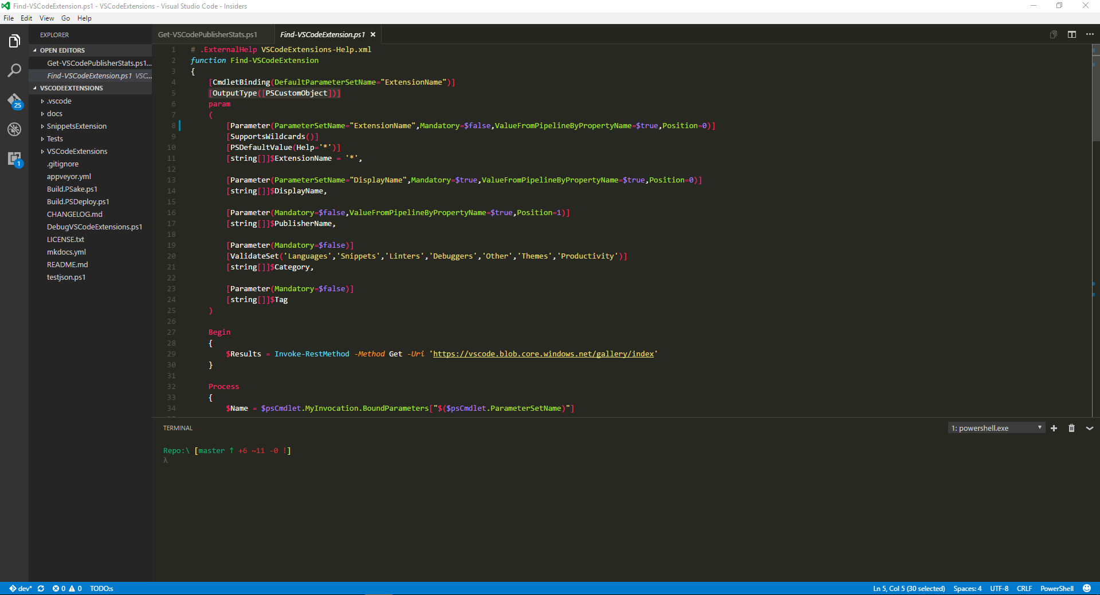
Visual Studio Code

Slide 5
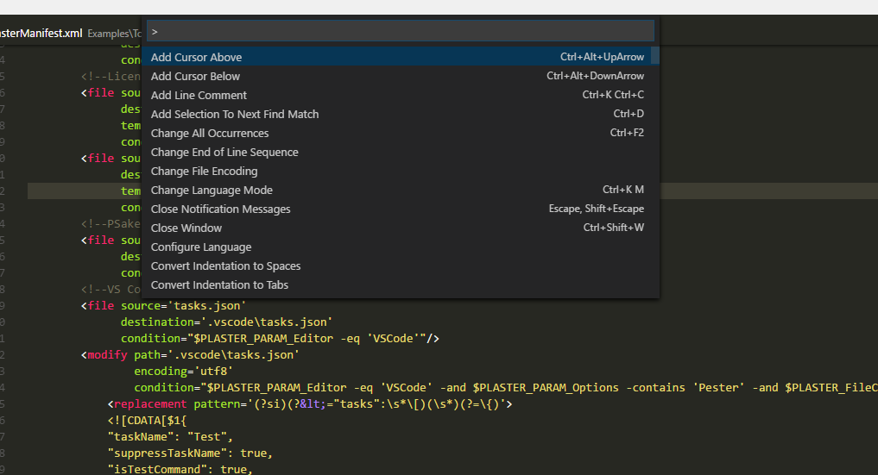
Command Palette

Slide 6
Snippets
$1, $2 for tab stops
${id}, ${id:label} and ${1:label} are Variables
${Name:Please enter Name} Variable with label and description
Variables with the same Labels are linked

Slide 7
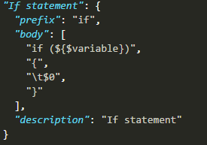
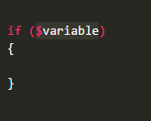
Example Snippet

Slide 8
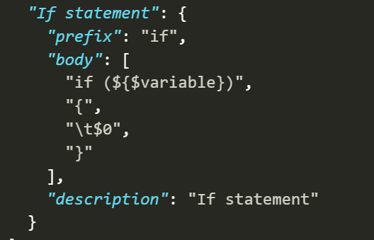
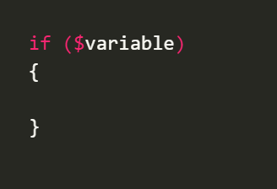
Example Snippet Output
Snippet
Output

Slide 9
Task Runners
Tasks that can be ran from the Command Palette or Keybinding
These are defined in a tasks.json file
Examples might be Running Pester tests, running psake, or running scriptanalyzer

Slide 10
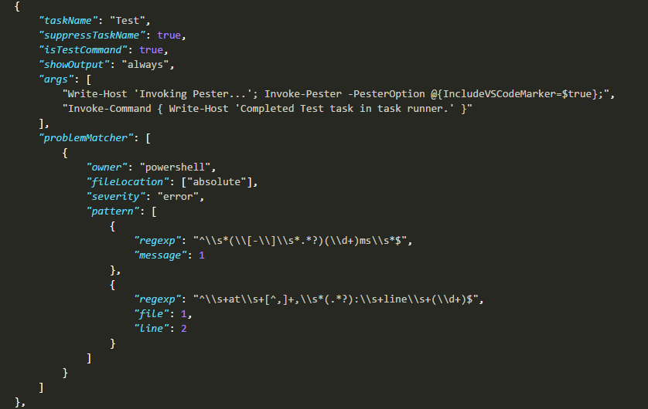
Example Pester Task

Slide 11
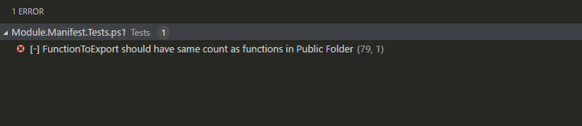
Task Output
Allows Navigation to lines with Errors with ctrl click
Can use VSCode’s problem matcher

Slide 12
Debugging
Breakpoints
Variable Inspection
Debug Console

Slide 13

Debugging Actions
F5 - Continue / Pause
F10 - Step Over
F11 - Step Into
Shift+F11 - Step Out
Ctrl+Shift+F5 - Restart
Shift+F5 - Stop

Slide 14
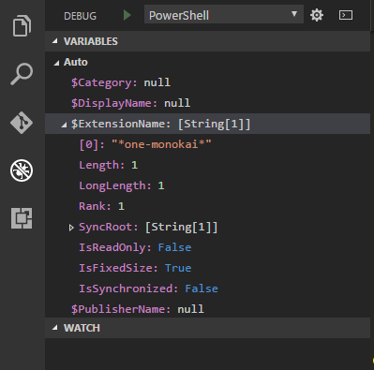
Debug Variables

Slide 15
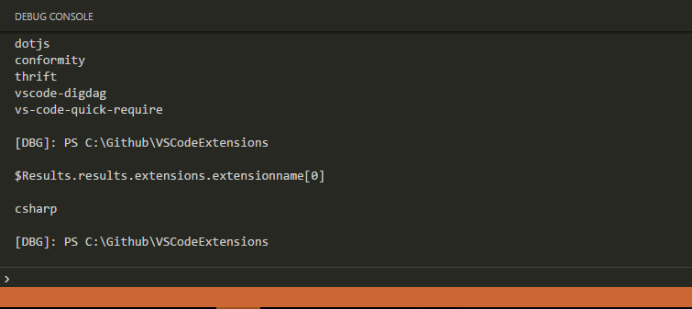
Debug Console

Slide 16
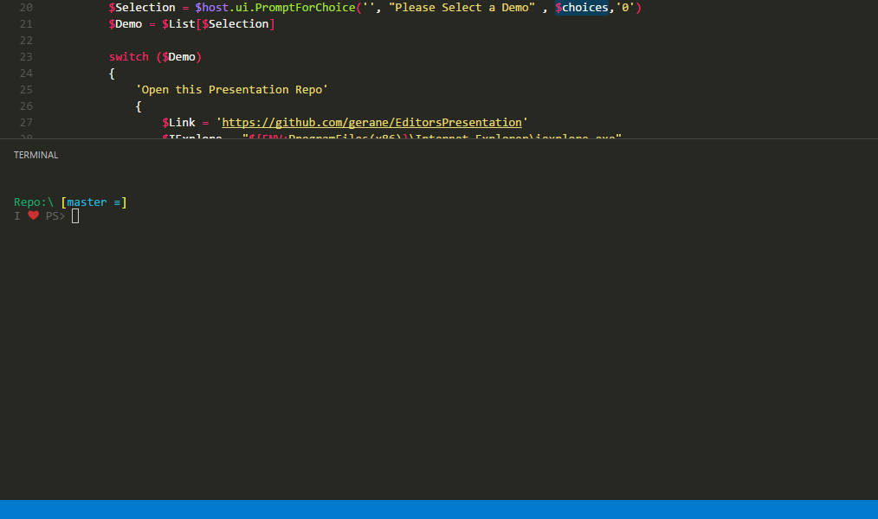
Terminal

Slide 17
Terminal
Ctrl + ` = Open Terminal
Ctrl + Shift + c = copy
Ctrl + Shift + v = paste
Can set keybinding for run selection in terminal

Slide 18
Extensions
Extension Marketplace https://marketplace.visualstudio.com/VSCode
Extensions Module https://www.powershellgallery.com/packages/vscodeextensions

Slide 19
Extension Categories
Debuggers
Languages
Linters
Snippets
Themes
Other

Slide 20
PowerShell Extension
The Extension that gives VSCode PowerShell support
Syntax Highlighting
Debugging
Intellisense
PowerShell Editor Services

Slide 21
Extending the Editor
An API for extending the Editor with PowerShell.
Editor Commands - Commands written in PowerShell and used to interact with the Editor
$psEditor – Variable that allows PowerShell to tie into the Editor

Slide 22
Editor Commands
PowerShell Commands that can be executed from Command Palette
The Command Menu can be tied to a Keybinding Ex. Alt + P
Can be shipped inside of an extension and loaded at import

Slide 23
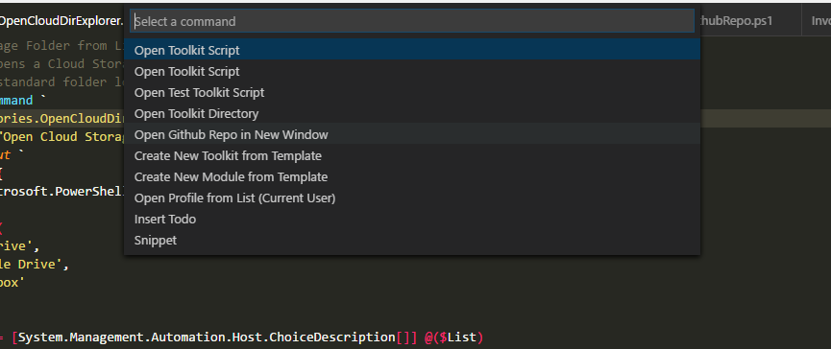
Editor Command Menu

Slide 24
PowerShell Editor Services
Features:
Intellisense
Code Navigation
Debugging
Console Services
Extension Services

Slide 25
Cross Platform
Potential for cross platform or browser PowerShell support.
Would use a VM or remote host for PowerShell support.

Slide 26
Open Source
PSES can be adopted by any Editor
Will give users the same PowerShell experience in any Editor.
PSES Extensions will work in any Editor.

Slide 27
Monaco Editor
The Core Editor that powers VSCode
Adapted to be ran in a browser
The OneDrive Editor runs Monaco under the hood

Slide 28
Links
Editors Presentation https://github.com/gerane/EditorsPresentation
Editors Blog Post http://brandonpadgett.com/releasepipeline/Part-2-Development-Environment/
ISE Preview https://blogs.msdn.microsoft.com/powershell/2016/01/20/introducing-the-windows-powershell-ise-preview/
ISESteroids http://www.powertheshell.com/isesteroids/
PowerShell Studio https://www.sapien.com/software/powershell_studio

Slide 29
Links
Editor Commands Examples https://github.com/gerane/EditorCommands
OneDrive Intellisense Demo https://1drv.ms/u/s!AtjVFRnUPSTLhMoEWPp1QzSJ2I72EQ
Monaco Editor Demo https://microsoft.github.io/monaco-editor/index.html

