Slide 1

Types and Annotations for CIDOC CRM Properties
Vladimir Alexiev, PhD, PMP
Data and Ontology Management Group
Ontotext Corp
Invited report
Digital Presentation and Preservation of Cultural and Scientific Heritage (DiPP2012) Conference
18 Sep 2012, Veliko Tarnovo, Bulgaria

Slide 2
Presentation Outline
Background and significance of CIDOC CRM
Quick CRM tutorial and links for more info
Problem domain: more data about Properties
Available CRM means and corresponding problems
  Property Types
  E13 Attribute Assignment
  Short-cuts and Long-cuts
Solution Alternatives
  Split Properties
  Statement Reification
  Property Reification
  Named Graphs
CIDOC CRM Properties
18 Sep 2012
#<number>

Slide 3
CONCEPTUAL REFERENCE MODEL
CIDOC CRM
CIDOC CRM Properties
18 Sep 2012
#<number>

Slide 4
CIDOC CRM
Created by International Committee for Documentation (CIDOC) of International Council of Museums (ICOM)
  More than 10y of development, official standard ISO 21127:2006
  Available at http://www.cidoc-crm.org/
  Maintained by CRM SIG, crm-sig@ics.forth.gr
Provides a common semantic framework to which any CH data can be mapped
  Intended to promote shared understanding of CH data and a "semantic glue" to mediate between different CH sources
  Few classes (82) and properties (142); quite expressive because it is abstract
  Original focus: history, archaeology, cultural heritage (CH)
  Used in various projects, including libraries, archives, museums
CIDOC CRM Properties
18 Sep 2012
#<number>

Slide 5
Importance of CIDOC CRM
CIDOC CRM can map and subsume various domain specific standards, thus allowing to compare, unify and inter-map them
  E.g. influenced LIDO (events), EDM (subjects, events), mapped EAD, mapped UNIMARC, created FRBR as ontology (FRBRoo), etc
Everything is connected… at the community (human) and technical (Semantic Web) levels
CRM
FRBRoo
FRBR
ISBD
ONIX
RDA
MARC
Gordon Dunsire,
U Strathclyde
DC
CIDOC CRM Properties
18 Sep 2012
#<number>

Slide 6
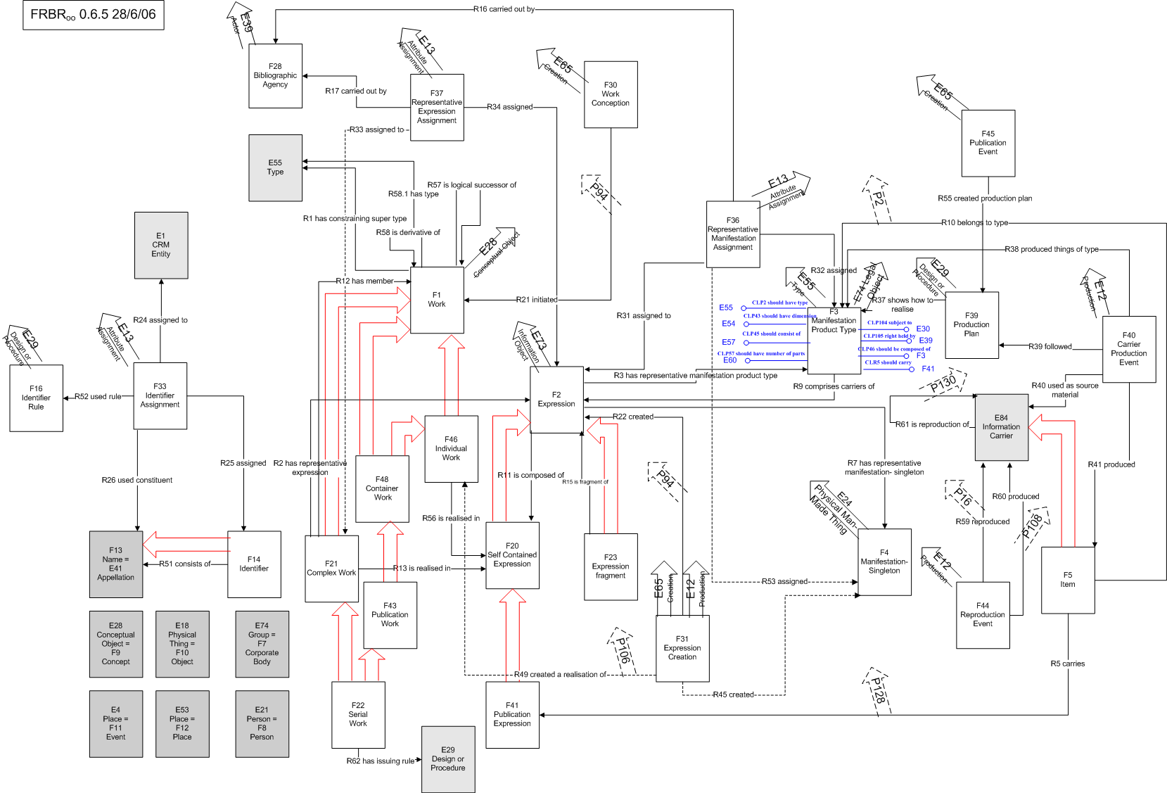
Example: FRBR as a CRM Extension (FRBRoo)
http://www.cidoc-crm.org/frbr_drafts.html
CIDOC CRM Properties
18 Sep 2012
#<number>
Notes:
Functional Requirements for Bibliographic Records (FRBR) is an important conceptual entity-relationship model developed by the International Federation of Library Associations and Institutions (IFLA).
FRBRoo recasts FRBR in the form of a CRM extension ontology, and therefore an Object Oriented form

Slide 7














Ontotext CH Projects and Clients
Clients: UK, KR, SE, NL, BG, US
Research projects executed by Ontotext
Projects using OWLIM: EU, PL, JP
CIDOC CRM Properties
18 Sep 2012
#<number>

Slide 8
Ontotext CRM experience
FP7 MOLTO: museum data is based on CRM
  Multilingual Online Translation. Knowledge infrastructure, interoperability between natural language and structured queries,
  Museum object descriptions in 15 languages. Gotehnburg Museum case
ResearchSpace project of the British Museum is based on CRM
  Advising British Museum and Yale Center for British Art on representing their collections in CRM
Providing feedback and contributing to RDF definition of CRM
  Implementing CRM search based on Fundamental Relations
CIDOC CRM Properties
18 Sep 2012
#<number>

Slide 9
CRM Tutorial
http://www.cidoc-crm.org/cidoc_tutorial/index.html
  By Stephen Stead, recorded in Crete in Nov 2008. Few hours of video & transcript
  Project funded by Operational Programme "Information Society" (GR and EU)
http://personal.sirma.bg/vladimir/crm-tutorial/
  62 slides (screens) & transcript. HTML, Kindle and PDF versions
Quite useful for understanding the principles of CRM
  Persistent entities (Endurants) vs Temporal entities (Perdurants)
  Persistent entities "meet" at Events
  Time and Place are connected to persistent entities only through Periods/Events (can't have fields " birth place" or "birth date")
  Physical Things vs Conceptual Objects
  Multiple inheritance of Classes (entities) and Properties
  Most properties are bidirectional (symmetric or have inverses)
CIDOC CRM Properties
18 Sep 2012
#<number>

Slide 10
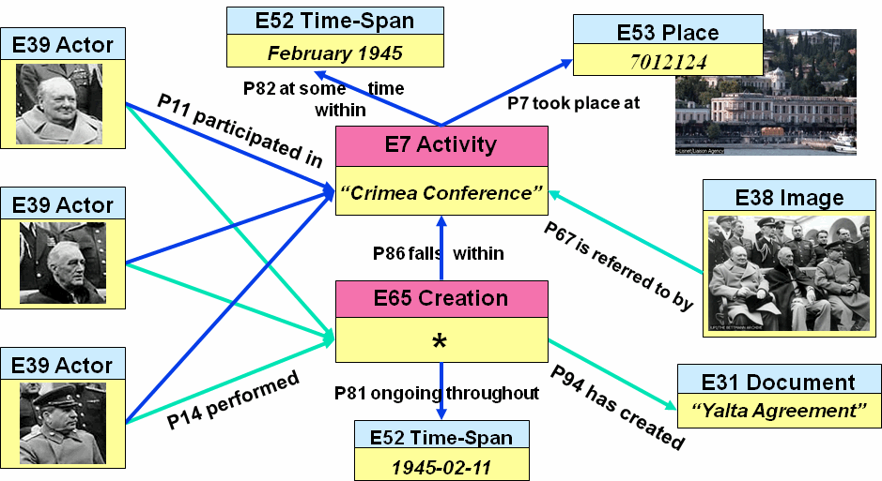
Example: Entities meet at Events
CIDOC CRM Properties
18 Sep 2012
#<number>
Notes:
Persistent entities (including Actors, Physical Things and Conceptual Objects) meet at events
Most properties are bidirectional. E.g. P11_had_participant has inverse P11i_participated_in
Time and Place are attached only to Events/Periods
Class hierarchy infers additional types (e.g. Creation is an Activity is an Event)
Property hierarchy infers additional properties (e.g. P14i_performed infers P11i_participated_in).
E7 Activity is an E4 Event that is intentionally carried out by instances of E39 Actor
P14 is reserved for the main performers of E7 Activity while P11 are all kinds of participants

Slide 11
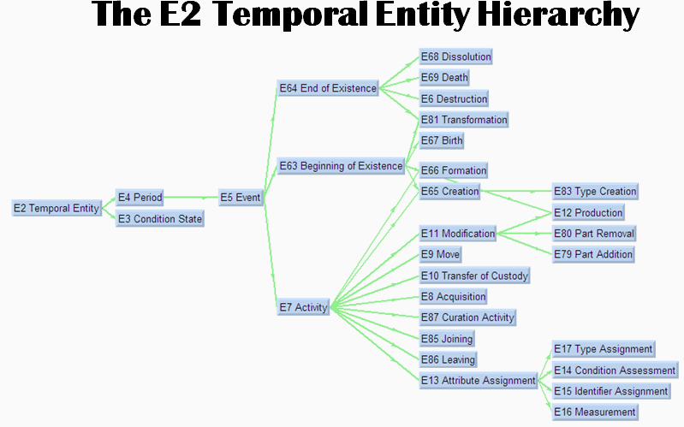
Example: E2 Temporal Entity Multi-Hierarchy
CIDOC CRM Properties
18 Sep 2012
#<number>
Notes:
Illustrations of multiple inheritance:
E65 Creation (of conceptual object) and E12 Production (of physical man-made thing) both inherit from:
E63 Beginning of Existence (that also comprises Birth of Person and Formation of Group)
E7 Activity (that is intentionally performed by Actor)
Note: E12 Production inherits directly from E11 Modification, since conceptually a Production is a really important Modification (from nothing to something)
E81 Transformation is both E64 End of Existence (of an old thing being "recycled") and E63 Beginning of Existence (of a new thing being created)

Slide 12
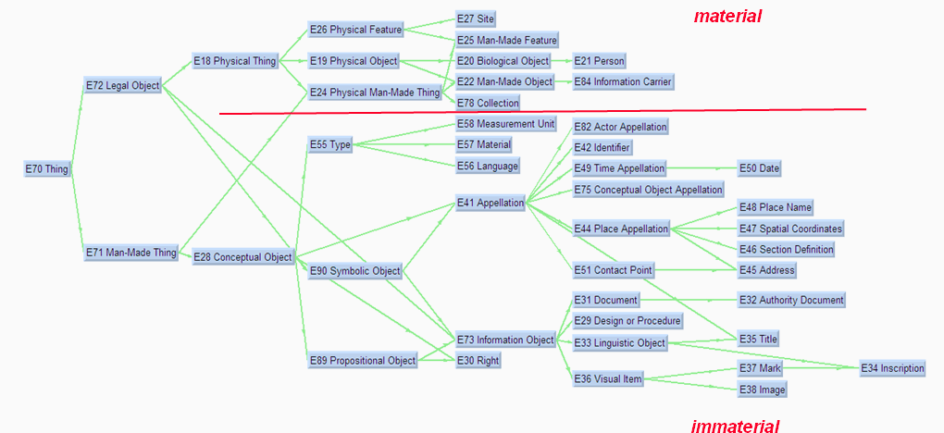
Example: E70 Thing (persistent) Multi-Hierarchy
CIDOC CRM Properties
18 Sep 2012
#<number>
Notes:
Persistent things are Physical (material) vs Conceptual (immaterial).
Another branch of the persistent item hierarchy (not shown here) are Actors.
E24 Physical Man-Made Thing can carry (P128) E73 Information Objects (text E33 Linguistic Object, E38 Image, E34 Inscription etc)
Other conceptual objects include E55 Type and its subclasses (e.g. Material, Language), E41 Appellation (of Actor, Time, Place; Title of work of art, etc)

Slide 13
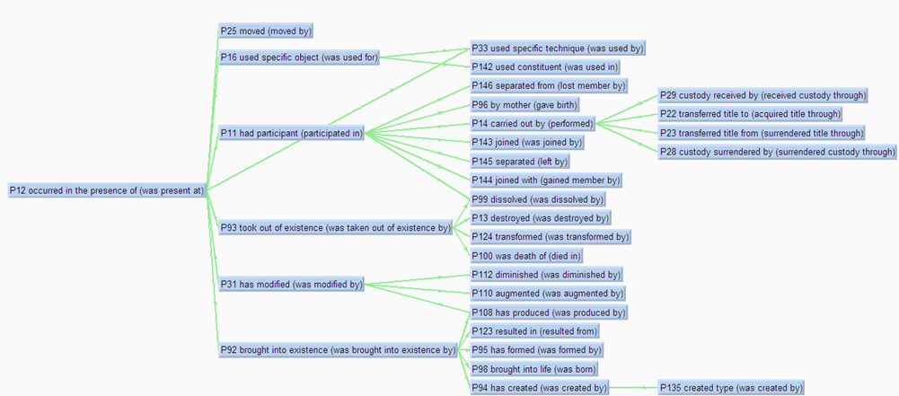
Example: P12 (Participation) Property Multi-Hierarchy
CIDOC CRM Properties
18 Sep 2012
#<number>

Slide 14
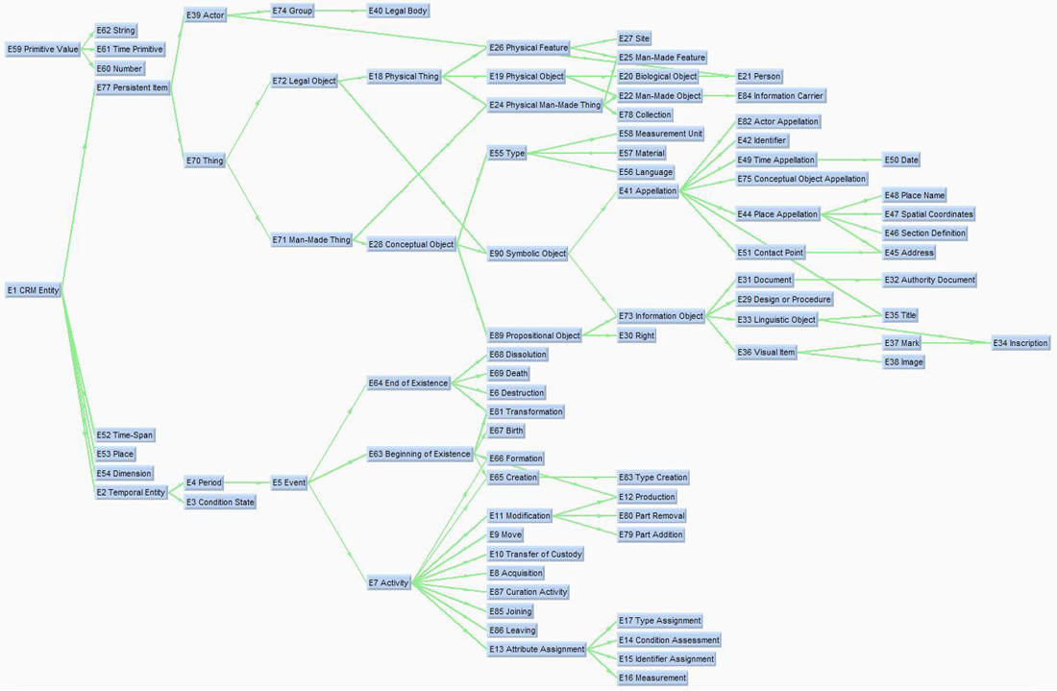
CRM Graphical Representation
Library of CRM representation patterns
  Class diagram (see to the right)
  Important "usage examples" as diagrams (34)
  Handy entity & property index on front
http://www.cidoc-crm.org/cidoc_graphical_representation_v_5_1/graphical_representaion_5_0_1.html
  one page per pattern
  PPT version
http://personal.sirma.bg/vladimir/crm-graphical/
  All patterns on one page
  Handy anchors , e.g. #acquisition is Acquisition Information
  PPT version with notes
CIDOC CRM Properties
18 Sep 2012
#<number>

Slide 15
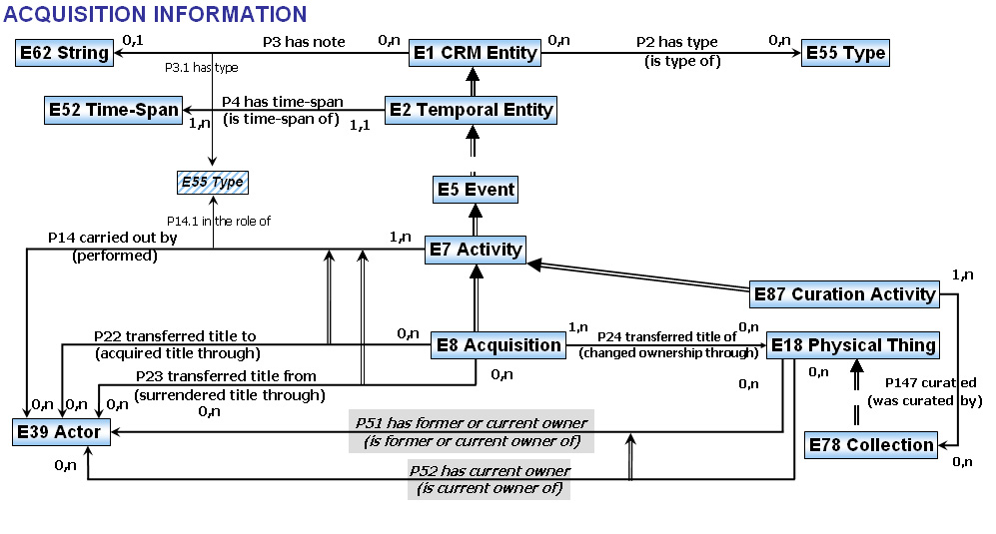
Usage Example: Acquisition of E18 Thing by E39 Actor
E.g. acquisition of an object by an actor (organization)
CIDOC CRM Properties
18 Sep 2012
#<number>
Notes:
Legend
Single arrow (e.g. E18 --P52-> E39): property instance (e.g. E18 Physical Thing has current owner (P52) E39 Actor).
Inverse property name is shown
Cardinalities (only advisory!) are shown
Double property arrow (e.g. P52=>P51): property inheritance (e.g. P52 current owner implies P51 former or current owner)
Double entity arrow (e.g. E8=>E7): class inheritance (e.g. E8 Acquisition is E7 Activity)
Most entities inherit from E1 CRM Entity, therefore can have general types (P2) and notes (P3)
Thin arrow (e.g. P14 --P14.1-> E55): property of property (e.g. carried out by (P14) in the role of (P14.1) E55 Type)
We'll have a lot more to say about this in the second half of the presentation

Slide 16
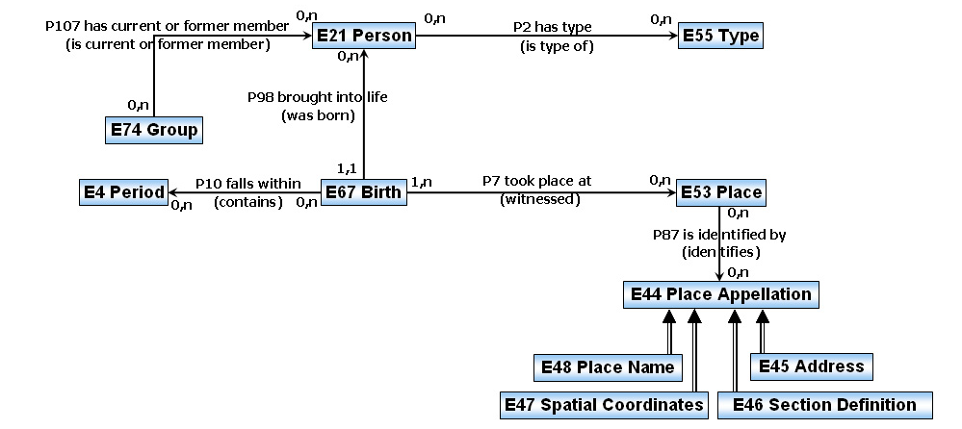
Usage Example: Person Nationality
Birth represented as explicit event.
  Place and Time of birth represented explicitly (in this case, Time relates to Period)
Nationality represented as a Group
Would be nice to correlate this Group to Place (not done here)
CIDOC CRM Properties
18 Sep 2012
#<number>

Slide 17
CRM Specification
http://www.cidoc-crm.org/official_release_cidoc.html
  version 5.0.4 (Nov 2011) as DOC and PDF files
http://personal.sirma.bg/vladimir/crm/
  version 5.0.1 (Mar 2009) as hyper-linked HTML and Kindle version
  Main file: http://personal.sirma.bg/vladimir/crm/entity_list_cleaned.html: class &property hierarchies and definitions
  Created from this cross-referenced version http://www.cidoc-crm.org/docs/cidoc_crm_5_0_1_cross_reference/cidoc_crm_5_0_1_cross_reference.rar after further cleaning and corrections
  Includes useful anchors, e.g. #E1_CRM_Entity and #P1_is_identified_by--identifies
  Very useful for online citing and discussions
  Introduction: important info about CRM Scope and Extension principles
CIDOC CRM Properties
18 Sep 2012
#<number>

Slide 18
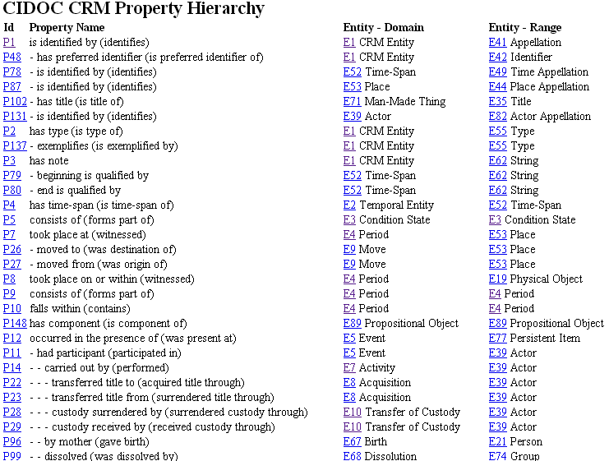
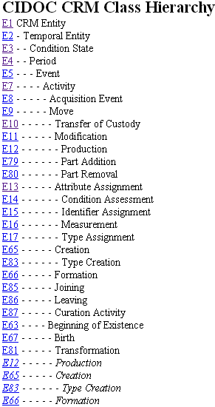
CRM Spec: Property and Class Hierarchies
CIDOC CRM Properties
18 Sep 2012
#<number>
Notes:
Nesting (dashes) shows hierarchy
Properties show the corresponding Domain and Range
Hyperlinks lead to definition
Italic shows second occurrence due to multiple inheritance

Slide 19
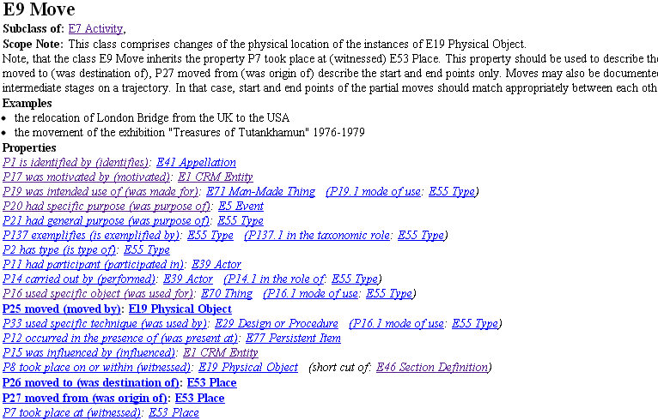
CRM Spec: Entity definition
CIDOC CRM Properties
18 Sep 2012
#<number>
Notes:
Code and name of the class
Subclasses and superclasses, with hyperlinks
Scope Note: defines the semantics of the entity (the most important section)
Examples: provides illustrative examples
Properties: all properties having this class as Domain
Bold: "own" properties
Italic: inherited properties
Referenced by: own properties having this class as Range
Inherits references: inherited properties having this class as Range

Slide 20
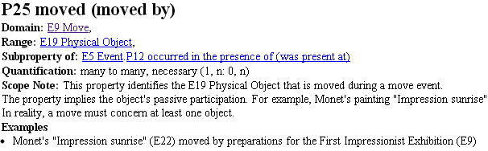
CRM Spec: Property definition
CIDOC CRM Properties
18 Sep 2012
#<number>
Notes:
Code and name of the property (forward and inverse direction)
Domain and Range classes
Subproperties and superproperties
Quantification: property cardinality, but only advisory
Scope Note: defines the semantics of the property (the most important section). Includes information about short-cuts (see further)
Examples: provides illustrative examples

Slide 21
CRM PROPERTIES
Types, Annotations, Uncertainty, Additional Data
CIDOC CRM Properties
18 Sep 2012
#<number>

Slide 22
Problem Statement
In CH it is often important to capture not just statements (facts or suppositions), but also additional information about them:
Who said what when
Roles and qualifications of relations, e.g. "Michelangelo (E21 Person) performed (P14) the painting of the Sistine Chapel (E7 Activity) in the role of master craftsman (E55 Type)"
Other data about relations, e.g. "The painting Bathing Susanna (E18 Physical Thing) changed ownership through (P24) an auction (E8 Acquisition) as lot number 15".
The status of a statement (fact, proposed, disputed, etc)
Comments or discussions about a statement
Relations to other data that justifies or disproves a statement
Indication of probability or uncertainty
CIDOC CRM Properties
18 Sep 2012
#<number>

Slide 23
ResearchSpace Annotation Needs
The ResearchSpace project (http://www.researchspace.org) is funded by the Andrew W. Mellon foundation, designed and administered by the British Museum (BM), and developed by a consortium led by Ontotext Corp. Annotation needs to capture Research Discourse:
provide comments about any field
reply to someone else's comments, forming a discussion
link another semantic object by embedding it in a comment
link a field of another semantic object to use as justification. E.g. the dating of Rembrandt's "Bathing Susanna" is established as 1636 because a drawing reproduction by Willem de Poorter is signed and dated 1636.
dispute old value
propose new value, with justification in the form of comment or link to another object
CIDOC CRM Properties
18 Sep 2012
#<number>

Slide 24
CRM MEANS AND PROBLEMS
CIDOC CRM Properties
18 Sep 2012
#<number>

Slide 25
Property Types
CRM includes 13 "property types", e.g.
  "P3.1 has type" can distinguish different kinds of notes (P3 has note)
  "P14.1 in the role of" can distinguish different participant roles (P14 carried out by)
But "properties of properties" cannot be implemented in RDF directly
CRM recommends to implement them as sub-properties (e.g. P3a_name, P3b_description, etc)
  This approach is not convenient if the specific relations are numerous and come from a thesaurus
  E.g. the BM collection database includes 14 vocabularies for association codes (e.g. Acquisition Person, Production Person, Production Place) with over 230 codes
  If these 230 codes are implemented as 230 sub-properties, then an application will need to deal with all of them!
CIDOC CRM Properties
18 Sep 2012
#<number>

Slide 26
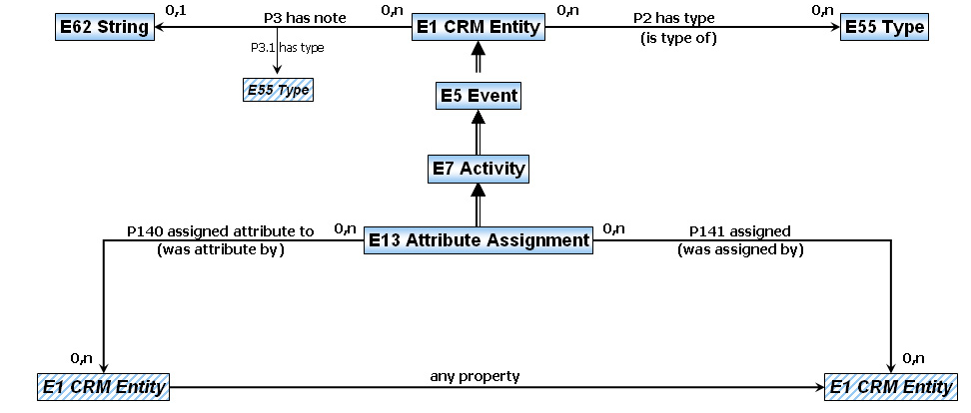
E13 Attribute Assignment
CIDOC CRM Properties
18 Sep 2012
#<number>

Slide 27
E13 Attribute Assignment (cont)
E13 goes a long way towards providing statement annotation capabilities. E13 has fields (some inherited) for recording:
  who: P14_carried_out_by from E7_Activity
  when: P4_has_time-span from E5_Event
  said what: P3_has_note from E1_CRM_Entity
  about what (subject): P140_assigned_attribute_to
  what value (object): P141_assigned
  "did" what, e.g. Dispute, Propose; Agree, Disagree, etc: a P2_has_type sub-property, from E1_CRM_Entity),
  what was the outcome, i.e. "dispositions" such as Proposed, Approved, Rejected, Published: another P2_has_type sub-property
However E13:
  Doesn't mention the property being annotated (called "any property")
  Cannot annotate primitive values (numbers, strings): P141 excludes E59_Primitive_Value, which is outside the E1_CRM_Entity class hierarchy
CIDOC CRM Properties
18 Sep 2012
#<number>

Slide 28
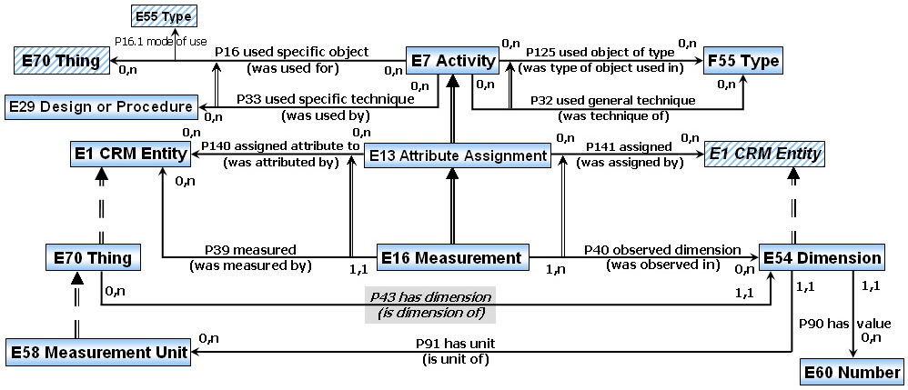
CRM Means: Short-cuts and Long-cuts
CRM considers some properties as "short-cuts" of longer, more elaborated "long-cuts". E.g. for Measurement:
  Short-cut: E70_Thing --P43_has_dimension-> E54_Dimension
  Long-cut: E1_CRM_Entity --P39B_was_measured_by-> E16_Measurement --P40_observed_dimension-> E54_Dimension. It allows us to record additional information about the Measurement, e.g. when it was made, by whom, etc
CIDOC CRM Properties
18 Sep 2012
#<number>

Slide 29
CRM Means: Short-cuts vs E13 (cont)
E13 is super-class of 4 long-cut classes:
  E14 Condition Assessment: P44 has condition
  E15 Identifier Assignment: P1 is identified by / P48 has preferred identifier
  E16 Measurement: P43 has dimension
  E17 Type Assignment: P2 has type
Other long-cuts are not derived from Е13 since they describe more complex business situations than assigning an attribute:
  E8 Acquisition: P51 has former or current owner, P52 has current owner
  E9 Move: P53 has former or current location, P55 has current location
  E10 Transfer of Custody: P49 former or current keeper, P50 has current keeper
  E36 Visual Item: P62 depicts
  E53 Place: P56 bears feature
  E53 Place, E46 Section Definition: P8 took place on or within
  E46 Section Definition: P59 has section
  E12 Production / E65 Creation: P130 shows features of
CIDOC CRM Properties
18 Sep 2012
#<number>

Slide 30
Problems with Short-cuts and E13
CRM : "An instance of the fully-articulated path always implies an instance of the shortcut property".
  Disagree, since the long-cut may have a status of Tentative, Proposed, Suggested or even Formerly Thought To Be (i.e. not currently considered true), while the short-cut should be considered true.
CRM: "E13 Attribute Assignment allows for the documentation of how the assignment of any property came about, and whose opinion it was, even in cases of properties not explicitly characterized as shortcuts".
  Unfortunately not true, because E13 doesn't mention the property being documented. E.g. you cannot document P14_carried_out_by but it's important in CH when it concerns the authorship of a work of art ("attribution")
Domains and ranges of short-cuts and long-cuts do not always agree.
  E.g. you can Measure any E1 Entity, but can say "P43 has dimension" only about E70 Thing (which are persistent things, different from Actors)
CIDOC CRM Properties
18 Sep 2012
#<number>

Slide 31
SOLUTION ALTERNATIVES
CIDOC CRM Properties
18 Sep 2012
#<number>

Slide 32
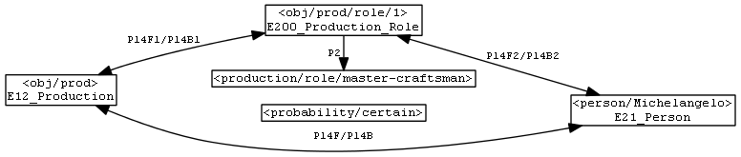
Solution 1: Split Properties
<obj/prod> P14F_carried_out_by <person/Michelangelo>.
<obj/prod> P14F_carried_out_by <person/GiovanniUnderstudy>.
<obj/prod> P14F1_carried_out_role <obj/prod/role/1>, <obj/prod/role/2>.
<obj/prod/role/1> a E200_Production_Role;
P14F2_carried_out_actor <person/Michelangelo>;
P2F_has_type <production/role/master-craftsman>;
P200F_has_probability <probability/certain>.
<obj/prod/role/2> a E200_Production_Role;
P14F2_carried_out_actor <person/GiovanniUnderstudy>;
P2F_has_type <production/role/understudy>;
P200F_has_probability <probability/proposed>.
CIDOC CRM Properties
18 Sep 2012
#<number>
Notes:
We split P14 into P14F1 and P14F2.
Types, data and annotations can be attached easily to the intermediate node (here called E200_Production_Role).
Here we attach:
roles (<production/role/master-craftsman> vs <production/role/understudy>)
probability (<probability/certain> vs <probability/proposed>)

Slide 33
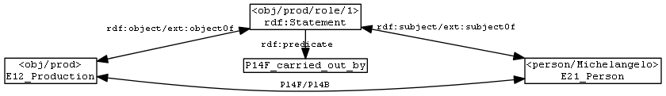
Solution 2: Statement Reification
RDF Reification Vocabulary (similar to E13 Attribute Assignment):
  rdf:Statement: intermediate node (E13 Attribute Assignment)
  rdf:subject: points to the triple's subject (P140 assigned attribute to)
  rdf:predicate: URI of the property (missing in CRM)
  rdf:object: points to the triple's object (P141 assigned)
Isomorphic to Solution 1 but is generic (property-independent)
CIDOC CRM Properties
18 Sep 2012
#<number>

Slide 34
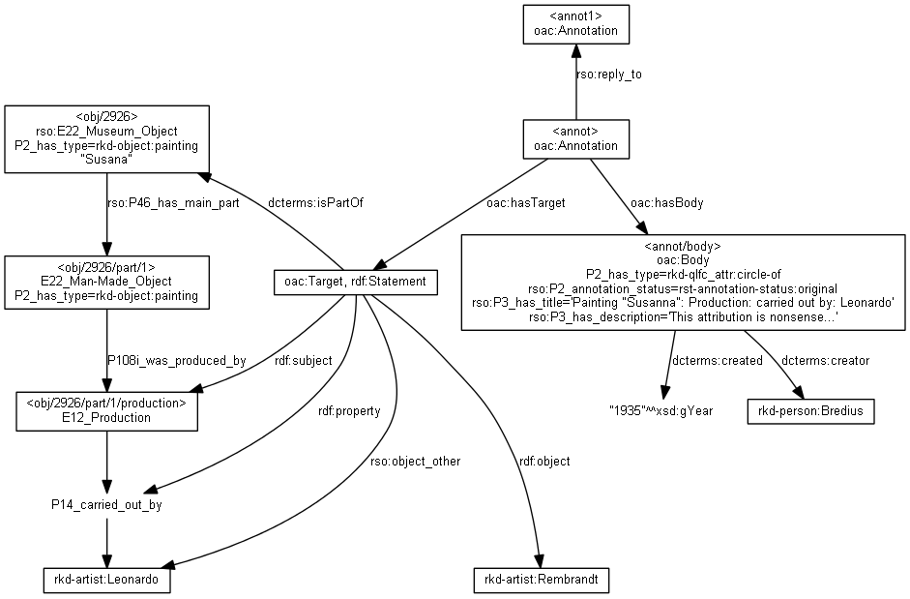
Solution 2 example: Annotation in ResearchSpace
CIDOC CRM Properties
18 Sep 2012
#<number>
Notes:
Uses RDF Reification (rdf:Statement) and the Open Annotation Collaboration ontology (oac:Annotation, oac:Target, oac:Body) to represent annotation of a statement.
The statement is also connected to the museum object that it is part of using dcterms:isPartOf. This allows us to find all annotations concerning the current museum object

Slide 35
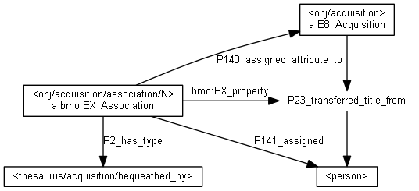
Solution 2 example: BM Association Mapping
bmo:EX_Associaton is a subclass of E13 that adds PX_property.
Used by BM to extend CRM properties (e.g. P23_transferred_title_from) to represent more specific situations such as Bequeathal (transferring title without any remuneration)
CIDOC CRM Properties
18 Sep 2012
#<number>

Slide 36
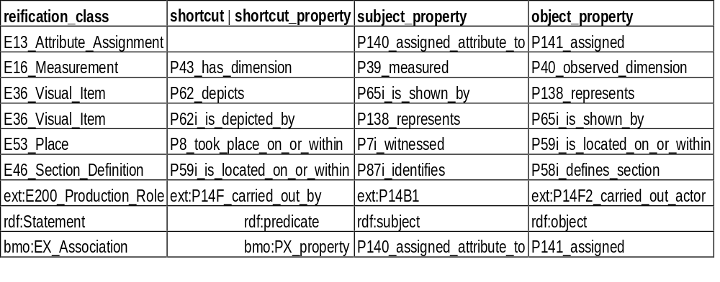
Solution 3: Property Reification Vocabulary
Describes reification (short-cut vs long-cut) patterns explicitly
A record with prv:shortcut is specific: applies only to that shortcut
A record with prv:shortcut_property is generic: it can point to different properties
The trouble with E13 is that it has neither prv:shortcut, nor prv:shortcut_property
CIDOC CRM Properties
18 Sep 2012
#<number>

Slide 37
Solution 4: Named Graphs
We could put the statements in separate Named Graphs (TriG notation):
<obj/prod/role/1> {
<obj/prod> P14F_carried_out_by <person/Michelangelo> }
<obj/prod/role/2> {
<obj/prod> P14F_carried_out_by <person/GiovanniUnderstudy> }
And then add data about these named graphs:
{ # default named graph
<obj/prod/role/1> a E200_Production_Role;
P2F_has_type <production/role/master-craftsman>;
P200F_has_probability <probability/certain>.
<obj/prod/role/2> a E200_Production_Role;
P2F_has_type <production/role/understudy>;
P200F_has_probability <probability/proposed>.}
Appropriate if we want to annotate several statements, but forces us to talk about complete statements. Sample SPARQL query:
SELECT ?person ?type ?probability WHERE {
GRAPH ?role {<obj/prod> P14F_carried_out_by ?person}.
?role P2F_has_type ?type; P200F_has_probability ?probability.}
CIDOC CRM Properties
18 Sep 2012
#<number>
Notes:
We split P14 into P14F1 and P14F2.
Types, data and annotations can be attached easily to the intermediate node (here called E200_Production_Role).
Here we attach:
roles (<production/role/master-craftsman> vs <production/role/understudy>)
probability (<probability/certain> vs <probability/proposed>)

