Slide 1
Large-scale Reasoning with a Complex Cultural Heritage Ontology (CIDOC CRM)
Vladimir Alexiev, Dimitar Manov, Jana Parvanova, Svetoslav Petrov
Practical Experiences with CIDOC CRM and its Extensions (CRMEX 2013)
TPDL 2012, 26 Sep 2013, Malta

Slide 2
Agenda
ResearchSpace project
RS Semantic Search
Fundamental Relation (FR) search
Implemented FRs
OWLIM Rules
Example: FR92i_created_by
Sub-FRs and Dependency Graph
Complexity: Classes (Type statements)
Complexity: Properties
Comparison to Other Repositories
Performance of Straight SPARQL Implementation
Performance of OurImplementation
Large-scale Reasoning with CIDOC CRM
CRMEX 2013
#<number>

Slide 3
ResearchSpace (RS) Project
Funded by Mellon Foundation, run by the British Museum, sw dev by Ontotext
  Stage 3 (Working Prototype): developed between Nov 2011 and Apr 2013.
  Stage 4: expected to start in 2013, with more development and more museums/galleries on board
Support collaborative research projects for CH scholars
  Open source framework and hosted environment for web-based research, knowledge sharing and web publishing
Intends to provide:
  Data conversion and aggregation (LIDO/CDWA/similar to CIDOC CRM)
  Semantic search based on Fundamental Relations
  Collaboration tools, such as forums, tags, data baskets, sharing, dashboards
  Research tools , such as Image Annotation, Image Compare, Timeline and Geographical Mapping...
  Web Publication
Semantic technology is at the core of RS because it provides effective data integration across different organizations and projects.
  Uses Ontotext's OWLIM repository: powerful reasoning (equivalent to OWL2 RL), fast performance, efficient multi-user access, full SPARQL 1.1 support, incremental assert and retract
Large-scale Reasoning with CIDOC CRM
CRMEX 2013
#<number>

Slide 4
RS Semantic Search
Allows a user that is not familiar with CRM or the BM data to perform simple and intuitive searches.
Features:
  Intuitive "sentence-based" UI
  Searches can be saved, bookmarked (put in a "data basket"), edited, shared between users
  Auto-completion across all searchable thesauri. Available search relations and appropriate Thesauri are coordinated
  Search across datasets. E.g. once the entity "Rembrandt" is co-referenced between the BM People and RKD Artists thesauri, paintings by Rembrandt can be found across the BM and RKD datasets
  Faceting of search results
  Details, thumbnails (lightbox), list, timeline view
  Put search result to data basket, invoke RS tool
Large-scale Reasoning with CIDOC CRM
CRMEX 2013
#<number>

Slide 5
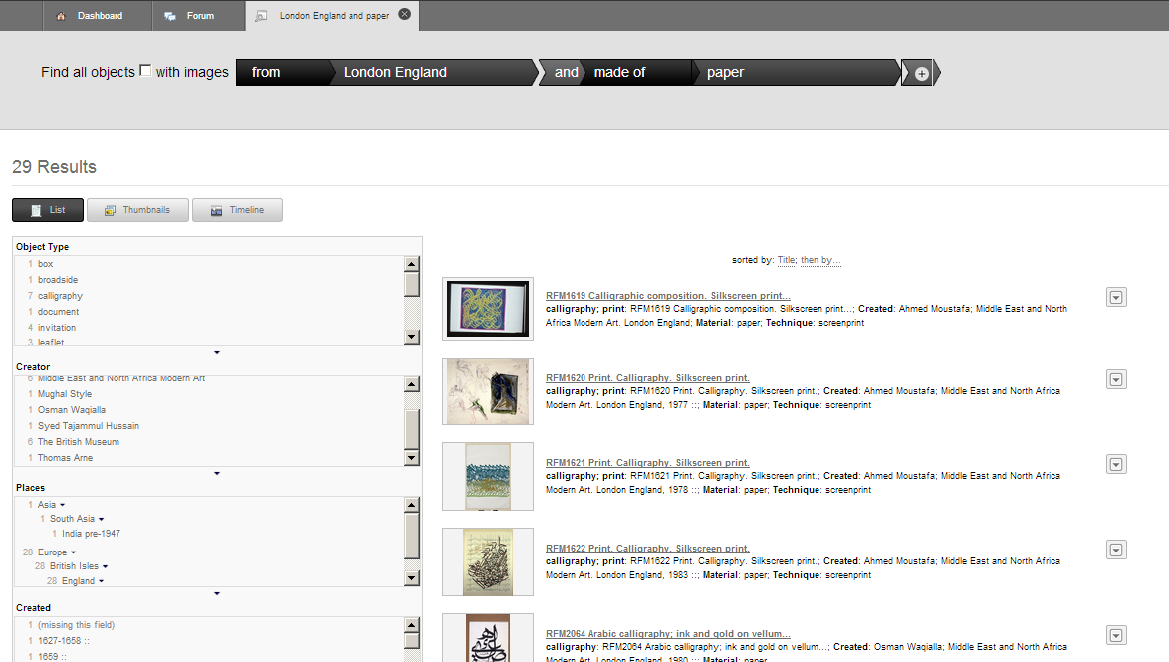
RS Search: Example 1
Large-scale Reasoning with CIDOC CRM
CRMEX 2013
#<number>

Slide 6
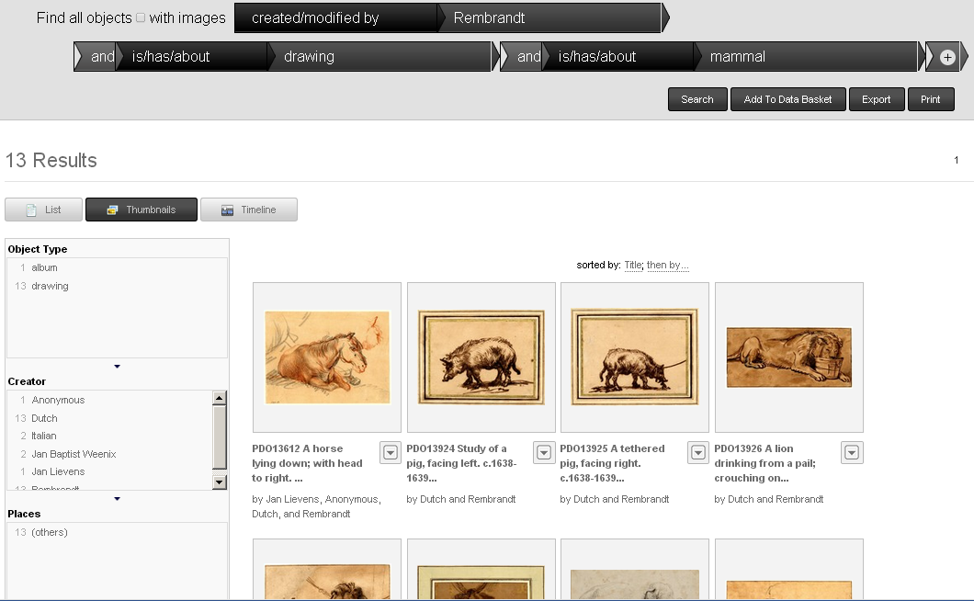

RS Search: Example 2
Finds narrower terms
RS Video by Dominic Oldman (RS PI and BM IT dev manager)
http://www.youtube.com/watch?v=HCnwgq6ebAs
Large-scale Reasoning with CIDOC CRM
CRMEX 2013
#<number>

Slide 7
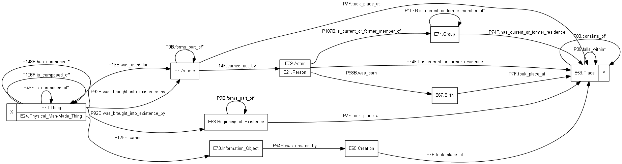
Fundamental Relation (FR) Search
How does a user search through a large CRM network?
An answer: Fundamental Relations.
  Aggregate a large number of paths through CRM data into a smaller number of searchable relations.
  Provide a "search index" over the CRM relations
E.g.: FR "Thing from Place"
Initial implementation presented at SDA 2012 (TPDL 2012), Sep 2012, Cyprus (CEUR WS Vol.912)
Large-scale Reasoning with CIDOC CRM
CRMEX 2013
#<number>

Slide 8
Implemented FRs
N | FR | Description
1 | FR92i_created_by | Thing (or part/inscription thereof) was created or modified/repaired by Actor (or group it is member of, e.g. Nationality)
2 | FR15_influenced_by | Thing's production was influ-enced/motivated by Actor (or group it is member of). E.g.: Manner/ School/ Style of; or Issuer, Ruler, Magistrate who authorised, patronised, ordered the produc-tion.
3 | FR52_current_owner_keeper | Thing has current owner or keeper Actor
4 | FR51_former_or_current_owner_keeper | Thing has former or current owner or keeper Actor, or ownership/custody was transferred from/to actor in Acquisition/Transfer of Custody event
5 | FR67_about_actor | Thing depicts or refers to Actor, or carries an information object that is about Actor, or bears similarity with a thing that is about Actor
6 | FR12_has_met | Thing (or another thing it is part of) has met actor in the same event (or event that is part of it)
7 | FR67_about_period | Thing depicts or refers to Event/Period, or carries an information object that is about Event, or bears similarity with a thing that is about Event
8 | FR12_was_present_at | Thing was present at Event (eg exhi-bition) or is from Period
9 | FR92i_created_in | Thing (or part/inscription thereof) created or modified/repaired at/in place (or a broader containing place)
10 | FR55_located_in | Thing has current or permanent location in Place (or a broader containing place)
11 | FR12_found_at | Thing was found (discovered, excavated) at Place (or a broader containing place)
12 | FR7_from_place | Thing has former, current or permanent location at place, or was created/found at place, or moved to/from place, or changed ownership/custody at place (or a broader containing place)
13 | FR67_about_place | Thing depicts or refers to a place or fea-ture located in place, or is similar in features or composed of or carries an infor-mation object that depicts or refers to a place
14 | FR2_has_type | Thing is of Type, or has Shape, or is of Kind, or is about or depicts a type (e.g. IconClass or subject heading)
15 | FR45_is_made_of | Thing (or part thereof) consists of ma-terial
16 | FR32_used_technique | The production of Thing (or part thereof) used general technique
17 | luc:myIndex | The full text of the thing's description (including the-saurus terms and textual descriptions) matches the given keyword. FTS using Lucene built into OWLIM.
18 | FR108i_82_produced_within | Thing was created within an interval that intersects the given interval or year.
19 | FR1_identified_by | Thing (or part thereof) has Identifier. Exact-match string
20 | FR138i_has_representation | Thing has at least one image repre-sentation. Used to select objects that have images
21 | FR138i_representation | Thing has image representation. Used to fetch all images of an object
22 | FR_main_representation | Thing has main image representation. Used to display object thumbnail in search results
23 | FR_dataset | Thing belongs to indicated dataset. Used for faceting by dataset
Large-scale Reasoning with CIDOC CRM
CRMEX 2013
#<number>

Slide 9
OWLIM Rules
OWLIM reasoning features:
  Custom rule-sets. The standard semantics that OWLIM supports (RDFS, RDFS Horst, OWL RL, QL and DL) are also implemented as rulesets.
  Fully-materializing forward-chaining reasoning. Rule consequences are stored in the repository and query answering is very fast.
  sameAs optimization that allows fast cross-collection search using coreferenced values
  Incremental retraction: when a triple is deleted, OWLIM removes all inferred consequences that are left without support (recursively)
  Incremental insert: when a triple is inserted (even an ontology triple), all rules are checked. If a rule fires, the new conclusion is also checked against the rules, etc.
  Efficient rule execution: rules are compiled to Java and executed quickly
120 OWLIM Rules to implement 23 FRs:
  14 rules implement RDFS reasoning, owl:TransitiveProperty, owl:inverseOf (OWL) and ptop:transitiveOver (PROTON )
  106 rules implement FRs. Used a method of decomposing an FR to sub-FR : conjunctive (e.g. checking the type of a node), disjunctive (parallel), serial (property path), transitive
Large-scale Reasoning with CIDOC CRM
CRMEX 2013
#<number>

Slide 10

Example: FR92i_created_by
Thing created by Actor
  Thing (or part/inscription thereof) was created or modified/repaired by Actor (or a group it is a member of)
Source properties:
  P46_is_composed_of, P106_is_composed_of, P148_has_component: navigates object part hierarchy
  P128_carries: to transition from object to Inscription carried by it
  P31i_was_modified_by (includes P108i_was_produced_by), P94i_was_created_ by: Modification/Production of physical thing, Creation of conceptual thing (Inscription)
  P9_consists_of: navigates event part hierarchy (BM models uncorrelated production facts as sub-events)
  P14_carried_out_by, P107i_is_current_or_former_member_of: agent and groups he's member of
Sub-FRs
  FRT_46_106_148_128 := (P46|P106|P148|P128)+
  FRX92i_created := (FC70_Thing) FRT_46_106_148_128* / (P31i | P94i) / P9*
  FR92i_created_by := FRX92i_created / P14 / P107i*
Large-scale Reasoning with CIDOC CRM
CRMEX 2013
#<number>

Slide 11
Rules for FR92i_created_by
Use a simple shortcut notation
  Script translates ";" to newline and "=>" to "---------"
  Also weaves from wiki
  Checks variable linearity
  Generates dependency graph (see next)
10 rules for FRT_46_106_148_128
7 rules for FR92i_created_by:
x <rdf:type> <rso:FC70_Thing>; x <crm:P31i_was_modified_by> y => x <rso:FRX92i_created> y
x <rdf:type> <rso:FC70_Thing>; x <crm:P94i_was_created_by> y => x <rso:FRX92i_created> y
x <rso:FRT_46_106_148_128> y; y <crm:P31i_was_modified_by> z => x <rso:FRX92i_created> z
x <rso:FRT_46_106_148_128> y; y <crm:P94i_was_created_by> z => x <rso:FRX92i_created> z
x <rso:FRX92i_created> y; y <crm:P9_consists_of> z => x <rso:FRX92i_created> z
x <rso:FRX92i_created> y; y <crm:P14_carried_out_by> z => x <rso:FR92i_created_by> z
x <rso:FRX92i_created> y; y <crm:P14_carried_out_by> z; z <rso:FRT107i_member_of> t
=> x <rso:FR92i_created_by> t
Large-scale Reasoning with CIDOC CRM
CRMEX 2013
#<number>

Slide 12
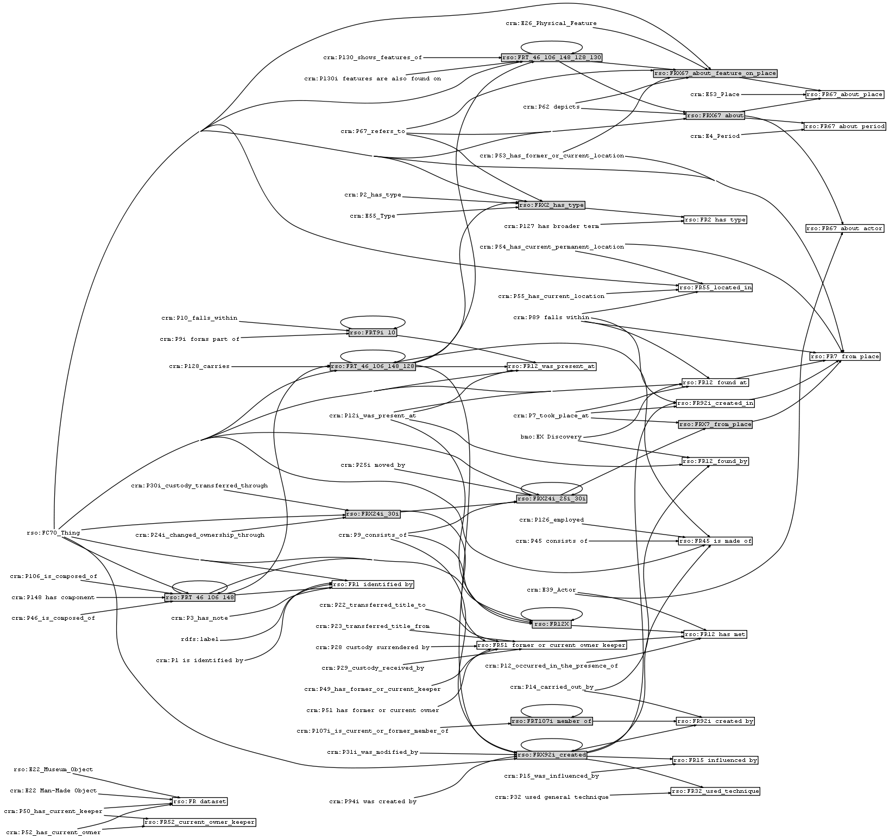
Sub-FRs and Dependency Graph
51 source classes/properties, shown as plain text
13 intermediate sub-FRs, shown as filled rectangles. Used by several FRs to simplify the implementation
19 target FRs, shown as rectangles
Large-scale Reasoning with CIDOC CRM
CRMEX 2013
#<number>

Slide 13
Volumetrics
Museum objects: 2,051,797 (most from the British Museum)
  Currently completing the ingest of Yale Center for British Art objects to RS (50k)
Thesaurus entries: 415,509 (skos:Concept)
  All kinds of "fixed" values that are used for search: object types, materials, techniques, people, places, … (a total of 90 ConceptSchemes)
Explicit statements: 195,208,156. We estimate that of these:
  185M are for objects (90 statements/object)
  9M are for thesaurus entries (22 statements/term)
Total statements: 916,735,486.
  Expansion ratio is 4.7x (i.e. for each statement, 3.7 more are inferred)
  Considerably higher compared to the typical expansion for general datasets
Nodes (unique URLs and literals): 53,803,189 (don't use blank nodes)
Repository size: 42 Gb
  Object full-text index: 2.5 Gb, thesaurus full-text index (used for search auto-complete): 22Mb.
Loading time (including all inferencing):
  22.2h on RAM drive
  32.9h on hard-disks
Large-scale Reasoning with CIDOC CRM
CRMEX 2013
#<number>

Slide 14
Complexity: Classes (Type statements)
238 classes, some of the top are summarizes in the table
415k skos:Concept (terms)
2M FC70_Thing (museum objects)
Hierarchy is 10 levels deep : E1>E77>E70>E71>E28>E90> E73>E36>E37>E34
For each Inscription, 12 type statements are inferred
6.3M E12_Production, repeated as the super-class E11_Modification, plus a few hundred Repairs
Each E12 also repeated as E63_Beginning_of_Existence; plus 100k Birth and Formation
Each E7 repeated as E5_Event, which is repeated as E4_Period (plus 19k historic Periods) and E2_Temporal_Entity
37% of all statements are type statements!
Class | Statement
owl:Thing | 36485904
E1_CRM_Entity | 36485903
E77_Persistent_Item | 17408450
E70_Thing | 17339714
E71_Man-Made_Thing | 17216212
E72_Legal_Object | 17192518
E28_Conceptual_Object | 14776488
E90_Symbolic_Object | 14629292
E2_Temporal_Entity | 11924877
E4_Period | 11924877
E5_Event | 11922986
E7_Activity | 11796470
E63_Beginning_of_Existence | 6377421
E11_Modification | 6296015
E12_Production | 6295825
rso:FC70_Thing | 2051797
skos:Concept | 415509
Total | 302149587
Lawyers of the world, rejoice!
museum objects
Terms, people, places, materials, techniques..
Large-scale Reasoning with CIDOC CRM
CRMEX 2013
#<number>

Slide 15
Reduce types: owl:Restriction vs Mixins
Erlangen CRM states owl:Restrictions, e.g.:
E72_Legal_Object SubClassOf: E70_Thing,
P104_is_subject_to some E30_Right,
P105_right_held_by some E39_Actor
  M.Doerr has criticized this for ontological over-commitment
  We don't need them so we cut them with XQuery tool deriving simpler profiles
E72_Legal_Object:
  Scope note: "material or immaterial items to which instances of E30 Right, such as the right of ownership or use, can be applied"
  Do we really need it it in the main hierarchy?
Just state P104 domain, and E72 will be inferred as needed
  Akin to Common Lisp mixins or Ruby traits
PSNC gives up rdfs:subClassOf inference
  Using OWLIM custom rules (flexibility is good!)
  For one node, all classes can be found with SPARQL 1.1 Path queries
  May be a bit drastic…
Large-scale Reasoning with CIDOC CRM
CRMEX 2013
#<number>

Slide 16
Complexity: Properties
Properties | Statements | Percent
rdf:type | 302149587 | 37.50%
Objects: CRM, rdfs:label | 365430152 | 45.35%
Extensions: BMO, RSO | 35903831 | 4.46%
FRs (70M=9%) and sub-FRs (26M=3%) | 96526377 | 11.98%
Thesauri: BIBO, DC, DCT, FOAF, SKOS, QUDT, VAEM | 5715250 | 0.71%
Ontology: RDF, RDFS, OWL | 4159 | 0.00%
Total | 805729356 | 100.00%
CRM inverses | 149465596 | 18.55%
Total 339 properties, grouped above
Type statements take 37%: too much (see prev slides)
Inverses (79) are convenient, but take 18% (duplicates)
Sub-properties: max depth is 4 (e.g.: P12>P11>P14>P22).
No estimate of the sub-property inference, sorry
Objects take the majority: 45%
Thesauri and ontologies are negligible: 0.7%
FRs take only 12%, which doesn't slow OWLIM perceptibly
Large-scale Reasoning with CIDOC CRM
CRMEX 2013
#<number>

Slide 17
Comparison to Other Repositories
Repo | Objects |  | Expl.stat. |  | Ex.st/obj |  | Total stat. |  | Expans. |  | Nodes |  | Density |  | Reasoning
CRM | 2.0 | 1 | 195 | 1 | 90 | 1 | 916 | 1 | 4.7 | 1 | 54 | 1 | 17.0 | 1 | rdfs+tran+FR
PSNC | 3.1 | 1.5 | 234 | 1.2 | 75 | 0.83 | 535 | 0.58 | 2.3 | 0.49 | 60 | 1.1 | 8.9 | 0.52 | rdfs-subClass
EDM | 20.3 | 9.8 | 998 | 5.1 | 50 | 0.56 | 3798 | 4.1 | 3.8 | 0.8 | 266 | 4.9 | 14.3 | 0.84 | owl-horst
FF |  |  | 1673 | 8.6 |  |  | 3211 | 3.5 | 1.9 | 0.4 | 456 | 8.4 | 7.0 | 0.41 | owl-horst
LLD |  |  | 6706 | 34 |  |  | 10192 | 11 | 1.5 | 0.3 | 1554 | 29 | 6.6 | 0.38 | rdfs+tran
Repos:
  RS CRM: http://test.researchspace.org:8081
  PSNC Polish Digital Library: http://dl.psnc.pl
  Europeana EDM: http://europeana.ontotext.com
  FactForge: http://www.factforge.net
  LinkedLifeData: http://linkedlifedata.com
First col is Million triples (exc. Expansion/Density), second col is ratio to CRM
Expansion=Total statements/Explicit statements: intensity of inference
Nodes=unique URIs and literals
Density=Statements/Nodes: relative density of the graph
Large-scale Reasoning with CIDOC CRM
CRMEX 2013
#<number>

Slide 18
Performance: SPARQL Implementation
Straight SPARQL 1.1 for
"FR92i_created_by rkd-artist:Rembrandt":
RS endpoint takes over 15 minutes to answer. If you add more FRs, even worse. The reflexive * really kills it
The query can be optimized a bit by using intermediate variables instead of property paths, but the performance is still untenable
select distinct ?obj {
?obj a rso:FC70_Thing;
(crm:P46_is_composed_of|crm:P106_is_composed_of|crm:P148_has_component|crm:P128_carries)*/
(crm:P31i_was_modified_by|crm:P94i_was_created_by) / crm:P9_consists_of* /
crm:P14_carried_out_by / crm:P107i_is_current_or_former_member_of*
rkd-artist:Rembrandt
} limit 20
Large-scale Reasoning with CIDOC CRM
CRMEX 2013
#<number>

Slide 19
Performance: our Implementation
Objects by Rembrandt: sub-second response time:
select distinct ?obj {?obj rso:FR92i_created_by rkd-artist:Rembrandt} limit 500
Find terms "drawing" and "mammal":
select * {?s rdfs:label "drawing"} → thes:x6544
select * {?s rdfs:label "mammal"} → thes:x12965
Drawings by Rembrandt about mammals: still sub-second response time, and the query is simple:
select distinct ?obj {
?obj rso:FR92i_created_by rkd-artist:Rembrandt;
rso:FR2_has_type thes:x6544, thes:x12965} limit 500
RS search takes 4.5s (significantly longer than the query alone) because after obtaining up to 500 objects, it executes several more queries to fetch their display fields, facets, and images
Facets are loaded into the browser using Exhibit, so subsequent facet restrictions are immediate
Large-scale Reasoning with CIDOC CRM
CRMEX 2013
#<number>

Slide 20

Thanks for listening!
Questions? vladimir.alexiev@ontotext.com
Large-scale Reasoning with CIDOC CRM
CRMEX 2013
#<number>

