Slide 1
Definitions and Glossary
Primary Insurance: Most prevalent payer across all encounters for the patient.
First Diagnosis: Payer mode within ±30 days of first HL diagnosis date.
First Chemo / Radiation / SCT: Payer mode within ±30 day window of first treatment date for that treatment type.
Last Chemo / Radiation / SCT: Payer mode within ±30 day window of last treatment date for that treatment type.
Post-Treatment Insurance: Most prevalent payer after last treatment of any type.
Missing: Consolidation of Unknown, Unavailable, Other, and No Information payer categories.
No Payer Assigned: No encounter with valid payer data found in the ±30 day window around the relevant date.
N/A (No Follow-up): Last treatment encounter was the patient's final encounter in the dataset (±30 days).
N/A (No Treatment): Patient had no recorded treatment of that type.
ENR Covers Window: Patient has enrollment records spanning the full ±30 day window around the event date.
ENR Does Not Cover: Patient's enrollment records do not fully cover the ±30 day window.
Hodgkin Lymphoma Cohort -- N = 8,770 | Chemo: 7,337 | Radiation: 1,207 | SCT: 953

Slide 2
Insurance Coverage Overview
All enrolled patients — N = 8,770
Payer Category | Primary Insurance | First Diagnosis
Medicare | 647 (7.4%) | 343 (3.9%)
Medicaid | 3,161 (36%) | 2,942 (33.5%)
Dual eligible | 809 (9.2%) | 536 (6.1%)
Private | 1,941 (22.1%) | 1,090 (12.4%)
Other government | 100 (1.1%) | 91 (1%)
No payment / Self-pay | 211 (2.4%) | 153 (1.7%)
Missing | 1,901 (21.7%) | 3,615 (41.2%)
Total | 8,770 (100%) | 8,770 (100%)
Primary Insurance = most prevalent payer across all encounters. First Diagnosis = payer mode within ±30 days of first HL diagnosis date.

Slide 3
Post-Treatment Insurance — All Patients
Most prevalent payer after last treatment — N = 8,770
Payer Category | Post-Treatment Insurance
Medicare | 269 (3.1%)
Medicaid | 1,379 (15.7%)
Dual eligible | 480 (5.5%)
Private | 708 (8.1%)
Other government | 33 (0.4%)
No payment / Self-pay | 97 (1.1%)
Missing | 191 (2.2%)
N/A (No Follow-up) | 5,613 (64%)
Total | 3,157 (36%)
Post-Treatment Insurance = most prevalent payer after last treatment of any type. N/A (No Follow-up) = last treatment was patient's final encounter (±30 days).

Slide 4
Chemotherapy Insurance
Insurance at primary, first, and last chemotherapy — N = 7,337
Payer Category | Primary Insurance | First Chemo | Last Chemo
Medicare | 621 (8.5%) | 495 (6.7%) | 704 (9.6%)
Medicaid | 2,574 (35.1%) | 2,271 (31%) | 1,810 (24.7%)
Dual eligible | 531 (7.2%) | 305 (4.2%) | 544 (7.4%)
Private | 1,787 (24.4%) | 1,670 (22.8%) | 1,464 (20%)
Other government | 92 (1.3%) | 126 (1.7%) | 99 (1.3%)
No payment / Self-pay | 195 (2.7%) | 277 (3.8%) | 233 (3.2%)
Missing | 1,537 (20.9%) | 2,193 (29.9%) | 2,483 (33.8%)
Total | 7,337 (100%) | 7,337 (100%) | 7,337 (100%)
Primary Insurance = most prevalent payer across all encounters. First/Last Chemo = payer mode within ±30 days of first/last chemotherapy date.

Slide 5
Chemotherapy Post-Treatment Insurance
Most prevalent payer after last chemotherapy — N = 7,337
Payer Category | Post-Treatment Insurance
Medicare | 268 (3.7%)
Medicaid | 1,398 (19.1%)
Dual eligible | 472 (6.4%)
Private | 709 (9.7%)
Other government | 34 (0.5%)
No payment / Self-pay | 96 (1.3%)
Missing | 190 (2.6%)
N/A (No Follow-up) | 4,170 (56.8%)
Total | 3,167 (43.2%)
Post-Treatment Insurance = most prevalent payer after last chemotherapy. N/A (No Follow-up) = last chemo was patient's final encounter (±30 days).

Slide 6
Radiation Insurance
Insurance at primary, first, and last radiation — N = 1,207
Payer Category | Primary Insurance | First Radiation | Last Radiation
Medicare | 59 (4.9%) | 37 (3.1%) | 40 (3.3%)
Medicaid | 639 (52.9%) | 590 (48.9%) | 577 (47.8%)
Dual eligible | 114 (9.4%) | 95 (7.9%) | 105 (8.7%)
Private | 206 (17.1%) | 126 (10.4%) | 120 (9.9%)
Other government | 9 (0.7%) | 10 (0.8%) | 9 (0.7%)
No payment / Self-pay | 16 (1.3%) | 18 (1.5%) | 17 (1.4%)
Missing | 164 (13.6%) | 331 (27.4%) | 339 (28.1%)
Total | 1,207 (100%) | 1,207 (100%) | 1,207 (100%)
Primary Insurance = most prevalent payer across all encounters. First/Last Radiation = payer mode within ±30 days of first/last radiation date.

Slide 7
Radiation Post-Treatment Insurance
Most prevalent payer after last radiation — N = 1,207
Payer Category | Post-Treatment Insurance
Medicare | 51 (4.2%)
Medicaid | 521 (43.2%)
Dual eligible | 137 (11.4%)
Private | 122 (10.1%)
Other government | 6 (0.5%)
No payment / Self-pay | 14 (1.2%)
Missing | 14 (1.2%)
N/A (No Follow-up) | 342 (28.3%)
Total | 865 (71.7%)
Post-Treatment Insurance = most prevalent payer after last radiation. N/A (No Follow-up) = last radiation was patient's final encounter (±30 days).

Slide 8
Stem Cell Transplant Insurance
Insurance at primary, first, and last SCT — N = 953
Payer Category | Primary Insurance | First SCT | Last SCT
Medicare | 53 (5.6%) | 48 (5%) | 52 (5.5%)
Medicaid | 331 (34.7%) | 281 (29.5%) | 218 (22.9%)
Dual eligible | 53 (5.6%) | 45 (4.7%) | 83 (8.7%)
Private | 249 (26.1%) | 225 (23.6%) | 194 (20.4%)
Other government | 11 (1.2%) | 13 (1.4%) | 11 (1.2%)
No payment / Self-pay | 20 (2.1%) | 26 (2.7%) | 29 (3%)
Missing | 236 (24.8%) | 315 (33.1%) | 366 (38.4%)
Total | 953 (100%) | 953 (100%) | 953 (100%)
Primary Insurance = most prevalent payer across all encounters. First/Last SCT = payer mode within ±30 days of first/last stem cell transplant date.

Slide 9
SCT Post-Treatment Insurance
Most prevalent payer after last SCT — N = 953
Payer Category | Post-Treatment Insurance
Medicare | 56 (5.9%)
Medicaid | 170 (17.8%)
Dual eligible | 66 (6.9%)
Private | 155 (16.3%)
Other government | 7 (0.7%)
No payment / Self-pay | 26 (2.7%)
Missing | 27 (2.8%)
N/A (No Follow-up) | 446 (46.8%)
Total | 507 (53.2%)
Post-Treatment Insurance = most prevalent payer after last SCT. N/A (No Follow-up) = last SCT was patient's final encounter (±30 days).

Slide 10
Diagnosis — Insurance by Enrollment Coverage
Payer at first HL diagnosis: patients with vs without enrollment covering ±30 day window
Payer Category | ENR Covers Window | ENR Does Not Cover
Medicare | 108 (6.2%) | 235 (3.3%)
Medicaid | 596 (34.2%) | 2,346 (33.4%)
Dual eligible | 221 (12.7%) | 315 (4.5%)
Private | 244 (14%) | 846 (12%)
Other government | 19 (1.1%) | 72 (1%)
No payment / Self-pay | 34 (2%) | 119 (1.7%)
Missing | 520 (29.9%) | 3,095 (44%)
No Payer Assigned | 0 (0%) | 0 (0%)
Total | 1,742 (100%) | 7,028 (100%)
ENR Covers Window = enrollment records span the full ±30 day window around first HL diagnosis. ENR Does Not Cover = enrollment gap in that window.

Slide 11
Chemotherapy — Insurance by Enrollment Coverage
Payer at first/last chemo: patients with vs without enrollment covering ±30 day window
Payer Category | First Chemo ENR Covers | First Chemo ENR Gap | Last Chemo ENR Covers | Last Chemo ENR Gap
Medicare | 91 (5.9%) | 404 (7%) | 136 (7.7%) | 568 (10.2%)
Medicaid | 448 (29.2%) | 1,823 (31.4%) | 499 (28.2%) | 1,311 (23.5%)
Dual eligible | 88 (5.7%) | 217 (3.7%) | 120 (6.8%) | 424 (7.6%)
Private | 290 (18.9%) | 1,380 (23.8%) | 293 (16.6%) | 1,171 (21%)
Other government | 22 (1.4%) | 104 (1.8%) | 16 (0.9%) | 83 (1.5%)
No payment / Self-pay | 46 (3%) | 231 (4%) | 25 (1.4%) | 208 (3.7%)
Missing | 547 (35.7%) | 1,646 (28.4%) | 680 (38.4%) | 1,803 (32.4%)
No Payer Assigned | 0 (0%) | 0 (0%) | 0 (0%) | 0 (0%)
Total | 1,532 (100%) | 5,805 (100%) | 1,769 (100%) | 5,568 (100%)
ENR Covers = enrollment records span the full ±30 day window around first/last chemotherapy. ENR Gap = enrollment gap in that window.

Slide 12
Radiation — Insurance by Enrollment Coverage
Payer at first/last radiation: patients with vs without enrollment covering ±30 day window
Payer Category | First Radiation ENR Covers | First Radiation ENR Gap | Last Radiation ENR Covers | Last Radiation ENR Gap
Medicare | 21 (5.2%) | 16 (2%) | 25 (6.1%) | 15 (1.9%)
Medicaid | 156 (38.8%) | 434 (53.9%) | 155 (37.8%) | 422 (52.9%)
Dual eligible | 36 (9%) | 59 (7.3%) | 40 (9.8%) | 65 (8.2%)
Private | 60 (14.9%) | 66 (8.2%) | 61 (14.9%) | 59 (7.4%)
Other government | 2 (0.5%) | 8 (1%) | 3 (0.7%) | 6 (0.8%)
No payment / Self-pay | 8 (2%) | 10 (1.2%) | 7 (1.7%) | 10 (1.3%)
Missing | 119 (29.6%) | 212 (26.3%) | 119 (29%) | 220 (27.6%)
No Payer Assigned | 0 (0%) | 0 (0%) | 0 (0%) | 0 (0%)
Total | 402 (100%) | 805 (100%) | 410 (100%) | 797 (100%)
ENR Covers = enrollment records span the full ±30 day window around first/last radiation. ENR Gap = enrollment gap in that window.

Slide 13
SCT — Insurance by Enrollment Coverage
Payer at first/last SCT: patients with vs without enrollment covering ±30 day window
Payer Category | First SCT ENR Covers | First SCT ENR Gap | Last SCT ENR Covers | Last SCT ENR Gap
Medicare | 28 (7.9%) | 20 (3.4%) | 28 (8.7%) | 24 (3.8%)
Medicaid | 60 (16.9%) | 221 (37%) | 44 (13.6%) | 174 (27.6%)
Dual eligible | 12 (3.4%) | 33 (5.5%) | 19 (5.9%) | 64 (10.2%)
Private | 117 (32.9%) | 108 (18.1%) | 88 (27.2%) | 106 (16.8%)
Other government | 5 (1.4%) | 8 (1.3%) | 4 (1.2%) | 7 (1.1%)
No payment / Self-pay | 12 (3.4%) | 14 (2.3%) | 13 (4%) | 16 (2.5%)
Missing | 122 (34.3%) | 193 (32.3%) | 127 (39.3%) | 239 (37.9%)
No Payer Assigned | 0 (0%) | 0 (0%) | 0 (0%) | 0 (0%)
Total | 356 (100%) | 597 (100%) | 323 (100%) | 630 (100%)
ENR Covers = enrollment records span the full ±30 day window around first/last SCT. ENR Gap = enrollment gap in that window.

Slide 14
Last Treatment = Last Encounter
Patients whose last treatment was within ±30 days of their last encounter (no follow-up)
Treatment Type | N With Treatment | Last Tx = Last Encounter | Had Follow-up Encounters
Any Treatment | 7,384 | 3,063 (41.5%) | 4,321 (58.5%)
Chemotherapy | 7,302 | 2,956 (40.5%) | 4,346 (59.5%)
Radiation | 1,111 | 73 (6.6%) | 1,038 (93.4%)
Stem Cell Transplant | 929 | 200 (21.5%) | 729 (78.5%)
Last Tx = Last Encounter: patient's last treatment date is within ±30 days of their last encounter date in the dataset.

Slide 15
Missing Post-Treatment Payer — Encounter Breakdown
Patients with Missing post-treatment payer: how many encounters exist after last treatment?
Payer Category | N Patients
0 | 1,965 (44.5%)
1-5 | 1,499 (33.9%)
6-10 | 348 (7.9%)
11-20 | 279 (6.3%)
21+ | 327 (7.4%)
Total | 4,418 (100%)
Shows how many post-treatment encounters exist for patients whose post-treatment payer is Missing or unassigned.

Slide 16
Insurance After Last Treatment — Dataset Retention
7,384 treated patients: 5,419 (73.4%) still in dataset, 1,965 (26.6%) no longer in dataset
Payer Category | Still in Dataset (N=5,419) | No Longer in Dataset (N=1,965)
Medicare | 269 (5%) | 290 (14.8%)
Medicaid | 1,379 (25.4%) | 213 (10.8%)
Dual eligible | 480 (8.9%) | 90 (4.6%)
Private | 708 (13.1%) | 530 (27%)
Other government | 33 (0.6%) | 42 (2.1%)
No payment / Self-pay | 97 (1.8%) | 79 (4%)
Missing | 191 (3.5%) | 721 (36.7%)
No Payer Assigned | 2,262 (41.7%) | 0 (0%)
Total | 5,419 (100%) | 1,965 (100%)
Still in Dataset = patient has encounters after last treatment. No Longer in Dataset = last treatment was final encounter (±30 days). Payer shown is post-treatment (still) or at last treatment (no longer).

Slide 17
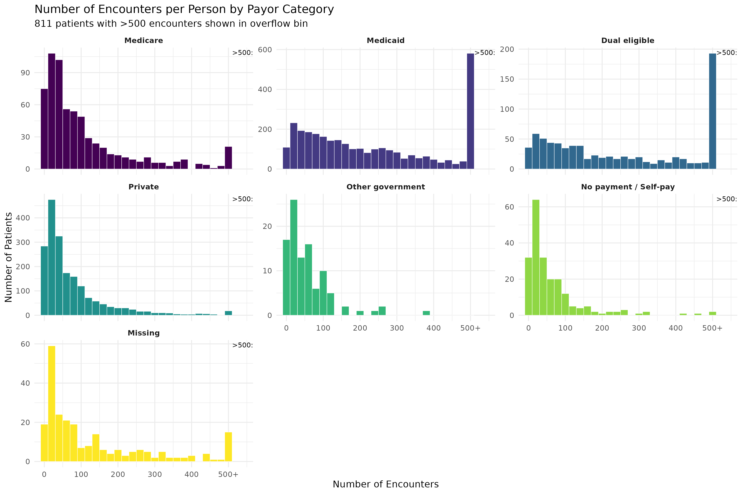
Encounters per Person by Payer Category
Distribution of total encounter counts by primary payer -- N = 8,770
Primary Insurance = most prevalent payer across all encounters. Payer categories consolidated to 6 + Missing.

Slide 18
Summary Statistics: Encounters per Person by Payer Category
Distribution of total encounter counts by primary insurance category -- N = 8,770
Payer Category | N | Mean | Median | Min | Q1 | Q3 | Max | 500+
Dual eligible | 809 | 447.7 | 210 | 2 | 77 | 473.0 | 8,631 | 191
Medicaid | 3,161 | 325.2 | 192 | 2 | 78 | 385.0 | 8,836 | 569
Medicare | 647 | 117.3 | 64 | 2 | 25 | 139.0 | 1,335 | 20
Missing | 1,901 | 117.4 | 66 | 2 | 22 | 154.0 | 1,161 | 58
No payment / Self-pay | 211 | 66.4 | 37 | 2 | 16 | 80.5 | 676 | 1
Other government | 100 | 58.2 | 42 | 2 | 14 | 77.5 | 387 | 0
Private | 1,941 | 77.3 | 42 | 2 | 18 | 95.0 | 1,085 | 17
Total | 8,770 | 212.0 | 93 | 2 | 32 | 243.0 | 8,836 | 856
Primary Insurance = most prevalent payer across all encounters. 500+ = patients with more than 500 total encounters.

Slide 19
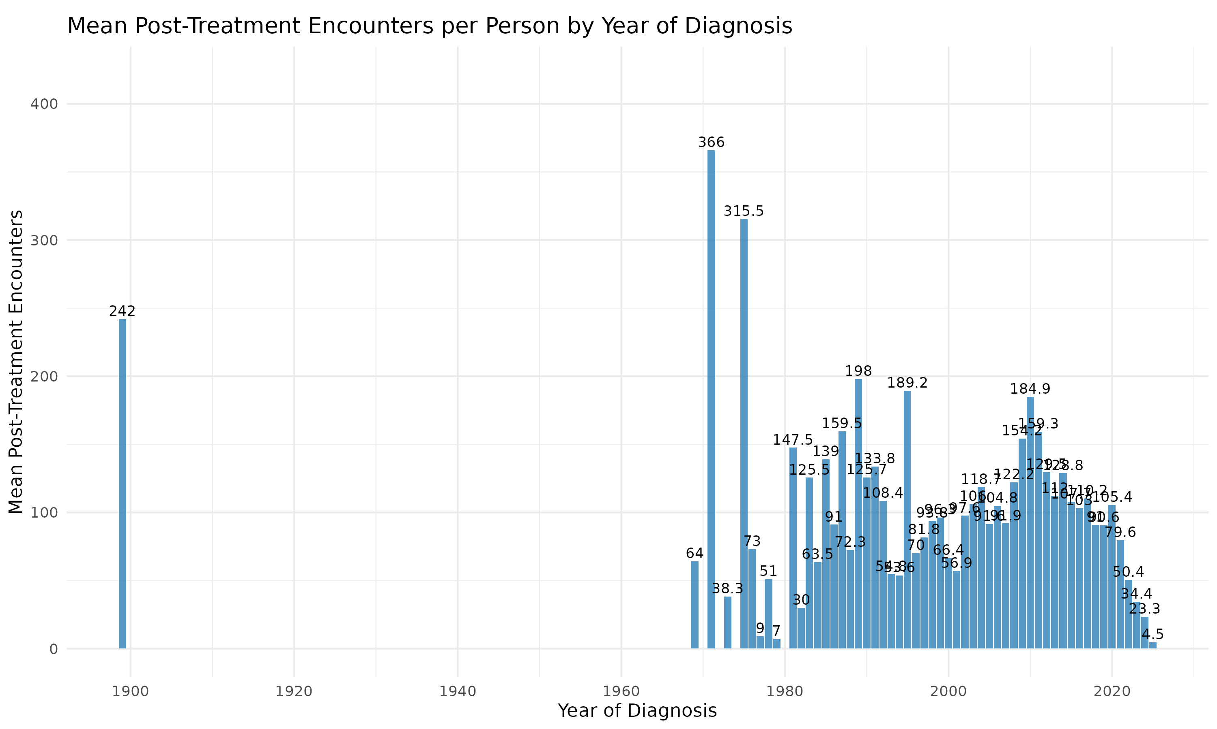
Mean Post-Treatment Encounters by Year of Diagnosis
Non-acute care encounters per person after last treatment, stratified by HL diagnosis year

Slide 20
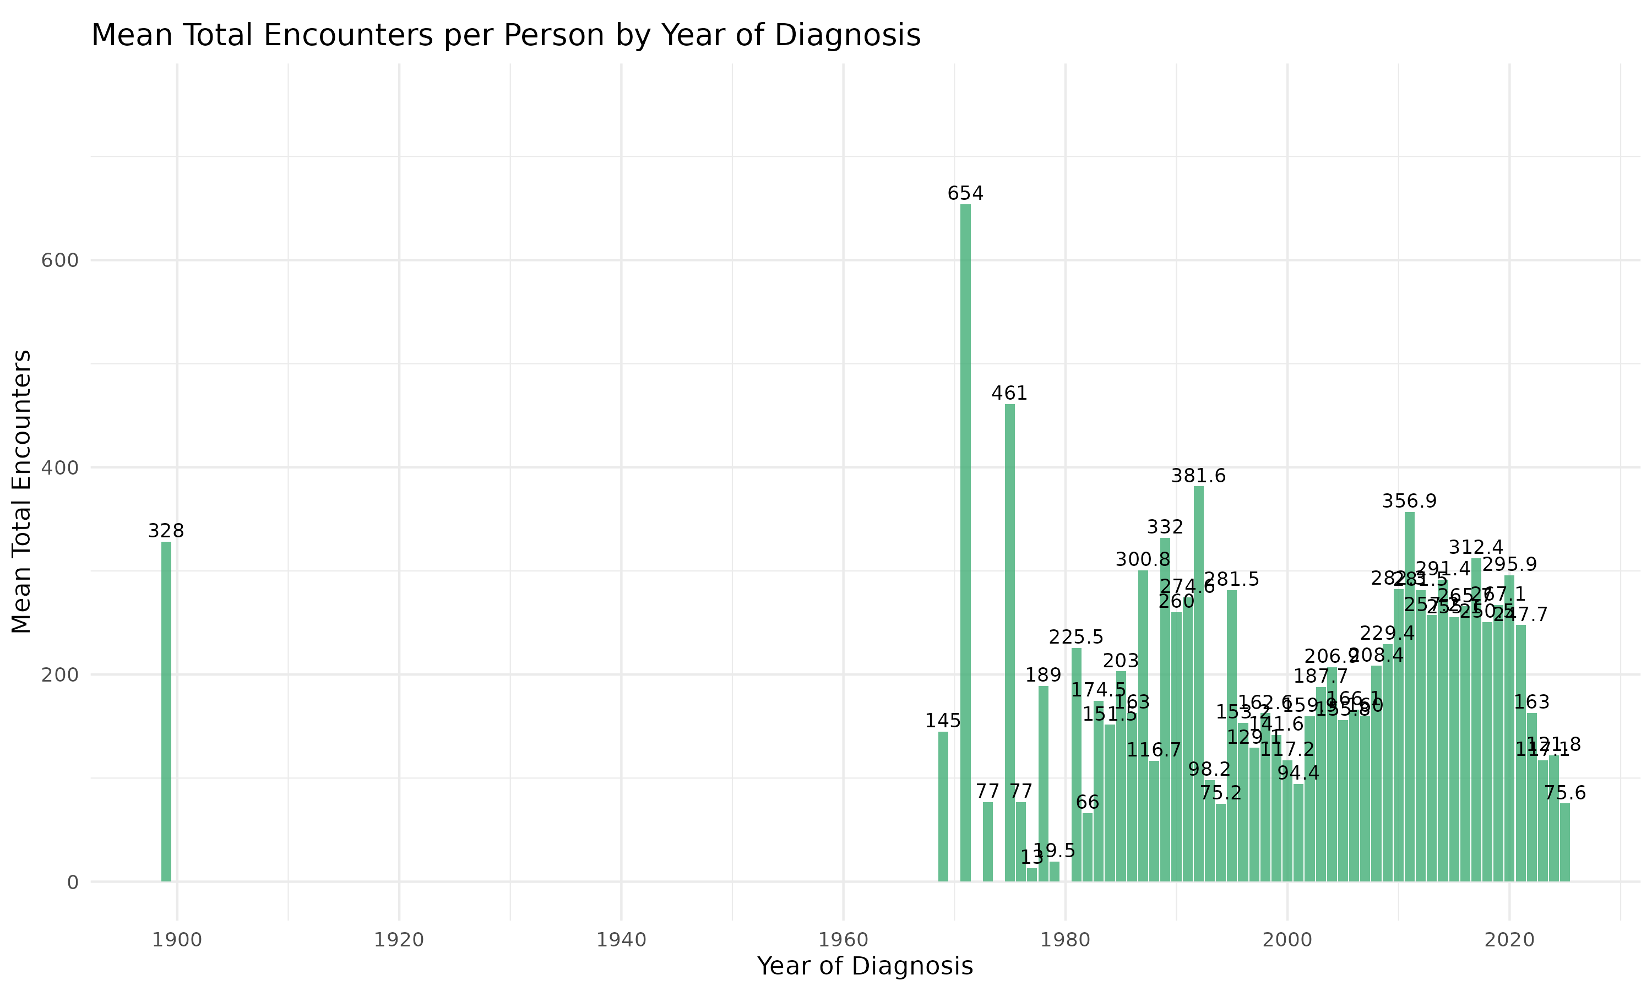
Mean Total Encounters by Year of Diagnosis
All encounters per person across the full observation window, stratified by HL diagnosis year

Slide 21
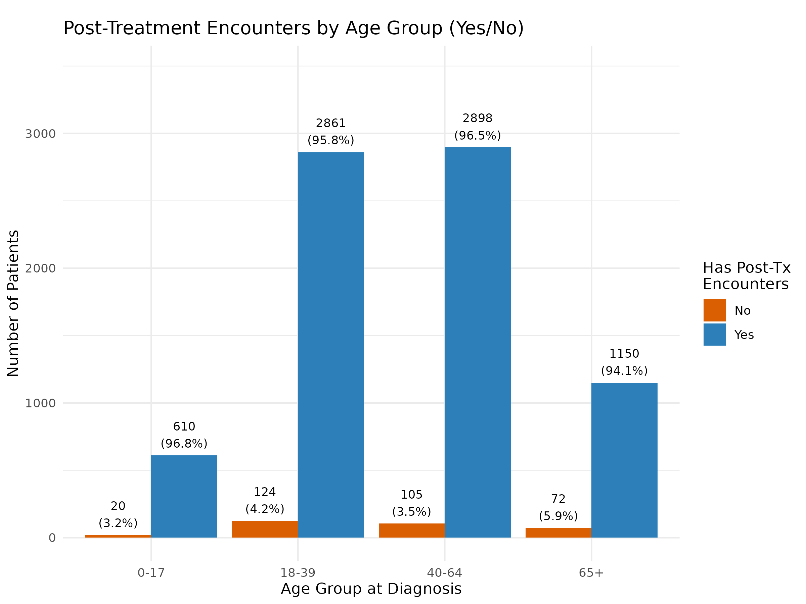
Post-Treatment Encounter Presence by Age Group at Diagnosis
Proportion with any post-treatment encounter by age group (0-17, 18-39, 40-64, 65+)
Age group determined at date of first HL diagnosis. Post-treatment = any encounter after last treatment of any type.

Slide 22
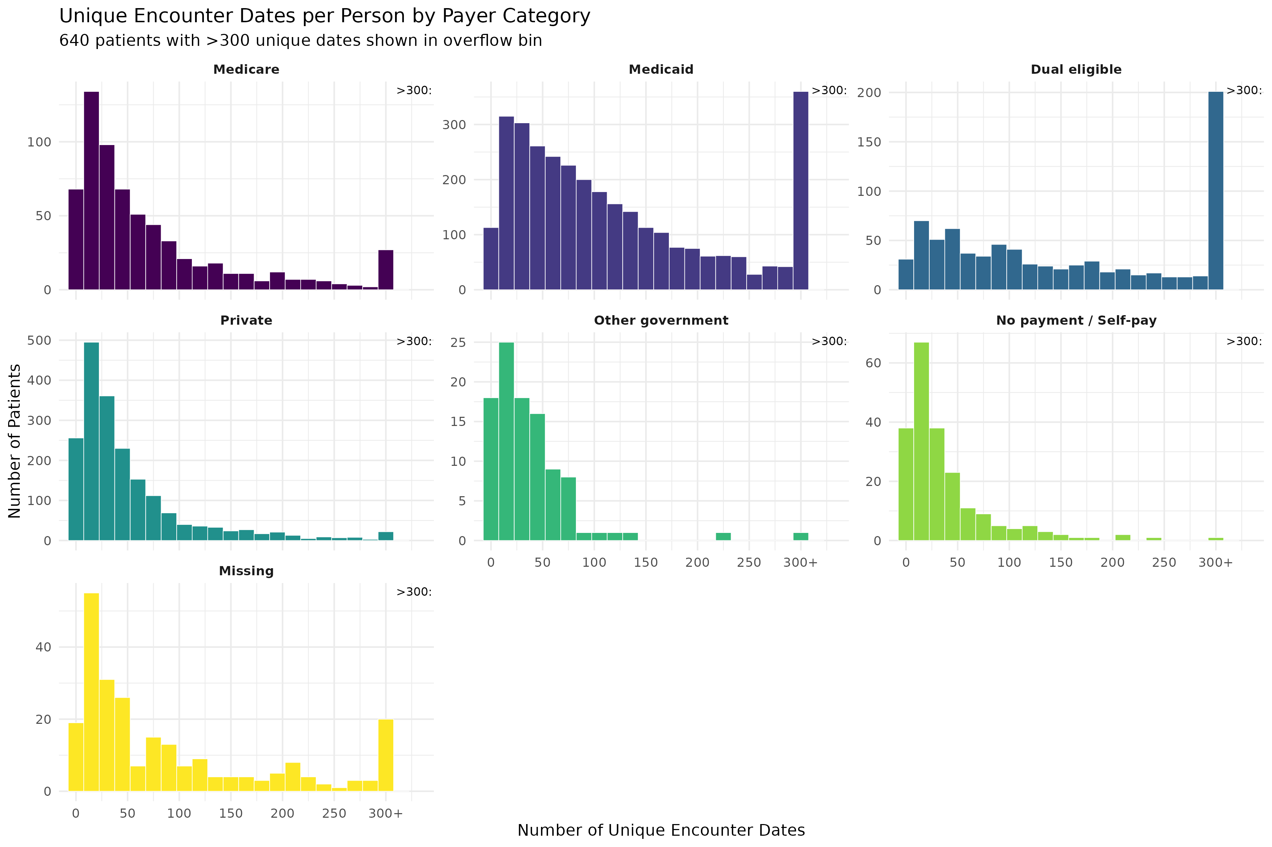
Unique Encounter Dates per Person by Payer Category
Distribution of distinct encounter dates by primary payer -- N = 8,770
Unique dates = distinct ADMIT_DATEs per patient. Multiple encounters on the same day count as one date.

Slide 23
Summary Statistics: Unique Dates per Person by Payer Category
Distribution of distinct encounter dates by primary insurance category -- N = 8,770
Payer Category | N | Mean | Median | Min | Q1 | Q3 | Max | 300+
Dual eligible | 809 | 262.0 | 130 | 2 | 51.0 | 291.0 | 3,920 | 194
Medicaid | 3,161 | 144.2 | 92 | 2 | 41.0 | 175.0 | 2,467 | 342
Medicare | 647 | 75.7 | 43 | 2 | 17.5 | 91.5 | 671 | 25
Missing | 1,901 | 66.8 | 37 | 2 | 13.0 | 85.0 | 653 | 55
No payment / Self-pay | 211 | 39.7 | 23 | 2 | 10.5 | 48.5 | 483 | 1
Other government | 100 | 38.3 | 26 | 2 | 12.0 | 50.0 | 314 | 1
Private | 1,941 | 51.7 | 31 | 2 | 14.0 | 63.0 | 592 | 22
Total | 8,770 | 109.0 | 54 | 2 | 21.0 | 126.0 | 3,920 | 640
Unique dates = distinct ADMIT_DATEs per patient. 300+ = patients with more than 300 unique encounter dates.

Slide 24
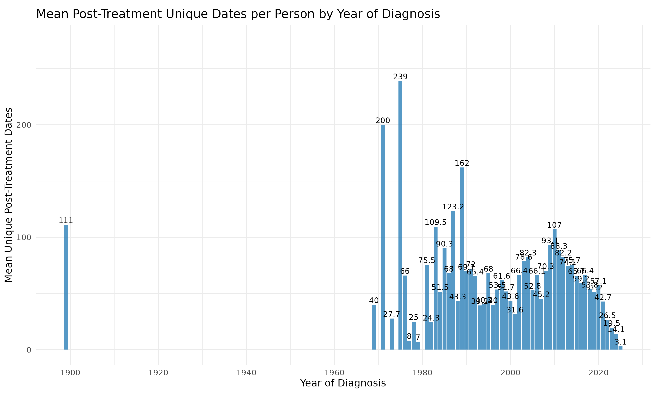
Mean Post-Treatment Unique Dates by Year of Diagnosis
Distinct encounter dates per person after last treatment, stratified by HL diagnosis year

Slide 25
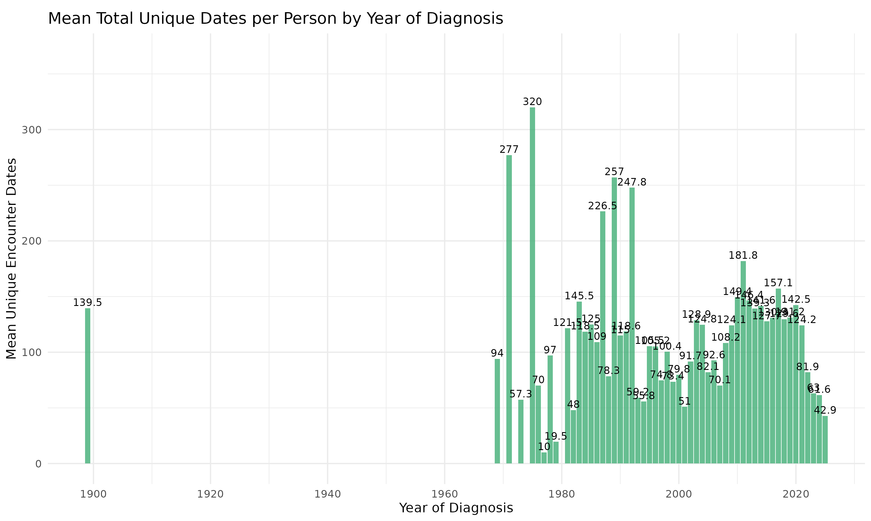
Mean Total Unique Dates by Year of Diagnosis
Distinct encounter dates per person across the full observation window, stratified by HL diagnosis year

