Slide 1
36104 · CLASS 1
Seeing Data
Visualisation, intelligence, and interpretation
How do charts create meaning?
Data Visualisation and Narratives

Slide 2
THE PREMISE
02
A chart is a claim about how the world is organised.
Opening question: What has the designer chosen to make visible—and what remains invisible?

Slide 3
CLASS 1 · SEEING DATA
03
By the end of today
• Explain how selection, encoding and framing turn data into meaning.
• Distinguish a fluent interpretation from a justified insight.
• Identify omissions, uncertainty and governance questions in a visualisation.
• Use an AI assistant to build a chart—and verify every claim it makes about the data.
• Critique a human-made chart and an AI-generated interpretation.
How the World Is Organised · Gerard Kelly
36104 Data Visualisation and Narratives

Slide 4
CLASS 1 · SEEING DATA
04
From evidence to narrative
DATA
ENCODING
CLAIM
NARRATIVE
→
→
→
structured evidence
a selective visual form
an interpretation to justify
an ordered account
At every step: selection · comparison · compression · framing · omission
How the World Is Organised · Gerard Kelly
36104 Data Visualisation and Narratives

Slide 5
COLD OPEN
05
Four datasets. The same mean, variance, correlation and regression line.
Prediction: will the four datasets look essentially the same?

Slide 6
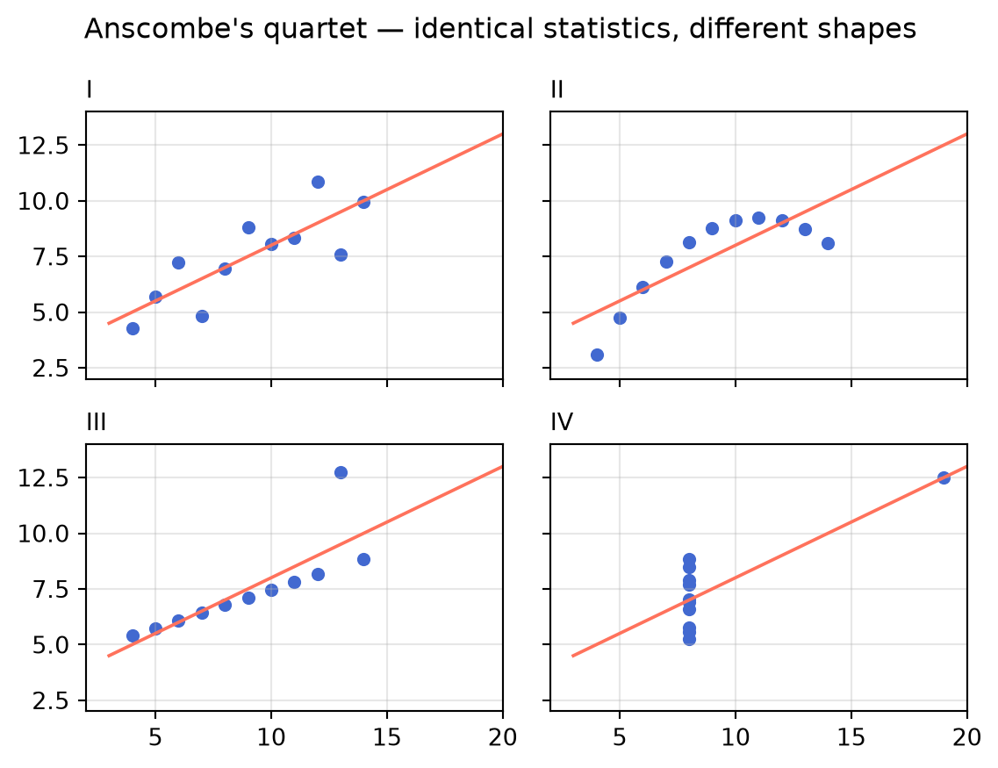
CLASS 1 · SEEING DATA
06
Looking changes the conclusion
Ask
• What does the summary hide?
• Which panel changes your interpretation most?
• What verification should precede a claim?
Anscombe (1973) · reproduction generated from code
36104 Data Visualisation and Narratives

Slide 7
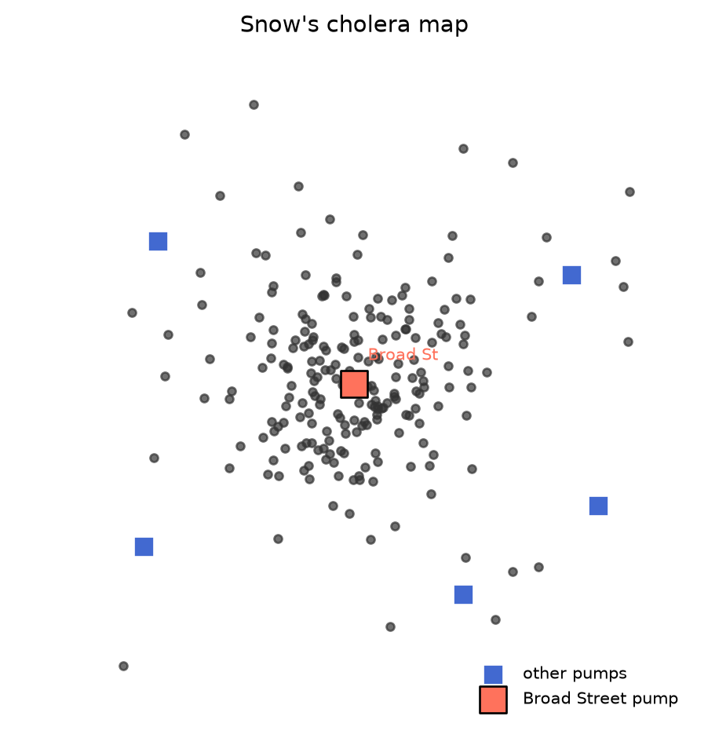
CLASS 1 · SEEING DATA
07
A picture can become an argument
John Snow’s cholera map
Deaths cluster around a water pump. Spatial arrangement turns individual cases into a claim about cause. Question: what evidence would strengthen—or weaken—the causal claim?
Snow (1855) · reproduction generated from code
36104 Data Visualisation and Narratives

Slide 8
VISUALISATION + AI
08
Fluent interpretation is not the same as valid interpretation.
An AI system can describe a pattern confidently without checking whether the data supports the claim.

Slide 9
CLASS 1 · SEEING DATA
09
A verification ladder for generated insight
1
TRACE
What data and transformation produced the chart?
2
CHECK
Do labels, scales, units and totals agree?
3
TEST
Does the visual pattern survive another view?
4
BOUND
What uncertainty or limitation qualifies the claim?
5
DISCLOSE
What did the intelligent tool contribute?
How the World Is Organised · Gerard Kelly
36104 Data Visualisation and Narratives

Slide 10
HOW CHARTS LIE
10
A chart can be perfectly accurate and still mislead.
Every number checked, every label true — and the impression still wrong. Here are the six mechanisms.

Slide 11
CLASS 1 · SEEING DATA
11
Six ways a true chart misleads
TRUNCATED AXIS
A bar race that starts at 90 turns 2% into double
CHERRY WINDOW
The trend depends on where you start the clock
DUAL AXES
Two scales, one plane — any story you like
AREA DISTORTION
Doubling the radius quadruples the impression
NO DENOMINATOR
Counts rise because the population did
HIDDEN SPREAD
The average is calm; the distribution is not
How the World Is Organised · Gerard Kelly
36104 Data Visualisation and Narratives

Slide 12
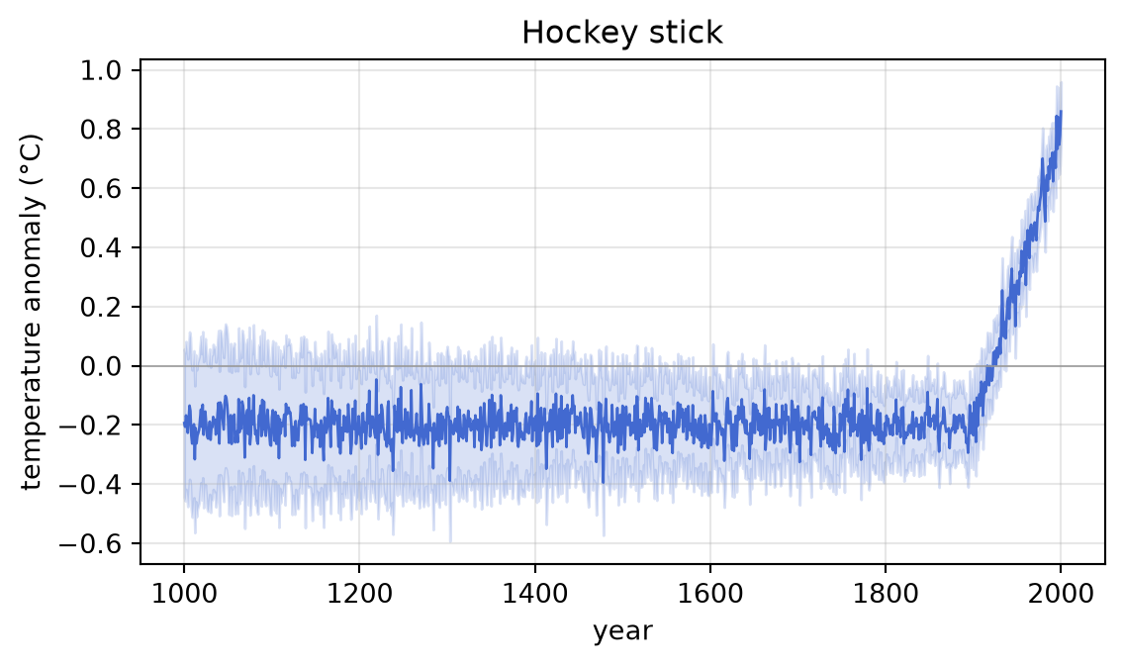
CLASS 1 · SEEING DATA
12
The window is part of the claim
The hockey stick
A millennium of context is what makes the recent rise legible as exceptional rather than noise. Zoom to 1990–2000 and the same data supports a different, weaker claim. Choosing the window is choosing the argument.
Mann, Bradley & Hughes (1999) · reproduction generated from code
36104 Data Visualisation and Narratives

Slide 13
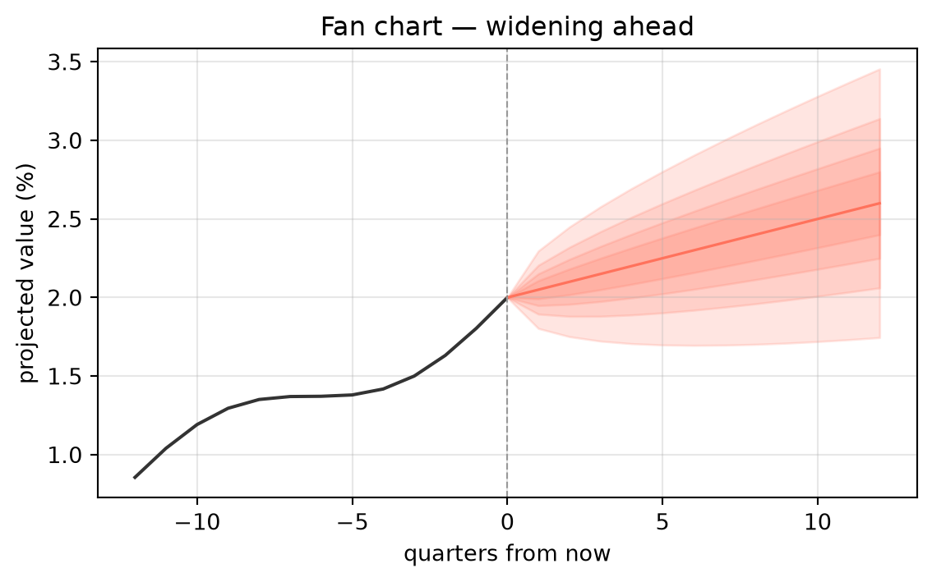
CLASS 1 · SEEING DATA
13
Uncertainty drawn rather than suppressed
The fan chart
A forecast that shows its own doubt: the bands widen exactly where knowledge thins. A single confident line over the same data would be fluent — and dishonest. Ask every chart: where did the uncertainty go?
Bank of England style · reproduction generated from code
36104 Data Visualisation and Narratives

Slide 14
THINK · PAIR · SHARE
14
Find a chart published this week. What claim does it make — and which of the six mechanisms should worry you?
5 minutes solo · 5 minutes in pairs · 5 minutes as a room. Keep the chart: it may become your Critique 1 artefact.

Slide 15
CLASS 1 · SEEING DATA
15
Notebook: build, describe, verify
• Open seeing_data_activities.ipynb in VS Code with your AI assistant on.
• Exercise 1 — reproduce Anscombe's lesson: summary statistics, then the picture.
• Exercise 2 — ask the assistant to chart the transport dataset, then run the checks.
• Exercise 3 — audit a generated interpretation: supported, unsupported, or unverifiable.
• Exercise 4 — make a true chart lie twice, then fix it (axes and windows).
• Exercise 5 (stretch) — put honest uncertainty on the recovery chart.
• Every exercise ends with a verification cell. Code that fails the check is a finding, not a failure.
How the World Is Organised · Gerard Kelly
36104 Data Visualisation and Narratives

Slide 16
BREAK
16
Back in 10 minutes.
When we return: who owns the data, and Critique 1.

Slide 17
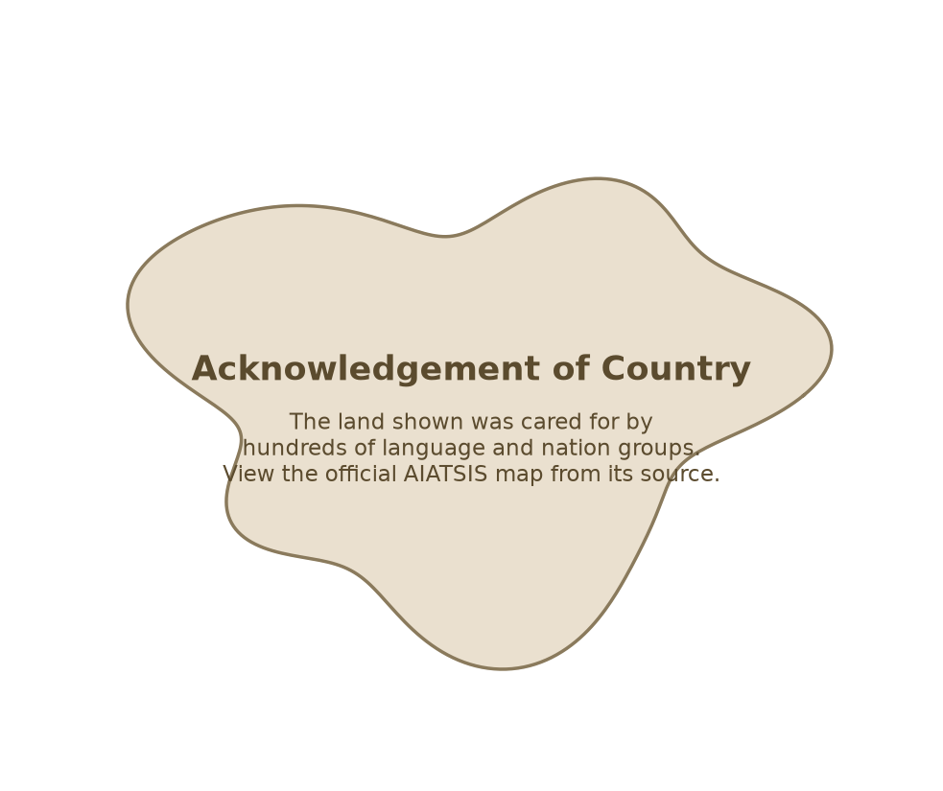
CLASS 1 · SEEING DATA
17
Representation is also governance
• Who is represented—and who is absent?
• Who collected, controls and can reuse the data?
• Who benefits from the visualisation?
• Who could be harmed or misled?
• What should not be visualised?
AIATSIS acknowledgement placeholder — not the copyright map
36104 Data Visualisation and Narratives

Slide 18
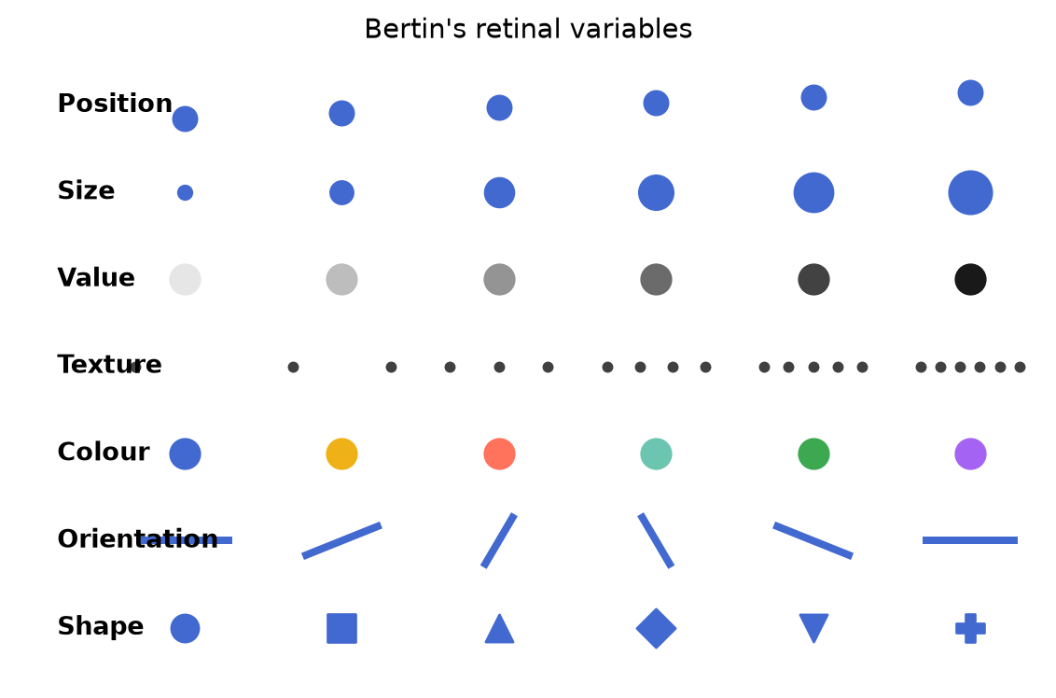
CLASS 1 · SEEING DATA
18
The small vocabulary of visual encoding
Bertin’s variables
• Position
• Size
• Value
• Texture
• Colour
• Orientation
• Shape
Bertin (1967) · reproduction generated from code
36104 Data Visualisation and Narratives

Slide 19
CLASS 1 · SEEING DATA
19
Critique the claim, not just the appearance
CLAIM
What does the chart invite us to believe?
AUDIENCE
Who is expected to act on it?
TASK
What comparison or judgement must they make?
EVIDENCE
What supports—or fails to support—the claim?
OMISSIONS
What is missing, compressed or hidden?
RESPONSIBILITY
Who benefits, and who carries the risk?
How the World Is Organised · Gerard Kelly
36104 Data Visualisation and Narratives

Slide 20
STUDIO · 45 MINUTES
Critique 1
Compare one human-made chart with one AI-generated interpretation.
10 min
15 min
10 min
10 min
Read
Interrogate
Verify
Share
Write the claim in one sentence.
Check audience, task, evidence and omissions.
Test one claim against the data or source.
Name one repair and one limitation.

Slide 21
CLASS 1 · SEEING DATA
21
Today’s three-hour rhythm
HOUR 1
HOUR 2
HOUR 3
Charts make claims
Build and verify
Critique and responsibility
Anscombe · Snow · six mechanisms · ladder
Notebook: chart, check, lie, repair
AIATSIS · Critique 1 studio · quiz
How the World Is Organised · Gerard Kelly
36104 Data Visualisation and Narratives

Slide 22
DIAGNOSTIC QUIZ
22
15 minutes. Open book, closed assistant.
Today's vocabulary: encoding, claim, omission, verification ladder, governance. The quiz calibrates the course to you — it is diagnostic, not punitive.

Slide 23
EXIT QUESTION
23
Could this visualisation lead someone to believe something the data does not support?
Exit ticket: one design decision you made, one risk you noticed, one thing to verify before next class.

