Slide 1
36104 · DATA VISUALISATION AND NARRATIVES
Choosing Visual Forms
Encoding, tidy data and visual tasks
What visual task are we performing?
Spring 2026

Slide 2
THE PREMISE
Chart selection begins with the comparison a person needs to make.
Do not name a chart until the audience and question are clear.

Slide 3
CHOOSING VISUAL FORMS
A stronger design workflow
AUDIENCE
QUESTION
VISUAL TASK
DATA SHAPE
VISUAL FORM
→
→
→
→
who uses it
what they need to know
comparison required
observations available
encoding selected
The topic does not uniquely determine the chart.
36104 Data Visualisation and Narratives
Choosing Visual Forms

Slide 4
CHOOSING VISUAL FORMS
One dataset, several tasks
• Which mode carries the most passengers? — magnitude or ranking
• How has use changed? — change over time
• Which mode is most variable? — distribution
• Do delays rise with passenger volume? — correlation
• How is the total divided? — part-to-whole
36104 Data Visualisation and Narratives
Choosing Visual Forms

Slide 5
CHOOSING VISUAL FORMS
Visual Vocabulary
• Deviation · Correlation · Ranking
• Distribution · Change over time · Magnitude
• Part-to-whole · Spatial · Flow
Ask what a reader must compare, locate, trace or estimate.
36104 Data Visualisation and Narratives
Choosing Visual Forms

Slide 6
CARD SORT
Describe the comparison before matching a task card.
Which questions legitimately fit more than one category?

Slide 7
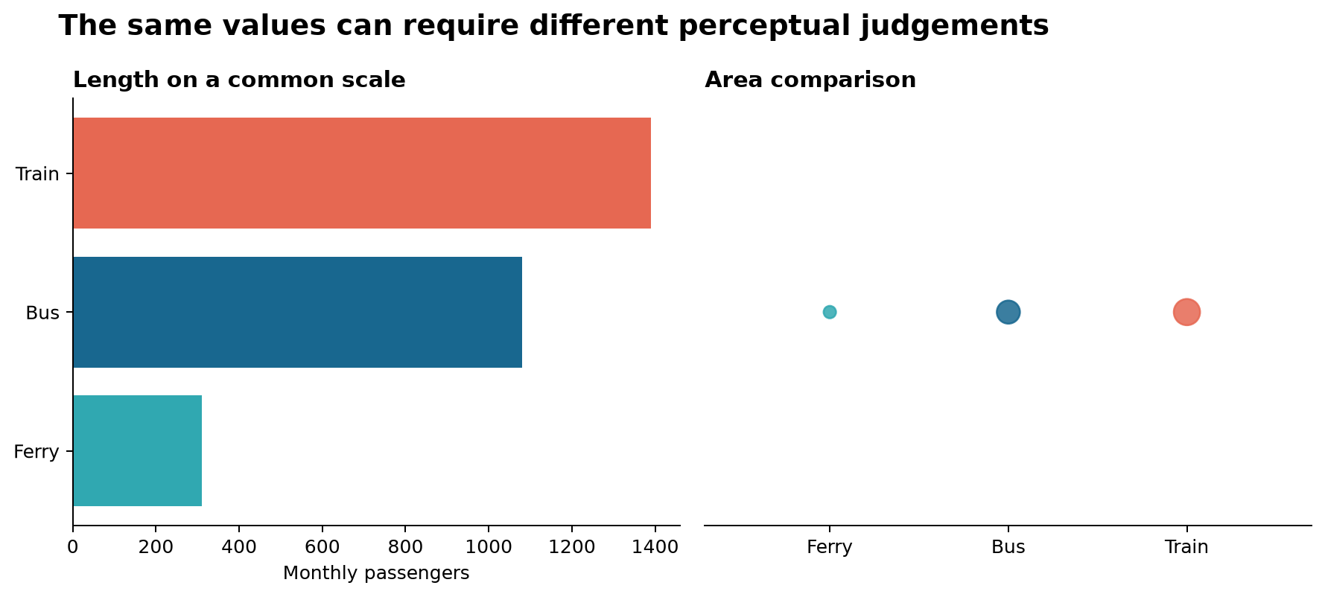
CHOOSING VISUAL FORMS
Visual channels are not equally precise
• Which comparison is faster?
• Which is more precise?
• When might area still be useful?
36104 Data Visualisation and Narratives
Synthetic teaching comparison

Slide 8
CHOOSING VISUAL FORMS
Magnitude and ranking
• Use bars, dots, ordered tables or small multiples.
• Ordering reduces search effort.
• A zero baseline matters when bar length represents magnitude.
36104 Data Visualisation and Narratives
Choosing Visual Forms

Slide 9
CHOOSING VISUAL FORMS
Distribution
• Histograms reveal frequency across intervals.
• Box plots compress centre, spread and extremes.
• Dot plots preserve observations when the dataset is small.
• Density and violin plots depend on smoothing choices.
36104 Data Visualisation and Narratives
Choosing Visual Forms

Slide 10
CHOOSING VISUAL FORMS
Correlation
• Inspect form, direction, strength and exceptions.
• Keep important groups visible.
• A fitted line can conceal curvature or subgroups.
• Association does not establish cause.
36104 Data Visualisation and Narratives
Choosing Visual Forms

Slide 11
CHOOSING VISUAL FORMS
Change over time
• Use ordered, connected forms when continuity matters.
• Check missing periods and irregular intervals.
• Mark methodological breaks.
• Use small multiples when overlapping lines obstruct comparison.
36104 Data Visualisation and Narratives
Choosing Visual Forms

Slide 12
CHOOSING VISUAL FORMS
Colour has several jobs
• Category — distinguish groups.
• Ordered magnitude — encode low to high.
• Deviation — diverge around a meaningful midpoint.
• Emphasis — direct attention.
Do not ask one palette to do all four jobs.
36104 Data Visualisation and Narratives
Choosing Visual Forms

Slide 13
CHOOSING VISUAL FORMS
Tidy data
VARIABLE
OBSERVATION
VALUE
→
→
one column
one row
one cell
Tidy structure supports reproducible filtering, grouping and visualisation.
36104 Data Visualisation and Narratives
Choosing Visual Forms

Slide 14
CHOOSING VISUAL FORMS
Generated cleaning must be checked
• Predict row count before reshaping.
• Preserve identifiers and meaningful missingness.
• Check types and category labels.
• Confirm aggregation level and totals.
• Explain the generated transformation.
36104 Data Visualisation and Narratives
Choosing Visual Forms

Slide 15
CHOOSING VISUAL FORMS
Compare before selecting
• Create candidates that answer different questions.
• Name the easy comparison in each.
• Identify information each candidate hides.
• Select for the stated audience.
• Reject one plausible alternative for a specific reason.
36104 Data Visualisation and Narratives
Choosing Visual Forms

Slide 16
CHOOSING VISUAL FORMS
Notebook checkpoints
• State audience, question and expected tidy shape.
• Pass the structural assertions.
• Classify the task before plotting.
• Complete at least two candidates.
• Record selection, rejection and remaining limitation.
Use the starter transformation only if syntax prevents progress.
36104 Data Visualisation and Narratives
Choosing Visual Forms

Slide 17
CHOOSING VISUAL FORMS
Gallery walk
• Read the audience and question before looking at the chart.
• Can you answer the question efficiently?
• What comparison is visually easiest?
• What is hidden or difficult?
• Leave one specific suggestion.
36104 Data Visualisation and Narratives
Choosing Visual Forms

Slide 18
EXIT TICKET
A defensible chart choice names both the selected form and the rejected alternative.
Record your audience, visual task, selection, rejection and remaining limitation.

