Slide 1
36104 · DATA VISUALISATION AND NARRATIVES
Seeing Data
Visualisation, intelligence and interpretation
How do charts create meaning?
Spring 2026

Slide 2
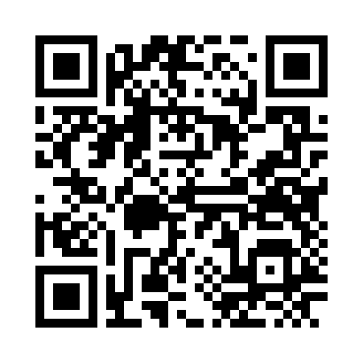
SEEING DATA
Choose a compatible group working environment
For the later group assignment, which environment would you prefer?
CANVAS SURVEY
AI-ASSISTED
Approved recording or transcription tools may be used
NO AI RECORDING
AI-assisted recording or transcription will not be used
NO PREFERENCE
Either working environment is acceptable
OPEN SURVEY
No academic advantage or penalty. Preference is private and changeable. Group choice is not blanket consent to every recording.
36104 Data Visualisation and Narratives
Seeing Data · private preference survey

Slide 3
SEEING DATA
Authorise the workflow—and name its boundaries
• Verified GitHub Education students can access Copilot Student without charge.
• Copilot works in VS Code and notebooks, but operates outside the UTS Microsoft tenant.
• Do not enter personal, confidential, restricted or unpublished assessment data.
• Individual-plan interactions may be used for model improvement unless the user opts out.
• Retention and agent behaviour vary by feature and model.
• Students must review, test, explain and disclose generated work.
THE REFRAME
State permitted AI-assisted coding practices in writing—then align them with current UTS and faculty requirements.
Educational authorisation is not the same as institutional procurement or security approval.
Before publishing: confirm current UTS/faculty rules and GitHub data settings.
36104 Data Visualisation and Narratives
Seeing Data · policy framing

Slide 4
THE PREMISE
A chart is a claim about how the world is organised.
Write: what has the designer chosen to make visible—and what remains invisible?

Slide 5
SEEING DATA
What you will be able to do
• Distinguish evidence, encoding, observation, insight and narrative.
• Identify unsupported or overconfident interpretation.
• Explain how visual choices shape meaning.
• Verify and repair an AI-assisted chart interpretation.
36104 Data Visualisation and Narratives
Seeing Data

Slide 6
PREDICT BEFORE LOOKING
Four datasets share the same mean, variance, correlation and regression line.
Sketch what you expect. How similar should the four plots look?

Slide 7
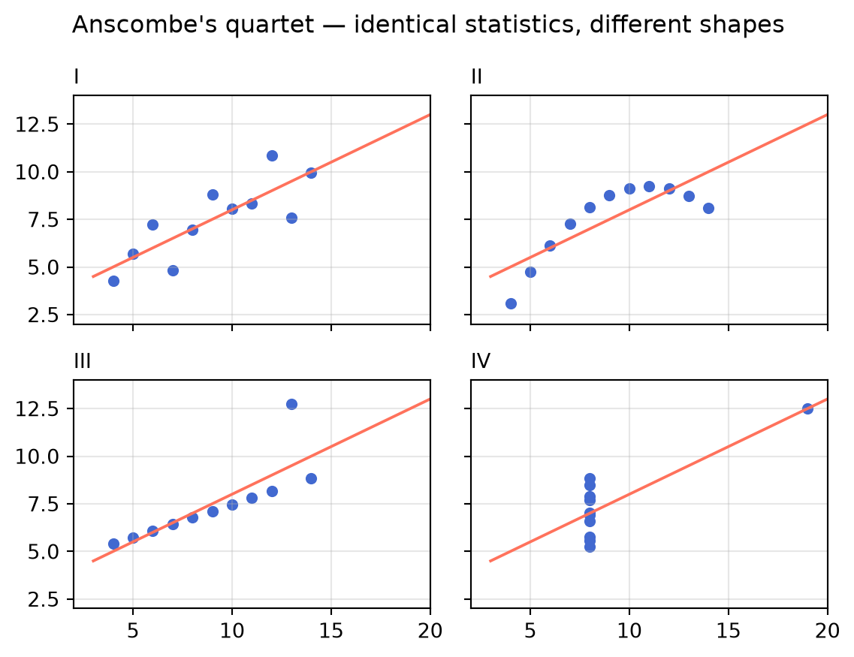
SEEING DATA
Looking changes the conclusion
• What does the summary conceal?
• Which panel changes your interpretation most?
• What should be checked before making a claim?
36104 Data Visualisation and Narratives
Anscombe (1973) · reproduction generated from code

Slide 8
SEEING DATA
From evidence to narrative
DATA
ENCODING
OBSERVATION
CLAIM
NARRATIVE
→
→
→
→
structured evidence
selective visual form
visible pattern
interpretation to justify
ordered account
Every transition involves selection, comparison, compression, framing and omission.
36104 Data Visualisation and Narratives
Seeing Data

Slide 9
SEEING DATA
Observation is not explanation
• Observation: deaths appear concentrated near one pump.
• Interpretation: proximity to that pump may be associated with illness.
• Causal claim: contaminated pump water caused the outbreak.
What additional evidence is required at each step?
36104 Data Visualisation and Narratives
Seeing Data

Slide 10
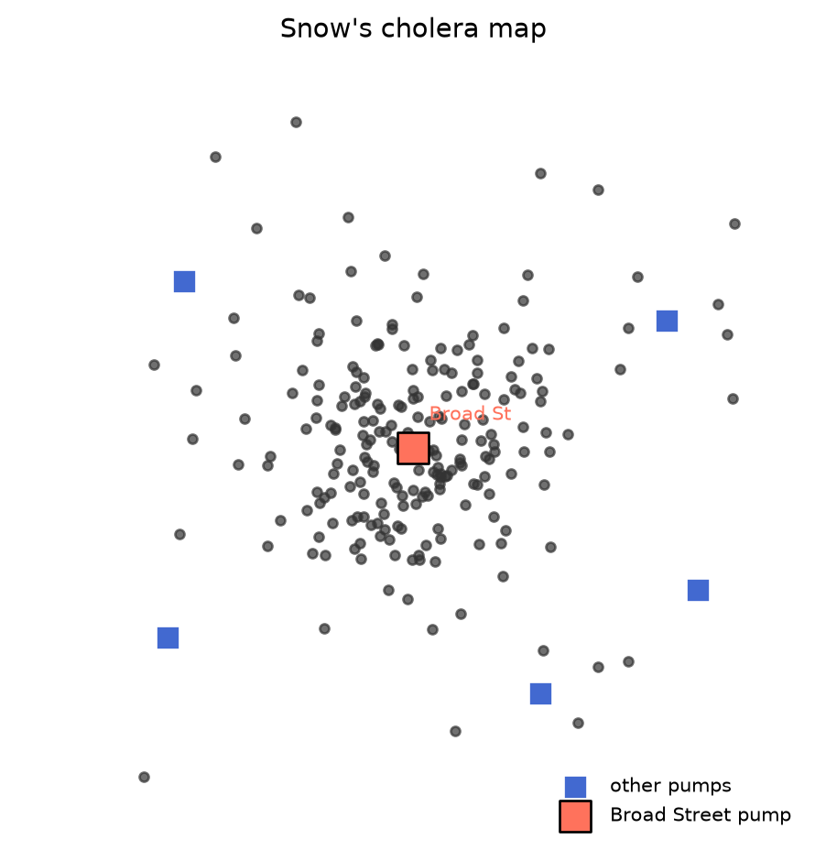
SEEING DATA
A picture can become an argument
• What is encoded spatially?
• What alternatives could create this pattern?
• How did the map work with other evidence?
36104 Data Visualisation and Narratives
Snow (1855) · reproduction generated from code

Slide 11
VISUALISATION AND AI
Fluent interpretation is not the same as valid interpretation.
Responsibility for a submitted claim remains with the student.

Slide 12
SEEING DATA
Audit generated language
• Supported directly — visible or calculated from the supplied data.
• Plausible but unverified — possible, but needs context or another test.
• Unsupported — no available evidence establishes it.
• Contradicted — the available evidence points against it.
36104 Data Visualisation and Narratives
Seeing Data

Slide 13
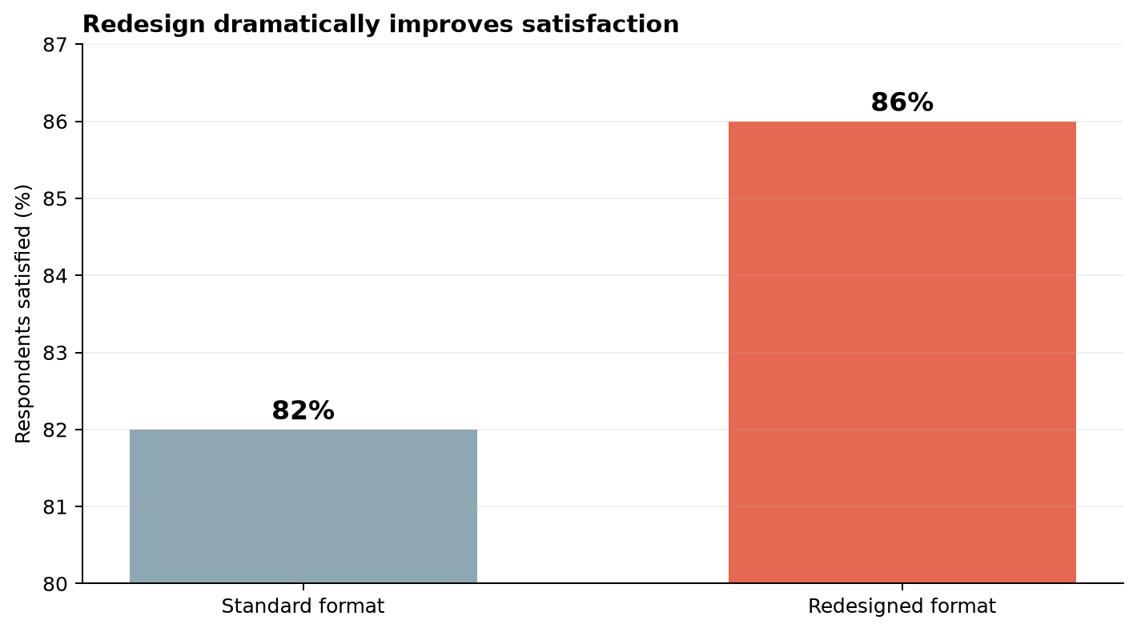
SEEING DATA
A true value can still be framed misleadingly
• What impression does the axis encourage?
• What does the title claim?
• What evidence is missing?
36104 Data Visualisation and Narratives
Teaching artefact · synthetic comparison

Slide 14
SEEING DATA
Verification ladder
• Trace — identify data and transformation.
• Check — inspect labels, units, scales and totals.
• Test — create another view or calculation.
• Bound — state uncertainty and limitation.
• Disclose — record the intelligent tool’s contribution.
36104 Data Visualisation and Narratives
Seeing Data

Slide 15
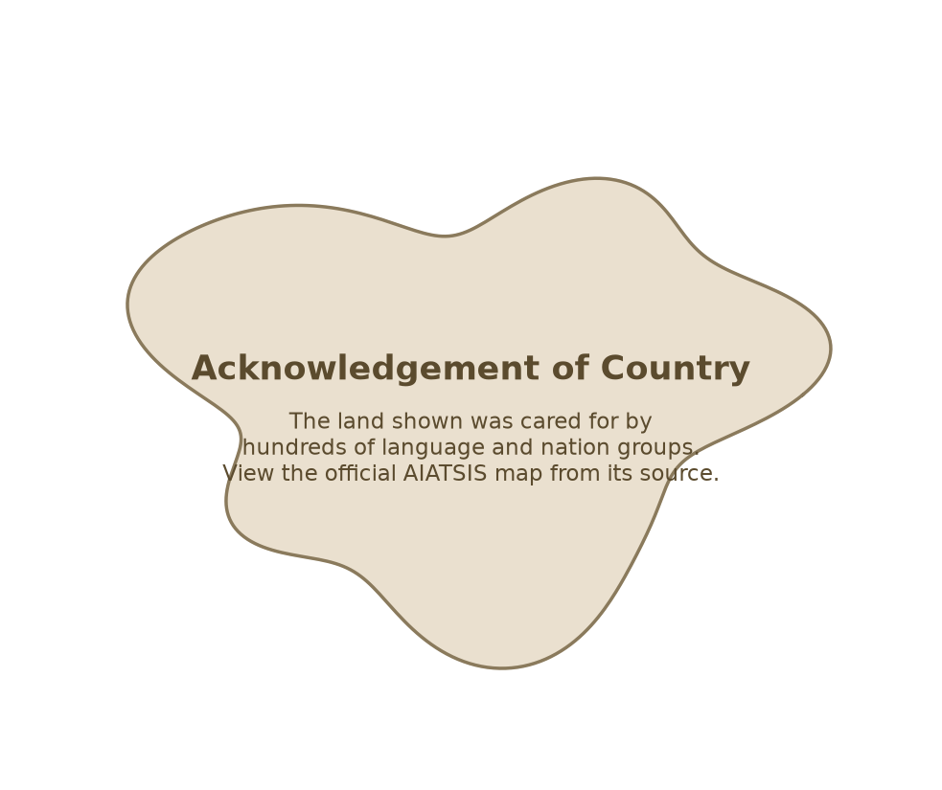
SEEING DATA
Representation is governance
• Who is represented?
• Who controls reuse?
• Who benefits?
• Who could be harmed?
• What should not be visualised?
36104 Data Visualisation and Narratives
AIATSIS acknowledgement placeholder—not the copyright map

Slide 16
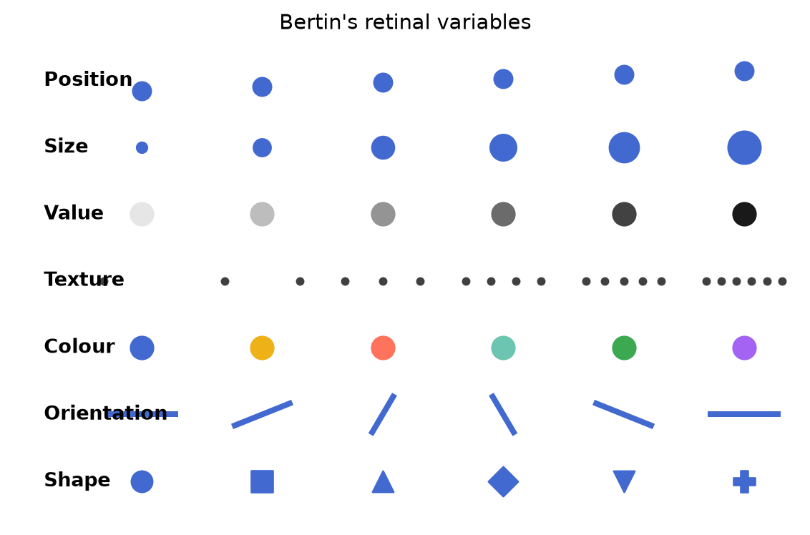
SEEING DATA
The visual grammar
• Position
• Size
• Value
• Texture
• Colour
• Orientation and shape
36104 Data Visualisation and Narratives
Bertin (1967) · reproduction generated from code

Slide 17
SEEING DATA
Notebook checkpoints
• Predict before calculating.
• Verify the shared summaries.
• Plot using common scales.
• Classify generated claims.
• Mislead without changing data, then repair.
• Record provenance.
Use the starter notebook only if syntax blocks the reasoning task.
36104 Data Visualisation and Narratives
Seeing Data

Slide 18
SEEING DATA
Critique and Repair
• Identify claim, audience and intended decision.
• Separate observation from interpretation.
• Name the visual task and channels.
• Identify omission, overclaim or possible harm.
• Specify verification and propose one concrete repair.
36104 Data Visualisation and Narratives
Seeing Data

Slide 19
EXIT TICKET
Could this visualisation lead someone to believe something the data does not support?
Record one claim, one limitation and one thing to verify.

