Slide 1


Slide 2
36104 · DATA VISUALISATION AND NARRATIVES
Seeing Data
Visualisation, intelligence, and interpretation
How do charts create meaning?
Data Visualisation and Narratives · Spring 2026

Slide 3
THE PREMISE
02
A chart is a claim about how the world is organised.
Opening question: What has the designer chosen to make visible—and what remains invisible?

Slide 4
SEEING DATA
03
By the end of today
• Explain how selection, encoding and framing turn data into meaning.
• Distinguish a fluent interpretation from a justified insight.
• Identify omissions, uncertainty and governance questions in a visualisation.
• Critique a human-made chart and an AI-generated interpretation.
How the World Is Organised · Gerard Kelly
36104 Data Visualisation and Narratives

Slide 5
SEEING DATA
04
From evidence to narrative
DATA
ENCODING
CLAIM
NARRATIVE
→
→
→
structured evidence
a selective visual form
an interpretation to justify
an ordered account
At every step: selection · comparison · compression · framing · omission
How the World Is Organised · Gerard Kelly
36104 Data Visualisation and Narratives

Slide 6
COLD OPEN
05
Four datasets. The same mean, variance, correlation and regression line.
Prediction: will the four datasets look essentially the same?

Slide 7
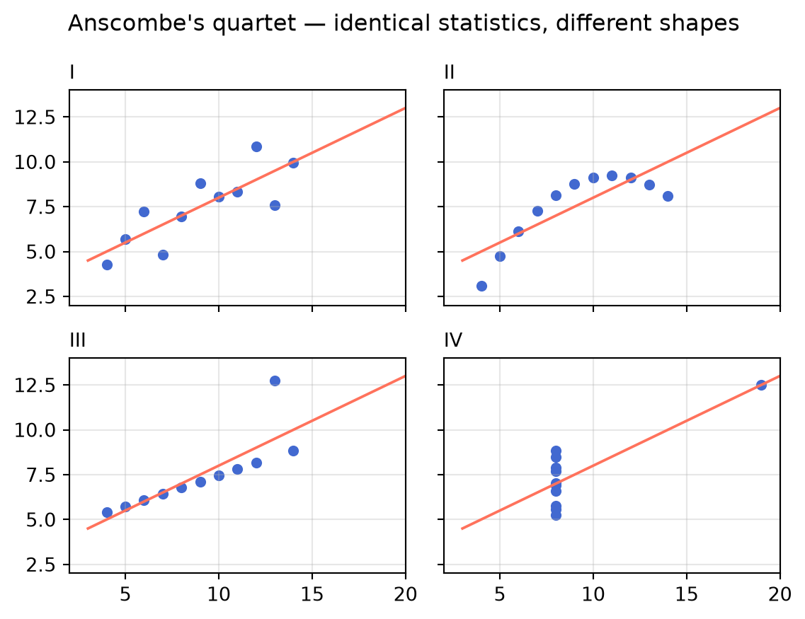
SEEING DATA
06
Looking changes the conclusion
Ask
• What does the summary hide?
• Which panel changes your interpretation most?
• What verification should precede a claim?
Anscombe (1973) · reproduction generated from code
36104 Data Visualisation and Narratives

Slide 8
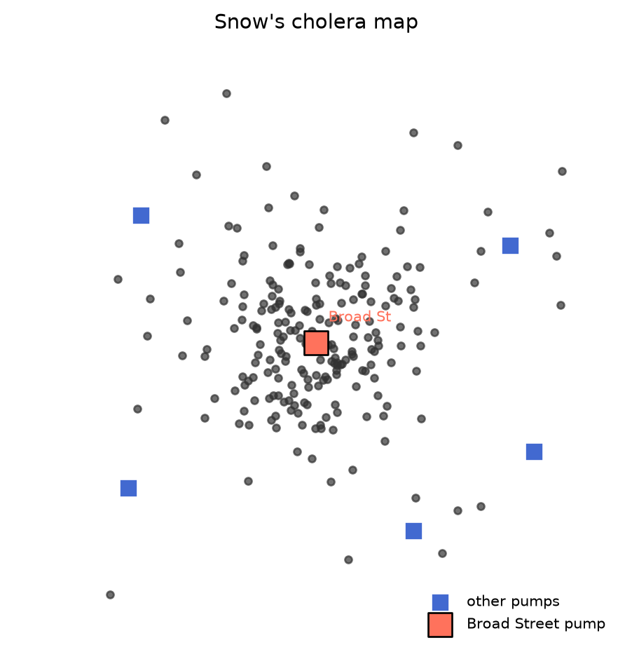
SEEING DATA
07
A picture can become an argument
John Snow’s cholera map
Deaths cluster around a water pump. Spatial arrangement turns individual cases into a claim about cause.
Question What evidence would strengthen—or weaken—the causal claim?
Snow (1855) · reproduction generated from code
36104 Data Visualisation and Narratives

Slide 9
VISUALISATION + AI
08
Fluent interpretation is not the same as valid interpretation.
An AI system can describe a pattern confidently without checking whether the data supports the claim.

Slide 10
SEEING DATA
09
A verification ladder for generated insight
1
TRACE
What data and transformation produced the chart?
2
CHECK
Do labels, scales, units and totals agree?
3
TEST
Does the visual pattern survive another view?
4
BOUND
What uncertainty or limitation qualifies the claim?
5
DISCLOSE
What did the intelligent tool contribute?
How the World Is Organised · Gerard Kelly
36104 Data Visualisation and Narratives

Slide 11
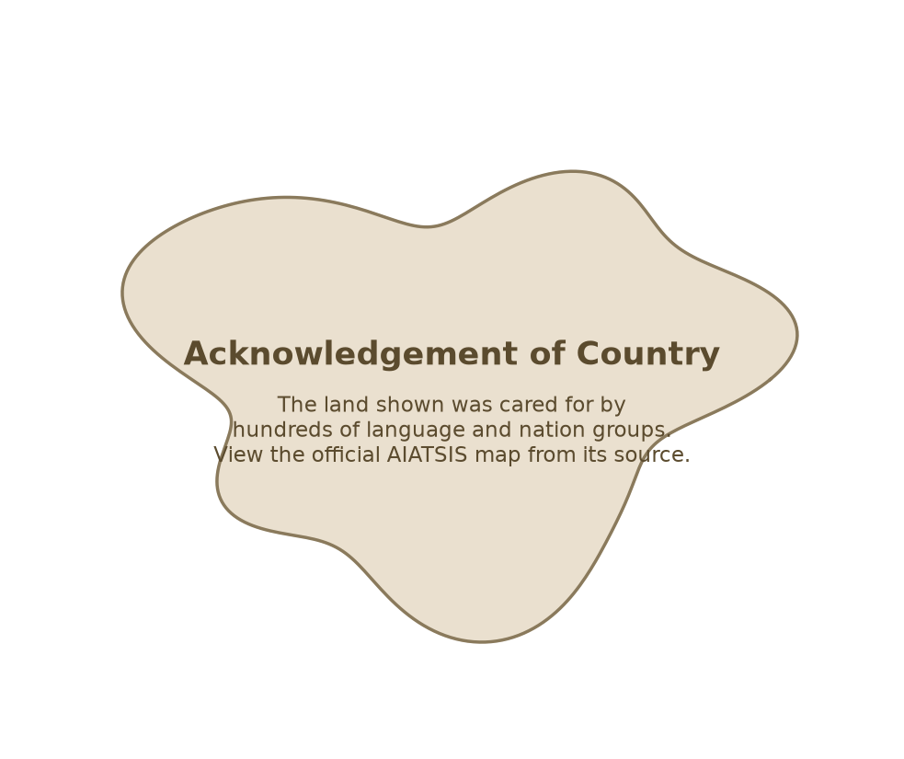
SEEING DATA
10
Representation is also governance
• Who is represented—and who is absent?
• Who collected, controls and can reuse the data?
• Who benefits from the visualisation?
• Who could be harmed or misled?
• What should not be visualised?
AIATSIS acknowledgement placeholder—not the copyright map
36104 Data Visualisation and Narratives

Slide 12
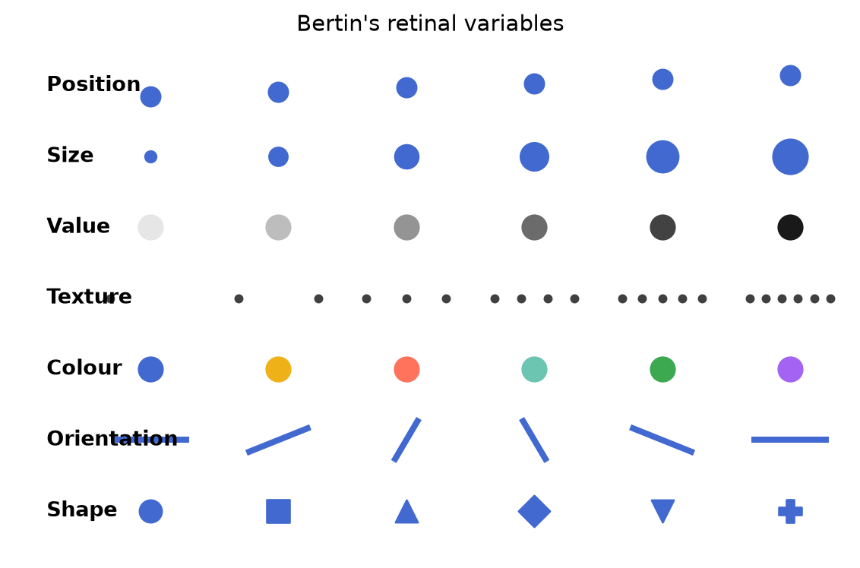
SEEING DATA
11
The small vocabulary of visual encoding
Bertin’s variables
• Position
• Size
• Value
• Texture
• Colour
• Orientation
• Shape
Bertin (1967) · reproduction generated from code
36104 Data Visualisation and Narratives

Slide 13
SEEING DATA
12
Critique the claim, not just the appearance
CLAIM
What does the chart invite us to believe?
AUDIENCE
Who is expected to act on it?
TASK
What comparison or judgement must they make?
EVIDENCE
What supports—or fails to support—the claim?
OMISSIONS
What is missing, compressed or hidden?
RESPONSIBILITY
Who benefits, and who carries the risk?
How the World Is Organised · Gerard Kelly
36104 Data Visualisation and Narratives

Slide 14
STUDIO · 45 MINUTES
Critique 1
Compare one human-made chart with one AI-generated interpretation.
10 min
15 min
10 min
10 min
Read
Interrogate
Verify
Share
Write the claim in one sentence.
Check audience, task, evidence and omissions.
Test one claim against the data or source.
Name one repair and one limitation.

Slide 15
SEEING DATA
14
Today’s three-hour rhythm
HOUR 1
HOUR 2
HOUR 3
Charts make claims
Seeing and framing
Critique and responsibility
Anscombe · evidence → narrative
Snow · Bertin · visual channels
AI interpretation · AIATSIS · studio
How the World Is Organised · Gerard Kelly
36104 Data Visualisation and Narratives

Slide 16
EXIT QUESTION
15
Could this visualisation lead someone to believe something the data does not support?
Complete the diagnostic quiz, then record one claim you would verify before sharing the chart.

