Slide 1


Slide 2
36104 · DATA VISUALISATION AND NARRATIVES
Choosing Visual Forms
Encoding, tidy data, and the Visual Vocabulary
What visual task are we performing?
Data Visualisation and Narratives

Slide 3
THE PREMISE
03
Good chart choice begins with the analytical task, not with the visual effect.
Opening question: before you pick a chart, what comparison must the reader actually make?

Slide 4
CHOOSING VISUAL FORMS
04
By the end of today
• Rank visual channels by the precision with which people read them.
• Classify an analytical question into an FT Visual Vocabulary category.
• Map a visual task to candidate chart forms, and name what each could mislead.
• Reshape wide data to tidy long form, by hand and with an AI assistant.
• Verify AI-wrangled data: identifiers, row counts, types, missing values.
How the World Is Organised · Gerard Kelly
36104 · UTS CRICOS 00099F · TEQSA PRV12060

Slide 5
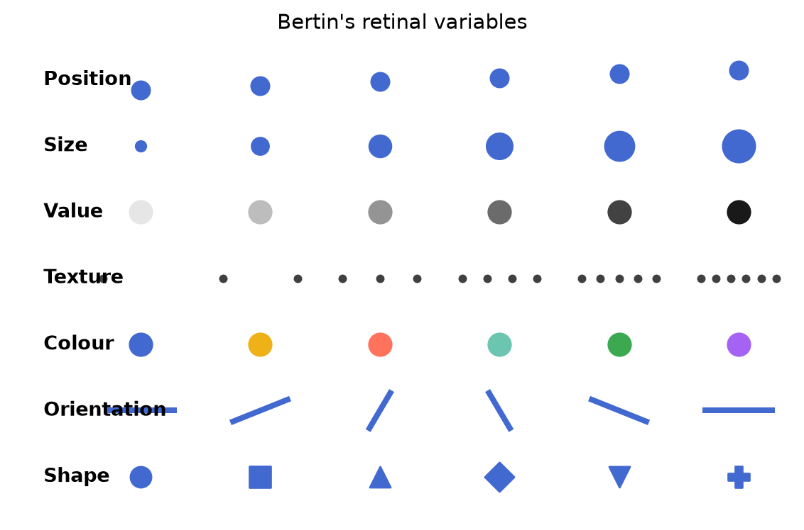
CHOOSING VISUAL FORMS
05
The small vocabulary of visual encoding
Bertin’s variables
• Position
• Size
• Value
• Texture
• Colour
• Orientation
• Shape
Bertin (1967) · reproduction generated from code
36104 · UTS CRICOS 00099F · TEQSA PRV12060

Slide 6
CHOOSING VISUAL FORMS
06
Channels are read at different precision
1
Position on a common scale
the workhorse, dot plots, scatterplots
2
Position on unaligned scales
small multiples pay a small tax
3
Length
bars, but only from a zero baseline
4
Angle · slope
pie charts and line slopes blur
5
Area
bubbles compress differences
6
Colour value · saturation
ordered, but coarse
7
Colour hue
categories only, never magnitude
After Cleveland & McGill (1984)
36104 · UTS CRICOS 00099F · TEQSA PRV12060

Slide 7
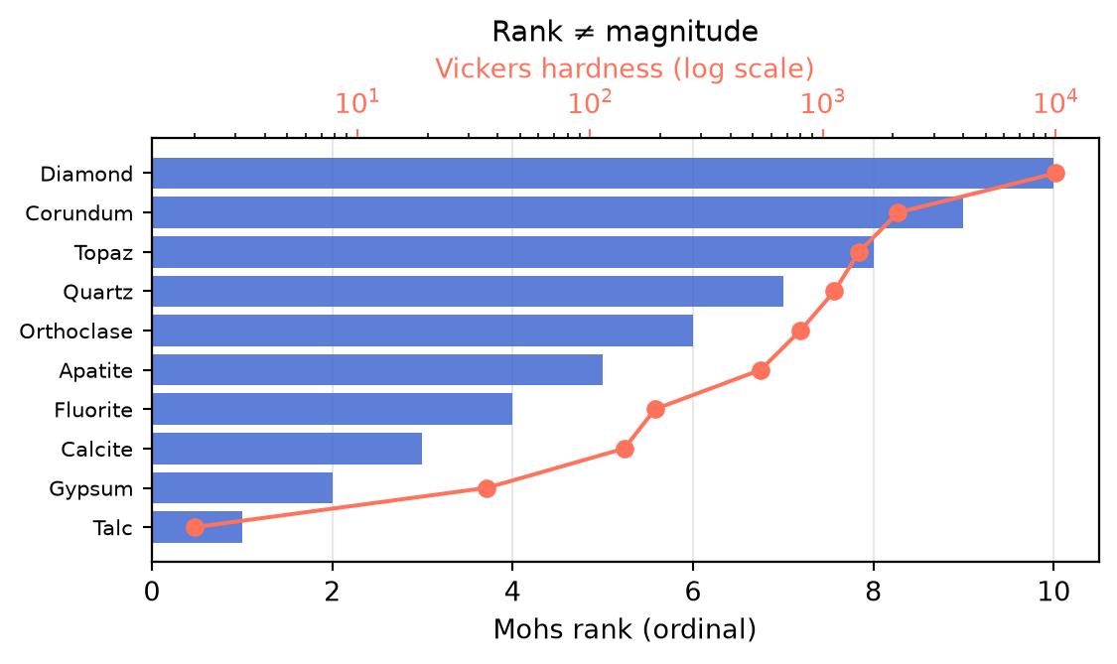
CHOOSING VISUAL FORMS
07
When the channel fights the data
Rank ≠ magnitude
Mohs hardness is an ordinal ladder. Encoded as evenly spaced bars it looks linear, but real hardness explodes near the top. The channel you choose asserts a scale. Choose one the data can honour.
Mohs (1825) · reproduction generated from code
36104 · UTS CRICOS 00099F · TEQSA PRV12060

Slide 8
THE CHANNEL SPRINT
08
Twelve charts · 40 seconds each. Name the channel doing the work.
Position, length, angle, area, colour value, colour hue, one dominates each chart. Write your call; we debrief three.

Slide 9
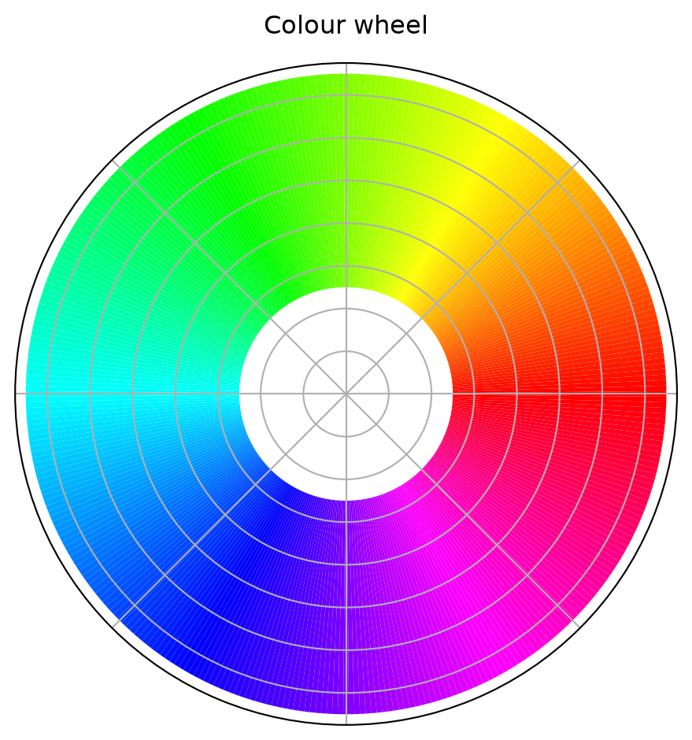
The colour wheel

Slide 10
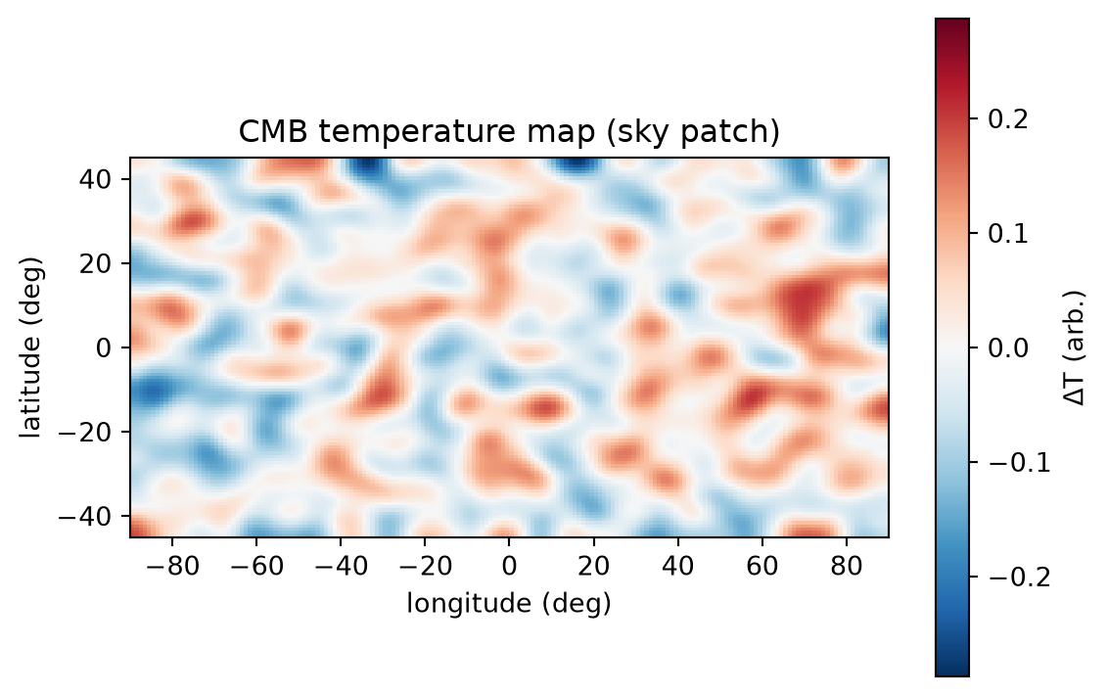
The cosmic microwave background

Slide 11
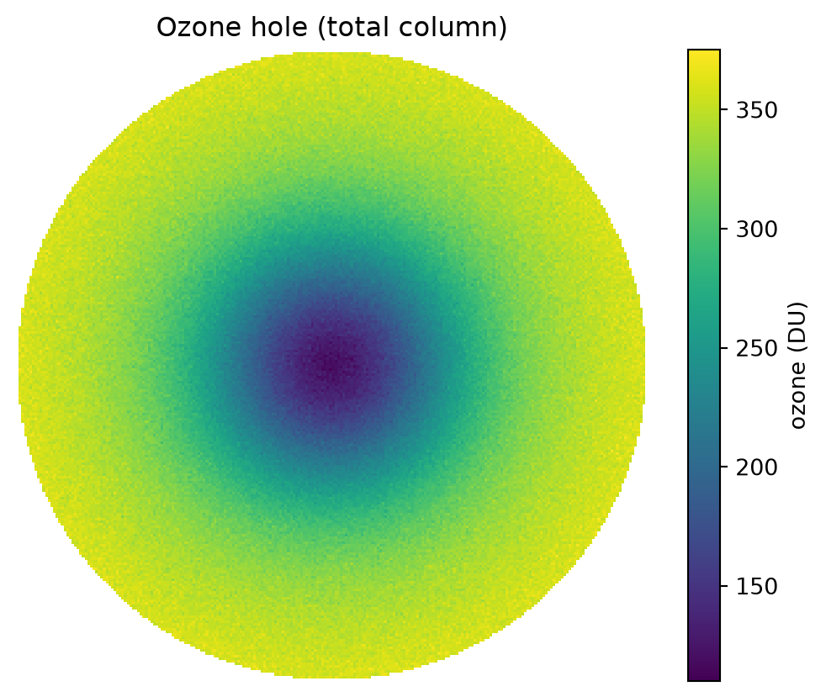
The ozone hole

Slide 12
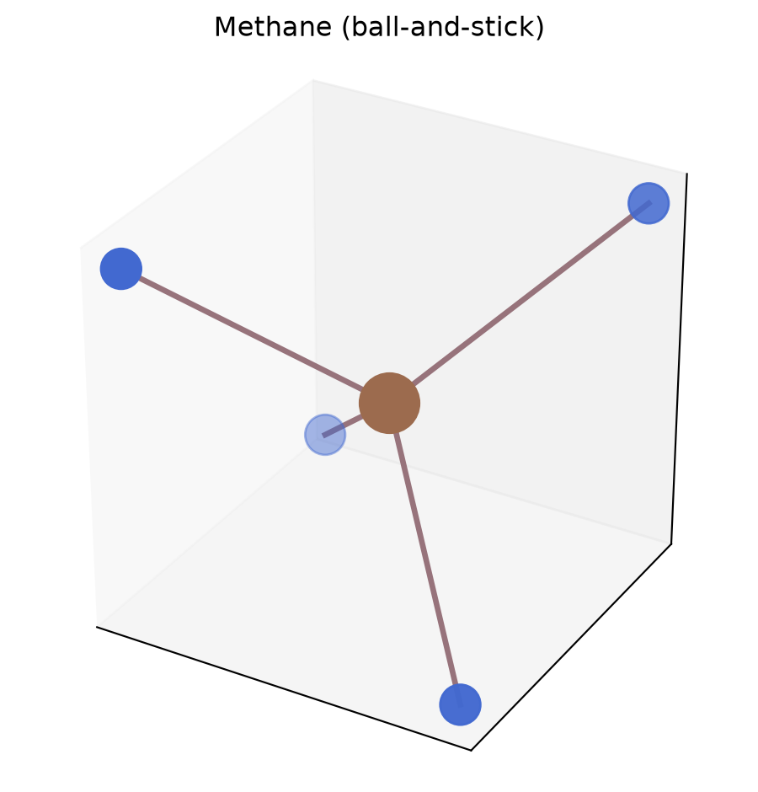
A molecule in 3D

Slide 13
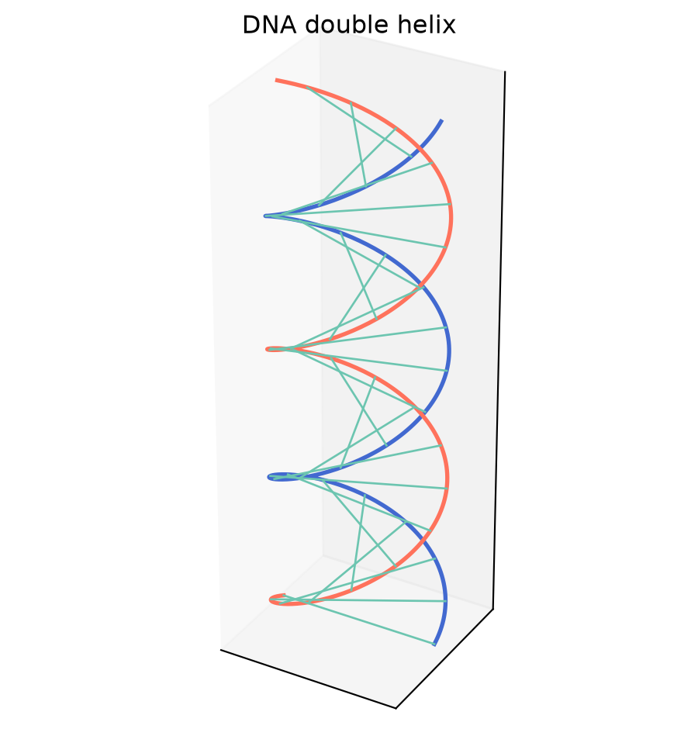
The DNA double helix

Slide 14
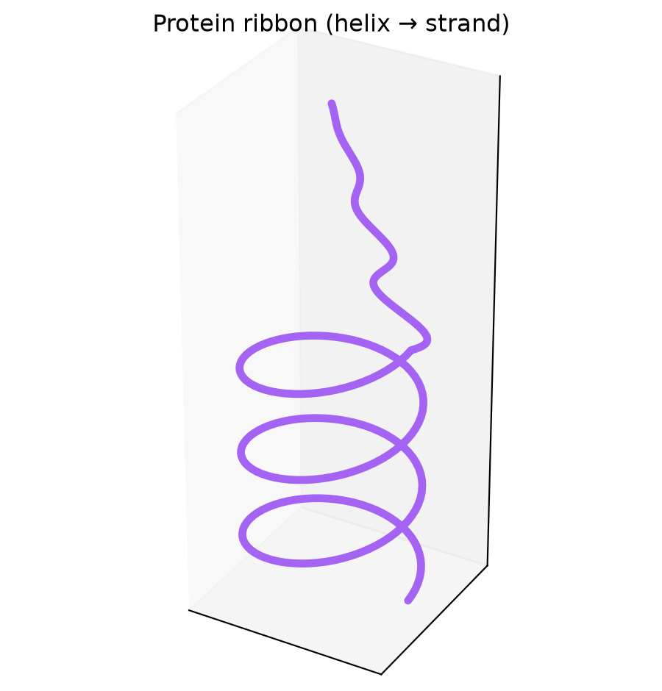
A protein ribbon

Slide 15
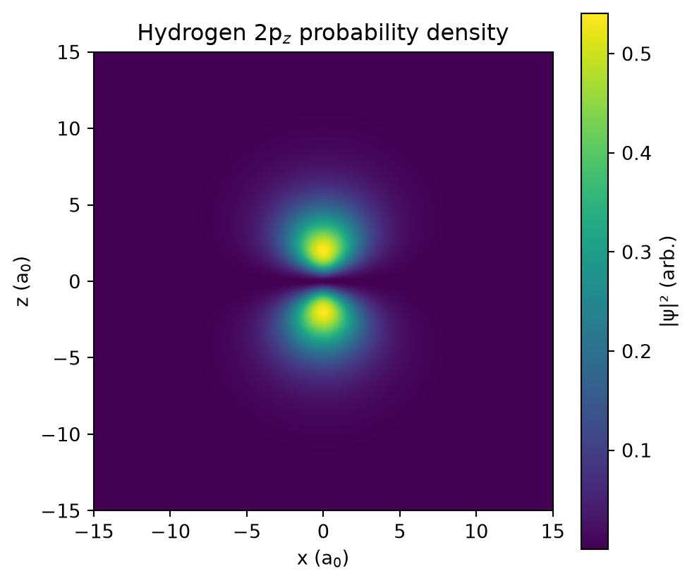
Atomic orbitals

Slide 16
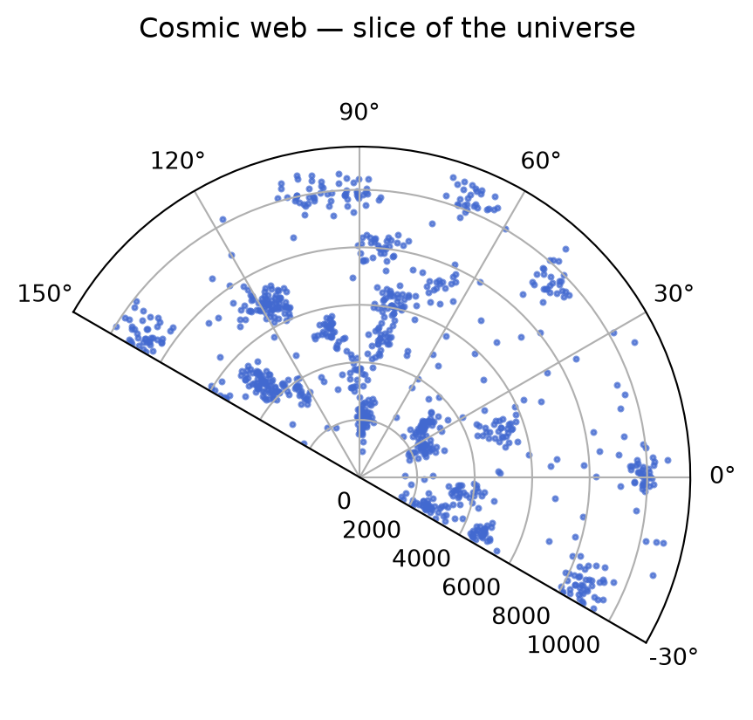
The cosmic web

Slide 17
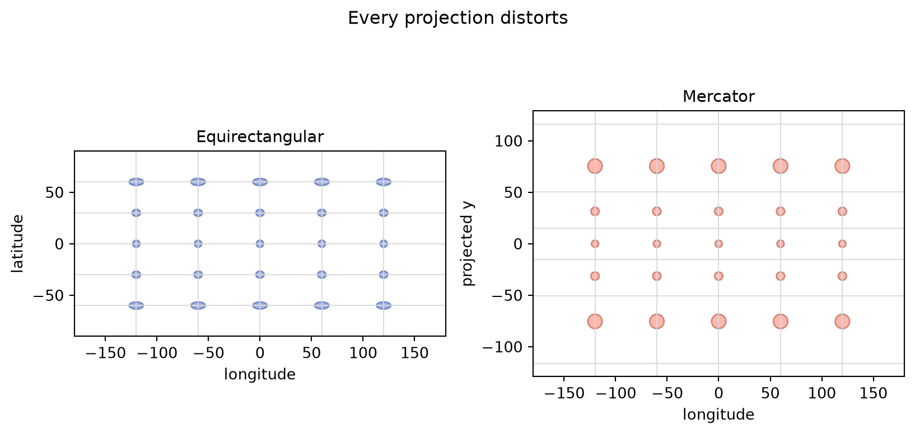
The map projection problem

Slide 18
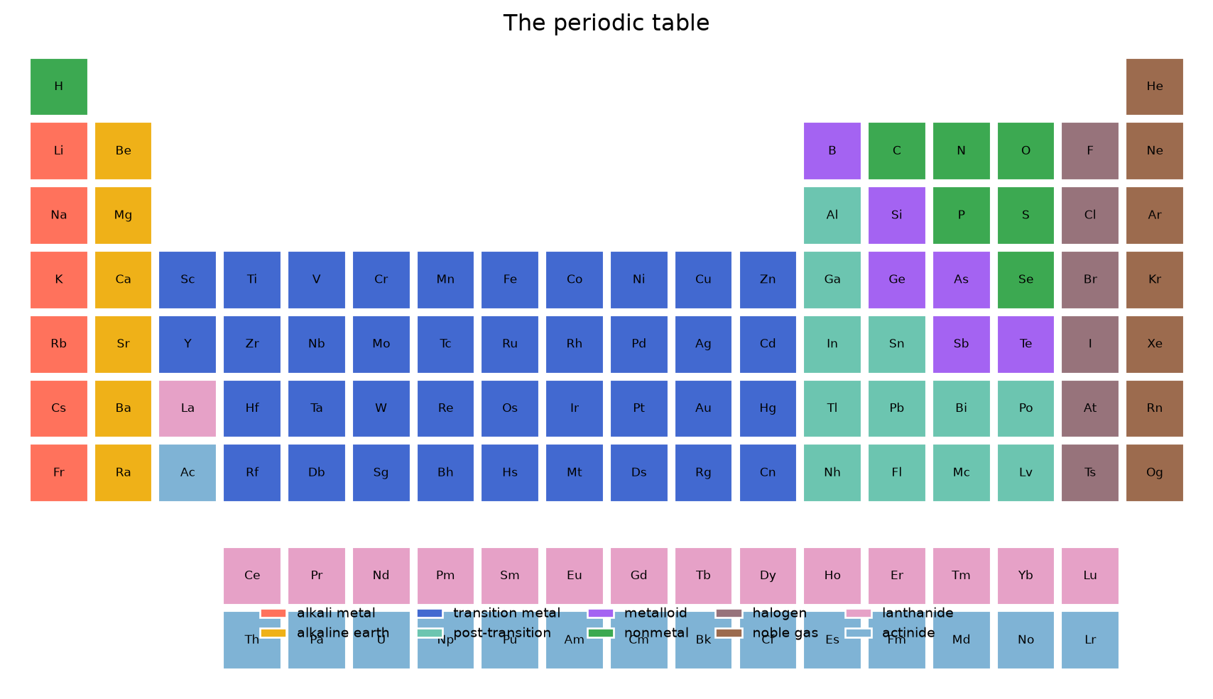
The periodic table

Slide 19
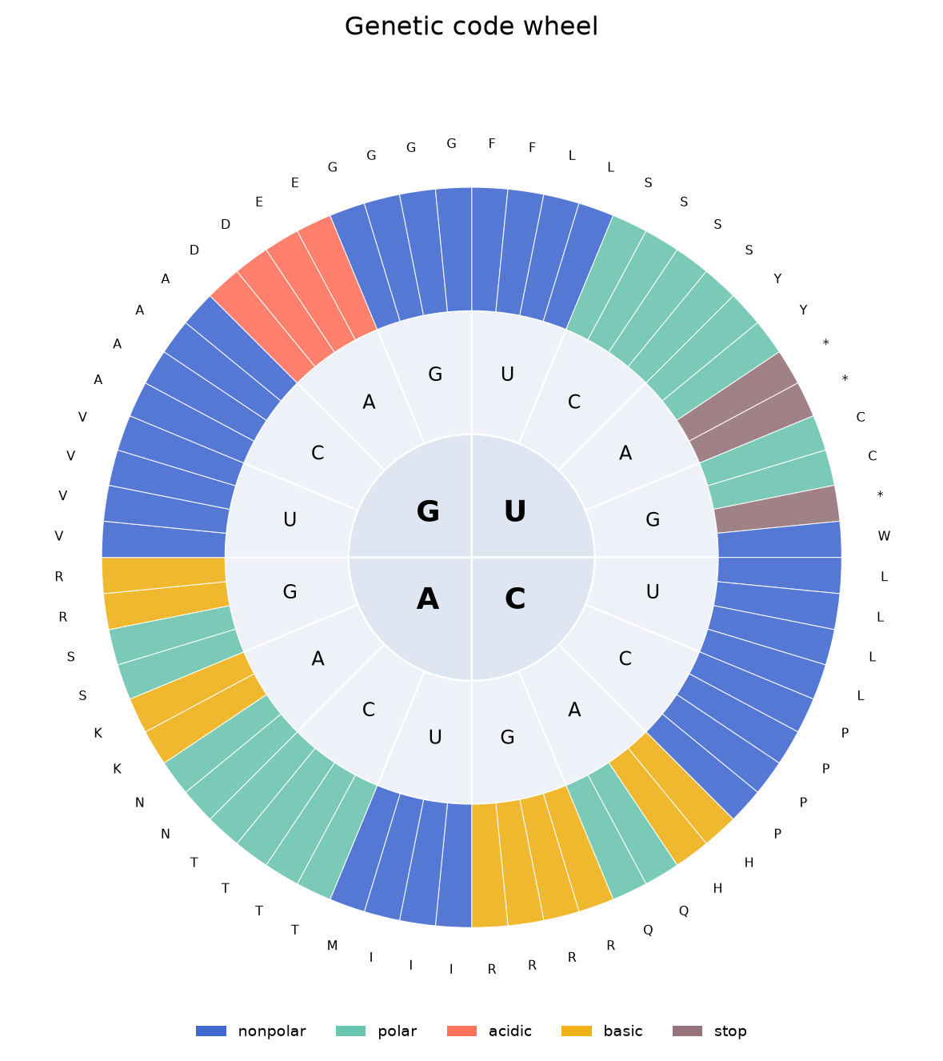
The genetic code wheel

Slide 20
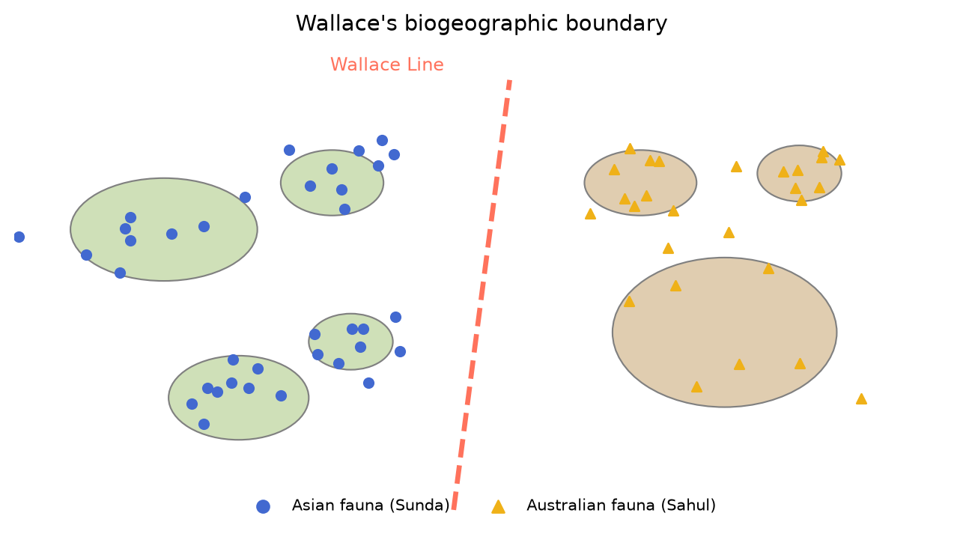
The Wallace line

Slide 21
THE SHARED LANGUAGE
21
Nine families of visual task. Every chart in this course belongs to one.
Deviation · Correlation · Ranking · Distribution · Change over time · Magnitude · Part-to-whole · Spatial · Flow

Slide 22
CHOOSING VISUAL FORMS
22
The FT Visual Vocabulary
DEVIATION
Values differ from a baseline or target
CORRELATION
Variables move together or apart
RANKING
Ordering items by value
DISTRIBUTION
Spread, range, clusters, outliers
CHANGE OVER TIME
Temporal pattern and trend
MAGNITUDE
Comparing sizes
PART-TO-WHOLE
Composition of a total
SPATIAL
Location and geography
FLOW
Movement, transfer, connection
How the World Is Organised · Gerard Kelly
36104 · UTS CRICOS 00099F · TEQSA PRV12060

Slide 23
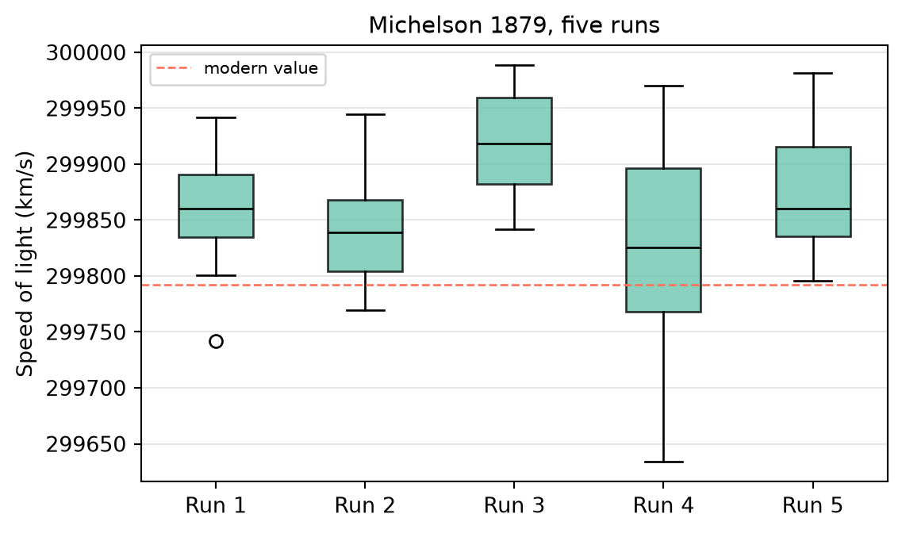
CHOOSING VISUAL FORMS
23
Distribution: show the spread, not the summary
The box plot
Median, quartiles, whiskers, outliers, five numbers standing in for the whole spread. Alternatives: histogram, dot plot, violin, density. Each reveals what the box compresses.
Tukey (1977) · reproduction generated from code
36104 · UTS CRICOS 00099F · TEQSA PRV12060

Slide 24
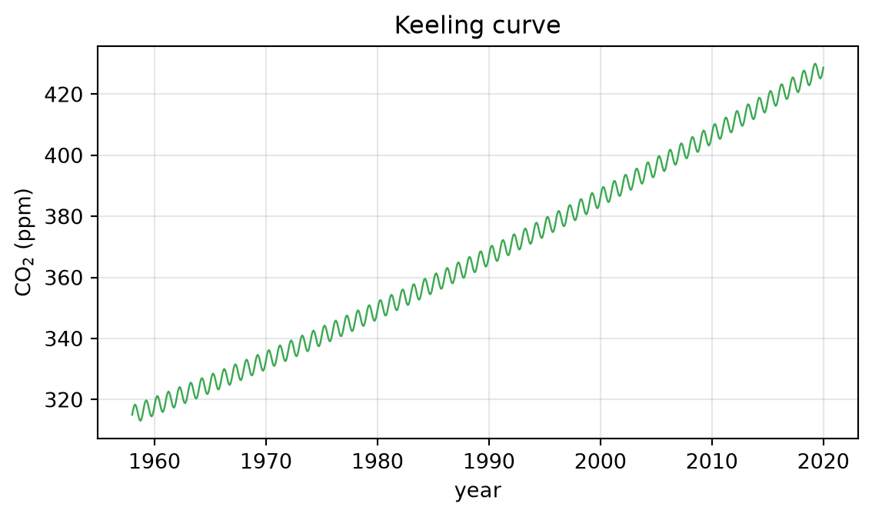
CHOOSING VISUAL FORMS
24
Change over time: the line over time is an argument
The Keeling curve
A rising saw-tooth: seasonal breathing on a relentless trend. The aspect ratio, the baseline and the window all change what the reader concludes.
Keeling (1960– ) · reproduction generated from code
36104 · UTS CRICOS 00099F · TEQSA PRV12060

Slide 25
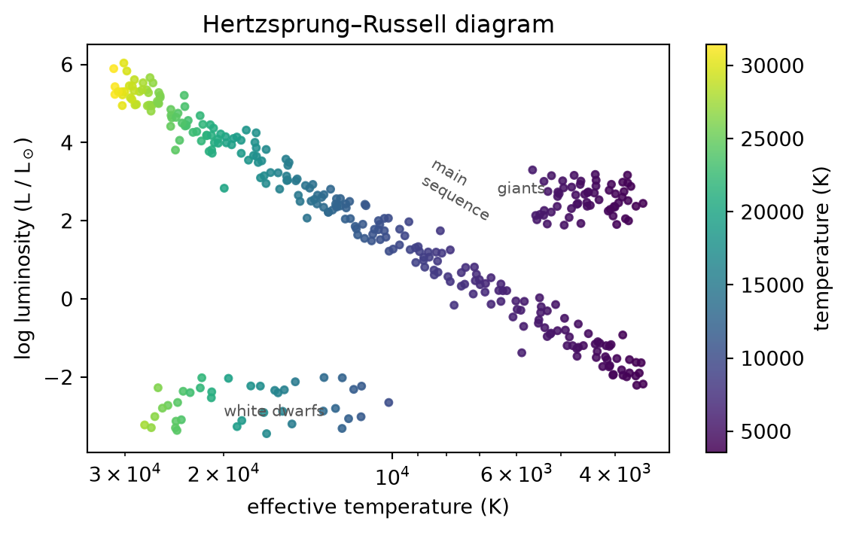
CHOOSING VISUAL FORMS
25
Correlation: two variables, one claim
Hertzsprung–Russell
A scatterplot of star brightness against temperature revealed the structure of stellar evolution. Position on both axes, the highest-precision channels doing the work.
Hertzsprung & Russell (1910s) · reproduction generated from code
36104 · UTS CRICOS 00099F · TEQSA PRV12060

Slide 26
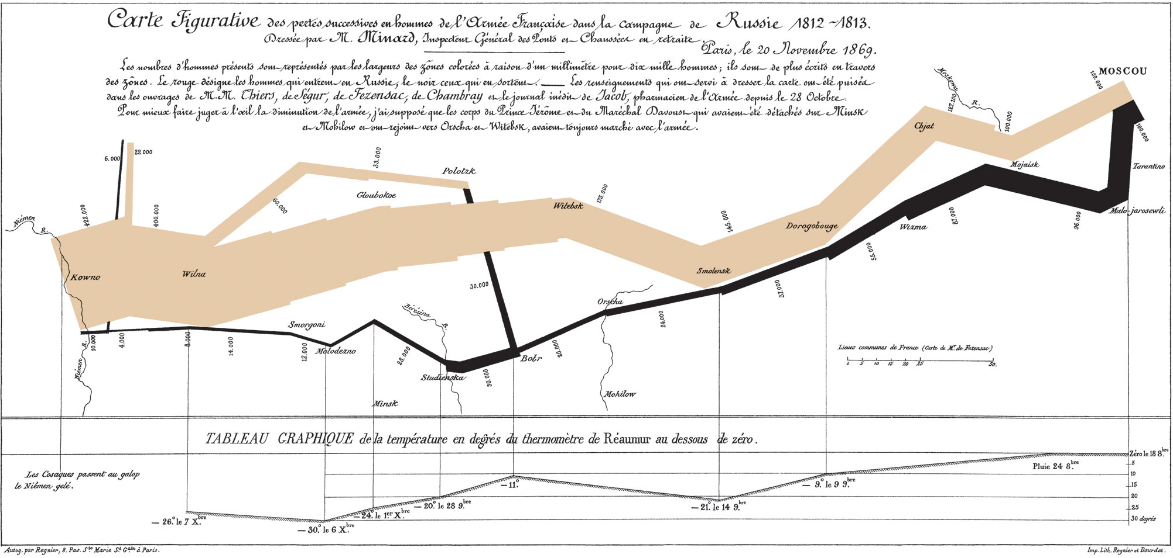
CHOOSING VISUAL FORMS
26
The original: Minard, 1869
Charles Joseph Minard, Carte figurative des pertes successives en hommes de l’Armée Française dans la campagne de Russie 1812–1813 (1869). Public domain.
36104 · UTS CRICOS 00099F · TEQSA PRV12060

Slide 27
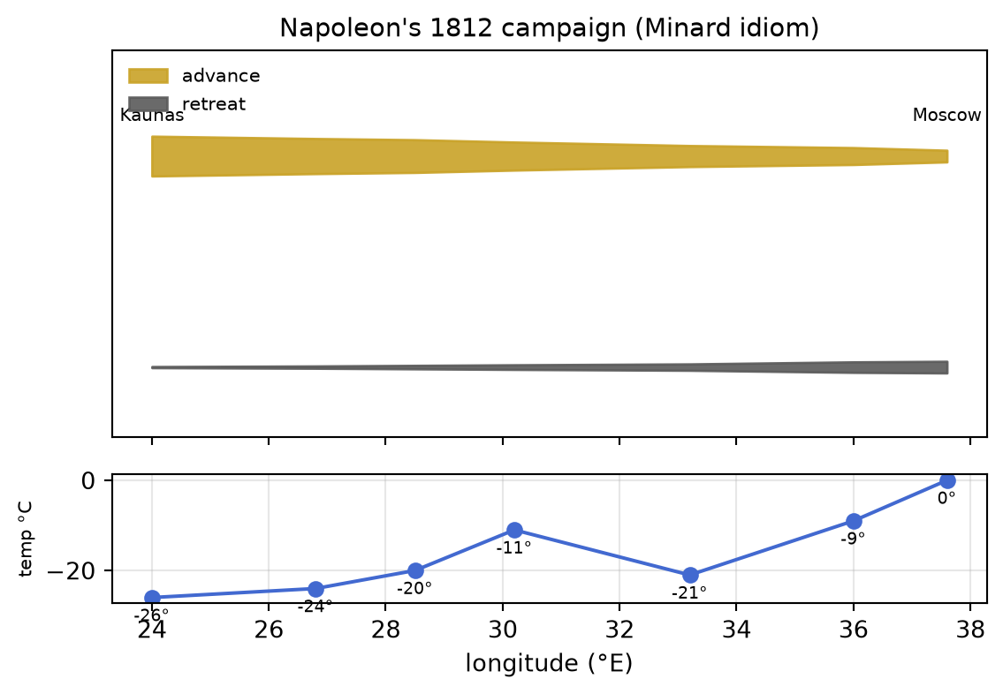
CHOOSING VISUAL FORMS
27
Spatial and flow: movement carries the claim
Minard’s march
Position, band width, colour and temperature in one plane, a flow map carrying an argument about catastrophe. Spatial and flow forms are powerful and expensive: use them when location or movement is the task.
Minard (1869) · reproduction generated from code
36104 · UTS CRICOS 00099F · TEQSA PRV12060

Slide 28
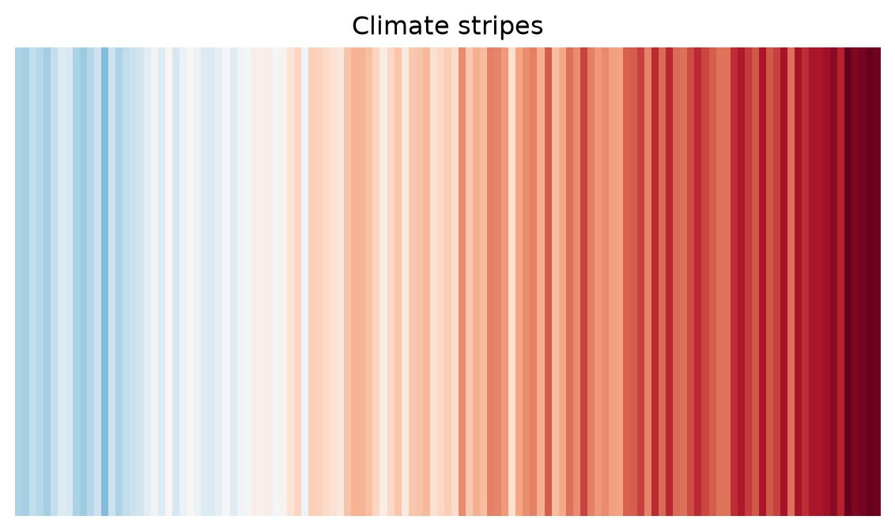
CHOOSING VISUAL FORMS
28
Colour is an encoding, not a decoration
Climate stripes
One channel, colour, encoding one variable, ordered and diverging around a baseline. Colour rules: sequential for ordered data, diverging around a meaningful midpoint, categorical hues only for categories. Check colour-blind safety.
Hawkins (2018) · reproduction generated from code
36104 · UTS CRICOS 00099F · TEQSA PRV12060

Slide 29
CHOOSING VISUAL FORMS
29
Colour rules, in six cards
SEQUENTIAL
Ordered data: light → dark, one hue
DIVERGING
Two directions around a meaningful midpoint
CATEGORICAL
Distinct hues for categories, never magnitude
COLOUR-BLIND
≈8% of men can't split red/green, check every palette
RAINBOW
Jet invents boundaries that aren't in the data
GREY IS A COLOUR
Mute the context, spend hue on the point
How the World Is Organised · Gerard Kelly
36104 · UTS CRICOS 00099F · TEQSA PRV12060

Slide 30
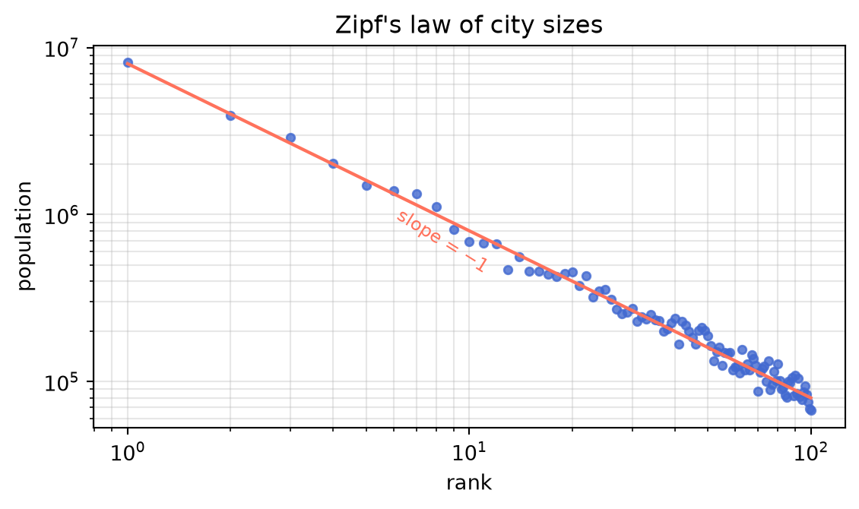
CHOOSING VISUAL FORMS
30
Ranking meets the scale question
Zipf’s law of cities
Rank cities by size and plot on log–log: a straight line appears, structure the linear view hides completely. The task (ranking) chose the form; the data chose the scale.
Zipf (1949) · reproduction generated from code
36104 · UTS CRICOS 00099F · TEQSA PRV12060

Slide 31
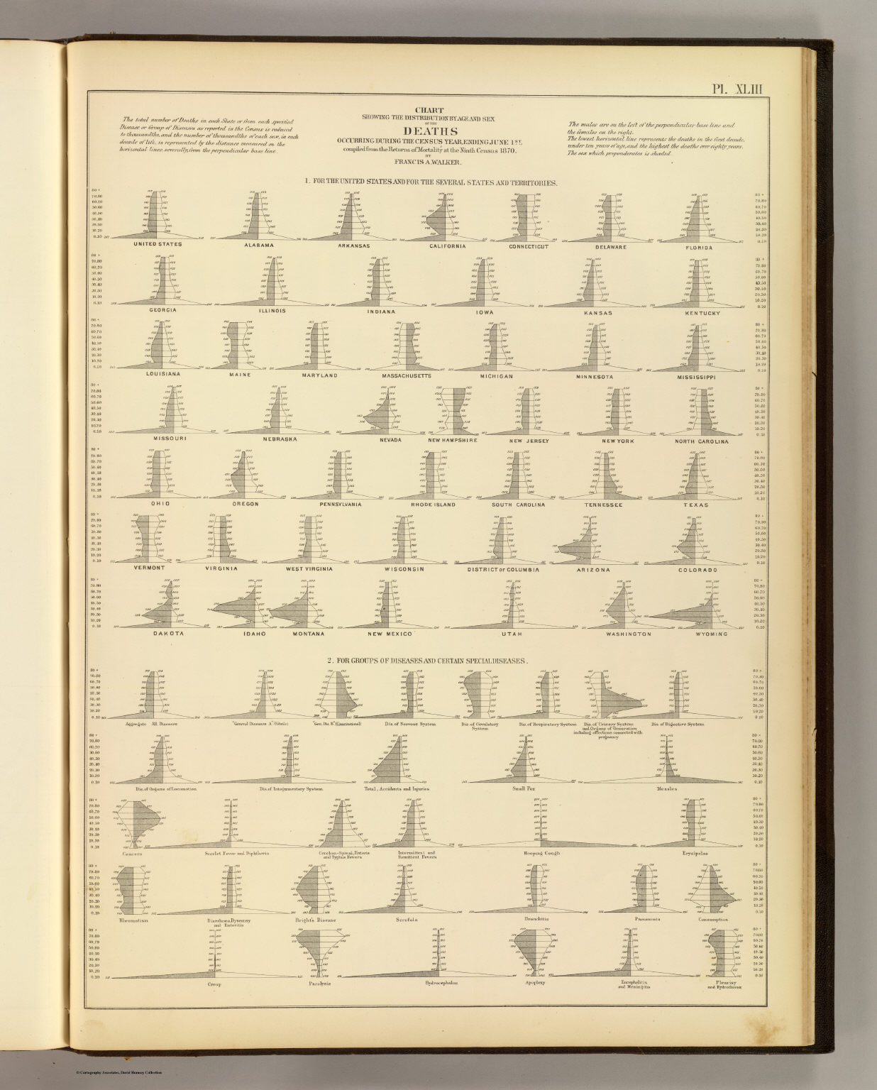
CHOOSING VISUAL FORMS
31
The original: the Statistical Atlas, 1874
Chart showing the distribution by age and sex of deaths, Statistical Atlas of the United States, Francis A. Walker (1874). Public domain.
36104 · UTS CRICOS 00099F · TEQSA PRV12060

Slide 32
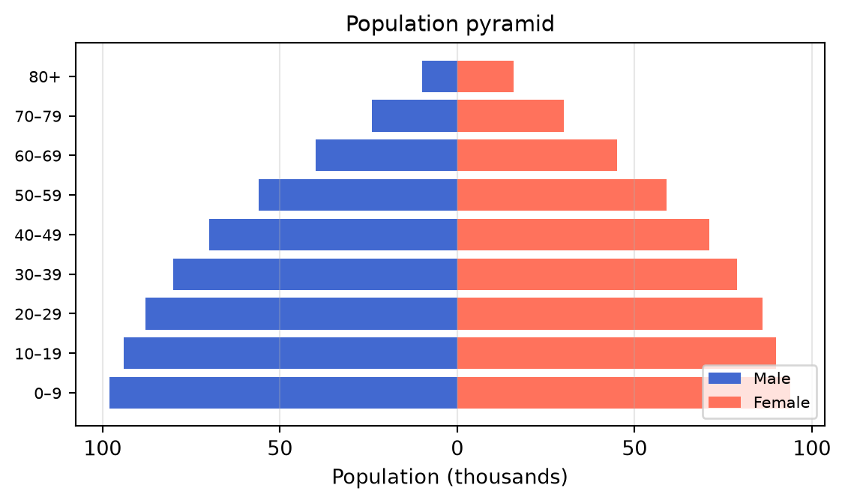
CHOOSING VISUAL FORMS
32
Distribution split by category
The population pyramid
Back-to-back bars: one distribution per group, mirrored so the shape of a whole population reads at a glance. Youthful and broad, or ageing and top-heavy, the silhouette is the finding.
Walker (1874) · reproduction generated from code
36104 · UTS CRICOS 00099F · TEQSA PRV12060

Slide 33
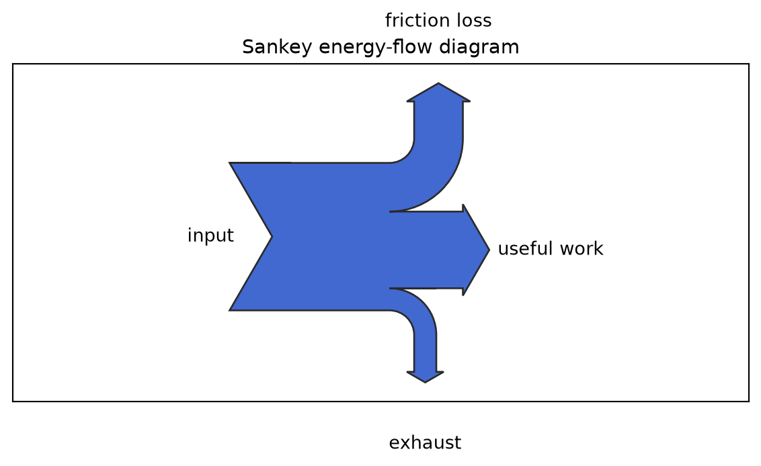
CHOOSING VISUAL FORMS
33
Flow: where the quantity goes
The Sankey diagram
Band width is the quantity; the branching shows where it goes. Energy in, useful work and losses out. Use flow forms when the reader's task is tracing movement, not just comparing totals.
Sankey (1898) · reproduction generated from code
36104 · UTS CRICOS 00099F · TEQSA PRV12060

Slide 34
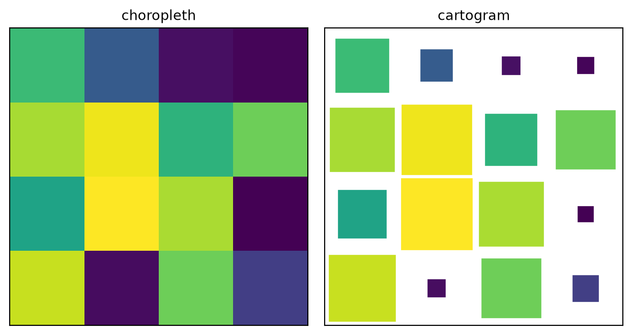
CHOOSING VISUAL FORMS
34
Spatial: the map is the task, and the trap
Choropleth vs cartogram
Colour by area and big empty regions dominate; size by population and geography distorts. Every map trades truth for truth. Ask: is location genuinely the task, or is a sorted bar chart the honest answer?
Reproduction generated from code
36104 · UTS CRICOS 00099F · TEQSA PRV12060

Slide 35
CHOOSING VISUAL FORMS
35
Baselines, aspect, and order
ZERO BASELINE
Bars encode length, they must start at zero
LINES MAY ZOOM
Position encodings can crop, say so on the axis
ASPECT RATIO
Bank slopes toward 45° to keep change readable
SORT ORDER
Alphabetical is a decision too, usually the wrong one
DUAL AXES
Two scales invite any story, small multiples instead
ANNOTATE
Title the finding; label the point that carries it
How the World Is Organised · Gerard Kelly
36104 · UTS CRICOS 00099F · TEQSA PRV12060

Slide 36
THINK · PAIR · SHARE
36
Sketch: monthly ridership for six regions, 2019–2025. Which form, and which channel does the work?
3 minutes solo sketch · 4 minutes compare in pairs · as a room: what did everyone choose, and what did nobody choose?

Slide 37
CHOOSING VISUAL FORMS
37
Tidy data: the shape charts want
COLUMN
ROW
CELL
each variable is a column
each observation is a row
each value is a cell
Wide → long is the reshape you will perform most often:
region 2023 2024 2025 region year riders Inner 1.30M 1.41M 1.52M → Inner 2023 1.30M Western 1.05M 1.13M 1.24M Inner 2024 1.41M Western 2023 1.05M
Tidy structure feeds Tableau, pandas, Altair, and AI-generated code.
Wickham, “Tidy Data” (2014)
36104 · UTS CRICOS 00099F · TEQSA PRV12060

Slide 38
CHOOSING VISUAL FORMS
38
AI-assisted wrangling: generate, then verify
1
IDENTIFIERS
Are the key columns intact, no invented or dropped categories?
2
ROW COUNT
Does the reshaped row count equal what arithmetic predicts?
3
TYPES
Numbers still numeric, dates still dates, no silent strings?
4
MISSING
Where did NaNs appear, and are they real or created?
5
SPOT TOTALS
Does one hand-computed total match the transformed table?
How the World Is Organised · Gerard Kelly
36104 · UTS CRICOS 00099F · TEQSA PRV12060

Slide 39
CHOOSING VISUAL FORMS
39
Notebook: classify, reshape, redesign
• Open visual_forms_activities.ipynb in VS Code; an AI assistant is available but not required.
• Exercise 1: channel precision: judge the same values in five encodings.
• Exercise 2: reshape the wide transport table to tidy long form; run the five checks.
• Exercise 3: classify six analytical questions into Vocabulary categories and draft one chart.
• Exercise 4: aspect ratio and baseline: same data, three impressions.
• Exercise 5: colour: pick the palette family for three datasets, then prove it.
• Exercise 6: redesign the weak chart three ways, one category per redesign.
How the World Is Organised · Gerard Kelly
36104 · UTS CRICOS 00099F · TEQSA PRV12060

Slide 40
BREAK
40
Back in 10 minutes.
When we return: the redesign studio: bring your weak-chart diagnosis.

Slide 41
THE COMMON MISTAKE
41
Choosing the most impressive form instead of the form the task needs.
Does the visual form fit the task, or does it encourage an easier but wrong interpretation?

Slide 42
STUDIO · 45 MINUTES
Redesign ×3
Take the weak chart. Redesign it three ways, each serving a different Visual Vocabulary category.
10 min
15 min
10 min
10 min
Diagnose
Redesign
Classify
Share
Name the task the original fails.
Three sketches, three categories.
Justify each category and form choice.
Trade one redesign; name one risk.

Slide 43
CHOOSING VISUAL FORMS
43
Today’s three-hour rhythm
HOUR 1
HOUR 2
HOUR 3
Channels and the Vocabulary
Tidy data and AI wrangling
Redesign studio
Precision · nine families · colour · baselines
Notebook: reshape, verify, classify, colour
Weak chart ×3 redesigns · critique · quiz
How the World Is Organised · Gerard Kelly
36104 · UTS CRICOS 00099F · TEQSA PRV12060

Slide 44
QUIZ
44
15 minutes. Open book, closed assistant.
Today's vocabulary: channels and their precision, the nine task families, tidy data, the five wrangling checks.

Slide 45
EXIT QUESTION
45
Does the selected visual form fit the task, or does it encourage an easier but wrong interpretation?
Bring one chart you suspect uses the wrong form to the next class, it becomes Critique 2 material.

