Slide 1
Fowler Middle School
Career Day
Gerardo Rodriguez
Interactive Developer, CMD Agency

Slide 2
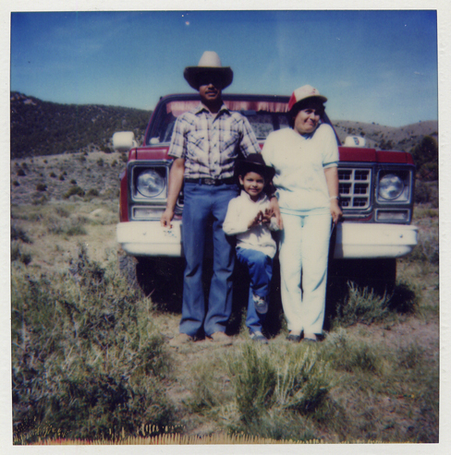
A little bit about myself…
Born in Reno, Nevada, 1982
I am the oldest of my siblings (2 sisters)
First in my family to attend and graduate from:
- Middle School
- High School
- College

Slide 3
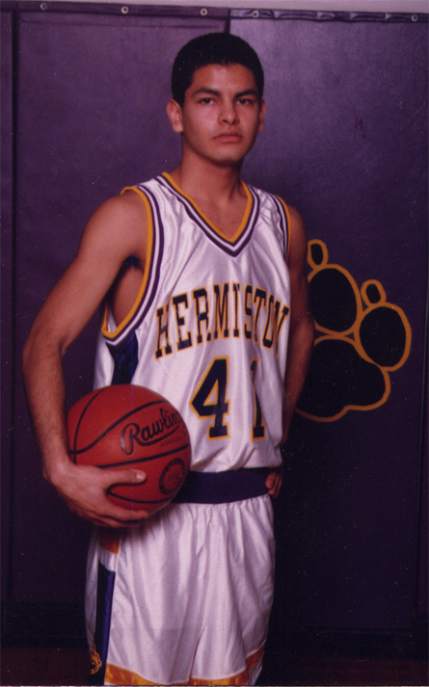
My High School Years…
Loved to draw, took all the Art classes I could.
Enjoyed Math as well.
Played Basketball & Soccer
Would always challenge myself, wanting to do the best I could, wanted to get the highest GPA possible.

Slide 4
College Years @ UO
Entered with Architecture as my Major, 2 years into the program, I decided it wasn’t for me.
Found a different path that allowed me to use both sides of my brain, graduated with a BFA in Digital Arts in 2006
Became a member of the MEChA student group
Mentored middle school students through the Ganas Program

Slide 5
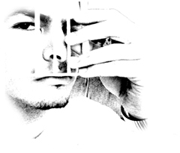
College Years @ AiPD
Upon leaving UO and trying to enter the “real world”, I quickly realized that I lacked specific skills that I needed to make it. After looking at all of my options, I ended up returning to school.
Graduated from AiPD in 2009 with a 2nd Bachelors in Web Design & Interactive Media
Learned how to write code, various programming languages.

Slide 6

Where I’m at now…
Interactive Developer @ CMD Agency
Began working as a contractor in February 2008.
Hired on Full Time upon graduating from AiPD in June 2009.
Still do work on the side, freelancing, to keep myself open to learning new things as the learning never stops.

Slide 7
What is Interactive Development?
Interactive Developer @ CMD Agency
Began working as a contractor in February 2008.
Hired on Full Time upon graduating from AiPD in June 2009.
Still do work on the side, freelancing, to keep myself open to learning new things as the learning never stops.

Slide 8
What is Interactive Development?
Program all the “coolness” of the web.
Make the designs come to life by writing the code.
Some programming languages that I’ve learned:
- XHTML
- CSS
- Javascript
- Actionscript
- PHP
- MySQL
To some, what we do is “magic”…

Slide 9
Why do I like my work?
Everyday is a new/different challenge.
- The learning never stops.
- It’s fast-paced.
- I can work both individually and as a team.
- Casual working environment.
- I can listen to my own music all day as I code.
- Very independent work schedule (general working hours)
- Could work from home if need be.
- New languages/technologies evolve daily, it seems.

Slide 10
What is my typical day?
Roll into work around 8:30.
- Get in contact with producers about projects
- Receive design comps & technical specs that I’ll use as my “floor plans”.
- Write Code!!! :)
- A few times a week, I go play basketball during lunch (our job pays for gym membership)
- Come back from lunch/basketball
- Sit down again, throw my headphones on, back to coding.
- When project is done, send project to QA.
- Fix bugs if found.
- Once no more bugs, upload all files to server and…TA-DA!!
The project is live and viewable to the whole world! :)

Slide 11
What makes a good developer?
Attention to detail
- Must be able to multi-task
- Be able to manage various projects at once
- Organization helps a lot
- Must be curious!
- Always be willing to learn
- Have mind open to alternate solutions/angles of attack
- Be able to communicate effectively, both verbally & written
- Knowing when to let go…

Slide 12
Portfolio available at:
http://www.gerardo-rodriguez.com
Company I work for:
http://www.cmdagency.com
You can contact me via:
Work: grodriguez@cmdagency.com
Freelance: gerardo@gerardo-rodriguez.com
Twitter: @_gerardo

