Slide 1
Portland Youth Bridge Builders 2012
Mt. Hood CC / Trio Program
Gerardo Rodriguez
Senior Web Developer, Dachis Group

Slide 2
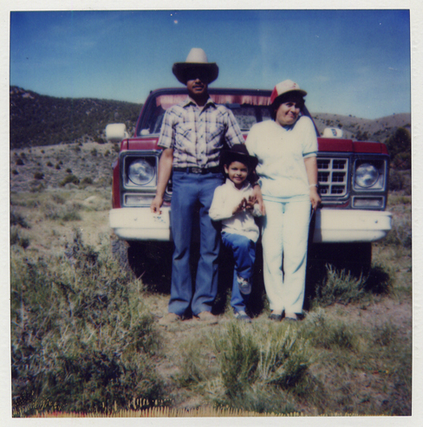
A little bit about myself…
Born in Reno, Nevada, 1982
I am the oldest of my siblings (2 sisters)
First in my family to attend and graduate from:
- Middle School
- High School
- College

Slide 3
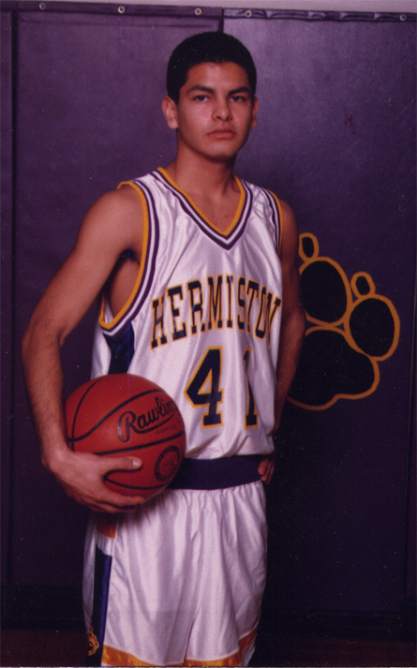
My High School Years…
Loved to draw, took all the Art classes I could.
Enjoyed Math as well.
Played Basketball & Soccer
Would always challenge myself, wanting to do the best I could, wanted to get the highest GPA possible.

Slide 4
College Years @ UO
Entered with Architecture as my Major, 2 years into the program, I decided it wasn’t for me.
Found a different path that allowed me to use both sides of my brain, graduated with a BFA in Digital Arts in 2006
Became a member of the MEChA student group
Mentored middle school students through the Ganas Program

Slide 5
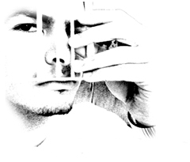
College Years @ AiPD
Upon leaving UO and trying to enter the “real world”, I quickly realized that I lacked specific skills that I needed to make it. After looking at all of my options, I ended up returning to school.
Graduated from AiPD in 2009 with a 2nd Bachelors in Web Design & Interactive Media
Learned how to write code, various programming languages.

Slide 6
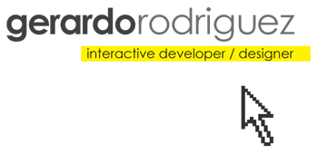
Where I’m at now…
Senior Web Developer @ Dachis Group
Started working for Dachis Group Feb 2012, after working for CMD Agency for 4 years. I landed a FT job as a Web Developer graduating from AiPD in June 2009.
Still do work on the side, freelancing, to keep myself open to learning new things as the learning never stops.

Slide 7
What is Web Development?

Slide 8
What is Web Development?
Program all the “coolness” of the web.
Make the designs come to life by writing the code.
Some programming languages that I’ve learned:
- XHTML
- CSS
- Javascript
- Actionscript
- PHP
- MySQL
To some, what we do is “magic”…

Slide 9
Why do I like my work?
Everyday is a new/different challenge.
- The learning never stops.
- It’s fast-paced. (Agency life)
- I work both individually and as a team.
- Casual working environment (clothing too).
- I can listen to my own music all day as I write code.
- Very independent work schedule (general working hours)
- Could work from home if need be.
- New languages/technologies evolve daily, it seems, which forces me to “stay on my toes”.

Slide 10
What is my typical day?
Roll into work around 8:30.
- Get in contact with producers about projects
- Receive design comps & technical specs that I’ll use as my “floor plans”.
- Write Code!!! :)
- A few times a week, I go play basketball during lunch (our job pays for gym membership)
- Come back from lunch/basketball
- Sit down again, throw my headphones on, back to coding.
- When project is done, send project to QA.
- Fix bugs if found.
- Once no more bugs, upload all files to server and…TA-DA!!
The project is live and viewable to the whole world! :)

Slide 11
What makes a good developer?
Attention to detail
- Must be able to multi-task
- Be able to manage various projects at once
- Organization helps a lot
- Must be curious!
- Always be willing to learn
- Have mind open to alternate solutions/angles of attack
- Be able to communicate effectively, both verbally & written
- Knowing when to let go…

Slide 12
A sneak peek at my portfolio…
http://www.gerardo-rodriguez.com

Slide 13
Portfolio available at:
http://www.gerardo-rodriguez.com
Company I work for:
http://www.dachisgroup.com
You can contact me via:
Work: gerardo.rodriguez@dachisgroup.com
Freelance: gerardo@gerardo-rodriguez.com
Twitter: @_gerardo

