Slide 1
PLAY
QUIT

Slide 2
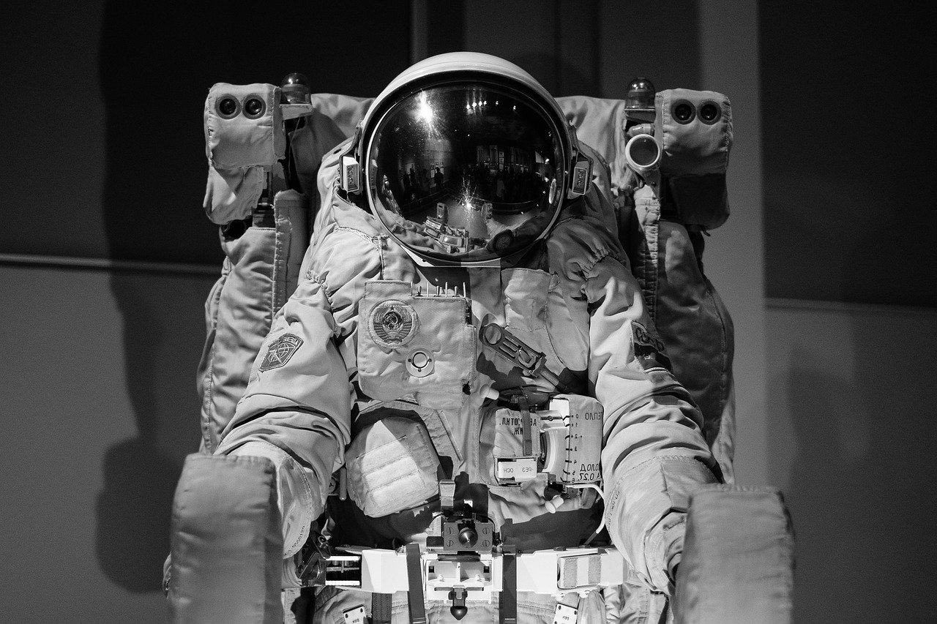
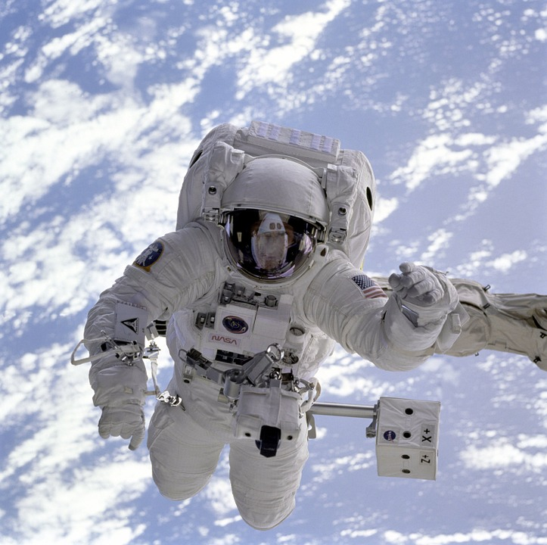
CHOOSE YOUR CHARACTER
PLAY

Slide 3
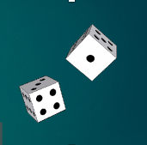
1
2
3
4
6
Jupiter
5
7
8

Slide 4


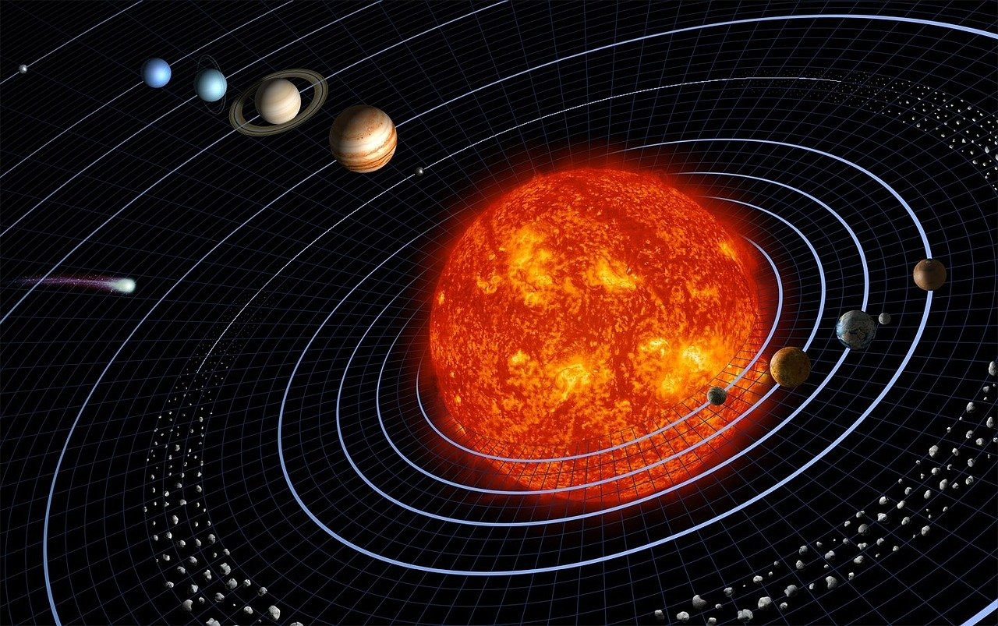

Arrived

Slide 5
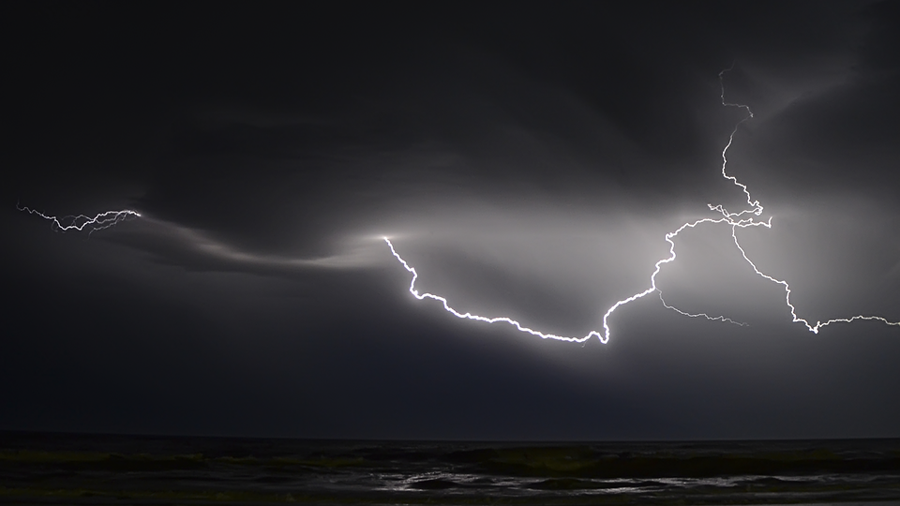
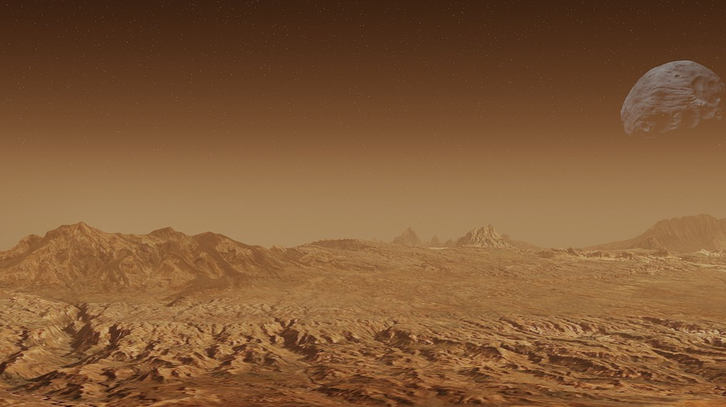
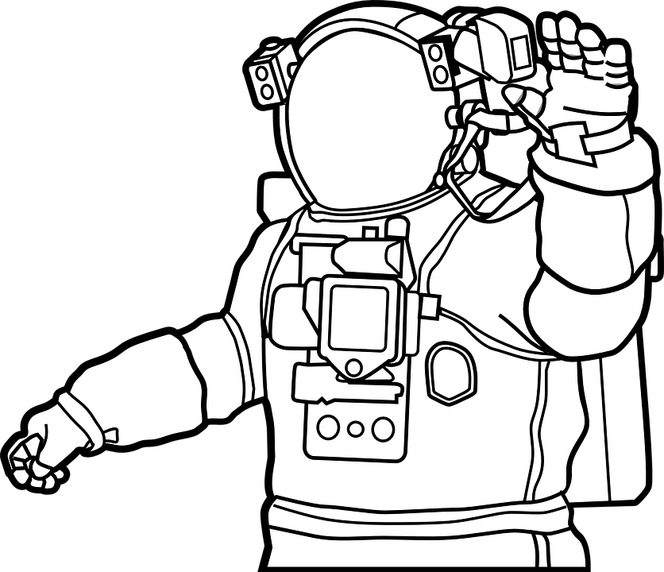

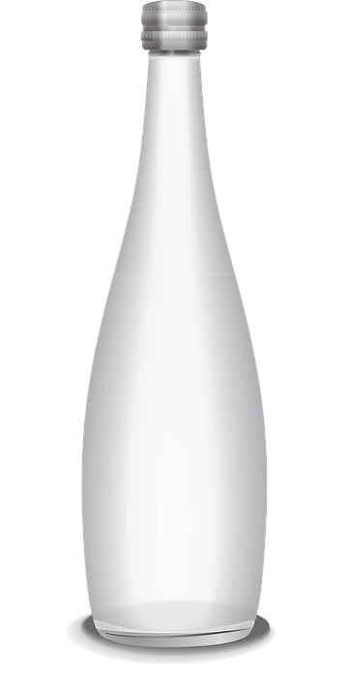
DAY 1
Oxygen
100%, 30 min left
Hailstorm approaching
What you need to get to survive?

Slide 6
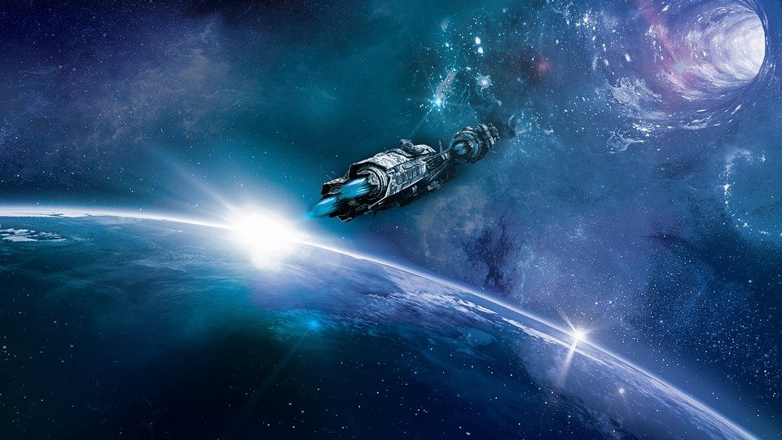
YOU HAVE WON THE GAME
Quit

