Slide 1
Project #3 Smoking
Gerardo Hernandez Macoto
2023

Slide 2
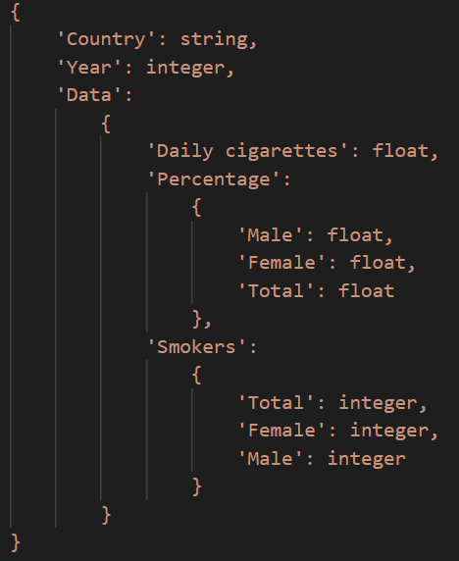
Smoking Dataset
The Smoking dataset represents a collection of information related to smoking across the world. The structure of the dataset can be visually represented below:
The limitations of the dataset included:
The year range (1980-2012)
The lack of additional information that might be useful to know about smoking (i.e., how many deaths caused by smoking)
Including more smoking products aside from cigarettes

Slide 3
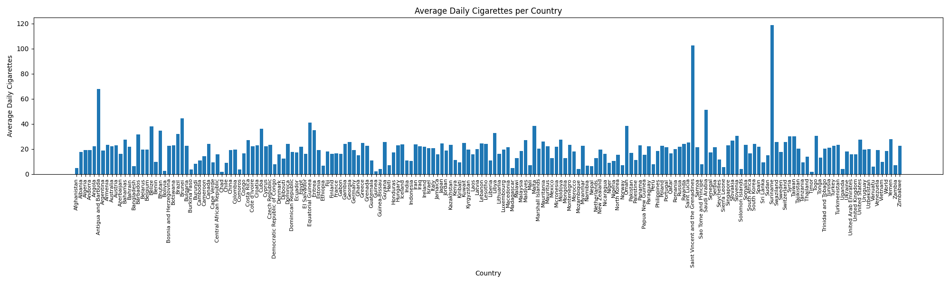
Question 1
What is the daily average number of cigarettes smoked in every country (from 1980 - 2012)?

Slide 4
Question 1 continued…
It’s important to know smoking habits across the globe to help aid in health research and to create preventions to minimize smoking habits. The figure gives a clear visualization on average daily consumption of cigarettes for each country and it reveals which countries have the highest or lowest smoking rates over time.
Notes:
It provides insight into the health, social, and economic impacts of smoking.

Slide 5
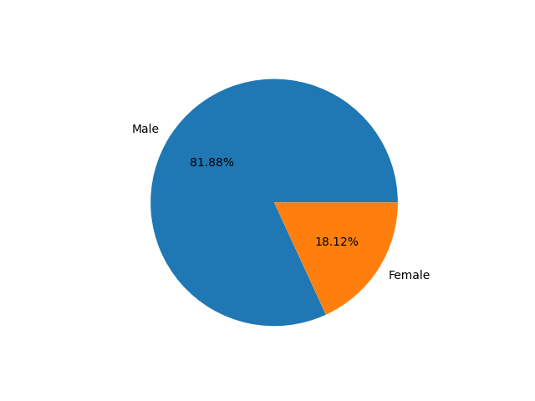
Question 2
What percentage of male and female smoked and how many for each?
Why is it important to know?
As shown in the figure, approximately 81.88% of smokers across the world are male, while 18.12% of smokers across the world are female. This is important to know for understanding the difference in smoking behaviors, identifying which group is at greater risk for smoking-related health problems, and creating policies to reduce smoking rates among certain groups.

Slide 6
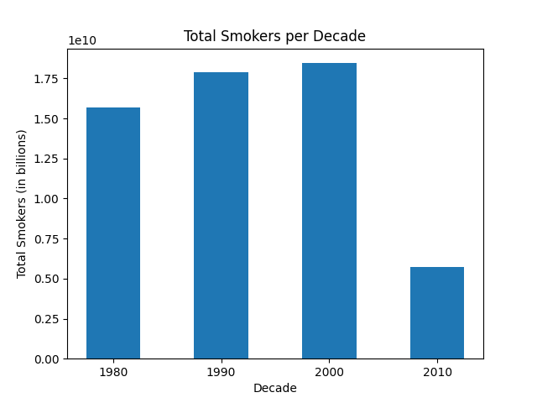
Question 3
What is the total number of smokers per decade?
Why is this important?
Based on the figure, Total Smokers per Decade, the data collected is based on the total number of smokers across the world for each decade. We see an increasing trend from 1980-2000 of smokers, but a sudden drop in smokers in 2010 of approximately 5.7 billion. This is important to know for identifying trends of smoking, progress in tobacco control and effective intervention policies.

