Slide 1
Project #2 Analyzing
Airlines
CSE 012
Gerardo Hernandez Macoto
2023

Slide 2
Airline Data
The airlines data represents a collection of information related to airlines which includes the airport, time, statistics (number of delays, flights, carriers, etc). The dataset represents flights in the United States.
The limitations of the dataset are the years the information was collected. The information collected from airlines range from 2003 until 2016.

Slide 3
Question 1
Which airport has the highest average number of flight delays?
Answer: ATL, 6923.75
The result above has answered my question by iterating through the airlines data and extracting specific information such as the statistics on flights and how many delays there were for each Airport Code. The airport codes were extracted and put into a list to prevent duplicates along with other parameters such as the amount of delays, the counter for the amount of times the airport code appeared in the dataset, and the average delay which was computed by using the total number of delays in each airport code and the counter.

Slide 4
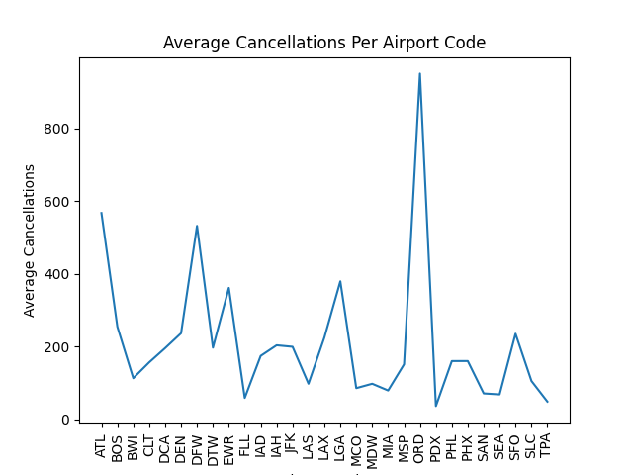
Question 2
Which flight code has, on average, been cancelled the most?
Answer:
ORD, 950.171052631579
The line graph gives a visual representation of the data extracted to quickly identify which airport code had, on average, the most flights cancelled.

Slide 5
Airline Stakeholders
The stakeholders in this situation would be the shareholders, employees/workers, and the customers. There would be a huge impact for the stakeholders based on flight delays and flight cancellations. The impacts would include a huge decline in revenue as customers would choose other airline competitors, employees/workers may have to work longer hours due to managing issues with delays/cancellations, and shareholders would likely cut their losses due to lower stock prices and gaining new investors would be difficult.

