Slide 1



FINAL PROJECT – Wine Quality Predictor
GERARD ROCA
28/06/2024

Slide 2

WINE QUALITY PREDICTOR
Introduction
The wine industry has a rich history and plays a significant role in many cultures and economies around the world
Quality assessment is crucial in the wine industry as it impacts market pricing, customer satisfaction, and overall brand reputation
Traditional methods of assessing wine quality often rely on expert tasters, which can be subjective and time-consuming.

Slide 3
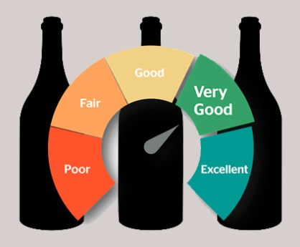
WINE QUALITY PREDICTOR
Objectives
The primary goal is to create a machine learning model capable of predicting the quality of wine based on its chemical properties
This model aims to provide an accurate and objective assessment of wine quality, potentially assisting winemakers in quality control and decision-making processes

Slide 4
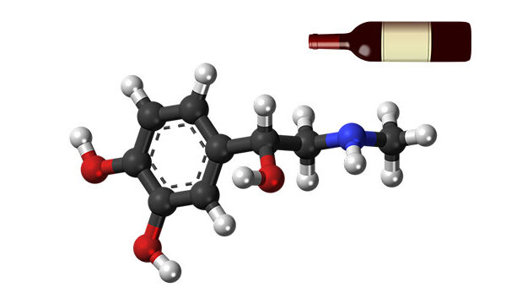
WINE QUALITY PREDICTOR
Data Description
Dataset: Red wine quality dataset from the UCI Machine Learning Repository / Wine Producers Worldwide (Kaggle)
Features:
Fixed acidity
Volatile acidity
Citric Acid
Residual sugar
Chlorides
Free sulfur dioxide
Total sulfur dioxide
Density
pH
Sulphates
Alcohol
Quality (target variable)

Slide 5
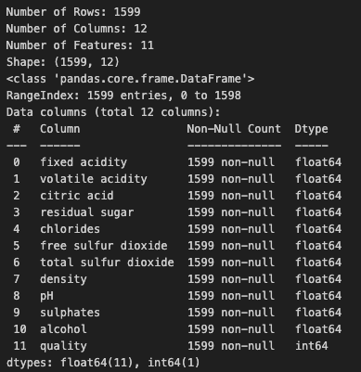
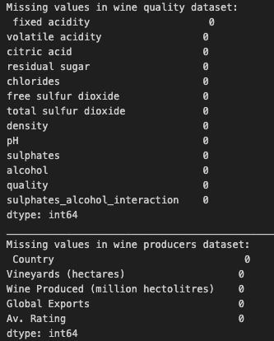
WINE QUALITY PREDICTOR
Data Processing
Data Cleaning:
Removal of null values and duplicates
Data type conversión
Transformations:
Normalization of numerical features
Creation of the interaction between sulphates and alcohol (Feature engineering)
Labeled quality data:

Slide 6

WINE QUALITY PREDICTOR
Data Processing
Labeled quality data:
Originally quality was measured from 1-10
Changed to Poor – Good – Excelent
Poor: 1-4
Good: 5-7
Excelent: 8-10

Slide 7
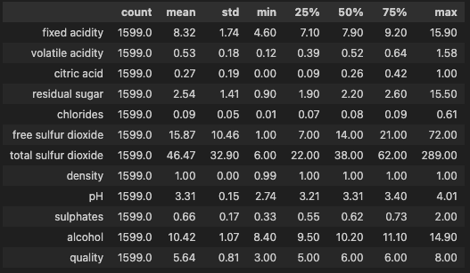
WINE QUALITY PREDICTOR
Data Processing

Slide 8
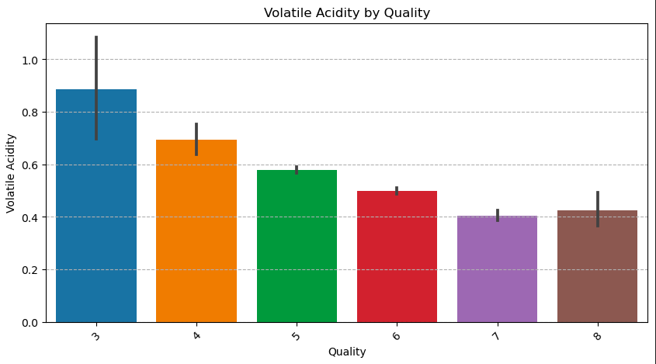
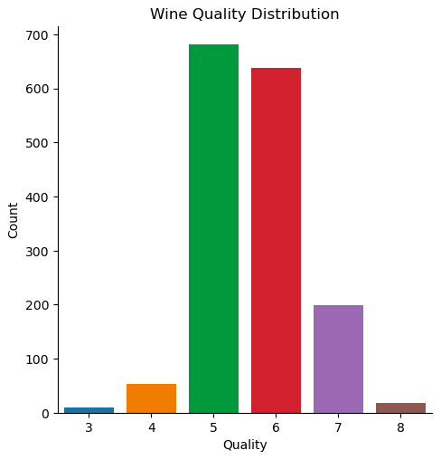
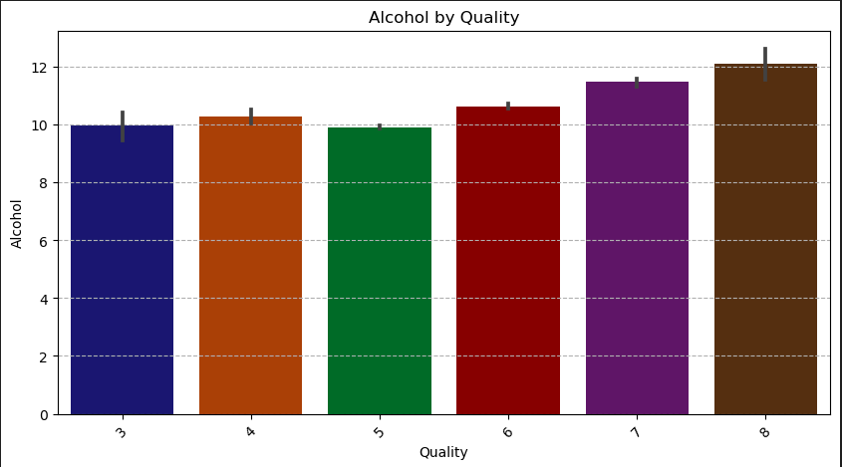
WINE QUALITY PREDICTOR
EDA

Slide 9
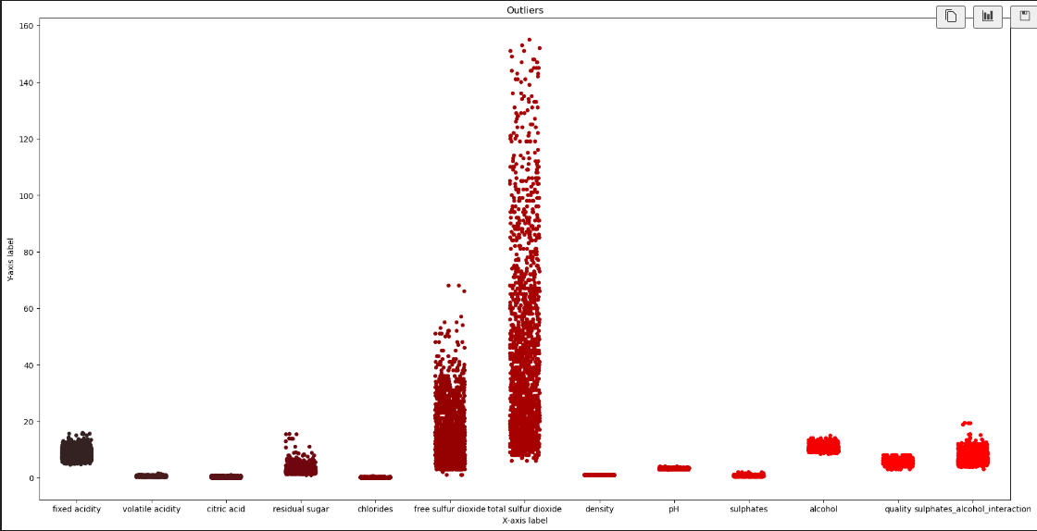
WINE QUALITY PREDICTOR
EDA

Slide 10
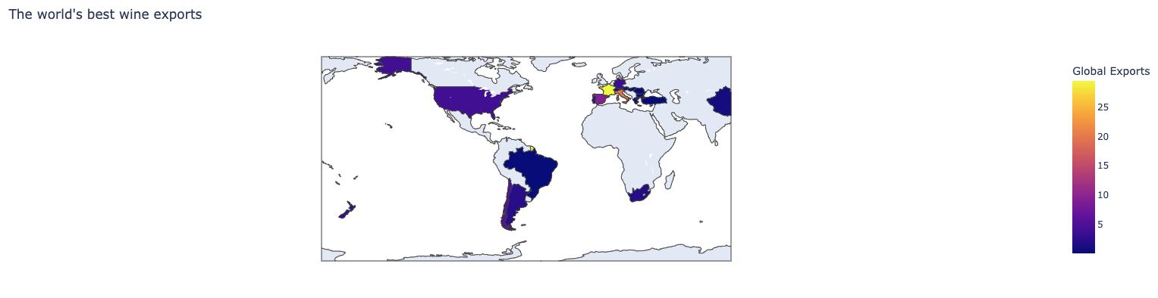
WINE QUALITY PREDICTOR
EDA

Slide 11
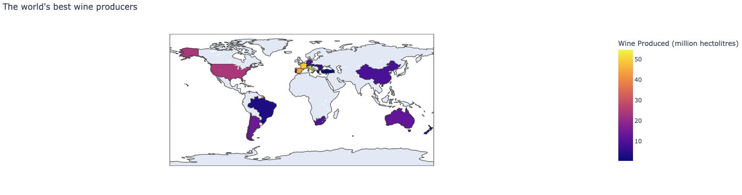
WINE QUALITY PREDICTOR
EDA

Slide 12
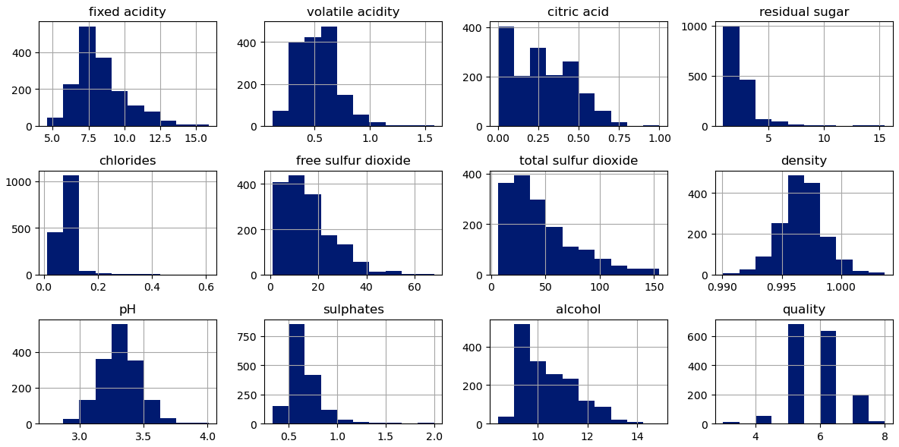
WINE QUALITY PREDICTOR
EDA

Slide 13
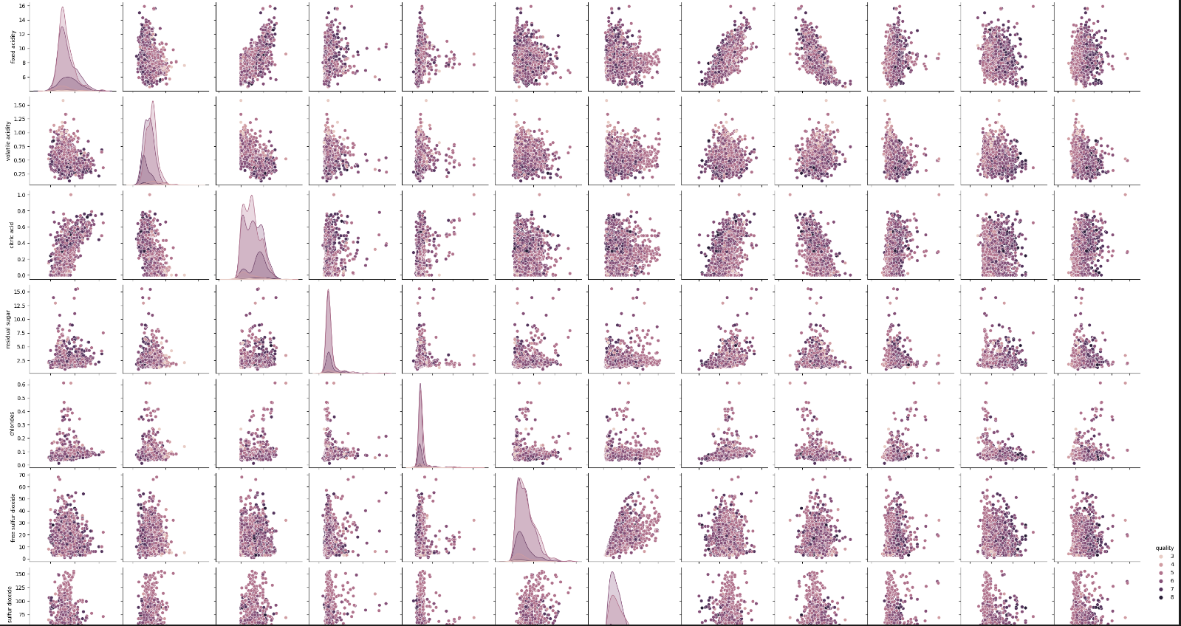
WINE QUALITY PREDICTOR
EDA

Slide 14
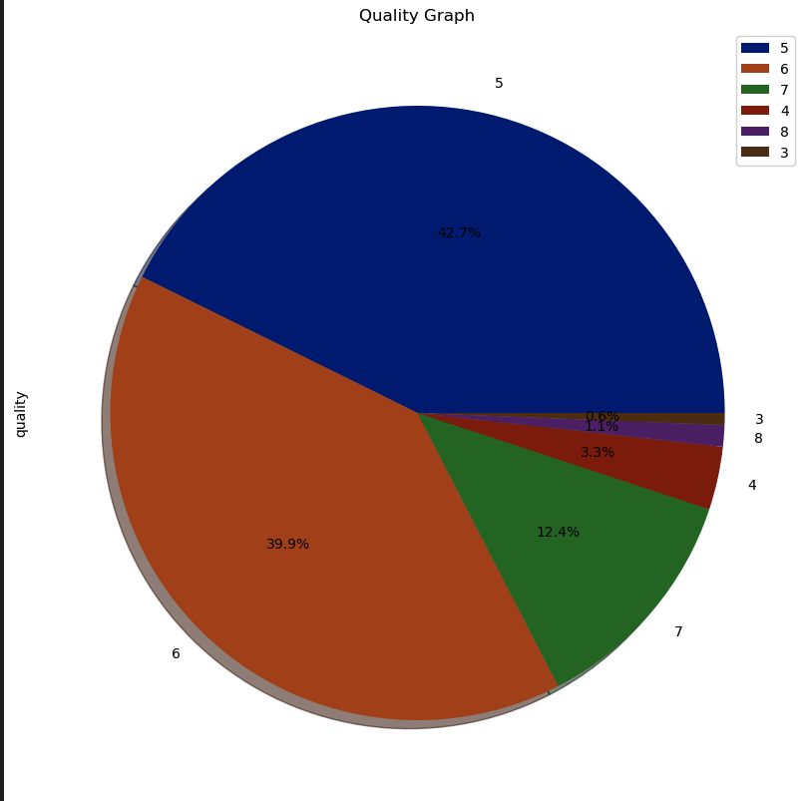
WINE QUALITY PREDICTOR
EDA

Slide 15
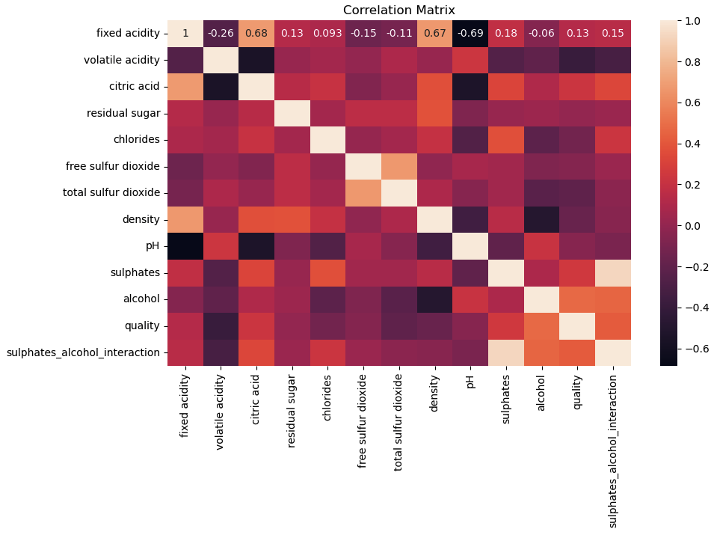
WINE QUALITY PREDICTOR
EDA

Slide 16
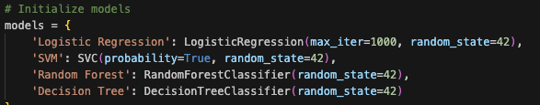
WINE QUALITY PREDICTOR
Modeling
Trained and tested models:
Logistic Regression
SVM
Random Forest
Decision Tree

Slide 17
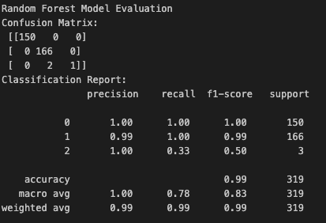

WINE QUALITY PREDICTOR
Model Evaluation

Slide 18
WINE QUALITY PREDICTOR
Conclusions
Conclusions:
Random Forest and SVM models performed the best
Wine quality is significantly influenced by alcohol content and sulphates
Next Steps:
Deploy App using Flask
Fulfill first Project objectives and develop

Slide 19
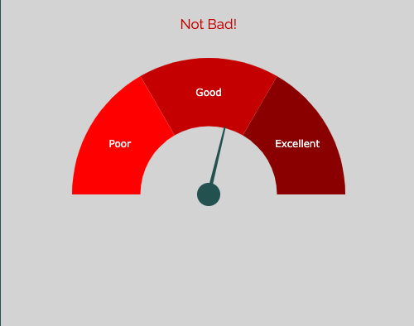
WINE QUALITY PREDICTOR
Expected Outcome
Insert wine components values to check quality
Fixed Acidity (g/dm^3)
value
Volatile Acidity (g/dm^3)
value
Citric Acid (g/dm^3)
value
Residual Sugar (g/dm^3)
value
Chlorides (g/dm^3)
value
Free Sulfur Dioxide (mg/dm^3)
value
Total Sulfur Dioxide (mg/dm^3)
value
Density (g/dm^3)
value
pH (0 - 14)
value
Sulfates (g/dm^3)
value
Alcohol (% vol)
value
Submit
Clear Fields

Slide 20

WINE QUALITY PREDICTOR
Desired Outcome
Insert wine name, year, country / scan
Wine Name
YYYY
Country
OR
Submit
Output: Quality, recommendations, link to shop

