Slide 1



NLP Project: Machine Translation Classifier (Human vs Machine)
GERARD ROCA

Slide 2
Introduction
Project Goal: Build a classifier to distinguish between human-translated and machine-translated sentences
Dataset:
TRAINING_DATA.txt: Contains labeled sentences (0: Machine, 1: Human)
REAL_DATA.txt: Contains sentences without labels for prediction

Slide 3
Data Preprocessing
Loading Data:
Used pandas to load and inspect the data
Cleaning Text:
Removed HTML tags, URLs, numbers, and punctuation.
Converted text to lowercase
Vectorize using TF-IDF

Slide 4
Model Training
Sentence-BERT Model:
Used SentenceTransformer to convert sentences into embeddings
Embedding Process:
Transformed both training and real data sentences into embeddings for model training and prediction
Algorithm: Random Forest Classifier
Training:
Split data into training and testing sets
Trained the model on the training set

Slide 5
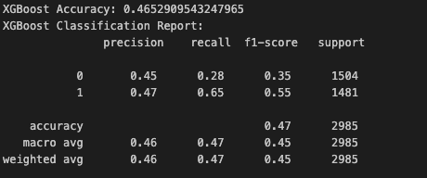
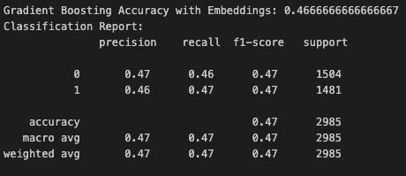
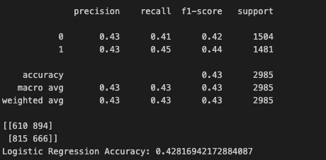
Aproaches

Slide 6
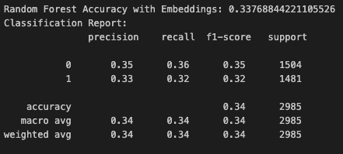
Model Evaluation
Switch labels -> 0.66

Slide 7
Predictions
Predicting Real Data:
Used the trained model to predict labels for sentences in REAL_DATA.txt.
Saving Predictions:
Exported the predictions to a .txt file for review

