Slide 1
Lecture 13
Compressive sensing

Slide 2
Compressed Sensing
A.k.a. compressive sensing or compressive sampling
[Candes-Romberg-Tao’04; Donoho’04]
Signal acquisition/processing framework:
  Want to acquire a signal x=[x₁…x_{n}]
  Acquisition proceeds by computing Ax of dimension m<<n
  (see next slide why)
  From Ax we want to recover an approximation x* of x
    Note: x* does not have to be k-sparse
    Method: solve the following program:
  minimize ||x*||₁
  subject to Ax*=Ax

Slide 3
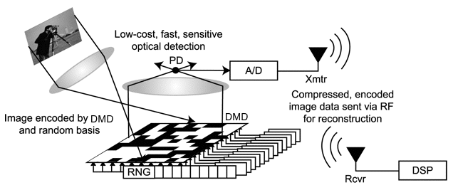
Signal acquisition
Measurement:
  Image x reflected by a mirror a (pixels randomly off and on)
  The reflected rays are aggregated using lens
  The sensor receives ax
Measurement process repeated k times → sensor receives Ax
Now we want to recover the image from the measurements

Slide 4
Solving the program
Recovery:
  minimize ||x*||₁
  subject to Ax*=Ax
This is a linear program:
  minimize ∑_{i} t_{i}
  subject to
    -t_{i} ≤ x*_{i} ≤ t_{i}
    Ax*=Ax
Can solve in n^{Θ(1)} time

Slide 5
Intuition
LP:
  minimize ||x*||₁
  subject to Ax*=Ax
On the first sight, somewhat mysterious
But the approach has a long history in signal processing, statistics, etc.
Intuition:
  The actual goal is to minimize ||x*||₀
  But this comes down to the same thing (if A is “nice”)
  The choice of L₁ is crucial (L₂ does not work)
Ax*=Ax
n=2, m=1, k=1

Slide 6
Analysis
Theorem: If each entry from A is i.i.d. as N(0,1), and m=Θ(klog(n/k)),
then with probability at least 2/3 we have that, for any x, the output x* of of the LP satisfies
  ||x*-x||₁ ≤ C ||x_{tail(k)}||₁
  where ||x_{tail(k)}||₁=min_{k-sparse x’} ||x-x’||₁ , also denoted by Err₁^{k}(x) .
Notes:
  N(0,1) not crucial – any distribution satisfying JL will do
  Can actually prove a stronger guarantee, so-called “L2/L1”
Comparison to “Count-Median” (like Count-Min, but for general x)
 | m | Recovery time | Failure probability | Guarantee
Count-Median | k log n | n log n (or faster) | 1/n | |x_{i}*-x_{i}| ≤ C ||x_{tail(k)}||₁/k
L1 minimization | k log (n/k) | poly(n) | “Deterministic” | ||x*-x||₁ ≤ C ||x_{tail(k)}||₁

Slide 7
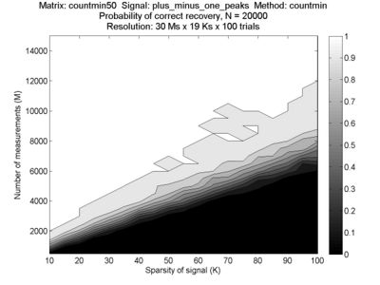
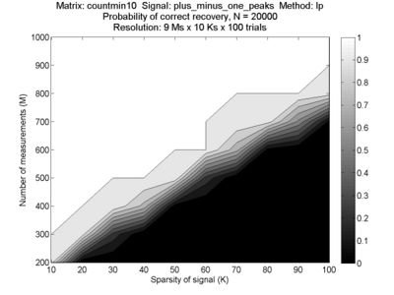
Empirical comparison
L1 minimization more measurement-efficient
Sketching can be more time-efficient (sublinear in in)

Slide 8
Restricted Isometry Property*
A matrix A satisfies (k,δ)-RIP if for any k-sparse vector x we have
(1-δ) ||x||₂ ≤ ||Ax||₂ ≤ (1+δ) ||x||₂
Theorem 1: If each entry of A is i.i.d. as N(0,1), and m=Θ(k log(n/k)), then A satisfies (k,1/3)-RIP w.h.p.
Theorem 2: (4k,1/3)-RIP implies that if we solve
  minimize ||x*||₁
  subject to Ax*=Ax
then ||x*-x||₁ ≤ C ||x_{tail(k)}||₁
*Introduced in Lecture 9

Slide 9
Proof of Theorem 1
Suffices to consider ||x||₂=1
We will take a union bound over k-subsets T of {1..n} such that Supp(x)=T
  There are (n/k)^{O(k)} such sets
For each such T, we can focus on x’=x_{T} and A’=A_{T}, where x’ is k-dimensional and A’ is m by k
Altogether: need to show that with probability at least 1-(k/n)^{O(k)}, for any x’ on a k-dimensional unit ball B, we have
2/3 ≤ ||A’x’||₂ ≤ 4/3
*We follow the presentation in [Baraniuk-Davenport-DeVore-Wakin’07]
A
A’
*
x’
x

Slide 10
Unit ball preservation
An ε-net N of B is a subset of B such that for any x’∈B there is x”∈N s.t. ||x’-x”||₂ < ε
Lect. 5: there exists an ε-net N for B of size (1/ε)^{Θ(k)}
  We set ε=1/7
By JL we know that for all x’∈N we have
7/8 ≤ ||A’x’||₂ ≤ 8/7
with probability 1-e^{-Θ(m)}
To take care of all x’∈B, we set x’=b₀x⁰+b₁x¹+…, s.t.
  All x^{j}∈N
  b_{j} <1/7^{j}
We get
  ||A’x’||₂ ≤∑_{j} ||Ax^{j}||/7^{j} ≤ 8/7 ∑_{j} ||x^{j}||/7^{j} =8/7*7/6=4/3
  Other direction analogous
Altogether, this gives us (1/3,k)-RIP with high probability
Δ
x’
x⁰
…and recurse on Δ

Slide 11
Proof of Theorem 2
See notes

Slide 12
Recap
A matrix A satisfies (k,δ)-RIP if for any k-sparse vector x we have
(1-δ) ||x||₂ ≤ ||Ax||₂ ≤ (1+δ) ||x||₂
Theorem 1: If each entry of A is i.i.d. as N(0,1), and m=Θ(k log(n/k)), then A satisfies (k,1/3)-RIP w.h.p.
Theorem 2: (4k,1/3)-RIP implies that if we solve
  minimize ||x*||₁
  subject to Ax*=Ax
then ||x*-x||₁ ≤ C ||x_{tail(k)}||₁

