Slide 1
Lecture 15 Sparse Recovery Using Sparse Matrices

Slide 2
Compressed Sensing: Recap
Want to acquire a signal x=[x₁…x_{n}]
Acquisition proceeds by computing Ax of dimension m<<n
From Ax we want to recover an approximation x* of x
Method: solve the following program (Lecture 13)
minimize ||x*||₁
subject to Ax*=Ax
or use a greedy algorithm (Lecture 14)
Guarantee: for some C>1
||x-x*||₁ ≤ C min_{k-sparse x”} ||x-x”||₁ (L1/L1)
as long as A satisfies (ck, δ)-RIP: for all ck-sparse x
(1-δ) ||x||₂ ≤ ||Ax||₂ ≤ (1+δ) ||x||₂
Notes:
Notes:
Sparsity in different basis
-

Slide 3
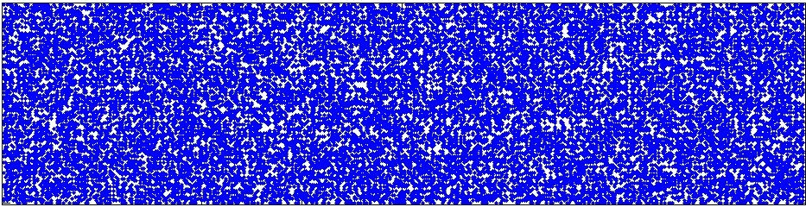
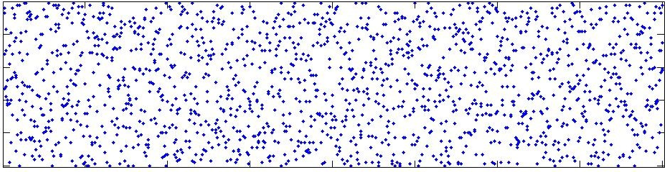
Choices for matrix A
Dense matrices:
Compressed sensing
Complexity/learning theory
(Fourier matrices)
Sparse matrices:
Data stream algorithms
Coding theory (LDPCs)
“Traditional” tradeoffs:
Sparse: computationally more efficient ( nlog n vs poly(n) )
Dense: shorter sketches ( k log (n/k) vs k log n)
…
The “best of both worlds” ?

Slide 4
dense vs. sparse
Restricted Isometry Property (RIP) [Candes-Tao’04]
Δ is k-sparse ⇒ ||Δ||₂≤ ||AΔ||₂ ≤ C ||Δ||₂
Holds w.h.p. for random Gaussian/Bernoulli: m=O(k log (n/k))
Consider m x n 0-1 matrices with d ones per column
Do they satisfy RIP ?
No, unless m=Ω(k²) [Chandar’07]
However, they can satisfy the following RIP-1 property [Berinde-Gilbert-Indyk-Karloff-Strauss’08]:
Δ is k-sparse ⇒ d (1-ε) ||Δ||₁≤ ||AΔ||₁ ≤ d||Δ||₁
Sufficient (and necessary) condition: the underlying graph is a
( k, d(1-ε/2) )-expander

Slide 5
Expanders
n
m
A bipartite graph is an (l,d(1-ε))-expander if for any left set X, |X|≤l, we have |N(X)|≥(1-ε)d |X|
Objects well-studied in theoretical computer science and coding theory
Constructions:
Probabilistic: m=O(l log (n/l))
Explicit: m=l quasipolylog n
High expansion implies RIP-1:
Δ is k-sparse ⇒ d (1-2ε) ||Δ||₁≤ ||AΔ||₁ ≤ d||Δ||₁
[Berinde-Gilbert-Indyk-Karloff-Strauss’08]
N(X)
d
X
m
n

Slide 6
Proof: d(1-ε/2)-expansion ⇒ RIP-1
Want to show that for any k-sparse Δ we have
d (1-ε) ||Δ||₁≤ ||A Δ||₁ ≤ d||Δ||₁
RHS inequality holds for any Δ
LHS inequality:
W.l.o.g. assume
|Δ₁|≥… ≥|Δ_{k}| ≥ |Δ_{k+1}|=…= |Δ_{n}|=0
Consider the edges e=(i,j) in a lexicographic order
For each edge e=(i,j) define r(e) s.t.
r(e)=-1 if there exists an edge (i’,j)<(i,j)
r(e)=1 if there is no such edge
Claim 1: ||AΔ||₁ ≥∑_{e=(i,j)} |Δ_{i}|r_{e}
Claim 2: ∑_{e=(i,j)} |Δ_{i}|r_{e} ≥ (1-ε) d||Δ||₁
d
m
n

Slide 7
∑_{e=(i,j)} |Δ_{i}|r_{e} ≥ (1-ε) d||Δ||₁
Let z_{e} = |Δ_{i}| for e=(i,j)
Lower bound ∑_{e} z_{e}r_{e}
What do we know about z_{e}, r_{e}
z_{e} is non-increasing
(from the reordering)
In any prefix of r of length ds, there are <ε/2 d s minuses
(from the expansion)
There are no minuses in the first d elements of r
(the first node has no overlapping edges)
The worst-case sequence r is as follows (in blocks of length d):
+,+,…,+, -,..,-,+,…,+ , ,-,..,-,+,…,+ , …..
d
m
n
■
0 minuses
ε/2 d minuses
ε/2 d minuses

Slide 8
Implication of RIP-1
We have RIP in the L1 norm
Now what ?
We will show that RIP-1 for expander matrices can be used to show null space property (notes), and therefore L1 minimization works
Altogether, this gives a a scheme with:
O(k log (n/k) ) measurements
Recovery time still poly(n)
However, thanks to the use of sparse matrices, the running time is faster
(the linear program iteratively computers Az for vectors z, which is fast if A is sparse)
Coordinate-wise updates are significantly faster

Slide 9
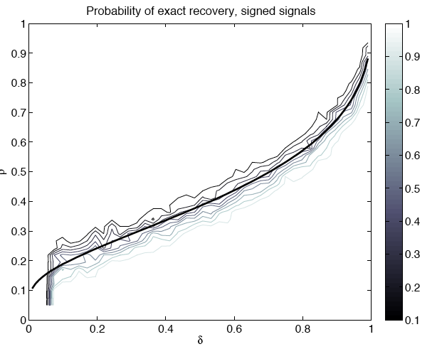
Sharp transition

Slide 10
Results
Scale:
Excellent
Very Good
Good
Fair
Paper | R/D | Sketch length | Encode time | Column sparsity | Recovery time | Approx
[CCF’02], [CM’06] | R | k log n | n log n | log n | n log n | l2 / l2
 | R | k log^{c} n | n log^{c} n | log^{c} n | k log^{c} n | l2 / l2
[CM’04] | R | k log n | n log n | log n | n log n | l1 / l1
 | R | k log^{c} n | n log^{c} n | log^{c} n | k log^{c} n | l1 / l1
[CRT’04] [RV’05] | D | k log(n/k) | nk log(n/k) | k log(n/k) | n^{c} | l2 / l1
 | D | k log^{c} n | n log n | k log^{c} n | n^{c} | l2 / l1
[GSTV’06] [GSTV’07] | D | k log^{c} n | n log^{c} n | log^{c} n | k log^{c} n | l1 / l1
 | D | k log^{c} n | n log^{c} n | k log^{c} n | k² log^{c} n | l2 / l1
[BGIKS’08] | D | k log(n/k) | n log(n/k) | log(n/k) | n^{c} | l1 / l1
[GLR’08] | D | k logn^{logloglogn} | kn^{1-a} | n^{1-a} | n^{c} | l2 / l1
[NV’07], [DM’08], [NT’08], [BD’08], [GK’09], … | D | k log(n/k) | nk log(n/k) | k log(n/k) | nk log(n/k) * log | l2 / l1
 | D | k log^{c} n | n log n | k log^{c} n | n log n * log | l2 / l1
[IR’08], [BIR’08],[BI’09] | D | k log(n/k) | n log(n/k) | log(n/k) | n log(n/k)* log | l1 / l1
[GLSP’09] | R | k log(n/k) | n log^{c} n | log^{c} n | k log^{c} n | l2 / l1
Caveats: (1) most “dominated” results not shown (2) only results for general vectors x are displayed
(3) sometimes the matrix type matters (Fourier, etc)
Notes:
emphasize arbitrary signals

Slide 11
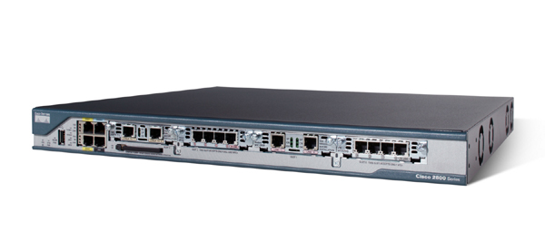
Application: Monitoring Network Traffic Data Streams
Router routs packets
Where do they come from ?
Where do they go to ?
Ideally, would like to maintain a traffic
matrix x[.,.]
Easy to update: given a (src,dst) packet, increment x_{src,dst}
Requires way too much space!
(2³² x 2³² entries)
Need to compress x, increment easily
Using linear compression we can:
Maintain sketch Ax under increments to x, since
A(x+Δ) = Ax + AΔ
Recover x* from Ax
destination
source
x

Slide 12






Application: Pooling Experiments
Pooling Experiments [Kainkaryam, Woolf’08], [Hassibi et al’07], [Dai-Sheikh, Milenkovic, Baraniuk], [Shental-Amir-Zuk’09],[Erlich-Shental-Amir-Zuk’09]

Slide 13
References
Survey:
A. Gilbert, P. Indyk, “Sparse recovery using sparse matrices”, Proceedings of IEEE, June 2010.

